Slide 1
9th Honors 1.04.16
Turn in:
Nothing
Take out :
Pen/Pencil
Partner List
Notes
Today’s Learning Objectives:
I can describe how industrialization in Europe helped contribute to the colonization of Africa.
Today’s Agenda:
Guns, Germs, and Steel (sort of…)
HW:
Prepare for your exam…with your notes
Create a STUDY GUIDE.

Slide 2
Guns, Germs, and Steel
Ok, let’s apply Jared Diamond’s argument to Africa: how did Guns, Germs, and Steel allow Europeans to conquer Africa?
Did anything change over time?
Was Africa different than other parts of the world?

Slide 3
Guns
How were “guns” utilized to conquer Africa?
Were guns utilized in a different way in the conquest of Africa?

Slide 4
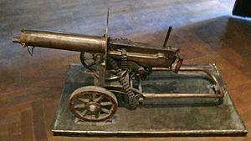
Guns
The Maxim Gun

Slide 5
Guns
The Maxim Gun
Developed by Hiram Maxim
Could shoot between 500-600 rounds per minute.
The gun’s “action” reloaded itself.
Advancement in machine gun as it didn’t require manual cranking of a mechanism.
A prototype was given to Henry Stanley in the late 1880’s

Slide 6
Guns
The 1st Matabele War
British South African Company
Cecil Rhodes (PM of Cape Colony)
Tribes began to rise up against the British.
100,000 (or so…) natives did not last long
For example: 4 maxim guns (a handful of soldiers) held off and defeated 5,000 advancing natives.

Slide 7
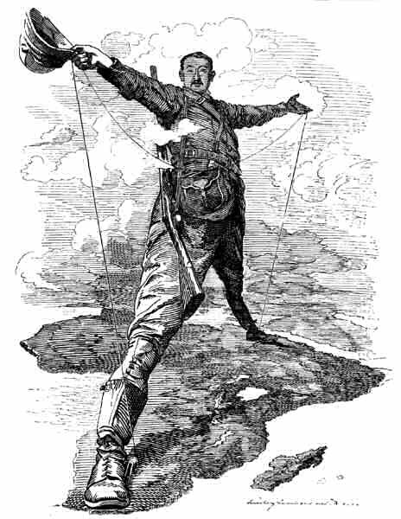
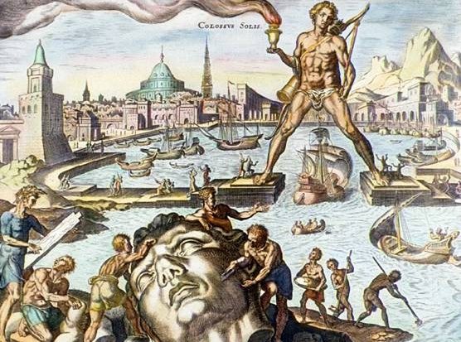
“Rhodes Colussus”
What do you know? What do you notice?
What message is being portrayed?

Slide 8
Germs
How did “germs” impact the conquering of Africa?
Was this different?

Slide 9
Germs
Quinine
Developed as a way to combat low temperatures by those native to Peru: ???
A muscle relaxant, fever reducer, pain killer…
First used by Europeans in mid 17th century to fight outbreak of malaria in Rome.

Slide 10
Germs
Quinine
Allowed Europeans to combat the issue of the “white man’s grave”
With it’s efficiency, opened the door to areas subject to malaria—the tropical areas of west Africa in particular.

Slide 11
Steel
How did “steel” impact the conquering of Africa?
Was this different than other parts of conquest?

Slide 12
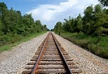
Steel
Railroads
British wished to control “Cape to Cairo”
French wanted to control East/West trade routes
Building of railways increased the Europeans ability to:
Colonize away from the coast.
Transport goods and materials
Build further infrastructure in the “Dark” continent

Slide 13
9th Honors 12.09.14
Turn in:
Critical Read of The Reality of the Congo
Take out :
UPDATE!!! Planner—Exam FRIDAY 12/12/14
Pen/Pencil
Partner List
Notes
Today’s Learning Objectives:
I can describe how industrialization in Europe helped contribute to the colonization of Africa.
Today’s Agenda:
Guns, Germs, and Steel (sort of…)
HW:
Thesis statement on the following prompt:
Is the Berlin Conference and the “Scramble for Africa” still impacting the continent today?

