Slide 1
10th Euro Studies 1.08.15
Turn in:
Charts
Take out:
Planner
Imperial Motives Chart
Pen/Pencil
Today’s objective:
I can describe how the Industrial Revolution impacted the balance of power in Europe and abroad.
Today’s Agenda:
Imperial Motives
Chart and placards
German Unification
Critically read 22.1 with notes
In-class
HW:
Print German Unification Assignment

Slide 2
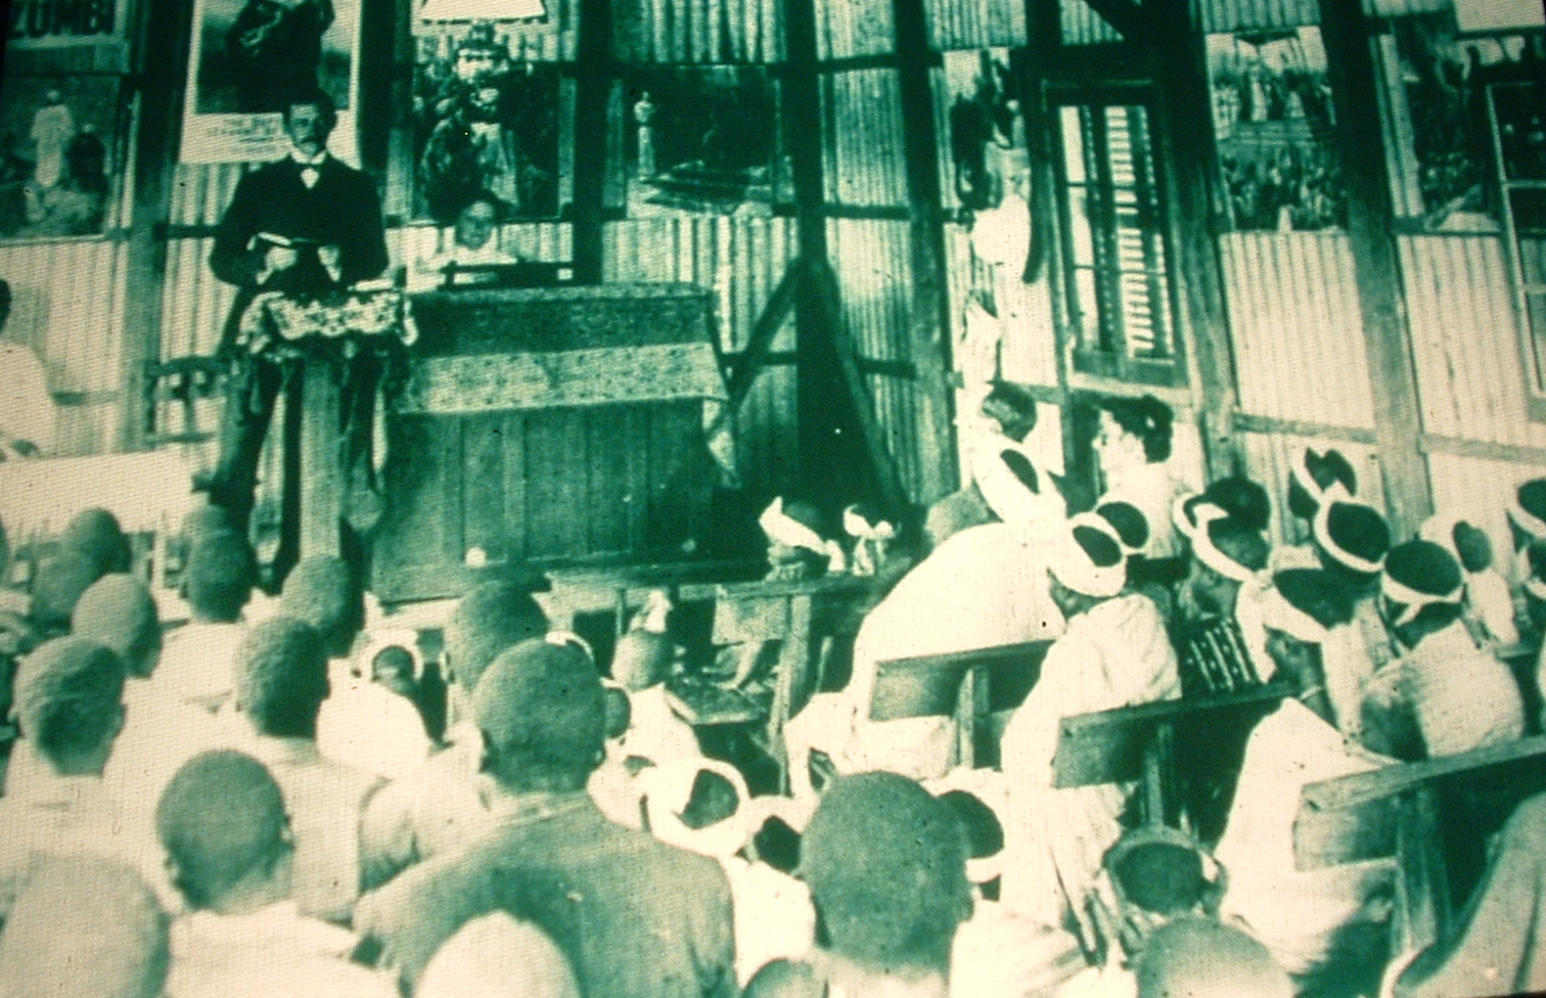
A Methodist Sunday School at Guiongua, Angola, 1925
Imperial motives: RELIGIOUS (Europeans spreading Christian values & education) or IDEOLOGICAL (teaching European customs & beliefs)

Slide 3
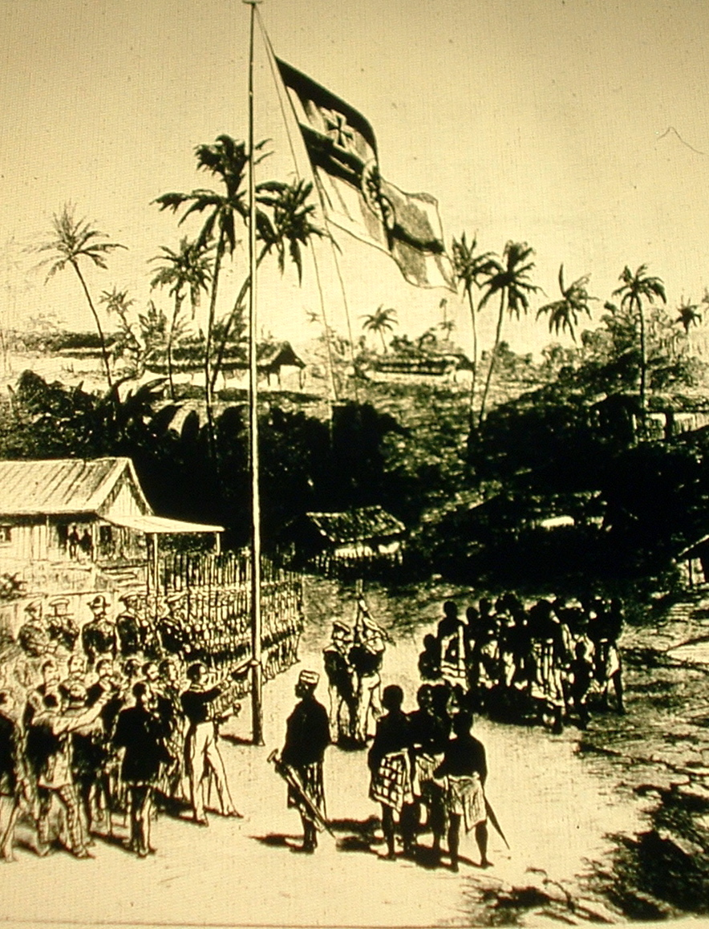
Germans taking possession of Cameroon in 1881
Imperial motives:
POLITICAL (flag shows national identity or desire to possess new territory, European & African leaders meeting, European military presence) or
EXPLORATORY (exploring foreign lands)

Slide 4
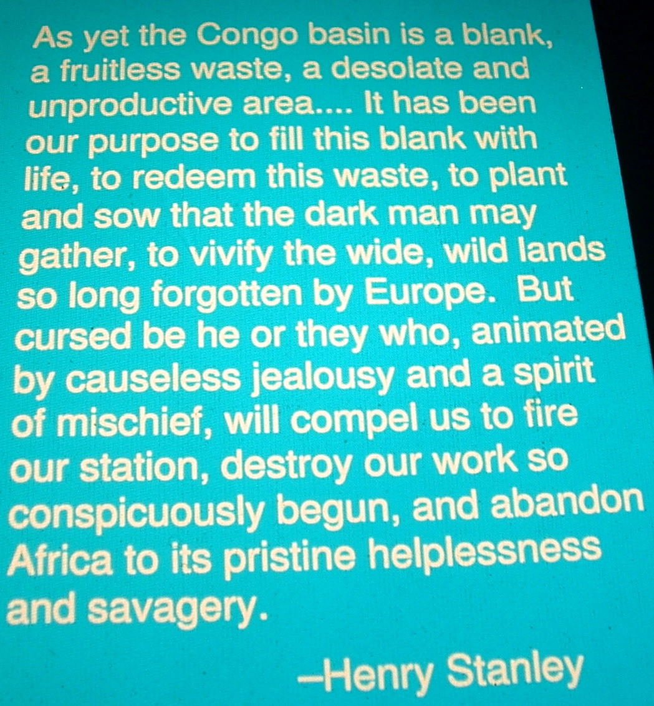
Quote from Henry Stanley in 1882
Imperial motive:
IDEOLOGICAL (belief in superiority of Europeans or that Europeans should “civilize” African)

Slide 5
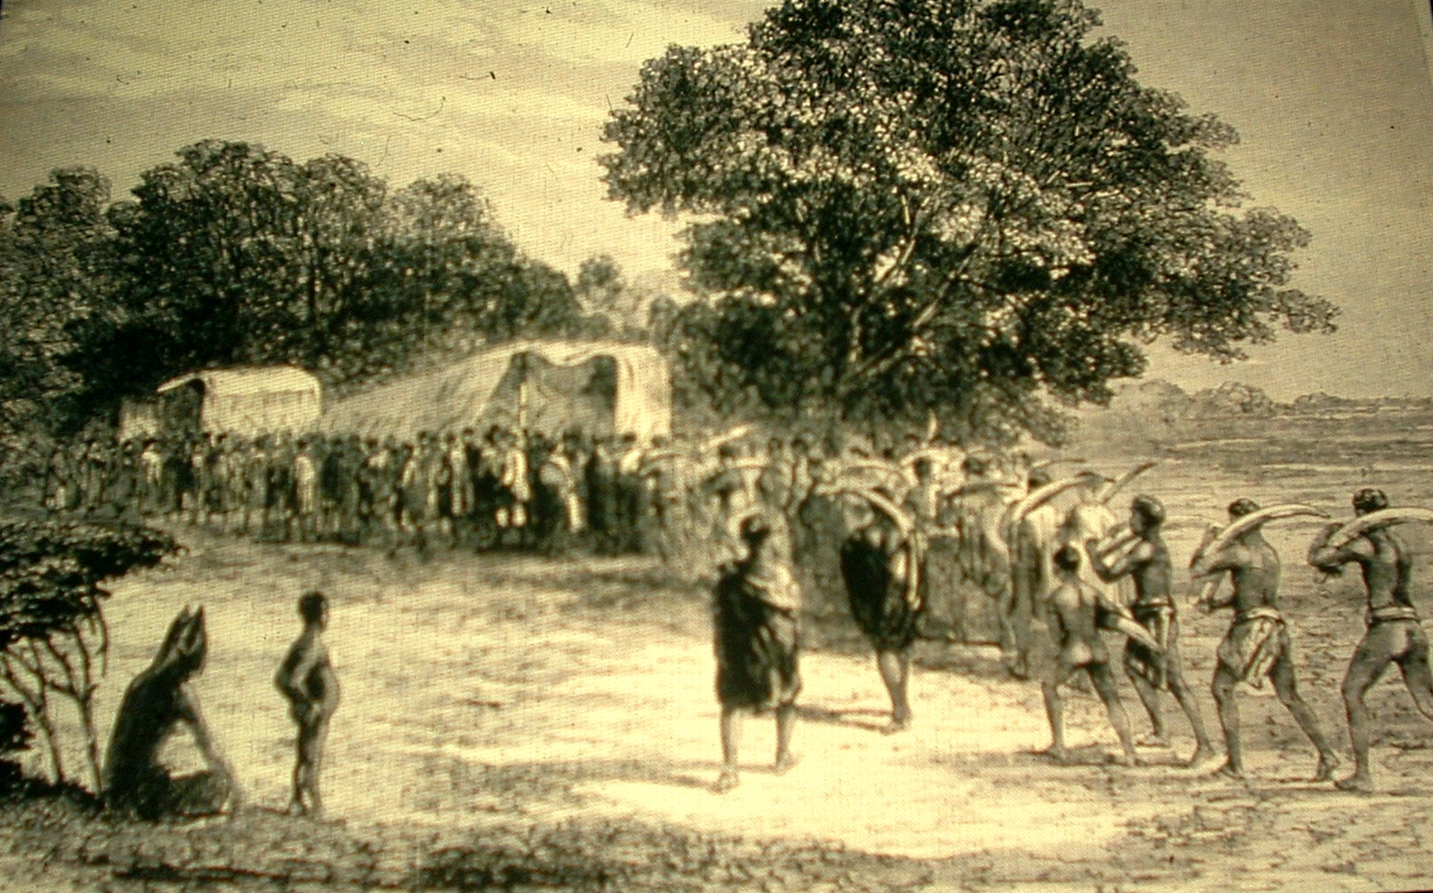
Africans bringing ivory to the wagon in South Africa, c. 1860
Imperial motives: ECONOMIC (collecting African resources)

Slide 6
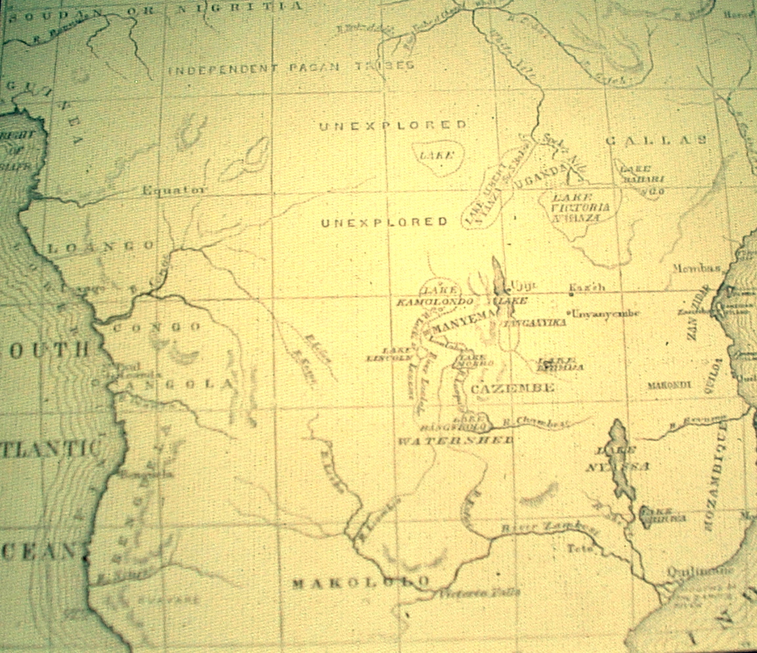
Sketch map of Central African, showing Dr. Livingstone’s exploration
Imperial motive: EXPLORATORY ( interest in unexplored territories, mapping geographic features of Africa)

Slide 7
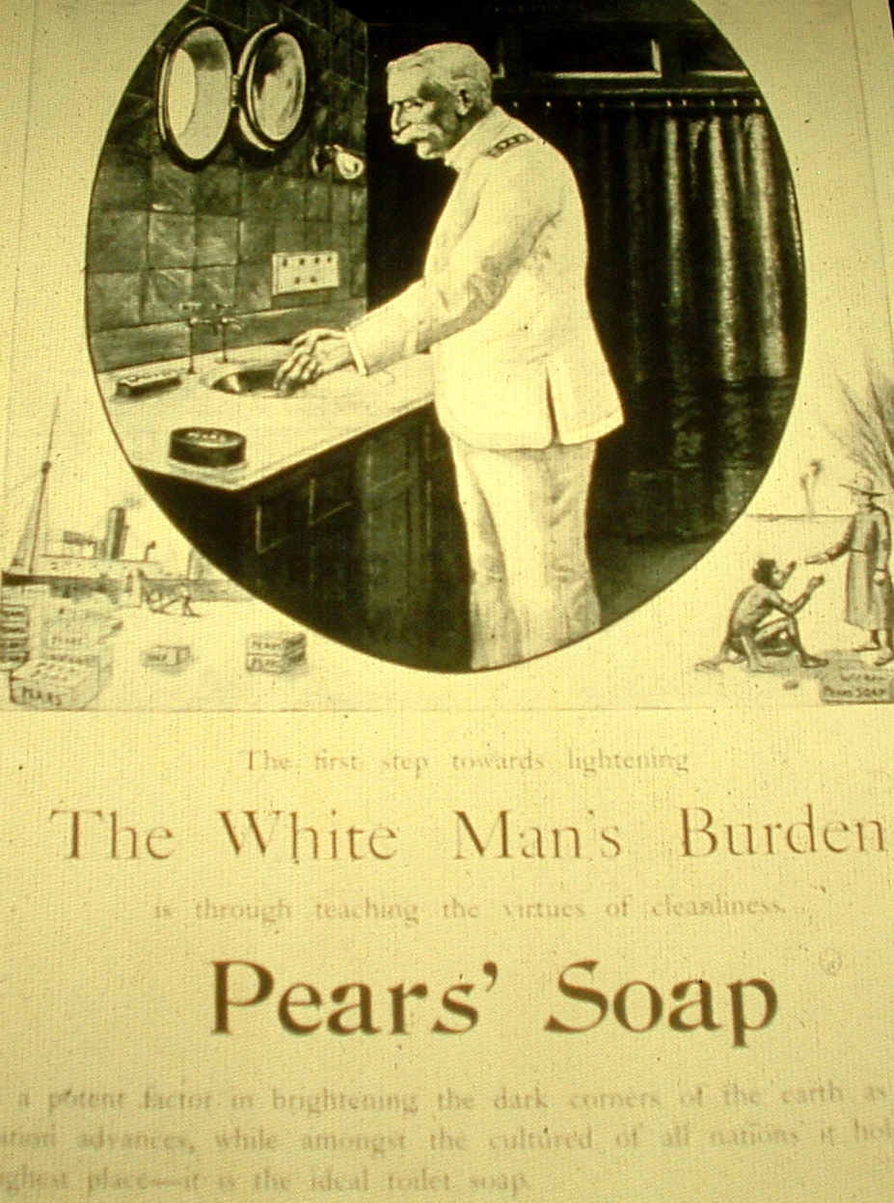
An advertisement for Pears’ Sope from the 1890s, and one stanza of the British poet Rudyard Kipling’s poem, The White Man’s Burden, written in 1899
Imperial motives:
IDEOLOGICAL (belief in European superiority, need to “civilize” captive peoples, need to cleanse “dark corners of the earth”) or
ECONOMIC (boats transporting goods to colonies, advertisement to sell product)

Slide 8
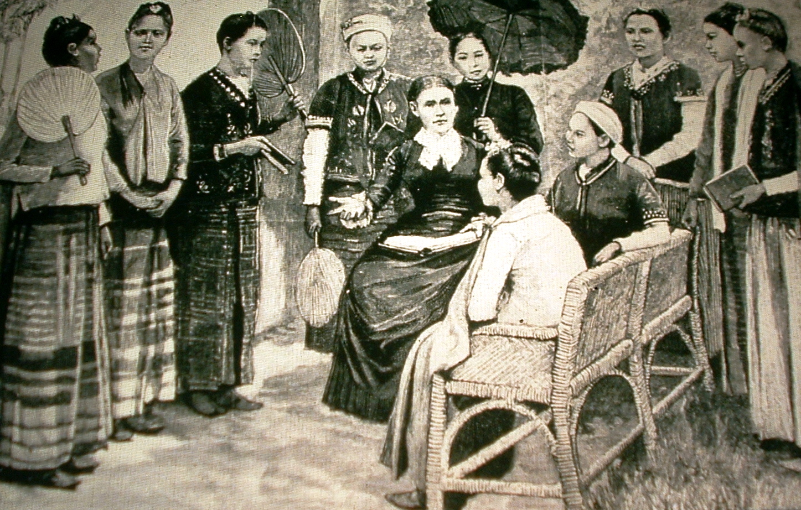
Mrs. Maria C. Douglas, a doctor and missionary, and the first class of pupil nurses in Burma, 1888.
Imperial motives: IDEOLOGICAL (teaching European values) or RELIGIOUS (education people of other cultures)

Slide 9
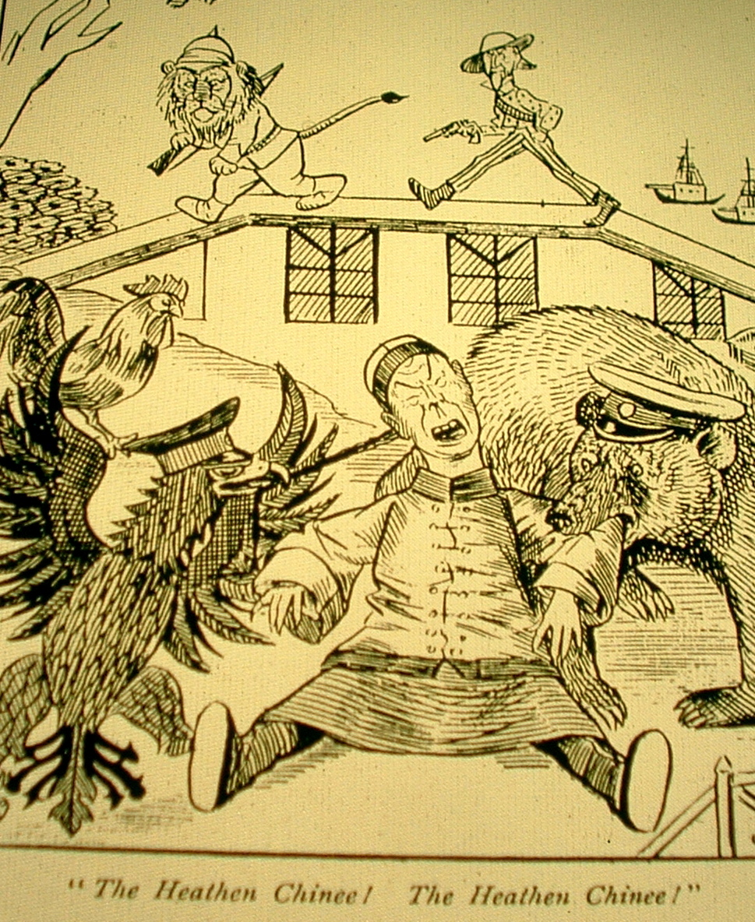
British cartoon showing the Chinese being savaged by European powers, and the poem The Partition of China 1897
Imperial motives:
POLITICAL (Europeans depicted as animals competing for piece of China) or
ECONOMIC (desire to trade in China to make cash) or
RELIGIOUS (Chinese depicted as heathen, calls on Christian duty to preach in China) or
IDEOLOGICAL (belief that foreigners should be “civilized” by Europeans)

Slide 10
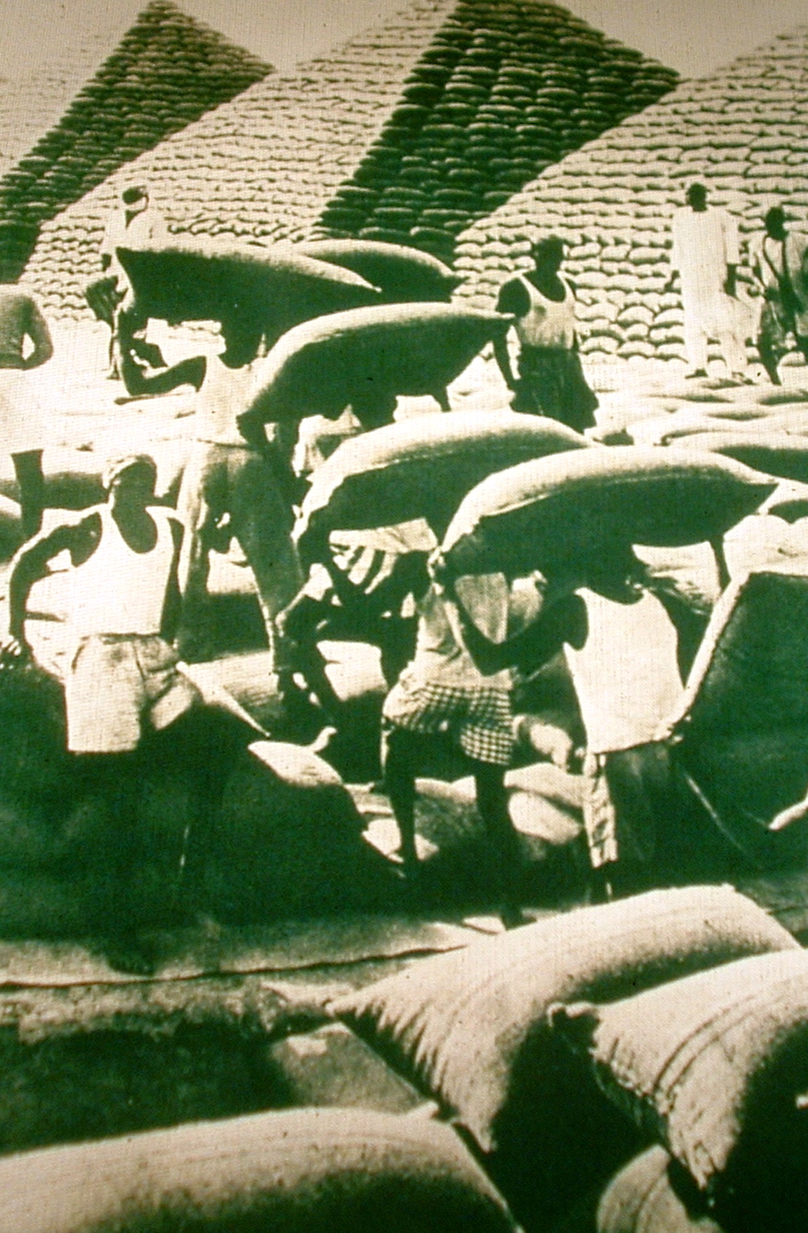
Bagged groundnuts in pyramid stacks in West Africa
Imperial motives:
ECONOMIC (Africans transporting indigenous goods)

Slide 11
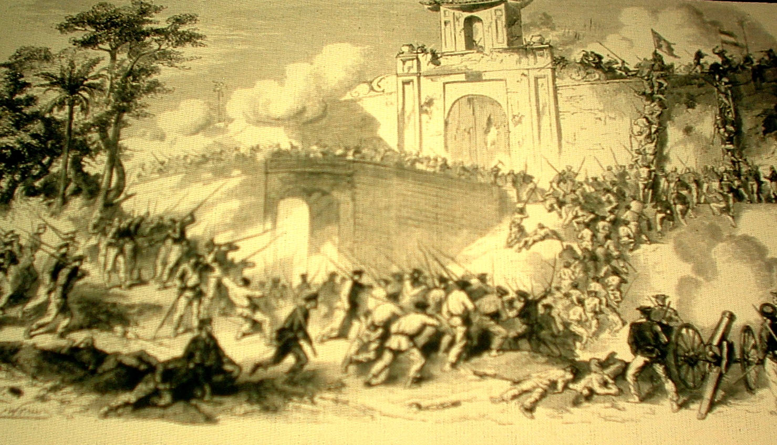
French capture of the citadel of Saigon, Vietnam
Imperial motives: POLITICAL (exerting military force, battling for possession of territory, carrying flags to establish political control)

Slide 12
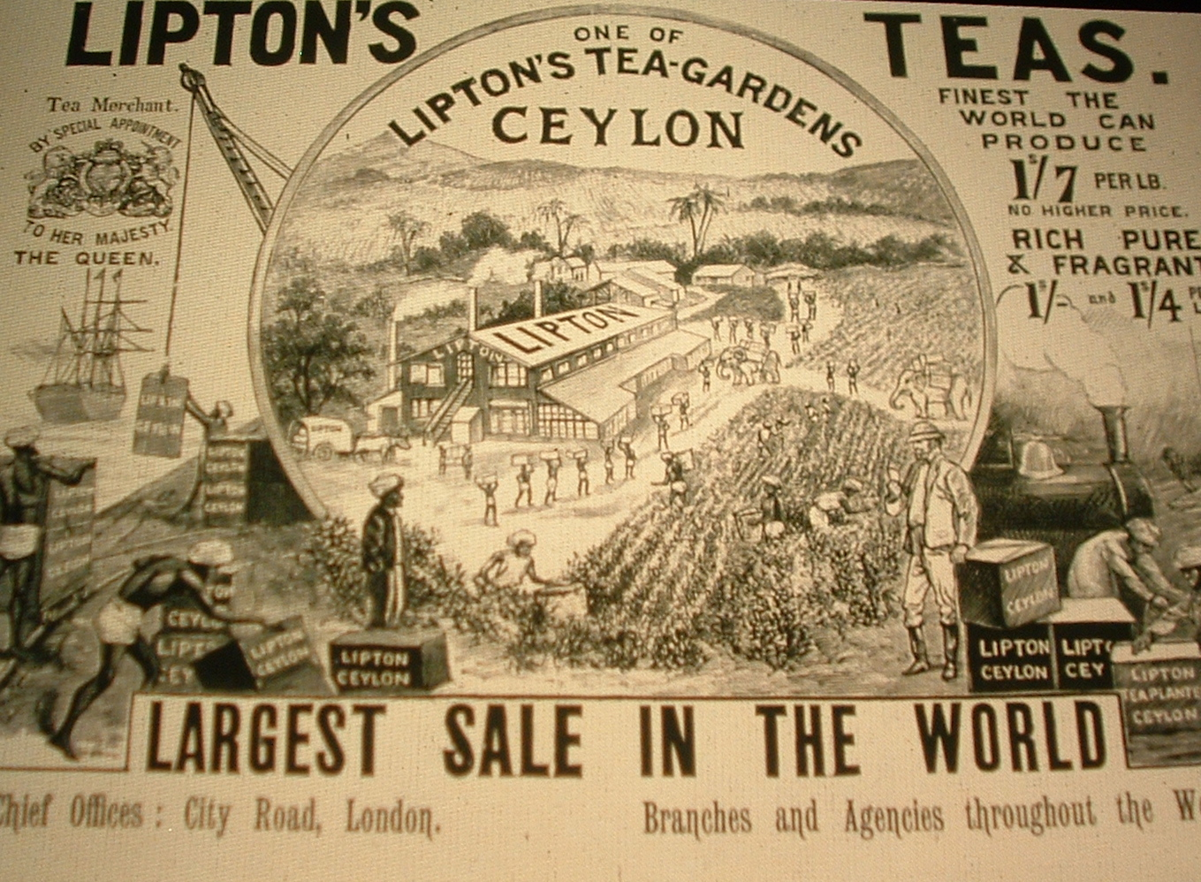
British Lipton Tea advertisement in the 1890s
Imperial motives: ECONOMIC (goods from Ceylon transported to London, use of indigenous labor and resources, exportation of industrial technology) or POLLITICAL (gaining national prestige through international trade)

Slide 13
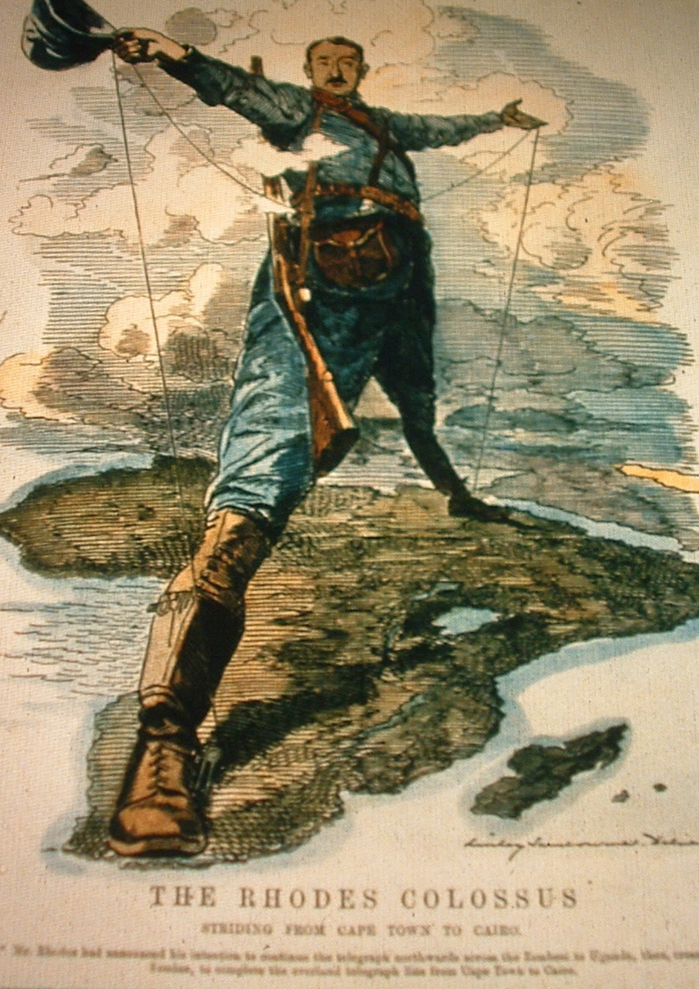
British cartoon “The Rhodes Colossus” showing Cecil Rhodes’ vision of making Africa “all British from Cape to Cairo” 1892
Imperial motives:
POLITICAL (desire to control African territory, desire to boost national pride and gain power by winning colonies, desire to have military presence) or
EXPLORATORY (exploring or venturing into unknown territory)

Slide 14
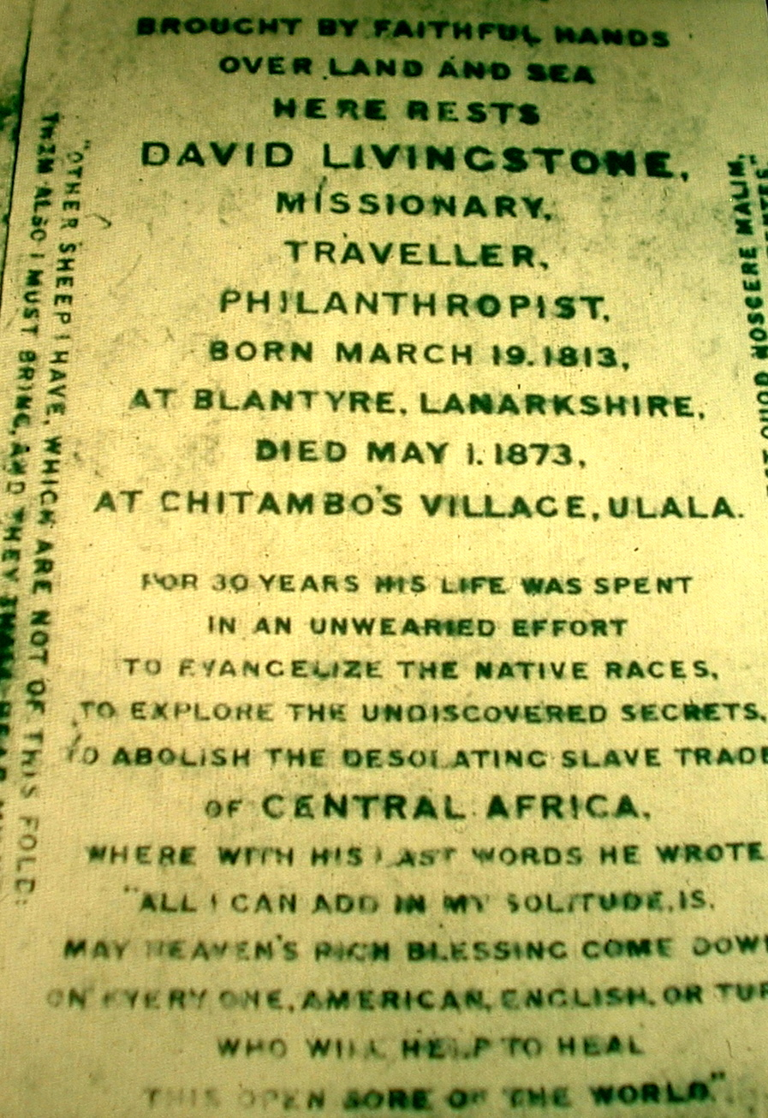
Epitaph and quote from missionary and explorer David Livingstone
Imperial motives:
RELIGIOUS (missionary who spreads his faith, desire to abolish the slave trade) or
EXPLORATORY (traveled to discover secrets of Africa)

Slide 15
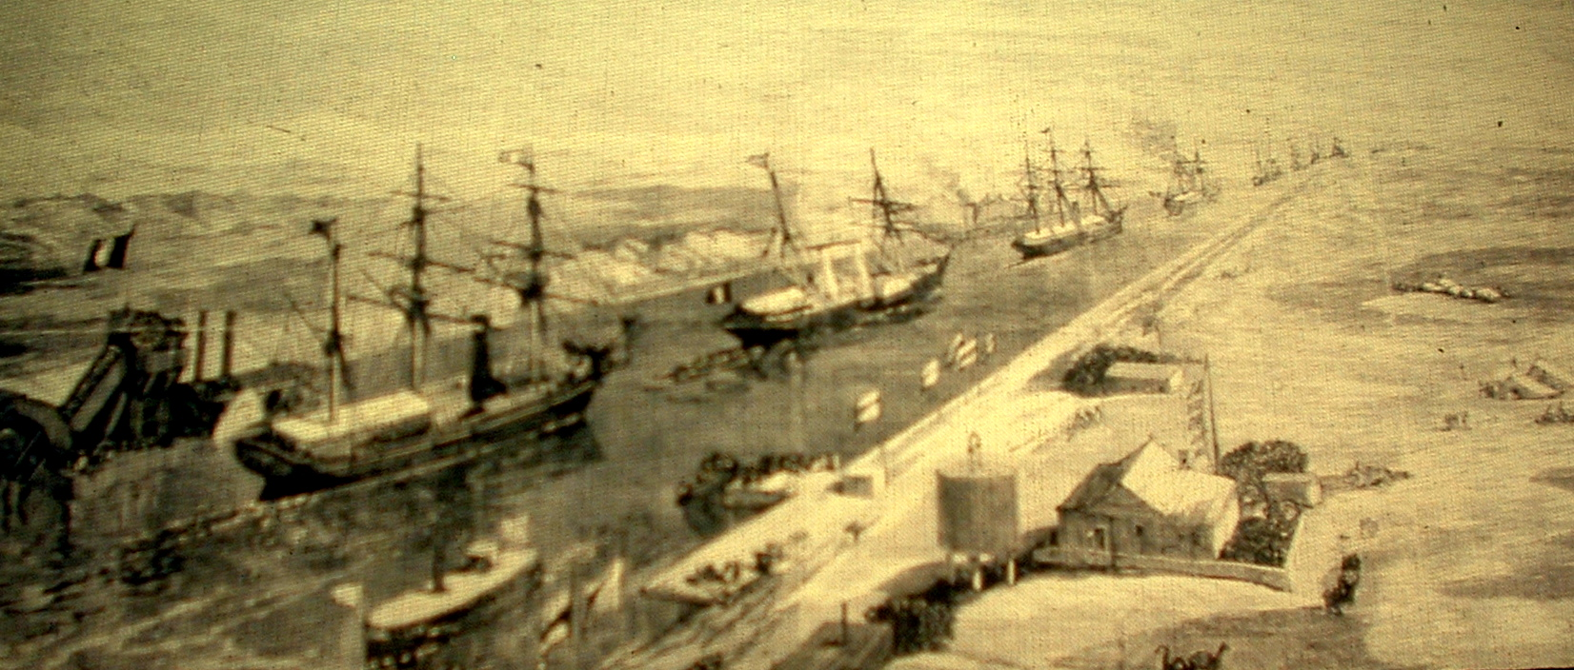
An imperial yacht passing through the Suez Canal in Egypt at the opening of the canal in 1870
Imperial motives: ECONOMIC (exportation of transportation methods to improve trade) or
POLTICAL (boosting national pride and prestige by controlling foreign territories)

