Slide 1
IB Psych 1/11/19
Turn in:
Nothing
Take out :
Planner
Writing Implement
NOTES
Inquiry Questions
Is every behavior associated with specific brain regions?
Is every psychological function associated with specific brain regions?
How are these areas “discovered?”
Are some psychological functions more localized than others?
Today’s Agenda:
Neuroplasticity
HW:
CRA Module 10

Slide 2
If you had to give up one of your senses, which would it be & why?
Which one sense could you absolutely not go without?
Are there limits to neuroplasticity? Could we adapt and “re-learn” to fill in the gaps of a lost sense?

Slide 3
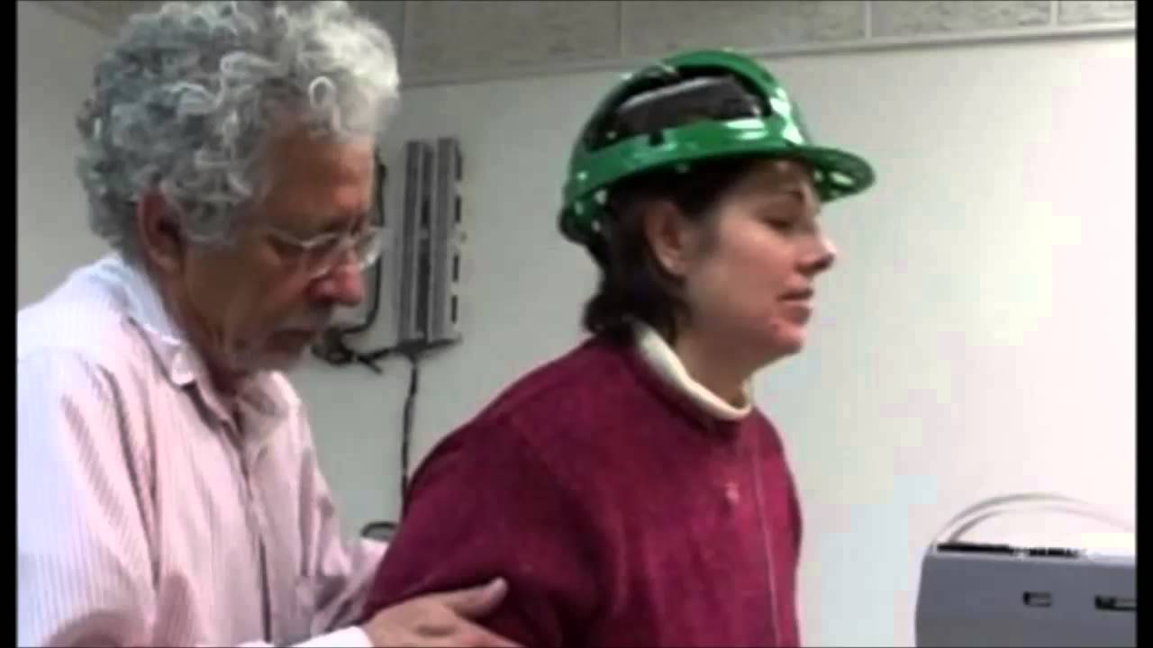
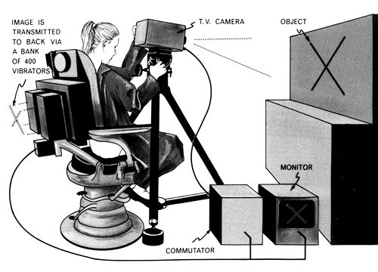
Are there limits to neuroplasticity? Could we adapt and “re-learn” to fill in the gaps of a lost sense?
Paul
Bach-y-rita
https://www.ted.com/talks/daniel_kish_how_i_use_sonar_to_navigate_the_world#t-771341

