Slide 1
9th Honors 1.16.15
Turn in:
Nothing—C/R out and finished…
Take out :
Pen/Pencil
Note-taking devices
Today’s Learning Objectives:
I can prepare to be brilliant on my semester 1 final exam!
Today’s Agenda:
Final Review
Content portion
Previous units—online
Mind Map—making connections & writing prep
HW:
Prepare for final:
MIND MAP TUESDAY!

Slide 2
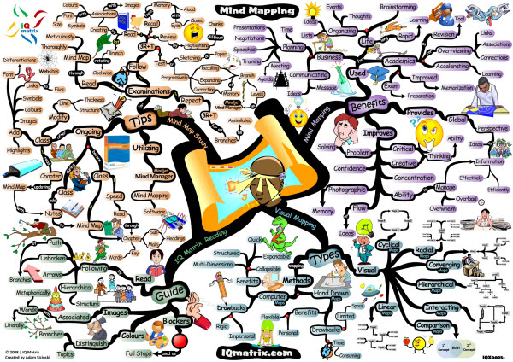
Mind Mapping…

Slide 3
Writing with connections
Thesis Statement: In William Goulding’s, Lord of the Flies, the fire, the Beast, and the mask are symbols that convey the belief that human nature is evil, which also reflects Thomas Hobbes’ desire for strong government rule as displayed in England in the 17th century.
In the novel, LOTF, the [LA concept from thesis] to [insert SS concept here] by [brilliant writing inserted here].
In looking at [SS concept from above] one also views the influence this had on [insert LA concept here] by [brilliant writing inserted here].
Repeat the process until you tie your final sentence back to your original thought or concept

Slide 4
