Slide 1
9th Honors 1.26.15
Turn in:
NOTHING!!!
Take out :
Pen/Pencil
Note-taking devices
Today’s Learning Objectives:
I can understand the development of China and it’s role in world history.
Today’s Agenda:
2nd semester overview
China
Map
Jared Diamond is BACK! YES!!!
HW:
Physical Map
C/R Jared Diamond writing…

Slide 2
Welcome to 2nd Semester of World Studies
Global Civics
What does it mean to be part of a society?
What is the relationship between an individual and a government?
What systems have we seen?
Are there other options?
Is there a perfect system?
When should you rebel?
How should you rebel?
If you are successful (very rare), then how do you build a new government system?

Slide 3
The Big Dogs
Comparative Approach:
China (5 weeks)
Ancient history
Colonization
Revolution
Communism
Present Day
USA! (5 weeks)
Colonial context
Philosophical foundations
Constitutional System

Slide 4
Global Civics What do our values mean in the real world?
Domestic:
Supreme Court cases
Politics
Elections
International: Contemporary World Problems
Recent History and Foreign Policy Problems
North Korea/South Korea
India/Pakistan
Middle East
Israel/Palestine
Iran, Iraq, Syria
Humanitarian crises in Africa

Slide 5
You will be a Senator. You will solve problems.
You will present a unique, complex and focused argument about how the United States should address one Foreign Policy issue.
Based on our history, values, and practical needs.
You will:
Choose an issue
Research the issue
Create a proposal (thesis)
Support that proposal (evidence, stats, info, stories: ethos (ethical), pathos (emotional), logos (logical))
Write a persuasive paper
Participate in Senate committee debates
Participate in a Senate Floor Debate

Slide 6
Modern History Modern Methods
We will be using more films this semester. Here are some possibilities:
To Live (China)
Gandhi (India/Pakistan)
Hotel Rwanda (Africa)
Invictus; Cry Freedom (clips)
Inside North Korea (NK)
Promises (Israel/Palestine)

Slide 7
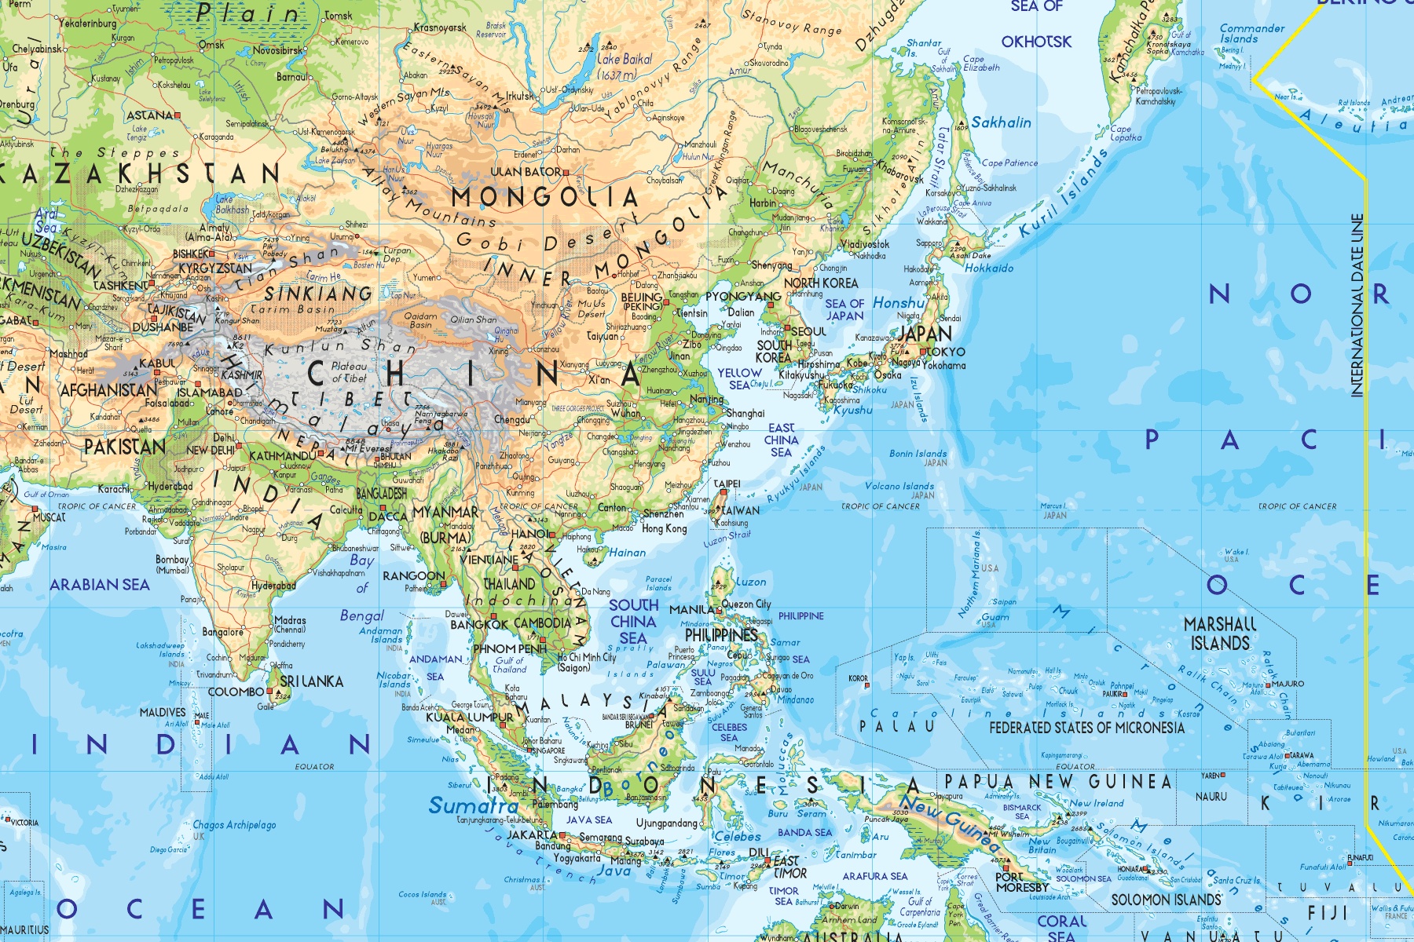

Slide 8
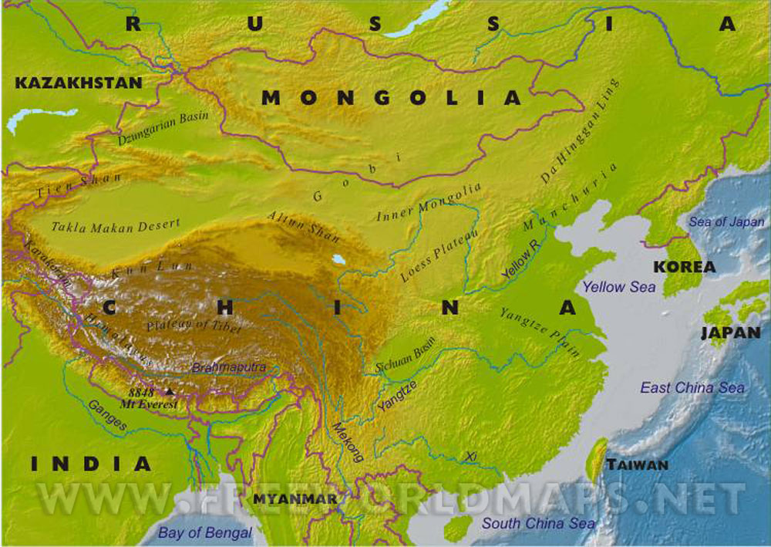

Slide 9
China/East Asia Guiding Questions
Physical: What is the impact of physical geography on Chinese history?
Religion: What is more important: the needs of the individual or the needs of society?
How should we behave in order to create an orderly society?
Is it more important to have order, or freedom?
Government (Dynastic System): What is authority based on?
What is power?
Why do some people have power over others? How does power change hands?
Education: How do you measure learning and merit?
How do societies pass on values and knowledge?
Defense: How did Asian nations respond to European colonization attempts?
Why is Japan unique?
Economics: Does communism work?
Is China really a communist country?

Slide 10
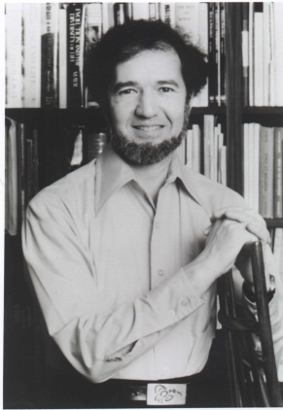
Description and Explanation
1. What is the difference between
description
and
explanation?
2. What type of question does description answer?
3. What type of question does explanation answer?
4. Does Jared Diamond describe or explain?

Slide 11
Description, Explanation, and Analysis
To Describe: to represent in words.
(“Papua New Guinea is a nation that occupies half of a large island in the South Pacific.”)
To Explain:
to make something understandable
“Jared Diamond explained his thesis to me.”
to give the reason for or cause of.
“But Jared, why is Papua New Guinea so poor?”
to show the logical development or relationships
“Jared explained to me how PNG’s geography limited its economic and technological development”)
To Analyze:
To separate something into its component parts,
To show how parts are related.
To show how causes lead to effects. (Why/How did something happen?)

Slide 13
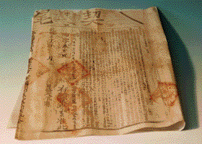
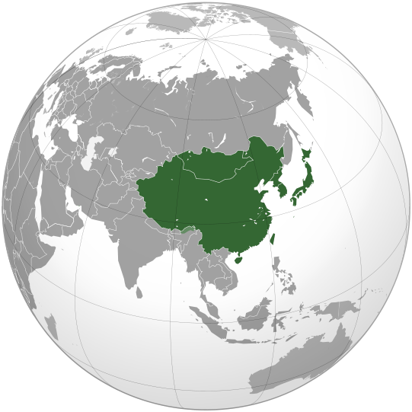
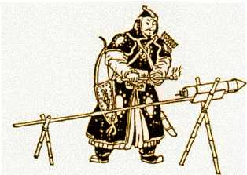
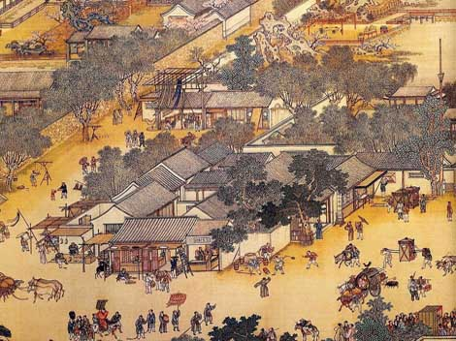
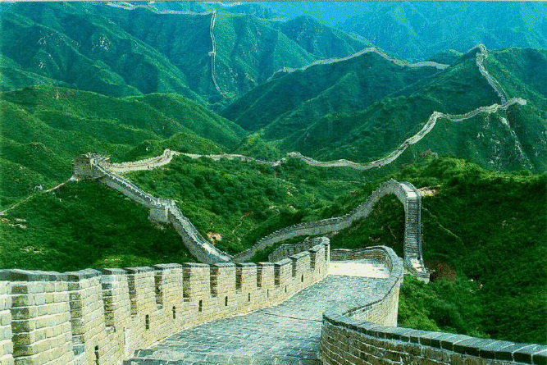
Why?
China has the longest recorded history of any human civilization.
For much of history China has been the biggest, most powerful, most advanced, nation in the world.

Slide 14
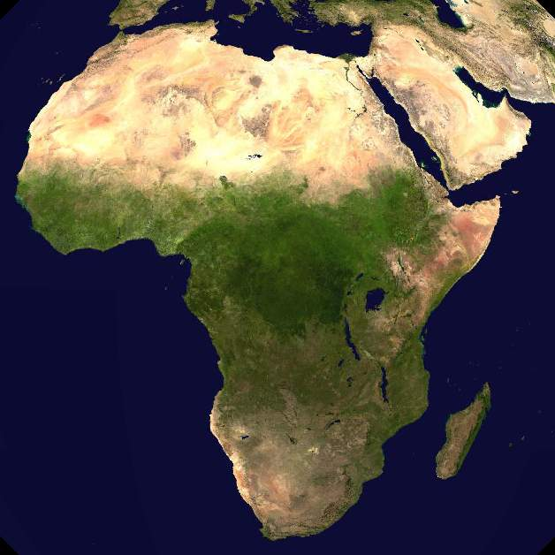
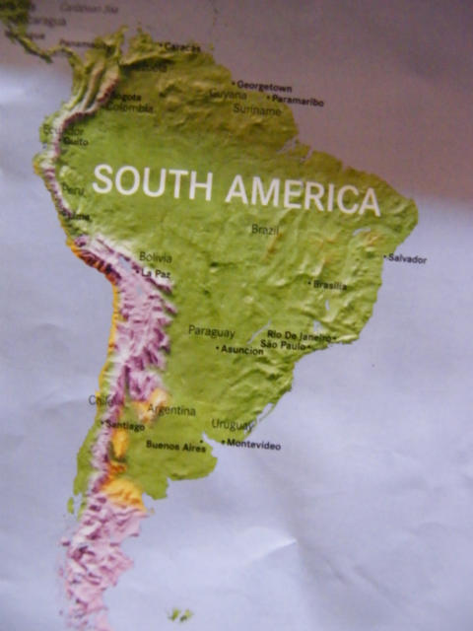
What did Jared Say about…?

Slide 15
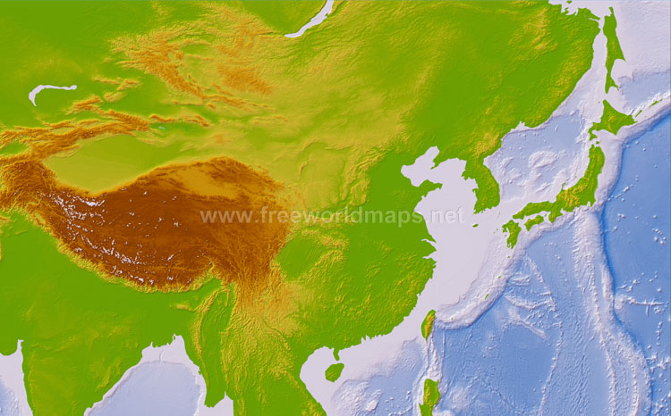
What WILL Jared Say about…?

Slide 16
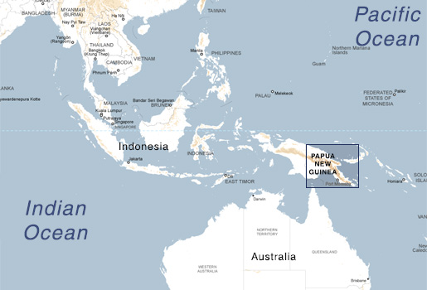
Jared Diamond tells us about PNG… What about China?
Jared sent me a message, but I don’t understand it.
The message says: “Geographic luck, good and bad, has played an important role in the development of East Asian Civilizations.”

Slide 17
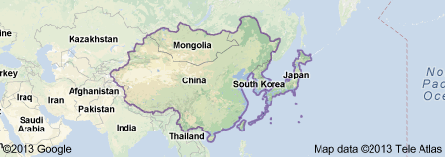
East Asia: Physical Geography
I. Analyze the geography:
What strengths do you see?
What weaknesses do you see?
Where will complex civilizations (cities) arise first?
Where will invasions come from?
II. Connect to History:
Pick two (2) geographic features (coasts, rivers, mountains, plateaus, etc.)
Describe the feature
“The Gobi is a large desert in northern China”, “The Korean Peninsula is a chunk of land between the Yellow Sea and the Sea of Japan”
Connect that feature to an Important Piece of Information that you took from the reading.
Explain the connection between the geographic feature and the Historical Information.
Support JD’s mysterious thesis:
“Geographic luck, good and bad, has played an important role in the development of East Asian Civilizations.”
Use the Physical maps of East Asia:
Textbook: 1139
Atlas: p. 118-121, 129

Slide 18
9th Honors 1.26.15
Turn in:
NOTHING!!!
Take out :
Pen/Pencil
Note-taking devices
Today’s Learning Objectives:
I can understand the development of China and it’s role in world history.
Today’s Agenda:
2nd semester overview
China
Map
Jared Diamond is BACK!
HW:
Physical Map
C/R Jared Diamond writing…

