Slide 1
10th World Studies 10.01.15
Turn in:
NOTHING
Take out:
Planner
Notes, & note-taking devices
Today’s objective:
I can describe how the shifting of power occurred during the Renaissance.
Today’s Agenda:
GOTR: Episode 3, The Medici Popes
HW:
Exploring the Duomo
Due to TII.com by FRIDAY 7:25am

Slide 2
Godfather’s of the Renaissance: Episode 2: The Magnificent Medici
(Reader’s Digest version…)
Florence, August 1466:
Lorenzo de Medici (Grandson of Cosimo), escapes an assassination attempt. He marries to strengthen ties (Power?)…$, church, social class, military muscle.
Art is still flourishing…Botticelli becoming more bold and secular. (isms?)
At 20, Lorenzo becomes Capo (“boss”) of the Medici family.
Creates a network of amici degli amici (“friends of friends) for the common people of Florence and Tuscany (region)
The Pazzi family plots with Pope Sixtus IV to murder both Lorenzo and his brother…what?!?

Slide 3
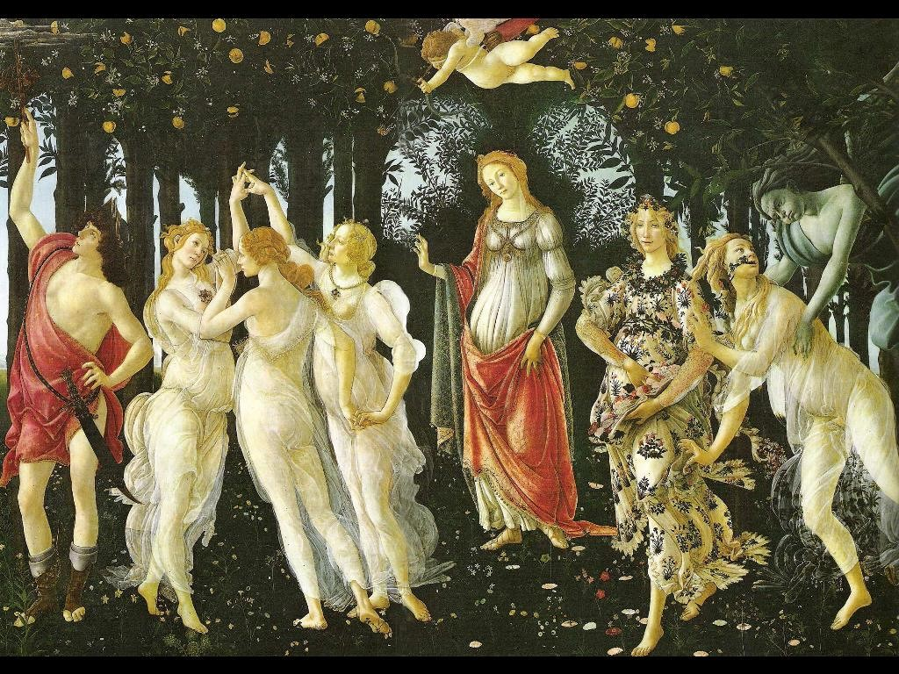

Slide 4
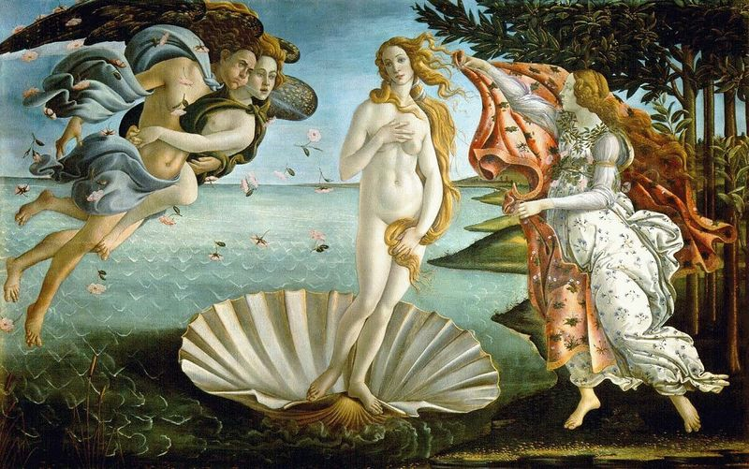

Slide 5
Godfather’s of the Renaissance: Episode 2: The Magnificent Medici
(Reader’s Digest version…)
Easter Sunday, April 26, 1478:
Mass at the cathederal…it’s crowded
Lorenzo and his brother (Giuliano) are attacked…Giuliano dies in front of his family, Lorenzo disappears…
The city erupts in chaos—think, two important families battling it out…picking sides, etc.
Then, at the window of his palace, Lorenzo shows himself…wounded severely, but ALIVE!
The city turns on the Pazzi

Slide 6
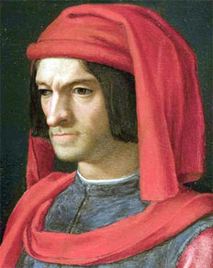
Godfather’s of the Renaissance: Episode 2: The Magnificent Medici
(Reader’s Digest version…)
The Pazzi and their allies try to finish the job they started…
Lorenzo travels to the south for help from other godfathers…king of Naples help (via a bribe) & the Pope’s plans are foiled.
As he returns to Florence, he is deemed, “Il Magnifico” and eliminates all opposition. He is now ruling as a dictator (but not in the sense we might think of…)
The Birth of Venus (Botticelli), da Vinci, Michelangelo both discovered…Buonarotti is “adopted” into the family.

Slide 7
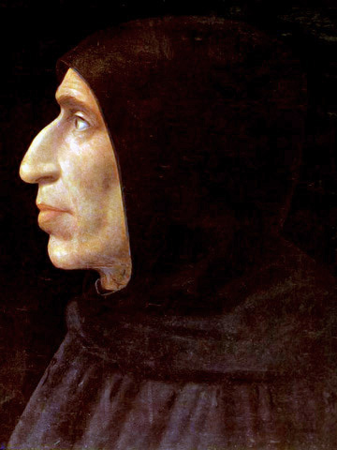
Godfather’s of the Renaissance: Episode 2: The Magnificent Medici
(Reader’s Digest version…)
All of this “culture” is upsetting to some…(who?)
Savonarola—a Dominican (not as much an “order,” but rather an army of priests.)
Tells of God’s punishment for Lorenzo and the Medici if they don’t repent…
1492: Lorenzo falls ill…is Savonarola right?!?
Support of Savonarola grows
Medici bank, business, and network of friends begins to decline.
Lorenzo dies…

Slide 8
Godfather’s of the Renaissance: Episode 2: The Magnificent Medici
(Reader’s Digest version…)
Bonfire of the Vanities (remember our connections to sin…)
Persecution of these Vanities…
Even Botticelli joins in…

Slide 9
Godfather’s of the Renaissance: Episode 3: The Medici Popes
NAME | IMPORTANCE | CONNECTION TO OTHERS…
Catherine de Medici
Giovanni de Medici
Guilio de Medici
Leonardo da Vinci
Martin Luther
Michelangelo
Niccolo Machiavelli

