Slide 1
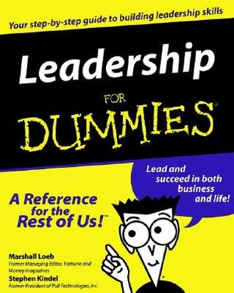
9th Honors 10.06.15
Turn in:
Critical read of “The Roman Empire”
Take out:
Planner (Larger Quiz Friday)
Stamp Sheet
Pen/NOTES
Today’s Learning Objectives:
I can explain how empires began to take shape and the different government structure that were implemented.
Today’s Agenda:
The Rest of the Punic Wars
Decline of the Republic & rise of the Empire
Begin watching “Mankind: the Story of All of Us” Episode 3
Empires
10 Key pieces of information
HW:
Leadership for Dummies
Available online…

Slide 2
Second Punic War (218-201 BCE)
Carthage: General Hannibal
Rome: General Scipio
Led an army against Carthaginian Iberia (Spain)
Led 60,000 men and dozens of elephants through Spain, along the Mediterranean coast, through Gaul, and across the Alps to Italy
Fought in Italy for 15 years, winning many battles
Battle of Cannae (216 BCE)
Romans lost over 50,000 soldiers
But Hannibal could not capture the city of Rome
Then led an army against Carthage itself
Then returned to Italy to defend the city of Rome
Battle of Zama (202 BCE)
Hannibal’s first and only defeat
Hannibal escaped and returned to Carthage
Carthage lost its fleet, Iberia (Spain), and the larger part of its territory in northern Africa

Slide 3
Between the wars…
Carthage
Carthage rebuilt its trading networks and commercial power
Rome
Rome felt threatened by competition from Carthage
Senator Cato ended all of his speeches with the warning: “Carthago delenda est!” (“Carthage must be destroyed!”)

Slide 4
Third Punic War (149-146 BCE)
Rome made unrealistic demands of Carthage
Carthage refused
Carthage had no mercenaries
Romans laid siege to Carthage
Roman siege was successful
300 noble children to be given to Rome as hostages
Carthage to be destroyed and rebuilt away from the coast
Forced to defend their own city
Romans burnt Carthage to the ground – became Roman province
Men killed; women and children sold into slavery

Slide 5
Results of the Punic Wars: During and After
Rome and Carthage had been what you might call the “superpowers” of the Mediterranean at the time
Roman control of Macedonia
Rome went on to conquer the remnants of Alexander the Great’s empire in Eurasia
Rome’s defeat of Carthage left Rome as the only remaining “superpower”
It was much easier for Rome to conquer the rest of the Mediterranean once Carthage was out of the way
Hannibal had made an alliance with the Macedonian king
Rome attacked and defeated Macedonia in 197 BCE
Fighting among the Greek city-states
Rome took over, ending Greek independence (146 BCE)
Kingdom of Pergamum
In modern-day Turkey
Under Roman rule in 133 BCE

Slide 6
Provincial Governments
Each conquered area was a province of Rome
Proconsuls
Each province was governed by a Roman proconsul
Typically a member of the patrician (noble) class
More often than not these were corrupt
Publicans
Publicans were tax collectors
Became a publican by auctioning for the job
Squeezed as much money out of conquered peoples as they could

Slide 7
Rome Grows Wealthy
Money (from taxes and war booty) and cheap goods flooded Rome
Upper classes grew wealthier, and new class of wealthy merchants and traders emerged
Government had more money than ever before
Whoever controlled the government could use this money for its own needs (e.g., government contracts)
Africa and Sicily – wheat
East – gems and luxury goods
Spain – silver and tin
This caused greater tension in the struggle for control of the government

Slide 8
Old Roman Values Diminish
Roman Army
Originally, it was staffed by volunteers
Professional army lacked the former volunteer fighting spirit
Morals and Values
Corruption replaced dedication to public service
Pursuit of luxury, pleasure, and soft living replaced hard work, patriotism, and simplicity

Slide 9
What did expansion mean for Rome?
Pros
Wealth
Power
Cons
Difficult to manage an empire
Wealth created new classes in Rome
From trade
From taxes
Multicultural empire required a multifaceted approach
Slaves gained by conquests displaced free farmers and workers
These problems ultimately ended the “Republic” and led to the “Empire”
Control of most of the Mediterranean

Slide 10
Rich Get Richer, Poor Get Poorer
Money from government contracts (building bridges, roads, and ships; supplying the armies)
High-interest loans
Bribes and graft in the provinces
Poor farmers and workers could not compete with the products of slave labor
Wealthy class bought up the lands of impoverished farmers
Impoverished farmers and others flooded the city of Rome
Latifundia, the large farms of the wealthy, became operated by slaves
These unemployed masses had one thing left—their right to vote
These unemployed masses—the “Roman mob”—threw their support to those politicians who offered “bread and circuses”

Slide 11
Rich Get Richer, Poor Get Poorer
https://www.youtube.com/watch?v=FsqJFIJ5lLs

Slide 12
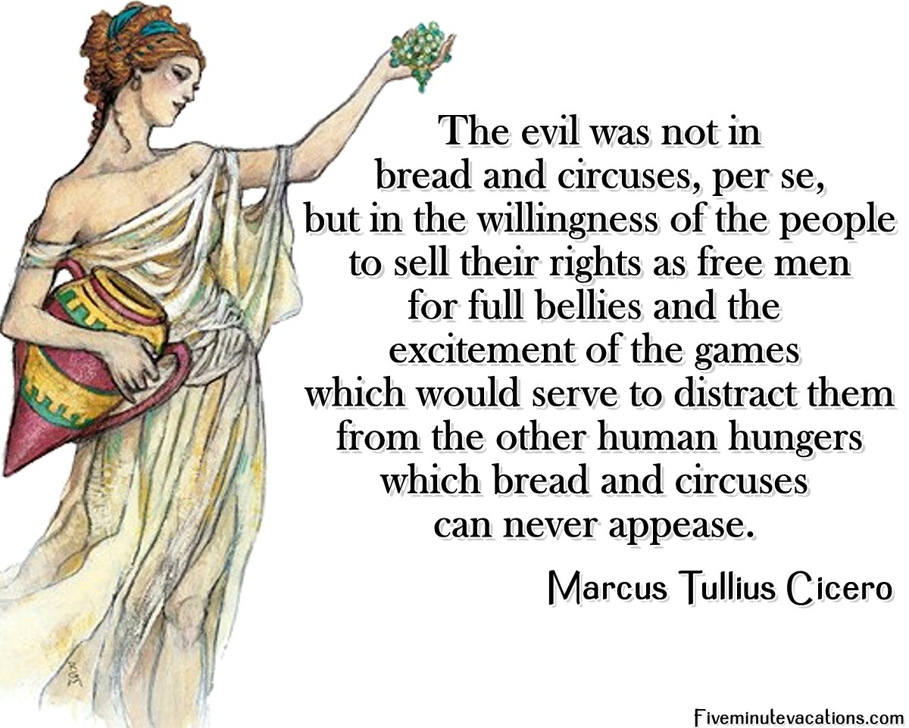
Rich Get Richer, Poor Get Poorer
Money from government contracts (building bridges, roads, and ships; supplying the armies)
High-interest loans
Bribes and graft in the provinces
Poor farmers and workers could not compete with the products of slave labor
Wealthy class bought up the lands of impoverished farmers
Impoverished farmers and others flooded the city of Rome
Latifundia, the large farms of the wealthy, became operated by slaves
These unemployed masses had one thing left—their right to vote
These unemployed masses—the “Roman mob”—threw their support to those politicians who offered “bread and circuses”

Slide 13
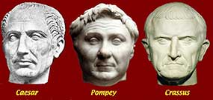
Shifts in Power…
1st Triumvirate
Great Popularity & Legal reputation
Great wealth and influence within Equestrian social order
One of Rome’s wealthiest men & great military reputation.

Slide 14
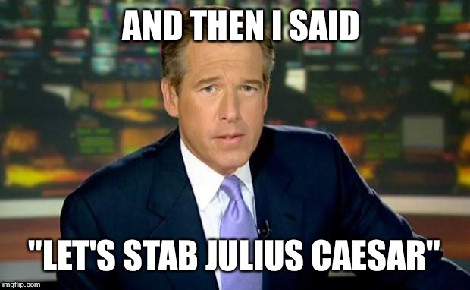
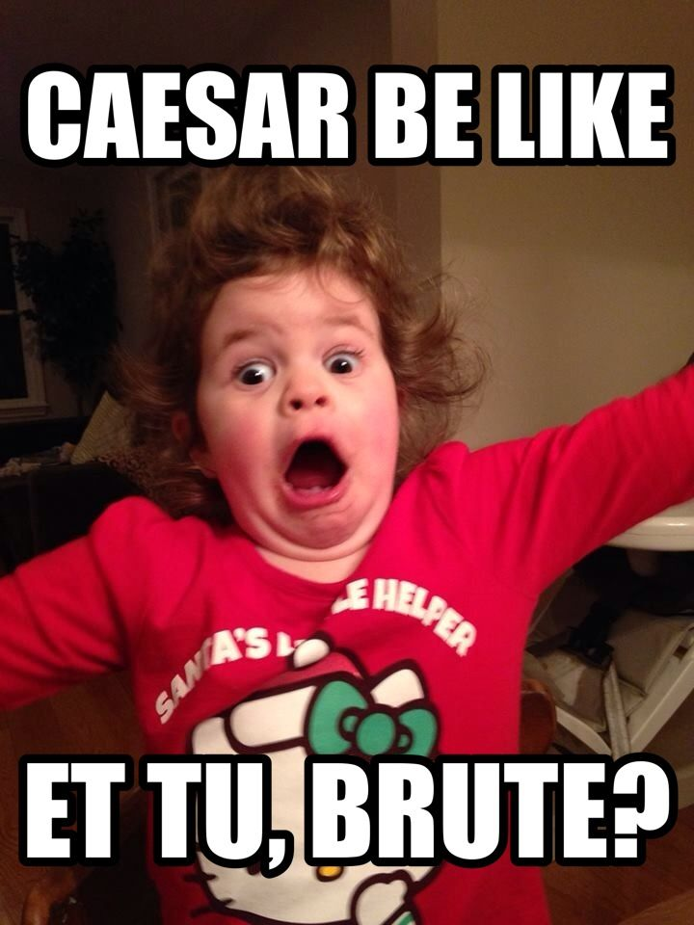
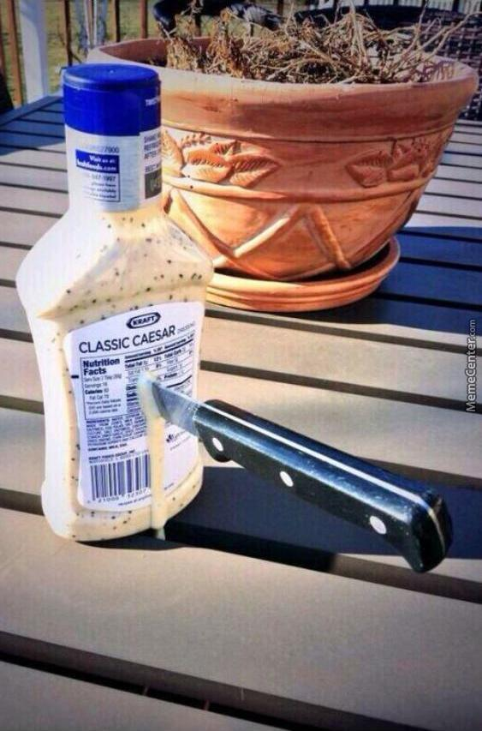
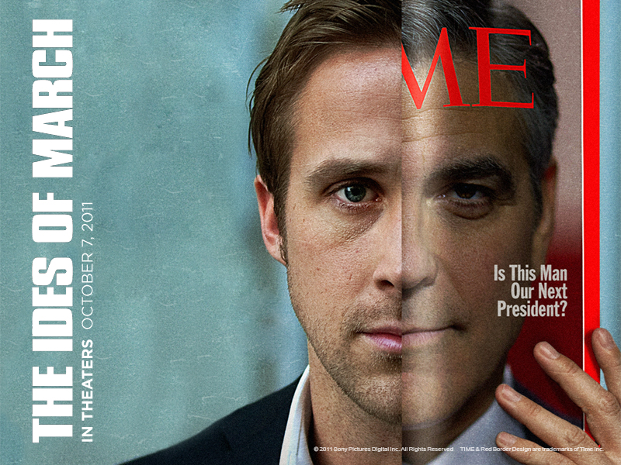
Shifts in Power…
Beware the Ides of March…
“Et tu Brute?”

Slide 15
Shifts in Power…

Slide 16
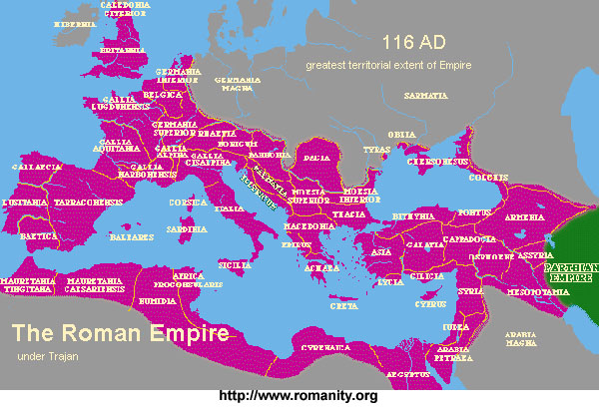
EMPIRE!!!

Slide 17
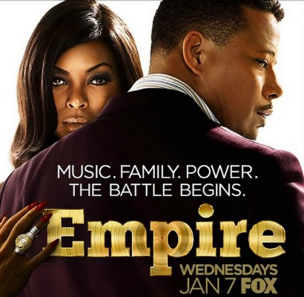
EMPIRE!!!
An extensive group of states or countries under a single supreme authority, formerly especially an emperor or empress:
A large commercial organization owned or controlled by one person or group
A large commercial organization owned or controlled by one person or group

Slide 18
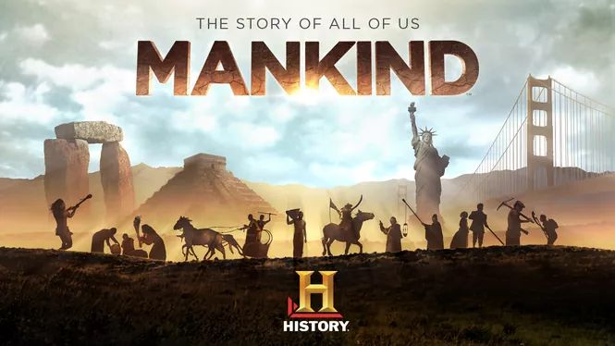
EMPIRE!!!
For notes: take notes as you watch…I will ask you to review and decide a “top 10” list later…

