Slide 1
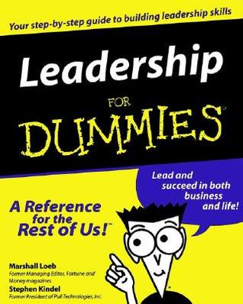
9th Honors 10.07.15
Turn in:
NOTHING…
Take out:
Planner (Larger Quiz Friday)
Stamp Sheet—CRA Roman Empire
Pen/NOTES
Leadership for Dummies
Today’s Learning Objectives:
I can explain how empires began to take shape and the different government structure that were implemented.
Today’s Agenda:
Begin watching “Mankind: the Story of All of Us” Episode 3
Empires
HW:
Leadership for Dummies
Available online…

Slide 2
Leadership for Dummies
Rule 1 | The ends justify the means.
Evidence | “in the actions of princes, where there is no impartial arbiter, one must consider the final result."
Analysis | Machiavelli lays the foundation of the separation of morality and ethics from ruling. In order to rule effectively, a leader need only concern himself with the outcome of his rule, and not the methods in which he rules.

