Slide 1
10th World Studies 10.12.18
Turn in:
Nothing
Take out:
Planner
Notes, & note-taking devices
Today’s objective:
I can provide brilliant answers and reflect on my level of note-taking as it corresponds to my understanding.
Today’s Agenda:
Martin Luther’s 95 Theses
Thesis Statements
HW:
Your “Reforms”

Slide 2
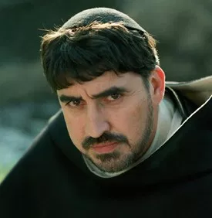
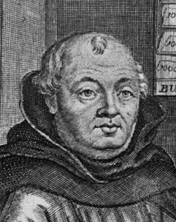
Johann Tetzel & “Indulgences”
Also a German monk…
Not regarded as very well educated—issues with Latin
But what a great “salesman!”
"As soon as the coin in the coffer rings, the soul from purgatory springs."
-- Johann Tetzel
Luther views this as an abuse of the sacrament of Penance/Reconciliation
What will he do???
Johann Tetzel selling his wares:
https://youtu.be/3U6YwOvOSO8?t=1845
“In the authority of all the saints, and in compassion towards thee, I absolve thee from all sins and misdeeds, and remit all punishment for ten days.”

Slide 3
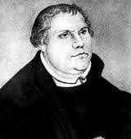
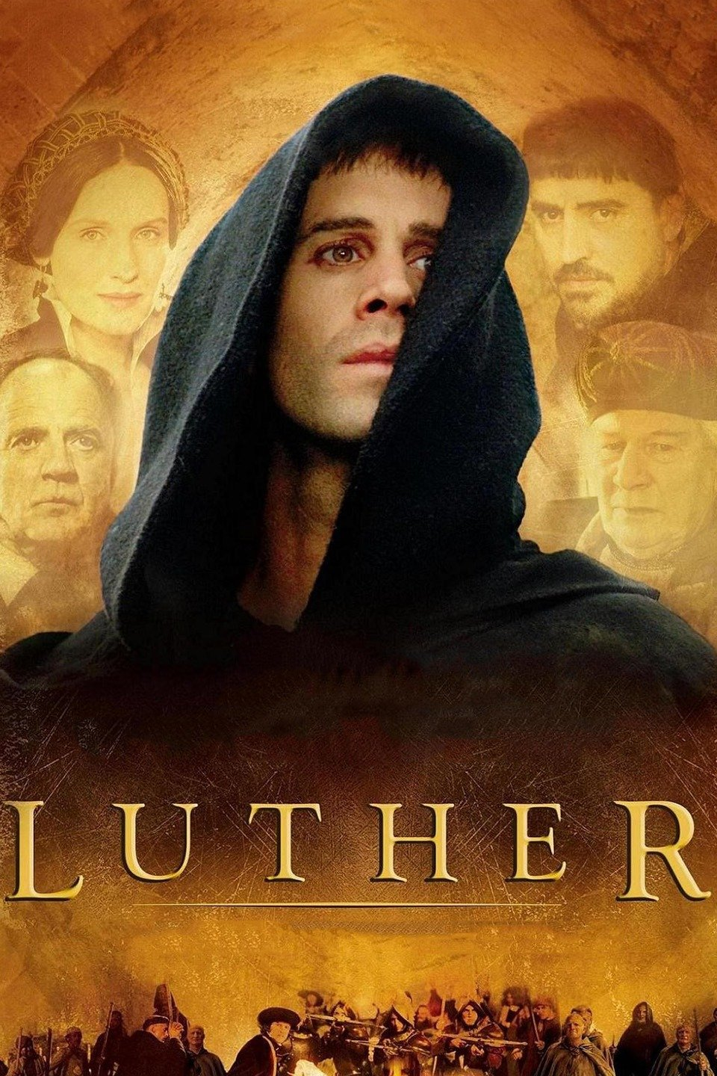
Martin Luther
Luther was a German monk and professor of theology (religion) at the University of Wittenberg.
Dissatisfaction with the Church leads him to take action…
Luther takes action: https://www.youtube.com/watch?v=smDf7TSNRp8
Notes:
Luther translates the Bible to German and believes that people should be able to interpret the Bible for themselves.
Coffer means chest

Slide 4
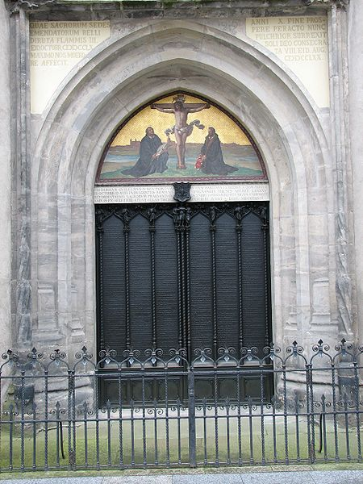
Martin Luther
Luther was a German monk and professor of theology (religion) at the University of Wittenberg.
October 31, 1517:
Luther nails a “letter” to the doors of the Wittenberg church…
What do you notice about the date?
How about:
November 1?
November 2?
Notes:
Luther translates the Bible to German and believes that people should be able to interpret the Bible for themselves.
Coffer means chest

Slide 5
Martin Luther—95 Theses
Amore et studio elucidande veritas hec subscripta disputabuntur Wittenberge, Presidente R.P. Martino Lutter, Artium et S. Theologie Magistro eiusdemque ibidem lectore Ordinario. Quare petit, ut qui non possunt verbis presentes nobiscum disceptare agant id literis absentes. In nomine domini nostri Hiesu Christi. Amen.
Notes:
Luther translates the Bible to German and believes that people should be able to interpret the Bible for themselves.
Coffer means chest

Slide 6
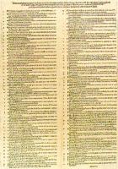
Martin Luther—95 Theses
Out of love for the truth and from desire to elucidate it, the Reverend Father Martin Luther, Master of Arts and Sacred Theology, and ordinary lecturer therein at Wittenberg, intends to defend the following statements and to dispute on them in that place. Therefore he asks that those who cannot be present and dispute with him orally shall do so in their absence by letter. In the name of our Lord Jesus Christ, Amen.
Notes:
Luther translates the Bible to German and believes that people should be able to interpret the Bible for themselves.
Coffer means chest

Slide 7
Preamble
Out of love for the truth and from desire to elucidate it, the Reverend Father Martin Luther, Master of Arts and Sacred Theology, and ordinary lecturer therein at Wittenberg, intends to defend the following statements and to dispute on them in that place. Therefore he asks that those who cannot be present and dispute with him orally shall do so in their absence by letter. In the name of our Lord Jesus Christ, Amen.
Notes:
Truth: Veritas: faithfulness
Elucidate: to make clear; to explain
Defend: “disceptare” reach an authoritative judgment or settlement.
Dispute: “disputabuntur” to discuss, debate.

Slide 8
Preamble: Paraphrase
Because of my love for the faith and my need to make it clear, I the Revered Father Martin Luther, teacher and professor of God’s Scripture at Wittenberg, wish to explain and guard my statements and open debate on the topics written. If one is not able to attend and debate in person, then do so in writing. In the name of our Lord Jesus Christ, Amen.
Out of love for the truth and from desire to elucidate it, the Reverend Father Martin Luther, Master of Arts and Sacred Theology, and ordinary lecturer therein at Wittenberg, intends to defend the following statements and to dispute on them in that place. Therefore he asks that those who cannot be present and dispute with him orally shall do so in their absence by letter. In the name of our Lord Jesus Christ, Amen.
Notes:
Truth: Veritas: faithfulness
Elucidate: to make clear; to explain
Defend: “disceptare” reach an authoritative judgment or settlement.
Dispute: “disputabuntur” to discuss, debate.

Slide 9
Preamble: Summary
Because of my love for the faith and my need to make it clear, I the Revered Father Martin Luther, teacher and professor of Sacred meaning at Wittenberg, wish to explain and guard my statements and open debate on the topics written. If one is not able to attend and debate in person, then do so in writing. In the name of our Lord Jesus Christ, Amen.
Because he has faith and love in God, and wants others to as well, would like to talk about his positions and beliefs openly. If one is not able to be here in person, please write. So be it.
Out of love for the truth and from desire to elucidate it, the Reverend Father Martin Luther, Master of Arts and Sacred Theology, and ordinary lecturer therein at Wittenberg, intends to defend the following statements and to dispute on them in that place. Therefore he asks that those who cannot be present and dispute with him orally shall do so in their absence by letter. In the name of our Lord Jesus Christ, Amen.
Notes:
Truth: Veritas: faithfulness
Elucidate: to make clear; to explain
Defend: “disceptare” reach an authoritative judgment or settlement.
Dispute: “disputabuntur” to discuss, debate.

Slide 10
Original: Paraphrase: Summary
Out of love for the truth and from desire to elucidate it, the Reverend Father Martin Luther, Master of Arts and Sacred Theology, and ordinary lecturer therein at Wittenberg, intends to defend the following statements and to dispute on them in that place. Therefore he asks that those who cannot be present and dispute with him orally shall do so in their absence by letter. In the name of our Lord Jesus Christ, Amen.
Because of my love for the faith and my need to make it clear, I the Revered Father Martin Luther, teacher and professor of God’s Scripture at Wittenberg, wish to explain and guard my statements and open debate on the topics written. If one is not able to attend and debate in person, then do so in writing. In the name of our Lord Jesus Christ, Amen.
Because he has faith and love in God, and wants others to as well, would like to talk about his positions and beliefs openly. If one is not able to be here in person, please write. So be it.
Notes:
Truth: Veritas: faithfulness
Elucidate: to make clear; to explain
Defend: “disceptare” reach an authoritative judgment or settlement.
Dispute: “disputabuntur” to discuss, debate.

Slide 11
TITLE…
Even though we know this work as the 95 Theses, Martin Luther gave it the title of “Disputation of Doctor Martin Luther on the Power and Efficacy of Indulgences.”
Notes:
Efficacy: the ability to produce a desired or intended result.

Slide 12
Table Groups in turbulent times…
Determine which of your group members happens to have the next birthday on the calendar…then, that individual remains standing…
That individual will be moving UP two (2) table groups in numeric order…
(i.e. #1 goes to #3)

Slide 13
Block Groups in turbulent times…
Determine which of your group members happens to have the most recent birthday on the calendar…then, that individual remains standing…
That individual will be moving Back one (1) table group in numeric order…
(i.e. #16 goes to #15)

Slide 14
At Your Table Groups
You will be assigned a series of Luther’s Theses. (The translated version is online…)
As an GROUP, you will need to PARAPHRASE your selection of lines.
As an INDIVIDUAL (and GROUP), you will need to SUMMARIZE your selection of lines.
PARAPHRASE: a restatement of a text, passage, or work giving the meaning in your own “vernacular”.
SUMMARY: A condensed statement or account of the main points of something. (i.e. GOTR “Reader’s Digest Version)

Slide 15
Luther’s 95 Theses
In 1517, the 95 Theses were nailed to a church door. They were written in Latin.
Luther’s intention/audience?:
NOT TO BREAK WITH CHURCH, BUT REFORM IT!
Criticized:
Indulgences
Power of Pope
Wealth of Church
God’s Grace won by FAITH ALONE! Catholic View of Luther’s time: Good Works earned you salvation

Slide 16
HW: ONLINE
One of our themes for this class is the “BEST WAY TO DO THINGS” and how this shifts through history…
With this in mind, for your homework this weekend, I would like you to consider what institution (again, think of power…) might be placing an injustice upon you or others in the world today…which institution needs REFORMING?
Got it??? Picture it in your mind…now, for the harder part…How might you go about REFORMING that institution?
Write a series of your own THESES…(at least 3) Focus on finding a SOLUTION to the issue.

