Slide 1
IB Psych 10/15/18
Turn in:
Nothing
Take out :
Planner
Writing Implement
Today’s Learning Objectives:
I can examine concepts of research.
Today’s Agenda:
Validity of a study…
Can we put it into practice?
HW:
NONE

Slide 2
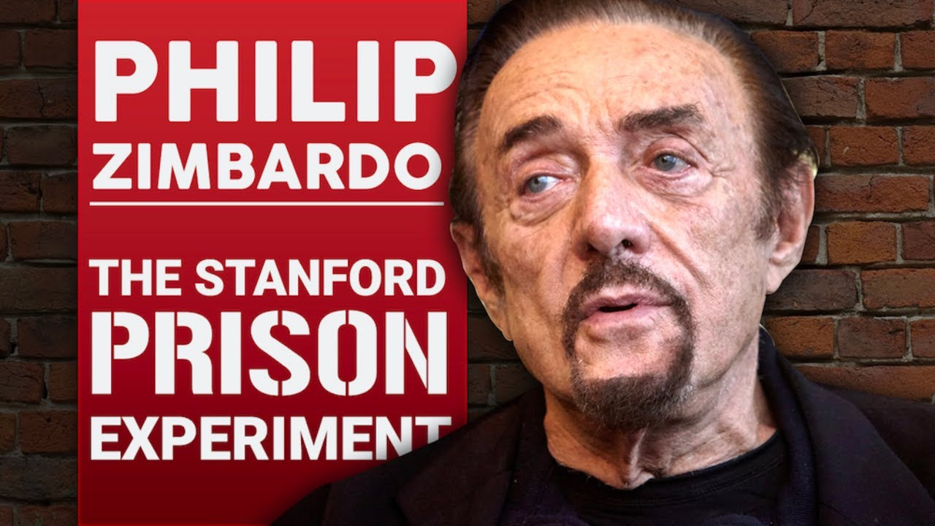
An Experiment, a career, a legend (at least in the world of psychology…) But, what of the design of the study? https://www.ted.com/talks/philip_zimbardo_on_the_psychology_of_evil

