Slide 1
10th Euro Studies 10.16.14
Turn in:
Mswati III
Divine Right of Kings reading
Take out:
Planner, Pen/pencil, NOTES, Mswati III Reading, DROK Reading
Today’s objective:
I can describe how Spain was unified and the impact of Philip II had on the balance of powers in Europe.
Today’s Agenda:
Monarch Chart
Map of Europe
Background on Isabella and Ferdinand
Spain: Philip II
HW:
Read pages 505-508
Begin working on map (focus on Spain…)
Begin working on chart (focus on Spain…)

Slide 2
Notes:
BALANCE OF POWER

Slide 3
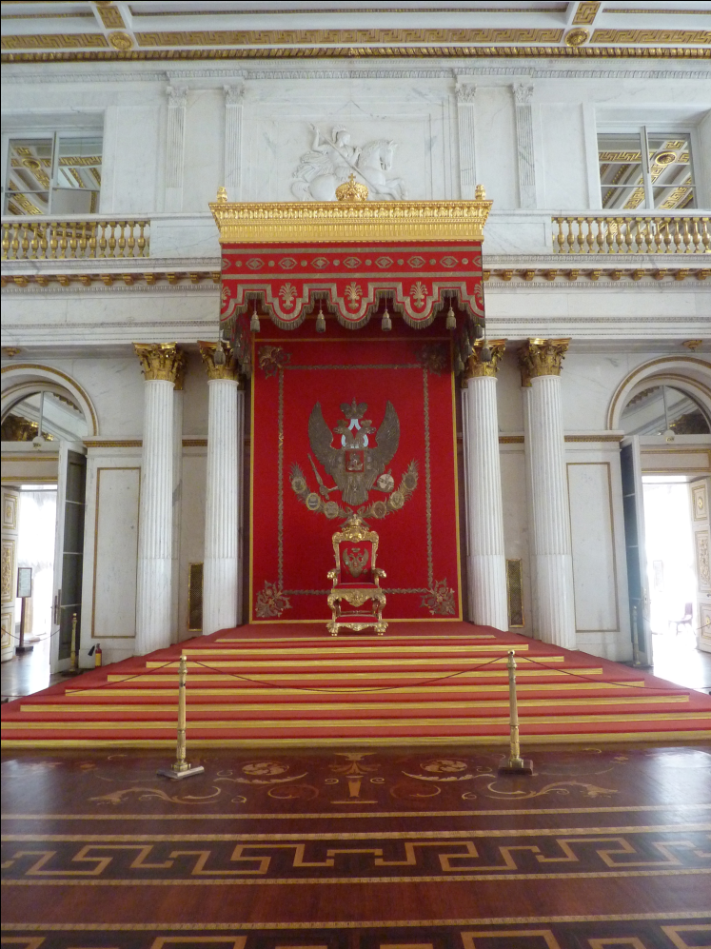
A power vacuum…Why?
-Black Plague and Wars (Crusades, etc…) weaken feudal lords
-Renaissance & Reformation weakens the power of the Catholic Church
-Age of Exploration makes kings rich
-Absolute Power is hereditary
DIVINE RIGHT OF KINGS
The belief that kings get their power
from God, not the people
-Jean Bodin: Only absolutism could provide
order and force people to obey authority

Slide 4
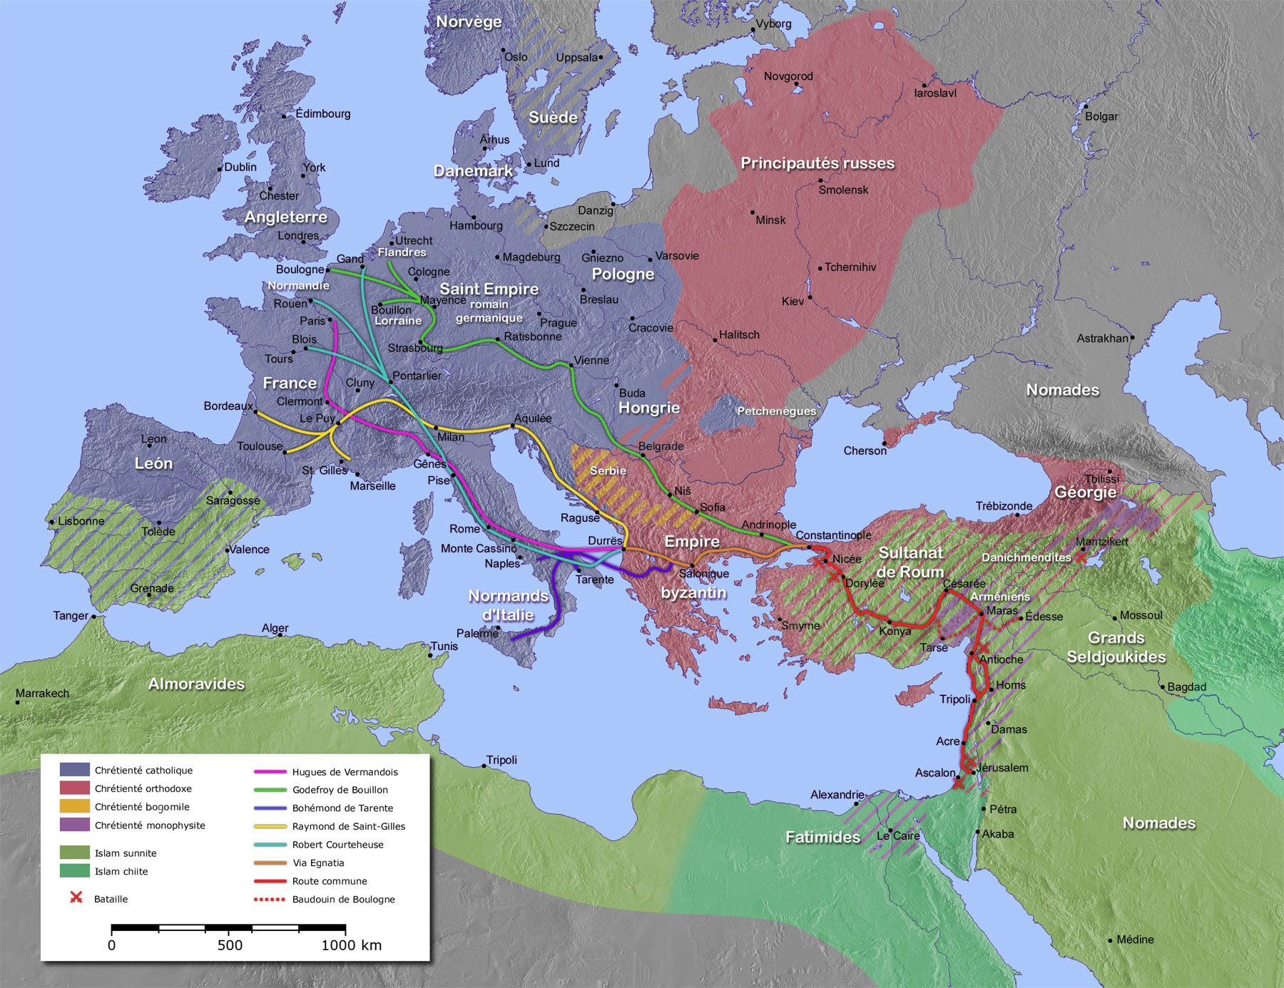

Slide 5
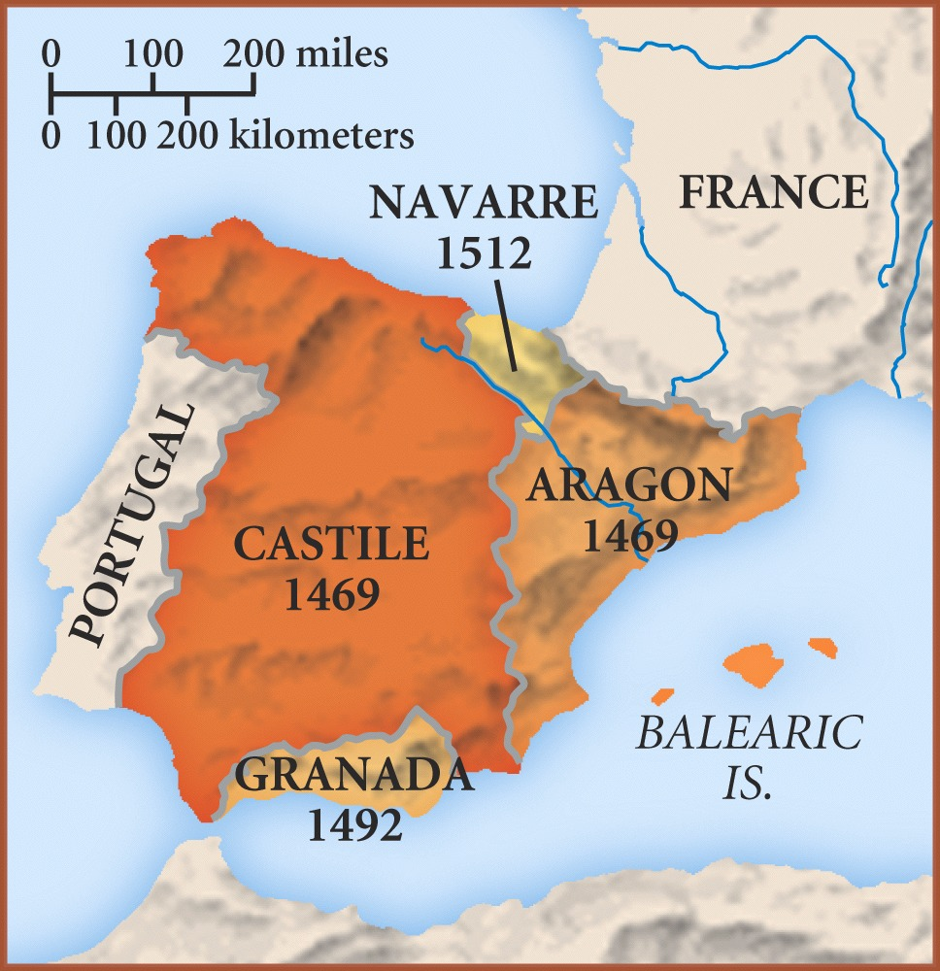
Ferdinand: Catholic
Isabella: Catholic
The Moors: Muslims

Slide 6
Ferdinand and Isabella
1400’s
Spain
Reconquista
Use of inquisition
Drove out of Granadans
Converted Jews and Muslims to Christianity
Sponsored Christopher Columbus
Promoted Catholicism and got gold

Slide 7
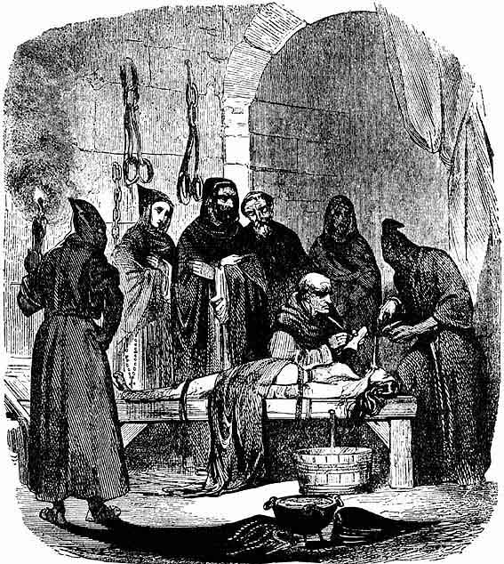
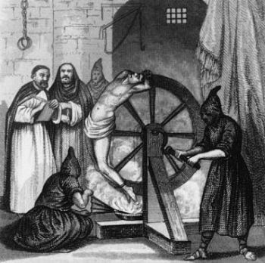
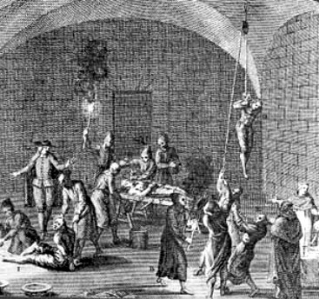
“Inquisition” Torture

Slide 8
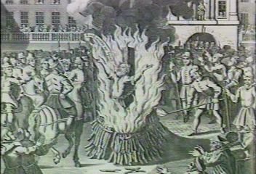
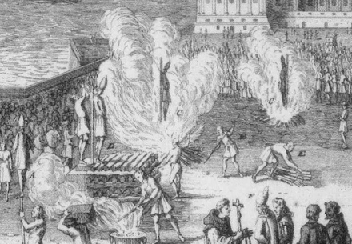
Auto de fe: “Act of Faith”

Slide 9
Spain a unified Catholic country
The Inquisition and expelling of the Jews and Moors was so successful, that by the 1500’s, Spain was almost completely Catholic
In the process, Isabella and Ferdinand became the most powerful kings in Europe

Slide 10
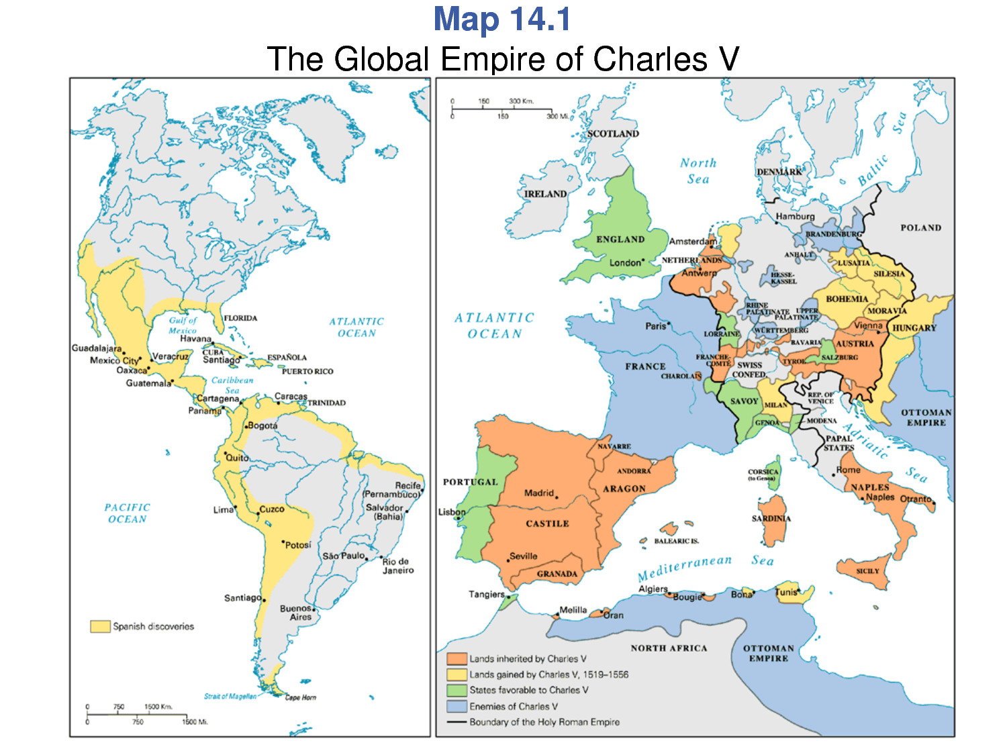
Charles V
Hapsburg family
HRE & Spain
Exploration
What do you notice about the map?
ORANGE=LAND INHERITED
YELLOW=LAND GAINED
GREEN=FRIENDLY LANDS
BLUE=ENEMIES

Slide 11
Charles V
ORANGE=LAND INHERITED GREEN=FRIENDS
YELLOW=LAND GAINED BLUE=ENEMIES

Slide 12
Phillip II
1500’s
Spain
His empire provided him with incredible wealth.
Had supplied Spain with estimated 339,000 pounds of gold. Roughly 16,000 tons of silver bullion were unloaded.
Defeated Ottoman fleet into fierce battle near Leponto.

Slide 13
10th Euro Studies 10.16.14
Turn in:
Mswati III
Divine Right of Kings reading
Take out:
Planner, Pen/pencil, NOTES
Today’s objective:
I can describe how Spain was unified and the impact of Philip II had on the balance of powers in Europe.
Today’s Agenda:
Monarch Chart
Map of Europe
Background on Isabella and Ferdinand
Spain: Philip II
HW:
Read pages 505-508
Begin working on map (focus on Spain…)
Begin working on chart (focus on Spain…)

