Slide 1
10th Euro Studies 10.17.14
Turn in:
Nothing
Take out:
Planner, Pen/pencil, Monarch Chart, Map of Europe
Today’s objective:
I can describe how the rise of Austria and Prussia impacted the balance of power in Europe.
Today’s Agenda:
Austria/Prussia (Hohenzollern Family)
Holy Roman Empire
30 Years’ War
Works in Progress (TBD due date):
Monarch Chart
Map of Europe
Online Text Book Issue Resolution
HW:
In-class: read 16.4 (525-529)
Maria Theresa Bio included
Map skills on 526 as well
Logout #4: will be available after school
Frederick the Great: critically read—make notes
Does his reign fit the model of Absolutism?

Slide 2
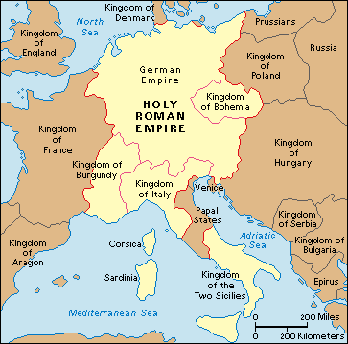
What is this Holy Roman Empire?
By the 16th Century (maybe it’s whole existence…) the Holy Roman Empire is:
NOT Holy
30 Years’ War
Investiture controversy
Who appoints Church officials
NOT Roman
It’s really “German” kingdoms
NOT an Empire
It’s a loose collection of feudal kingdoms…not to be “unified” until the late 19th Century

Slide 3
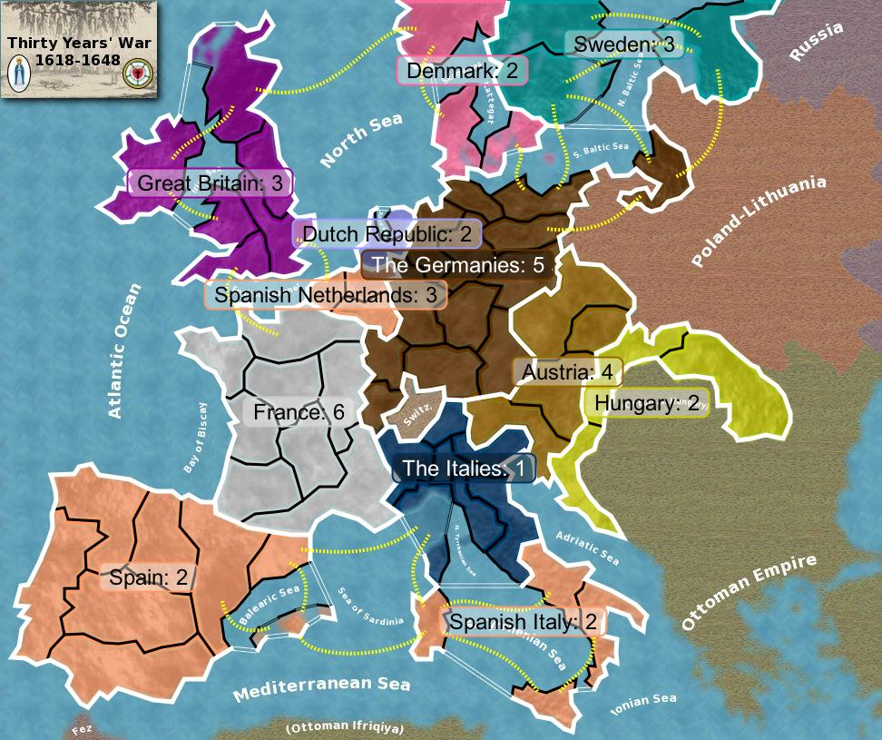
30 Years’ War
Kingdoms ruled by families:
1. Hapsburgs—Austria (but also Spain…Charles V quits on Spain, gives it to Philip II)
2. Hohenzollern –Prussia
Hapsburgs—Catholic
Hohenzollern—Lutheran
(religion AGAIN?!?)
HRE tries to tell his subjects how to practice their faith, they talk with their Protestant friends, & BOOM! It’s on!!!
The Hapsburgs are the big loser here…
20% of population
50% land once held

Slide 4
The Rest of Our Time together…
1. READ 16.4 (525-529) This is an individual activity…
Include Maria Theresa Bio
Include Maps on 526
2. Monarch Chart & Map: Focus on:
A. Maria Theresa—Austria
B. Frederick Wilhelm I—Prussia
3. Critical Read on Frederick (II) the Great
Make notes, questions, etc.
Be able to explain if he fits our concept of Absolutism

Slide 5
10th Euro Studies 10.17.14
Turn in:
Nothing
Take out:
Planner, Pen/pencil, Monarch Chart, Map of Europe
Today’s objective:
I can describe how the rise of Austria and Prussia impacted the balance of power in Europe.
Today’s Agenda:
Austria/Prussia (Hohenzollern Family)
Holy Roman Empire
30 Years’ War
Works in Progress (TBD due date):
Monarch Chart
Map of Europe
Online Text Book Issue Resolution
HW:
In-class: read 16.4 (525-529)
Maria Theresa Bio included
Map skills on 526 as well
Logout #4: will be available after school
Frederick the Great: critically read—make notes
Does his reign fit the model of Absolutism?

