Slide 1
10th WORLD Studies 10.22.18
Turn in:
Nothing
5/6: Stamp CRA of Alhambra Decree (1492)
Take out:
Planner,
Pen/Pencil,
Notes
Today’s objective:
I can begin to describe the changing political system following the Middle Ages, Renaissance, and Protestant Reformation.
Today’s Agenda:
NEW UNIT!
New Concept Formation
Examples of Concept, In-class
HW:
Definition of concept using our critical attributes…(stamp)

Slide 2
“Concept”—what is it?
Definition: an abstract or generic idea generalized from particular instances
Examples of a concept
Similarities/Differences
Critical Attributes of a concept
Main/Important things that ALL examples have in common
Let’s start with something arbitrary…like, PIZZA
Pizza? Really??? Yes…
List the traits of pizza…like, what is it? 60 seconds
ON YOUR OWN…WRITE IT DOWN!
Now, Define the concept, using the traits:
“Pizza is: _______” 60 seconds, ON YOUR OWN…WRITE IT DOWN!

Slide 3
PIZZA?!? What does this have to do with HISTORY?
NOTHING…but I like pizza…and hopefully it’s something with which we have a frame of reference & a “CONCEPT” within our brain…
TRAITS:
DEFINITION:
Let’s look…Examples/Non-Examples of the concept

Slide 4
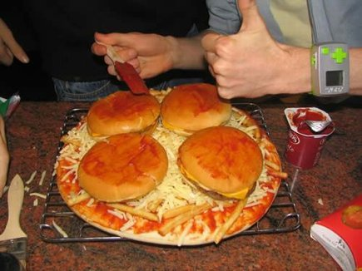
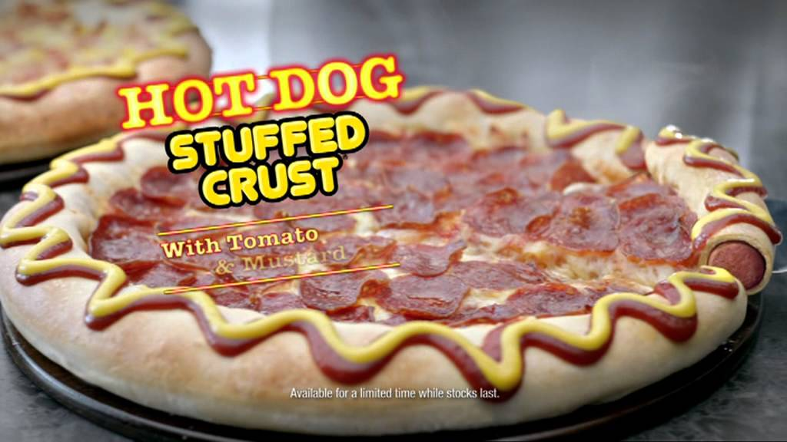
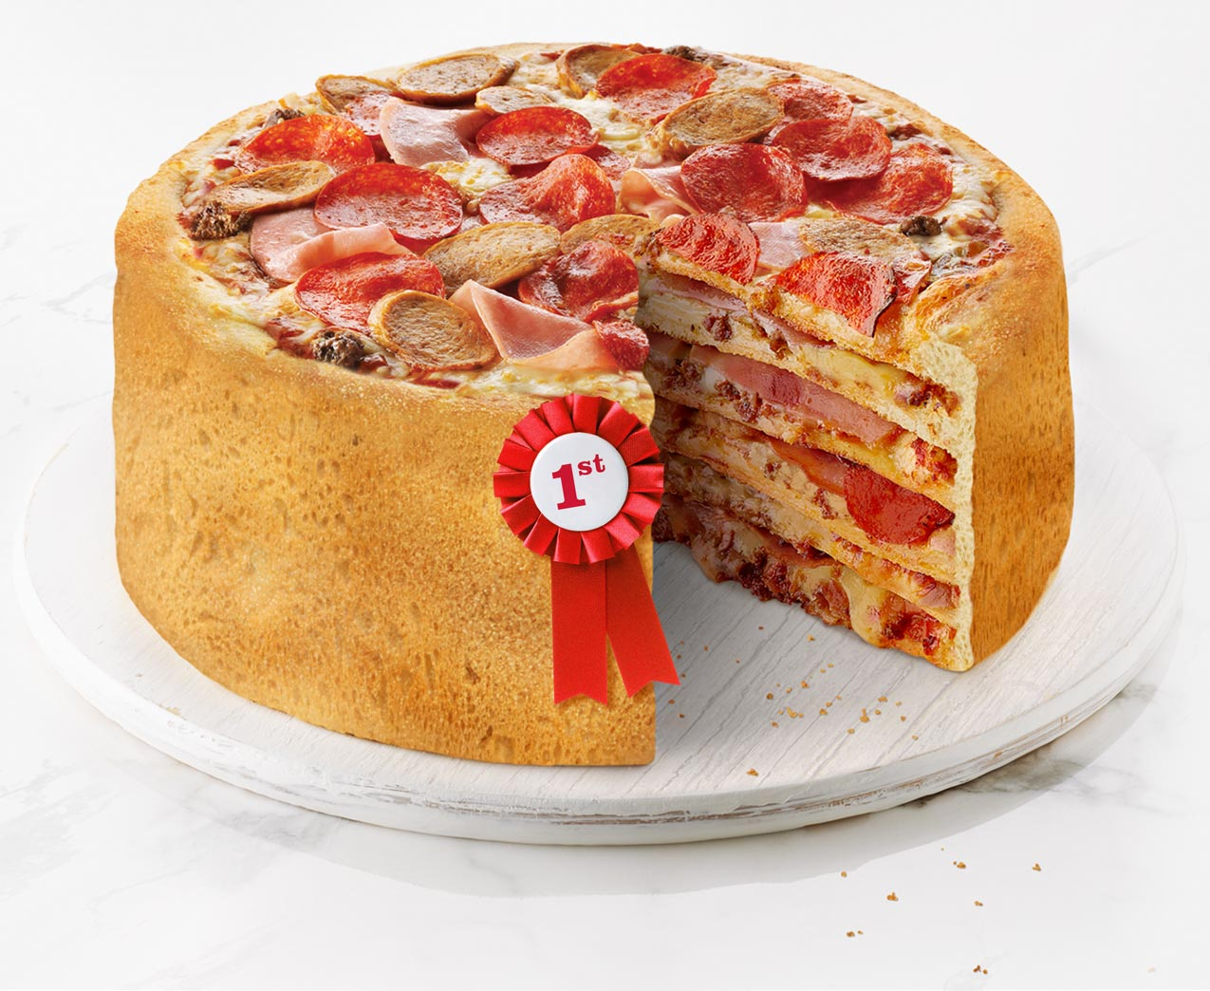
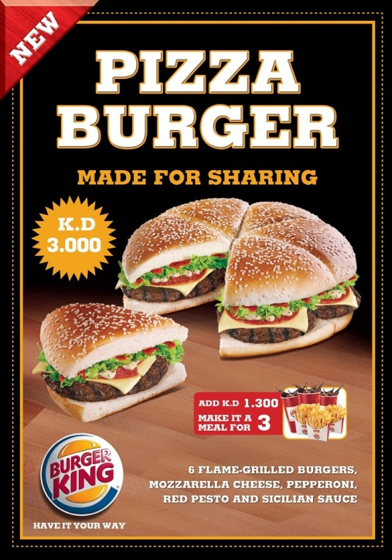
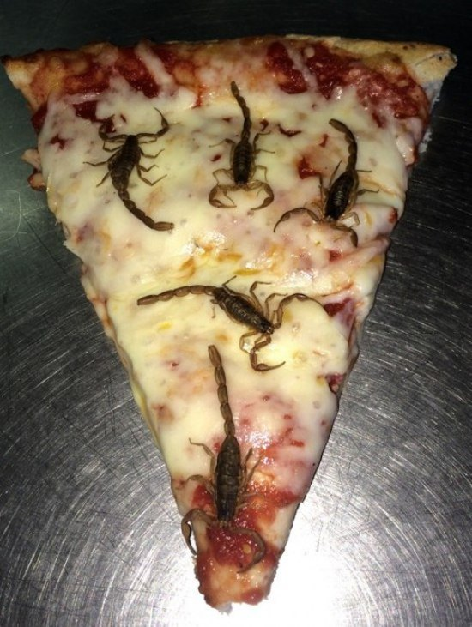
Do these examples qualify as “Pizza” according to our definition?

Slide 5
STEP #1
Critically Read each of the 4 examples
CRITICALLY READ ONLY!!!
EACH OF THESE IS AN EXAMPLE OF OUR CONCEPT
5 MINUTES…WHAT TRAITS MAKE THESE AN EXAMPLE?

Slide 6
STEP #2
Read each of the 4 examples AGAIN (yes, again…) and fill out your notes.
EACH OF THESE IS AN EXAMPLE OF OUR CONCEPT
Complete the “Concept Formation Notes”
ONLY THE SIMILARITIES AND DIFFERENCES

Slide 7
Critical attributes of our concept
STEP #3
Rule by “Divine Right” (Chosen by God)
Political Sovereignty—Control over ALL parts of the government (economy, war, domestic and foreign affairs)…
No checks and balances on political power (A single person—the MONARCH—is making all decisions…)

Slide 8
STEP #4
Use the critical attributes to create a definition for our concept. “This is a concept where…” or “This concept is…”
This concept is a form of government where all political power is located in a single monarch who rules by divine right without any checks or balances on his or her power.

Slide 9
OUR Definition
This concept is a form of government where:
all political (sovereignty) power is located in a monarch
who rules by (divine right)
(without any checks or balances) on his or her power.

Slide 10
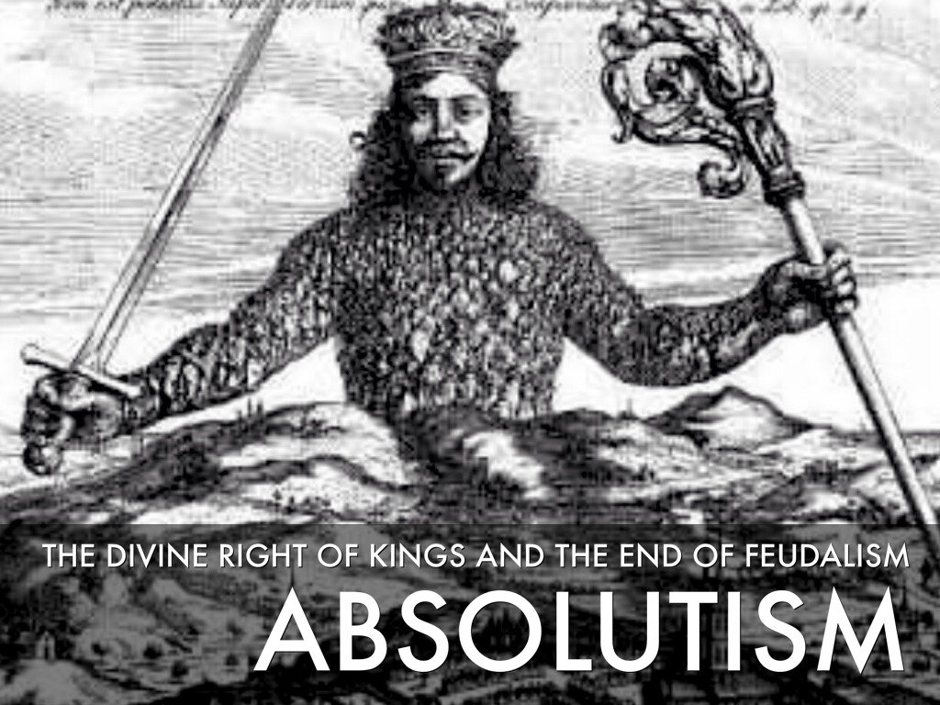
OUR LABEL…
1648-1763

Slide 11
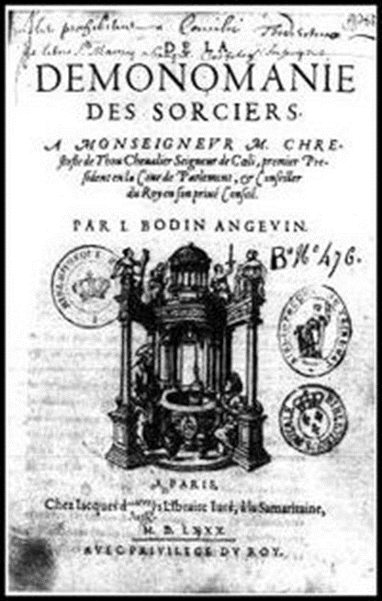
A power vacuum…Why?
-Black Plague and Wars weaken feudal lords
-Renaissance weakens the power of the Catholic Church
-Age of Exploration makes kings rich
-What will calm all of this craziness?!?
Jean Bodin: writer of political philosophy (and demonology)
“Six Books of the Commonweale”: Only absolutism could provide order and force people to obey authority

Slide 12
“Power corrupts…Absolute power is kind of neat.”
--John Lehman
“Power tends to corrupt…and absolute power corrupts absolutely.”
--Lord Acton
OUR LABEL…
Absolute Power: from God, over everything, over everyone.
1648-1763

Slide 13
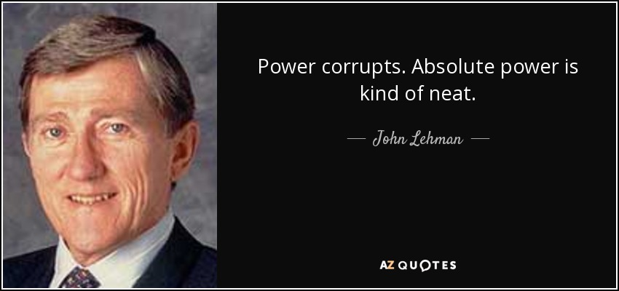
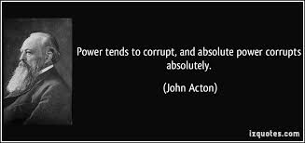
Age of Absolutism
-Age of Exploration = 5 powerful countries/families
England – The Tudors
France – The Bourbons
Spain – The Hapsburgs
Prussia – The Hohenzollerns
Russia – The Romanovs
Large Standing armies = Balance of Power in Europe
*No more feudal armies*
Notes:
“The absolute and perpetual power of a Republic”
Centralized Government
Central governments evolved into nation-states
with strict boundaries
with unified role
with permanent armies
Citizens shared:
language
colture
national loyalty
religion (sometimes)

