Slide 1
9th Honors 10.22.14
Turn in:
Cornell Notes on Video
Take out:
Planner, additional notes, pen/pencil
Today’s Learning Objectives:
I can describe cultural aspects of the Aztec civilization.
Today’s Agenda:
Some thoughts on the Aztecs
Viewing Guide project
HW:
“Aztecs Control Central America” Critical Read
A or B video—you will have time tomorrow as well—bring head phones if you’d like…

Slide 2
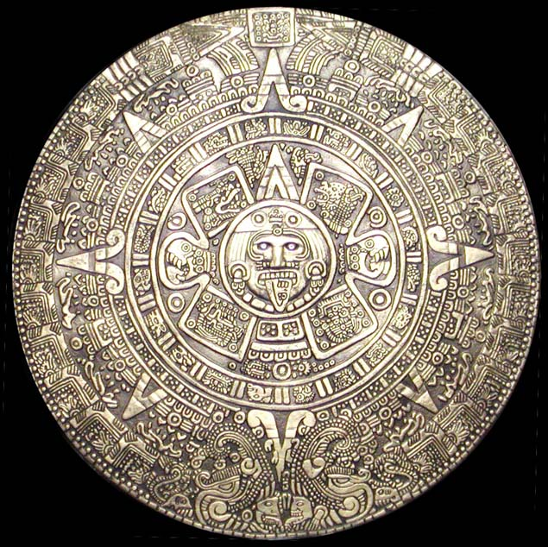
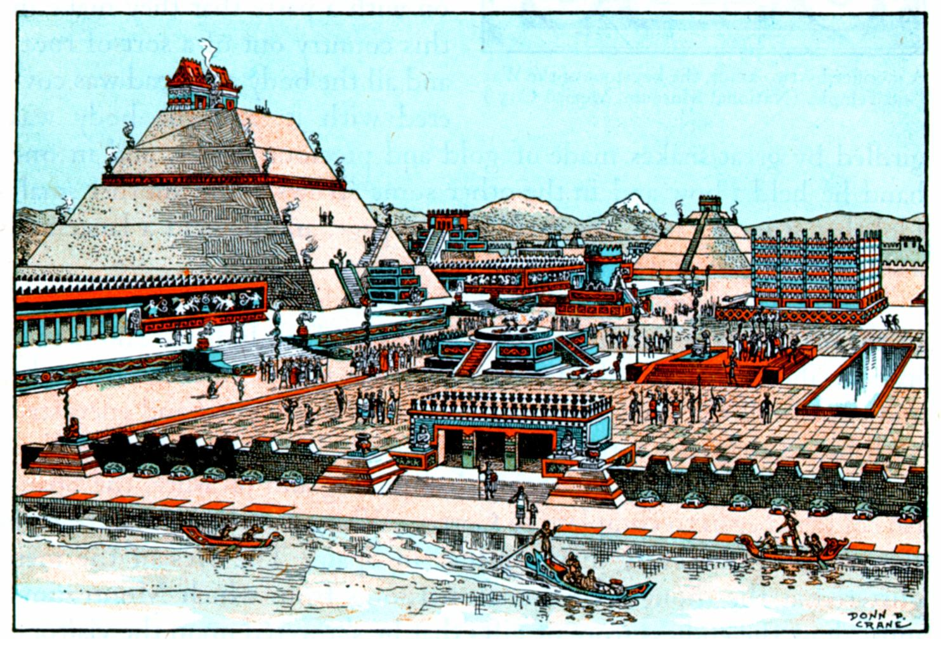
The Aztecs Aztlan: “White Land”

Slide 3
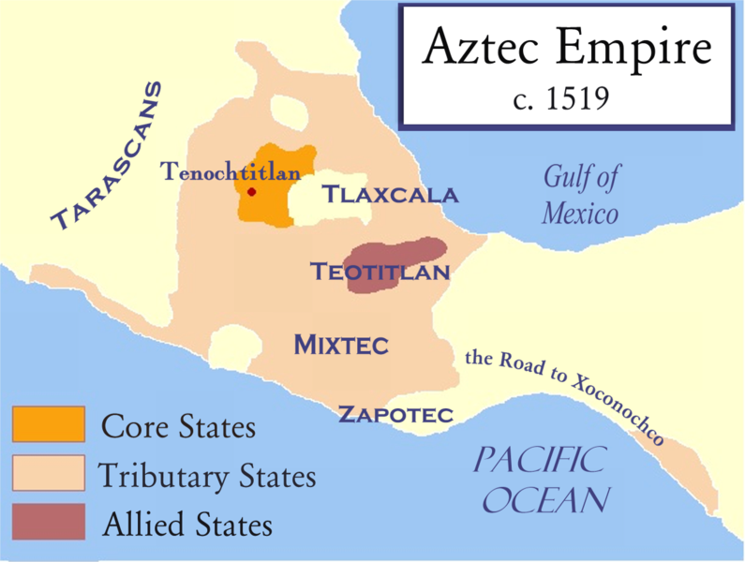

Slide 4
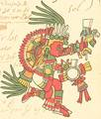
Religion
Polytheistic
Animism
The Aztec and the Maya each had over 1500 gods. These gods controlled all of the natural world:
Rain, sun, rivers, crops, even war—possibly multiple gods for the same purpose
The Aztecs believed that they had been chosen by the gods for a special job.
The Aztecs believed that their job was to feed and assist the gods.
If the Aztecs failed to feed the gods, the universe would be destroyed.

Slide 5
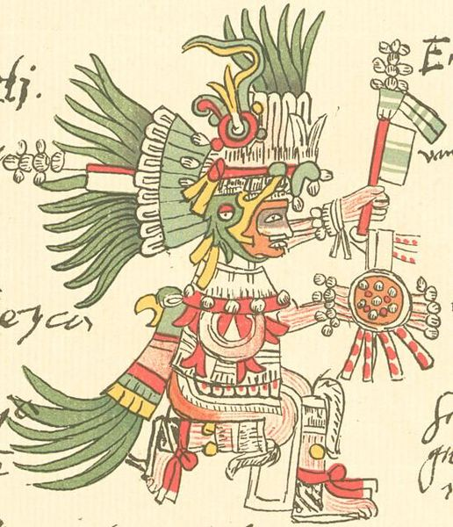
Huitzilopochtli
Weetz-ee-loh-POSHT-lee
Aztec God of War and Sun
Responsible for the sun rising, defeating darkness.
He cannot do it alone!

Slide 6
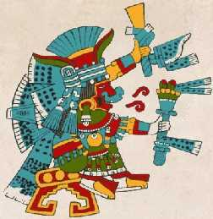
Tlaloc TL-La-Lock
The Rain God

Slide 7
Nanahuatzin (Nana-wat-zin) The Sun God --wait a minute…different role
Lit himself on fire to provide light, heat, and life for the world.
He needs blood to keep going.

Slide 8
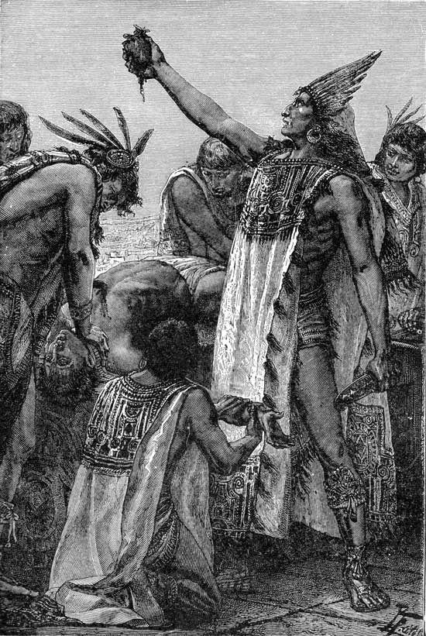
The Aztecs believed that they had been chosen by the gods for a special job.
The Aztecs believed that their job was to feed and assist the gods.
If the Aztecs failed to feed the gods, the universe would be destroyed.

Slide 9
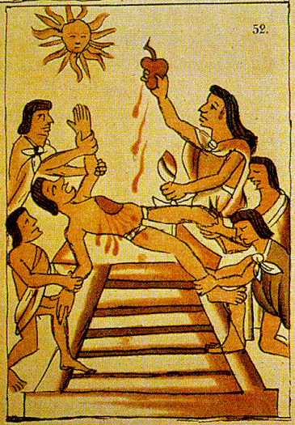

Slide 10
Rain is important
Children were especially chosen to be sacrificed to Tlaloc, the rain god.

Slide 11
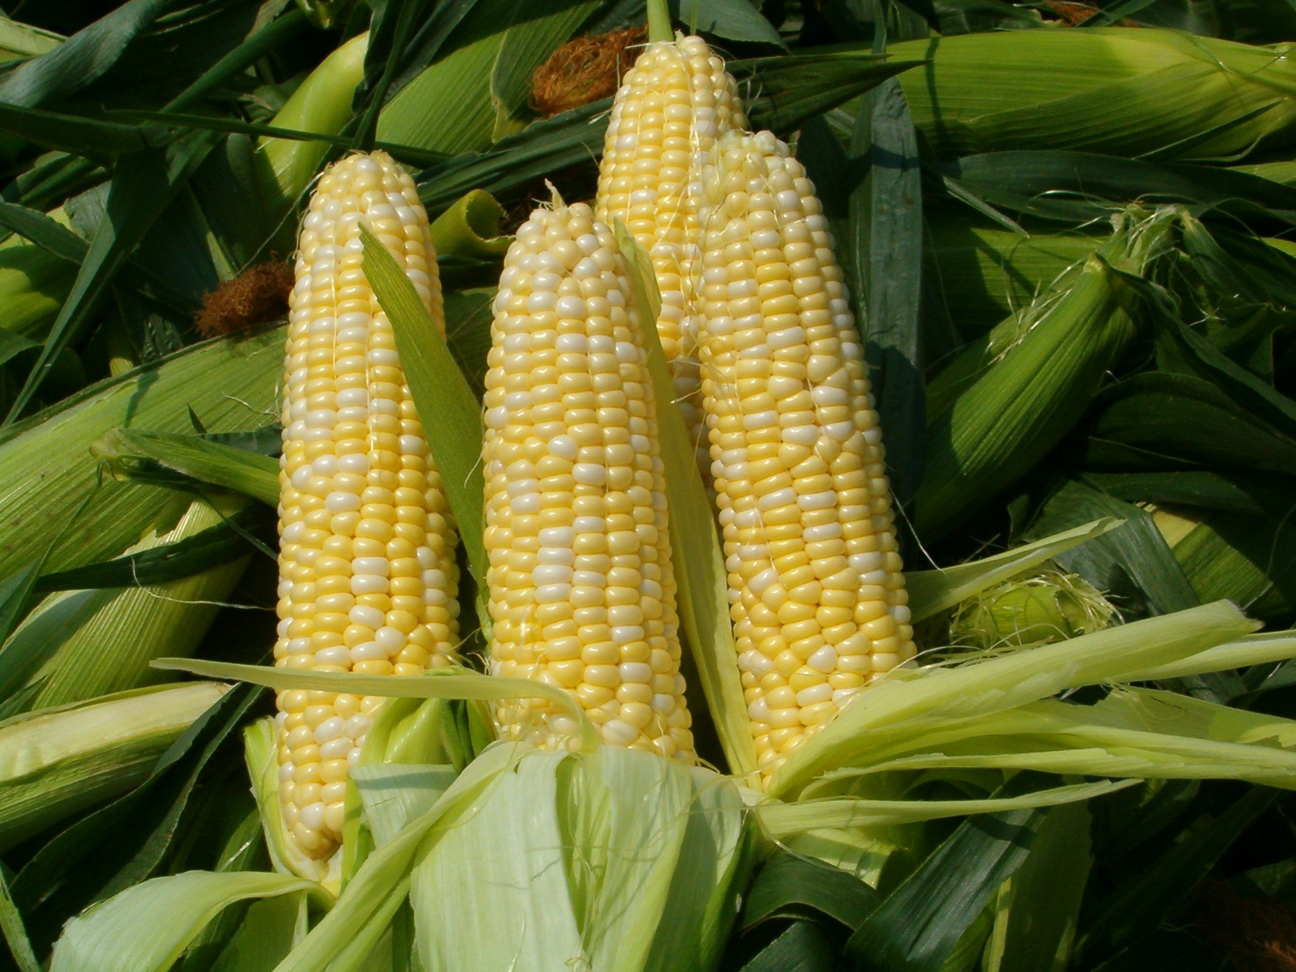
Corn! Gotta eat…right Mr. Maslow?

Slide 12
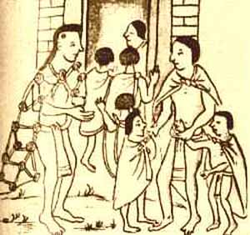
Child Sacrifices
Any Volunteers?
Evidence shows that nearly all of the children had some sort of deficiency—cavities, abscesses, bone disease, etc.
Also, suggested some might have fingernails removed prior to sacrafice…
What does this tell us?

Slide 13
Rain is important
Children were especially chosen to be sacrificed to Tlaloc, the rain god.
The Aztecs believed that the tears of new-born or very young children could ensure rain.

Slide 14
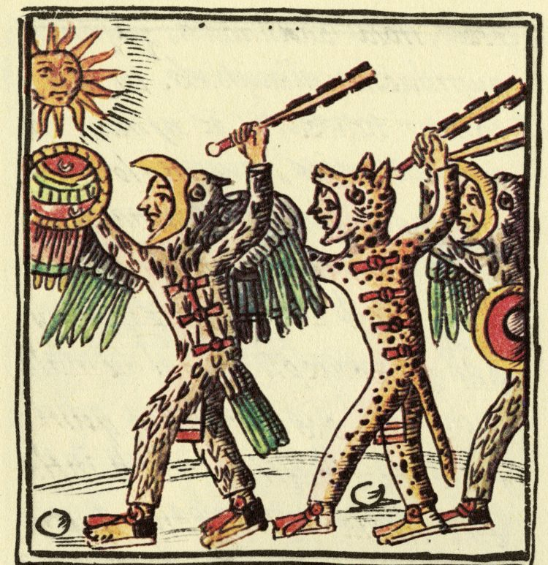
The Aztecs controlled the Valley of Central Mexico.
It was a theocratic empire.
The Aztecs would often wage wars for the sole purpose of gathering prisoners to sacrifice.

Slide 16
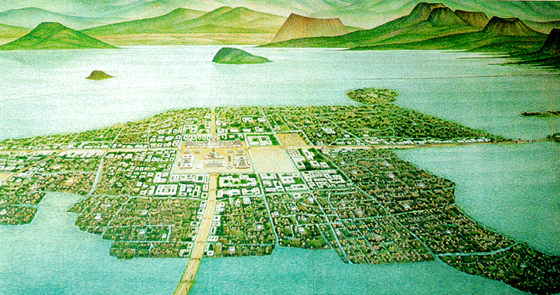
Tenochtitlan: Aztec Capital

Slide 17
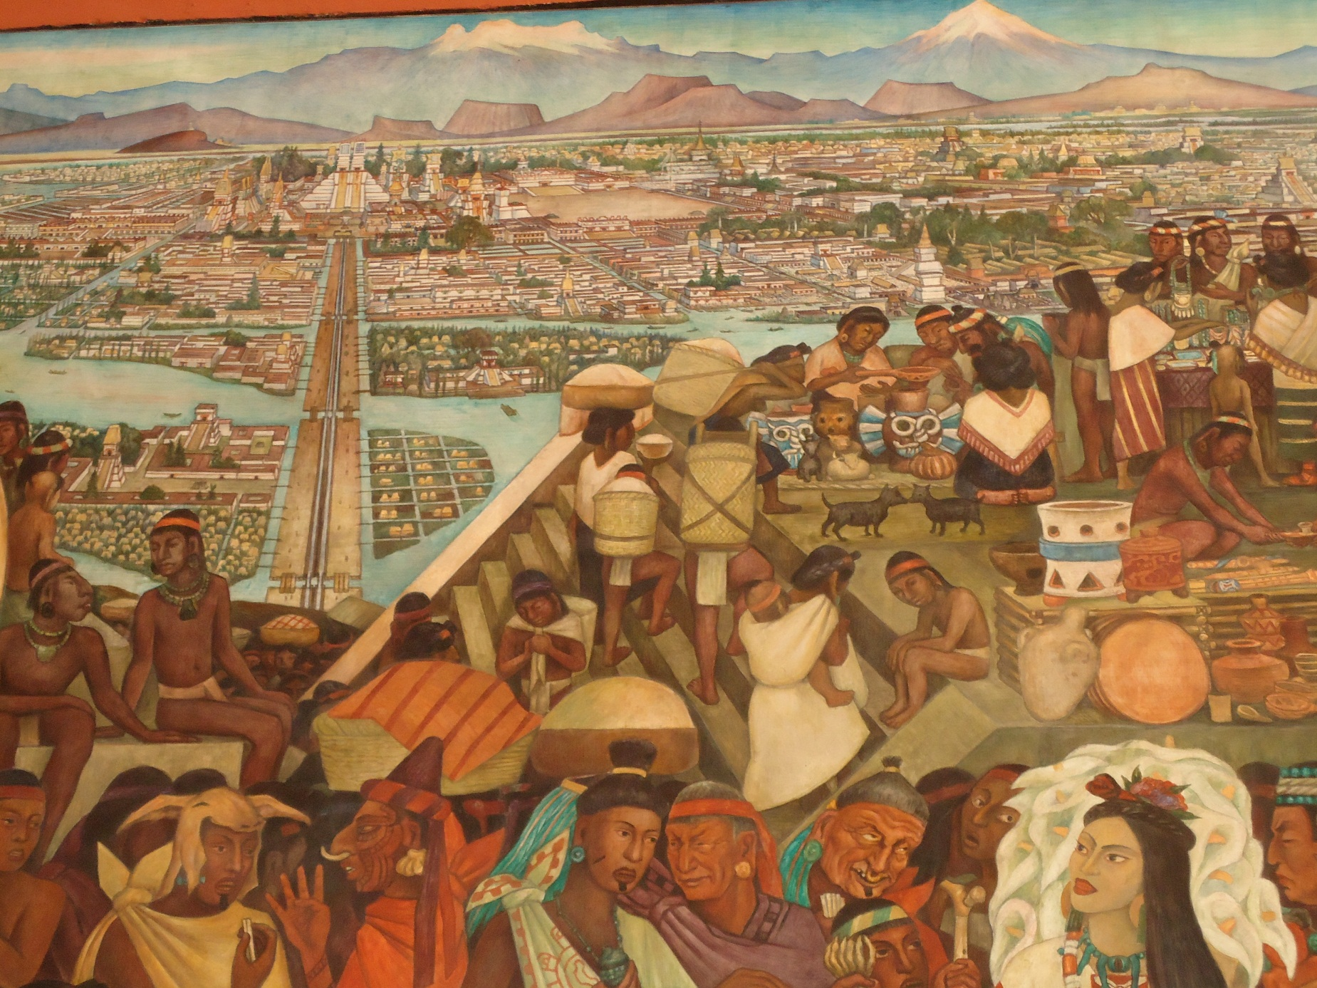
“The Venice of the New World”

Slide 18
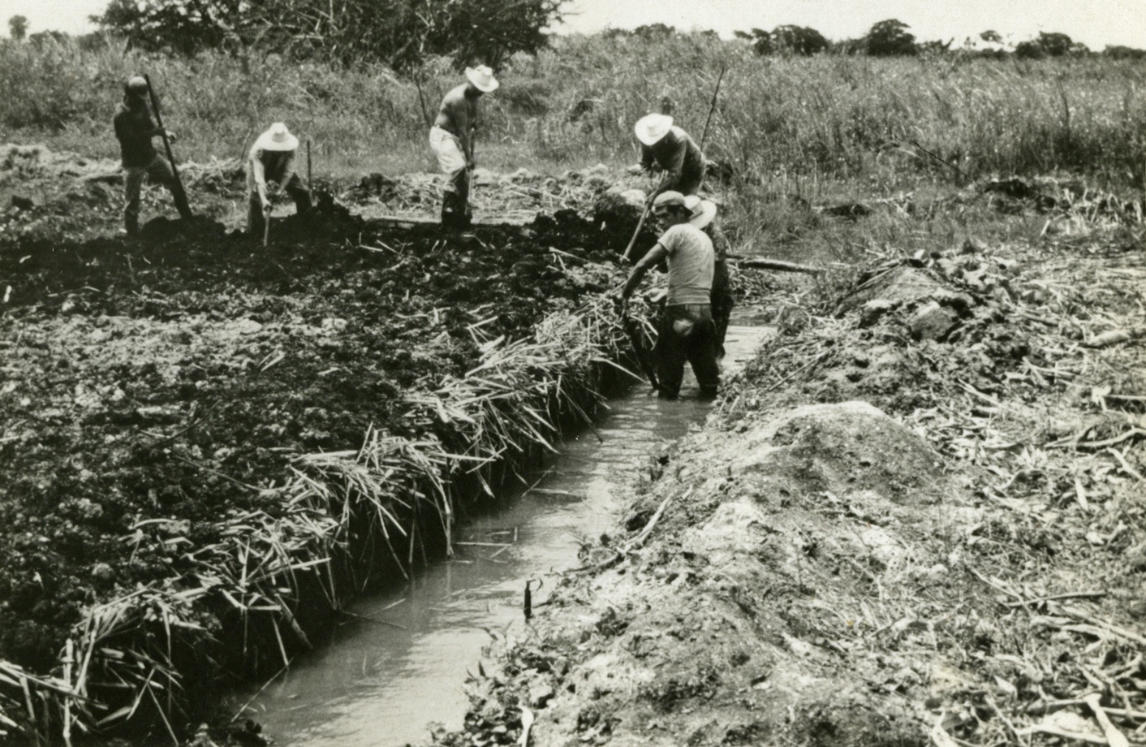
Chinampas: Aztec Agriculture
http://www.history.com/videos/aztec-ingenuity#aztec-ingenuity

Slide 19
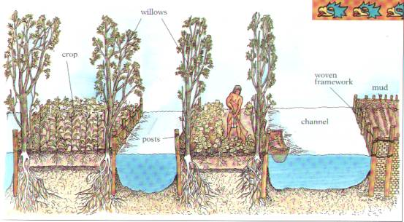

Slide 20
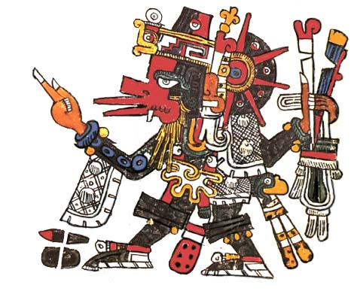
Aztec Mythology
Quetzlcoatl (Ketsal-ko-a-tl): a powerful god, who had left Mexico. He would return…
He had:
White skin!
Feathers
(or hair) on his face…

Slide 21
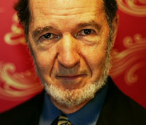

Slide 22
9th Honors 10.22.14
Turn in:
Cornell Notes on Video
Take out:
Planner, additional notes, pen/pencil
Today’s Learning Objectives:
I can describe cultural aspects of the Aztec civilization.
Today’s Agenda:
Some thoughts on the Aztecs
Viewing Guide project
HW:
“Aztecs Control Central America” Critical Read
A or B video—you will have time tomorrow as well—bring head phones if you’d like…

