Slide 1
10th Euro Studies 10.23.14
Turn in:
Nothing…
Take out:
Planner, Pen/pencil, Monarch Chart, Map of Europe
Today’s objective:
I can describe how France’s history of monarchs differs from other European nations during Absolutism.
Today’s Agenda:
France & the Bourbon Family
HW:
16.2 Guided Notes
Baseball Card Project

Slide 2
Civil War
In France
(1562-1598)

Slide 3
The Valois Family: The Beginning of the End
Henri II was the last powerful Valois
Three weak sons followed:
Francis II
Charles IX
Henri III
Catherine de Medici controlled the sons:
Was mother to the boys
Played both sides in the civil war
Developed a reputation for cruelty

Slide 4
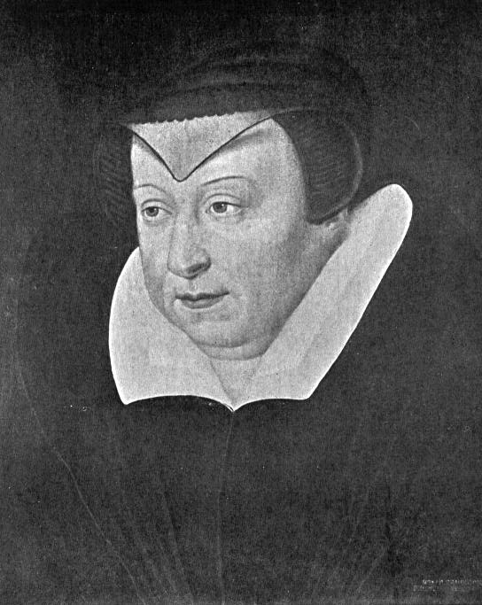
Catherine de Medici

Slide 5
The French Civil War
There were two sides:
Guise family led Catholics in North
Bourbon family led Huguenots in South
Fighting for the royal inheritance
Catherine supported the Guises in the first phase.
St. Bartholomew’s Day Massacre
August 24, 1572
20,000 Huguenots were killed
Henri of Navarre, a Bourbon, survived

Slide 6
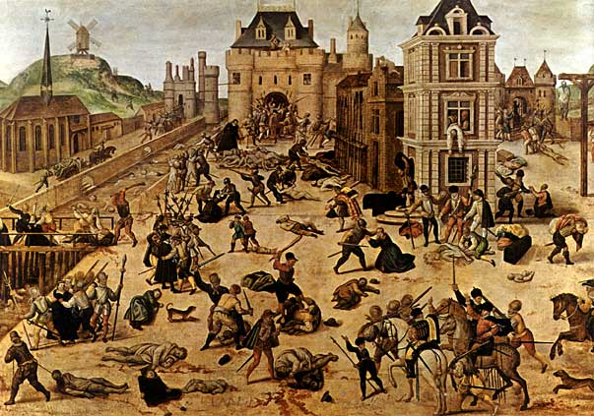
St. Bartholomew’s Day Massacre

Slide 7
The French Civil War
Catherine started supporting the Bourbons.
Henri of Navarre defeated Catholic League & becomes Henry IV of France.
Effects of Civil War:
France was left divided by religion
Royal power had weakened
Valois family now replaced by Bourbons
Catholic League
CIVIL WAR
Protestant Union

Slide 8
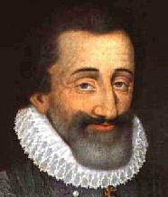
Absolute Monarchy in France
Religious Wars and Power Struggles
Bourbon Family
Henry of Navarre-converted to Catholicism
Survived the 1572 St. Bartholomew’s Day Massacre (of Huguenots)
Edict of Nantes (1598)
Henry’s declaration of religious toleration
Allowed Catholics and Huguenots to live in peace
Louis XIII and Richelieu
After Henry died, his son took over
Louis XIII
Henry of Navarre

Slide 9
Louis XIII and Cardinal Richelieu
Louis XIII was a weak King
Had an extremely powerful minister for support-Cardinal Richelieu
Richelieu took two major steps towards power
Moved against the Huguenots and all Protestants
Weakened the Nobles power and relied on the middle class instead

Slide 10
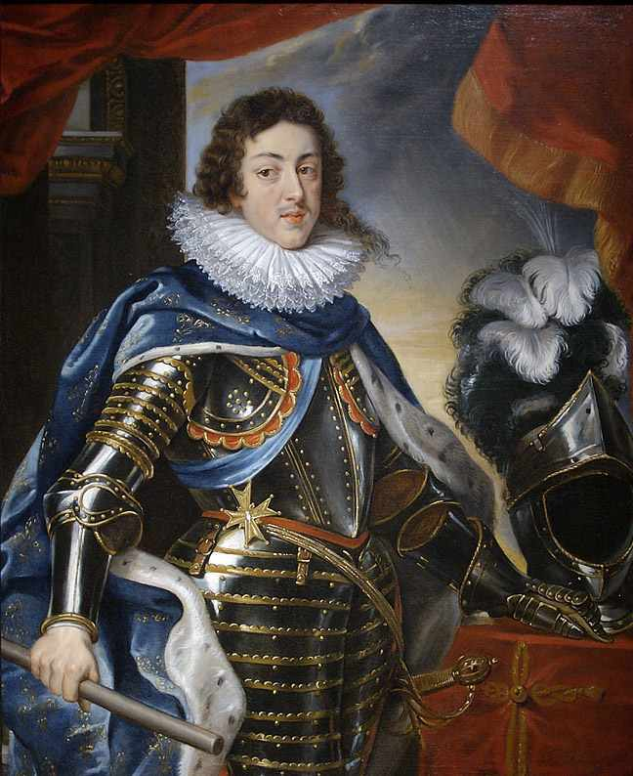
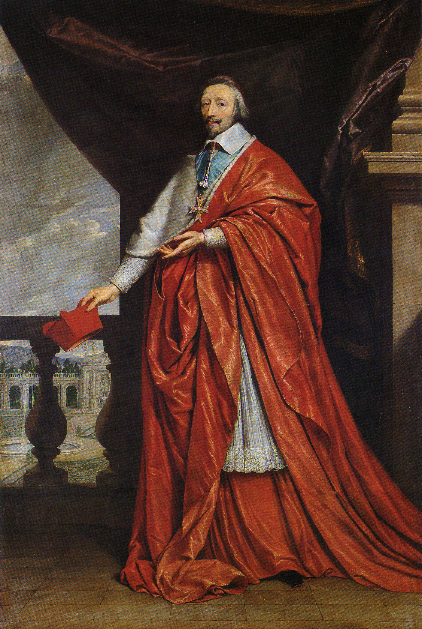
Louis XIII and Cardinal Richelieu

Slide 11
Louis XIV Comes to Power
Louis XIV, the Boy King (1643)
Was not the true leader until 1661
Cardinal Marazin ran the country
Louis Weakens the Noble’s Authority
Excluded the Nobles from his council
Economic Growth
Minister of Finance-Jean Baptiste Colbert
Gave tax benefits to companies

Slide 12
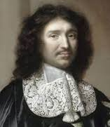
Show me the money! Jean-Baptiste Colbert
Mercantilism--economic
nationalism for the purpose
of building a wealthy
and powerful state.
Encouraged policies for the
purpose of the betterment
of France.

Slide 13
Data Set I
When viewing the paintings of Louis XIV, pay close attention to the King’s clothing and posture.
Keep in mind that the majority of the population of France would never actually see the king in person.
Instead, they would see statues and paintings of the king, much like these.

Slide 14
Data Set II

Slide 15
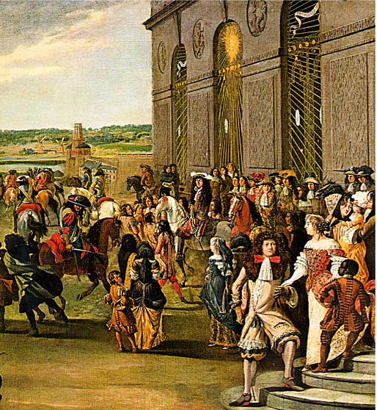
Data Set III
Louis took the nickname “Sun King”

Slide 16
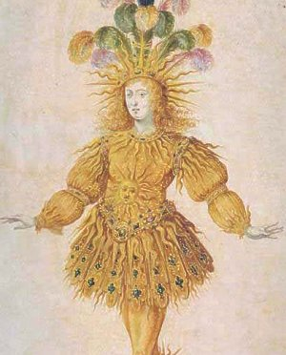
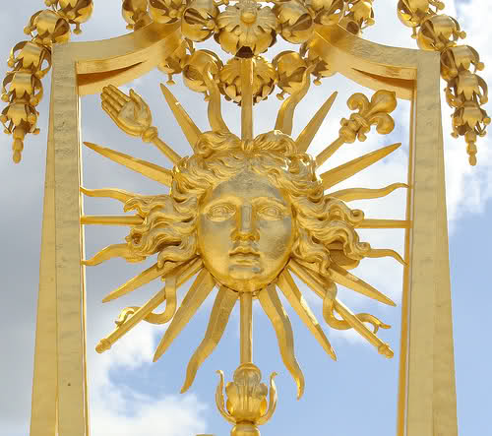

Slide 17
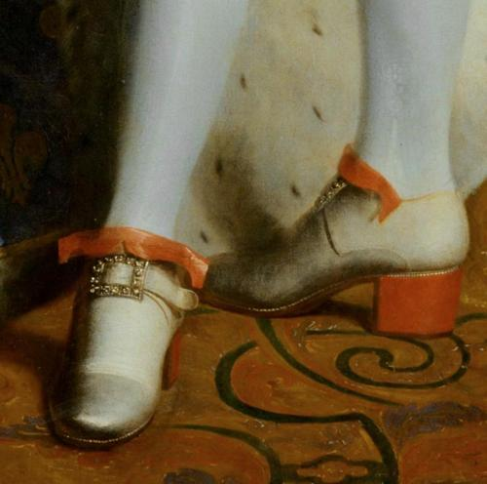
Data Set IV
Louis XIV was 5’ 3” and enacted laws that no one could have heels higher than the king, and that only nobility could wear red high heels

Slide 18
Data Set V

Slide 19
Data Set VI
King Louis XIV created a whole new bureaucracy, known as intendants. This bureaucracy was composed of people who were not from the hereditary, upper class aristocracy.
Many of the intendants were tax collectors in France during the reign of Louis XIV. They were given these high ranking positions based on merit and hard work instead of on heredity.

Slide 20
Data Set VII
Louis XIV limited the intendants’ terms to 2 years. Intendants who remained loyal to the king were allowed to remain in office.
The continuation of their high status in society depended on the stability of the government. The intendants were not appointed to oversee their own communities.

Slide 21
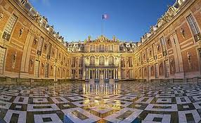
Data Set VIII
Here, the entire French nobility was expected to take residence and to participate in elaborate ceremonies, festivals and dinners. The elaborate ceremonies there impressed the king’s subjects and aroused the admiration and envy of all other European monarchs.
Notes:
Louis XIV’s elaborate rules of etiquette included the following:
People who wanted to speak to the king could not knock on his door. Instead, using the left pinkie finger, they had to gently scratch on the door, until they were granted permission to enter. As a result, many courtiers grew that fingernail longer than the others;
A lady never held hands or linked arms with a gentleman. Besides being in bad taste, this practice would have been impossible because a woman’s hooped skirts were so wide. Instead, she was to place her hand on top of the gentleman’s bent arm as they strolled through the gardens and chambers of Versailles;
When a gentleman sat down, he slid his left foot in front of the other, placed his hands on the sides of the chair and gently lowered himself into the chair. There was a very practical reason for this procedure. If a gentleman sat too fast, his tight pants might split;
Women and men were not allowed to cross their legs in public;
When a gentleman passed an acquaintance on the street, he was to raise his hat high off his head until the other person passed;
A gentleman was to do no work except writing letters, giving speeches, practicing fencing, or dancing. For pleasure he engaged in hawking, archery, indoor tennis, or hunting. A gentleman would also take part in battle and would sometimes serve as a public officer, paying the soldiers;
Ladies’ clothing did not allow them to do much besides sit and walk. However, they passed the time sewing, knitting, writing letters, painting, making their own lace, and creating their own cosmetics and perfumes.
~2.75 square miles

Slide 22
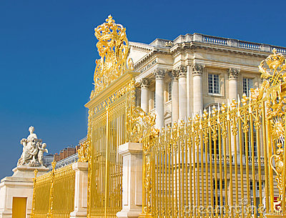

Slide 23
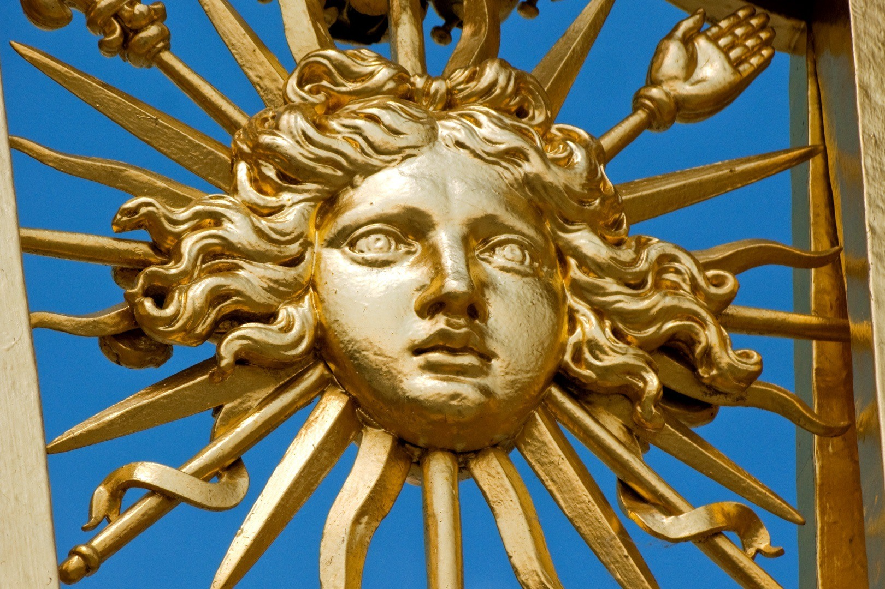

Slide 24
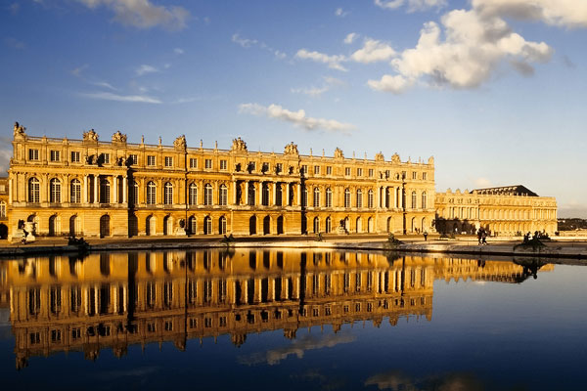

Slide 25
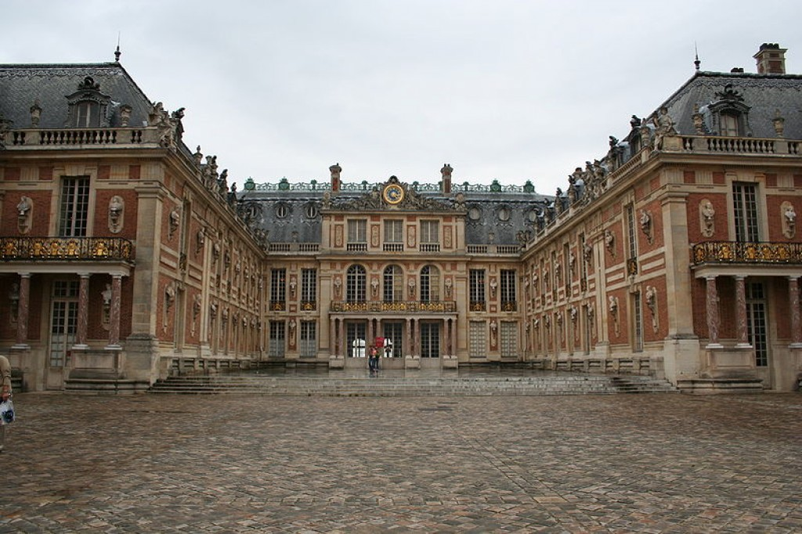

Slide 26
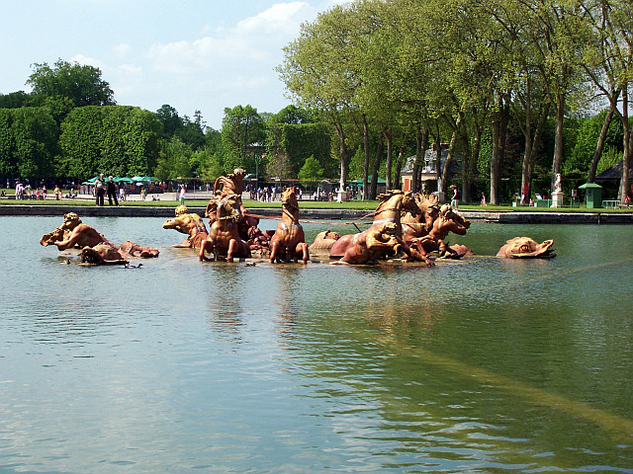

Slide 27
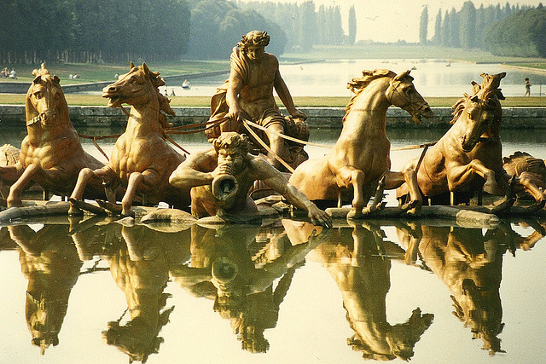

Slide 28
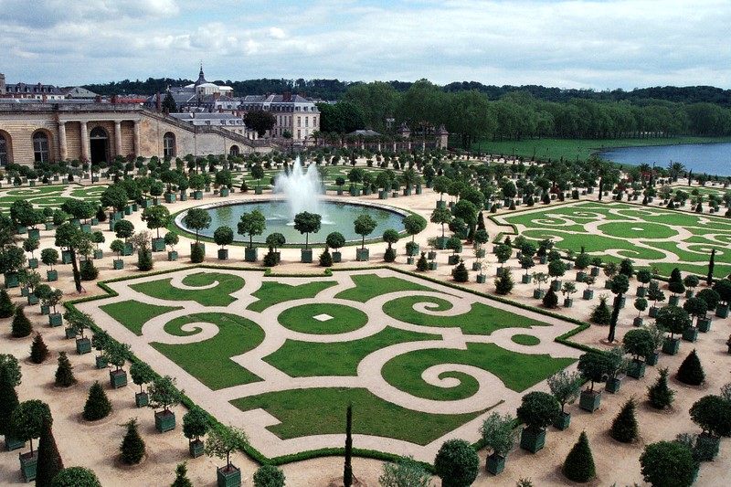

Slide 29
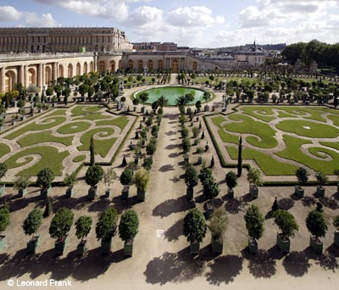

Slide 30
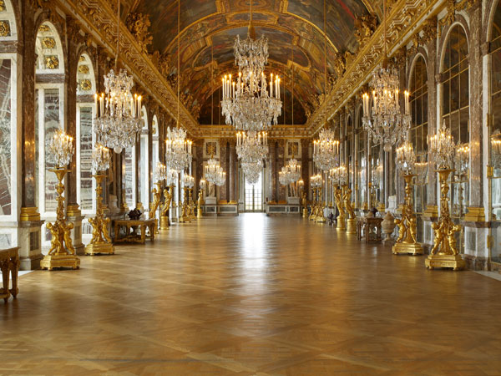

Slide 31
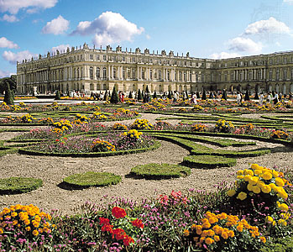

Slide 32
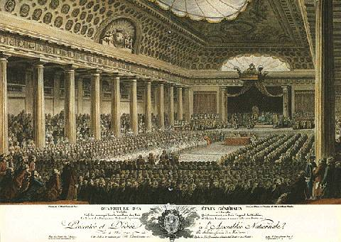
Data Set IX
Louis XIV never calls a meeting of the Estates General

Slide 33
Data Set X
Under Louis XIV, France was the most powerful country in Europe. The French army, numbering 100,000 in peacetime and 400,000 in wartime, was far ahead of other states’ armies in size, training, and weaponry.

Slide 34
10th Euro Studies 10.23.14
Turn in:
Nothing…
Take out:
Planner, Pen/pencil, Monarch Chart, Map of Europe
Today’s objective:
I can describe how France’s history of monarchs differs from other European nations during Absolutism.
Today’s Agenda:
France & the Bourbon Family
HW:
16.2 Guided Notes
Baseball Card Project

Slide 35
Show me the money! http://www.youtube.com/watch?v=OaiSHcHM0PA

Slide 36
After looking at the data:
How was King Louis able to maintain absolute power?

