Slide 1
10th WORLD Studies 10.24.18
Turn in:
Non/Examples of Absolutism (stamp)
Take out:
Planner,
Pen/Pencil,
Notes
Today’s objective:
I can begin to describe the political system as the Age of Absolutism begins to take shape in Europe.
Today’s Agenda:
30 Years’ War
(Utter Confusion…)
Spain & Philip II
HW:
Reading on Spain (16.1)
Map and Chart

Slide 2
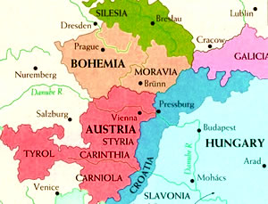
The Bohemian Phase (1618-1625)
As the fighting went on, mercenaries joined the fight looking to make some money in the war
Albrecht von Wallenstein, born a Czech Protestant, offered his services to the Emperor—Catholic Ferdinand II
Reluctantly the Emperor commissioned Wallenstein and his 125,000 soldiers
Wallenstein and his men unleashed destruction on Germany
The Emperor had no control over Wallenstein or his men, though
During the fighting in Bohemia, the Spanish attacked the holdings of Frederick along the Rhine River
Frederick V and the Protestants had their hands full already and could not win back the lands lost to the Catholics and Spain
For those of you trying to keep score…
Catholics: 1 Protestants: 0

Slide 3
The Danish Phase (1625-1630)
Habsburg enemies all over Europe were horrified at Wallenstein’s antics
King Christian IV of Denmark decided to enter the war to help the Protestants turn the tide in Germany
Wallenstein proved to be too much for King Christian
Feeling confident after Wallenstein’s successes, the Emperor issued the Edict of Restitution in 1629
The Edict outlawed all sects of Christianity other than Catholicism and Lutheranism
Lutheranism took a hit, though, because the Edict restored Protestant-held once-Catholic lands to the Church, effectively undoing the Peace of Augsburg—princes were able to determine C or L following in their respective lands (1555)

Slide 4
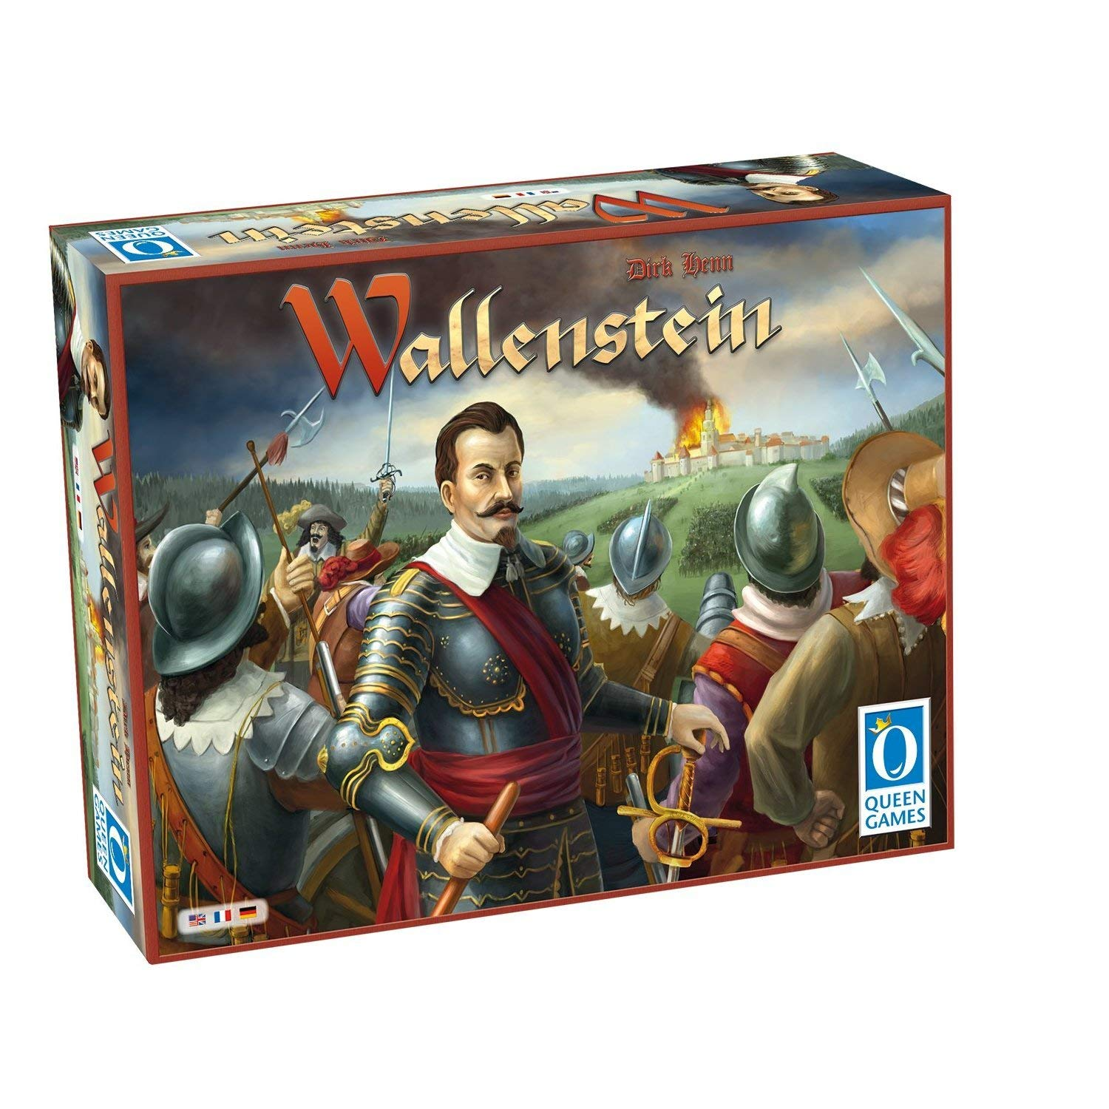
The Danish Phase (1625-1630)
But, you don’t get a board game unless you’re a big deal…so we’re not done with him just yet!
The Habsburgs reached the pinnacle of their power by 1630
Also by 1630, the Emperor (Ferdinand II) felt pressure from across Europe to control Wallenstein because he had become too powerful and unpredictable
The Emperor made Wallenstein back off
For those of you trying to keep score…
Catholics: 2 Protestants: 0

Slide 5
The Swedish Phase (1630-1635)
Protestantism on the continent seemed to be in trouble so King Gustavus Adolphus of Sweden entered his 100,000-man army in the contest
Gustavus Adolphus hoped to help the Protestants in Germany but he also hoped to exert his influence in the region
The French, at the urging of Cardinal (implies???) Richelieu (we’ll meet him in greater detail later…), subsidized the Swedish forces…(Steen, I’m lost…)
France hoped to undermine the Habsburgs by aiding the Habsburg enemies
Gustavus Adolphus experienced success in the North so the Emperor (Catholics) reluctantly requested the services of Wallenstein once again

Slide 6
The Swedish Phase (1630-1635)
Gustavus Adolphus suffered a wound in battle in 1632 and died…☹
By 1634, the Swedes were at the point of defeat
Things looked very bad for Protestants in Germany until…
BTW…For those of you trying to keep score…
Catholics: 3 Protestants: 0

Slide 7
The French Phase (1635-1648)
Wallenstein had been so angry at Ferdinand II at his dismissal, he turned on the Emperor in hopes of creating his own empire
In response, the Ferdinand II had Wallenstein’s men murder Wallenstein (for $$$)
Some of the Protestant Princes jumped ship and joined forces with the (HR)Emperor
France couldn’t stand to watch the Habsburg power increase so the French officially entered the war on the side of the Protestants
Neither side possessed the power to knock out the other so the fighting dragged on until 1643…and beyond
BTW…For those of you trying to keep score…
Catholics: 3 Protestants: 0
FRANCE: 1 (and WON…)

Slide 8
The Peace of Westphalia (1648)
The 30 Years’ War officially ended in (October 24) 1648 with the Peace of Westphalia
The treaties recognized the sovereignty of the 300+ German princes
The treaties disallowed papal meddling in German religious affairs
The treaties upheld the Peace of Augsburg, added Calvinism to the list of religions allowed in German states and nullified the Edict of Restitution (making only Catholic and Lutheran acceptable…)

Slide 9
Immediate Results of the 30 Years’ War
After the Peace in 1648:
the northern states in Germany (Prussia…) remained primarily Protestant—more specifically, Lutheran…
while the southern states in Germany (Bavaria…and “Austria”) remained primarily Catholic
The United Provinces (of the Netherlands…) and Switzerland won recognition as independent states
German princes won the right to form alliances and sign treaties as long as they didn’t declare war on the Holy Roman Empire
This essentially ends any power of the HRE…

Slide 10
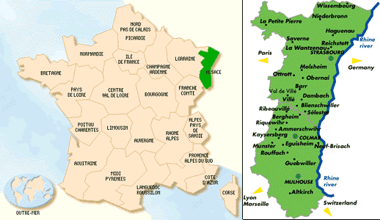
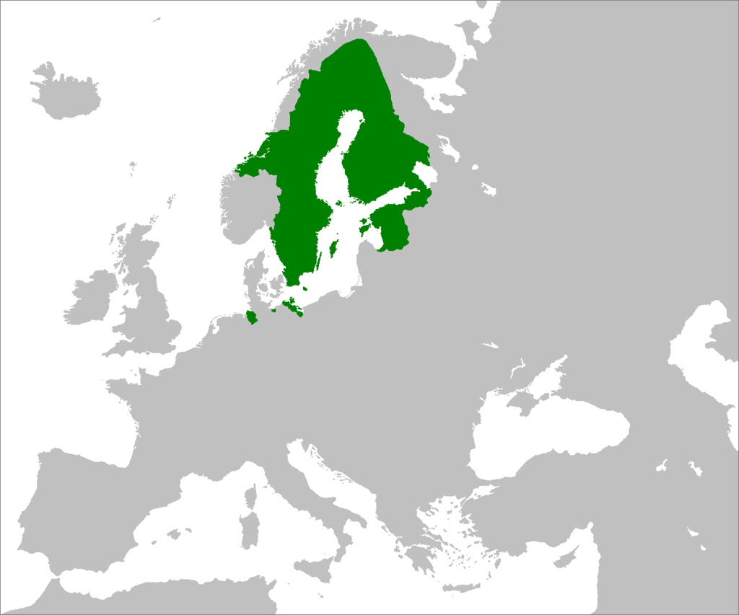
Immediate Results of the 30 Years’ War
Please remember these TWO Areas of Europe:
Sweden won cash and land in the Baltic region
France won the region of Alsace

Slide 11
Political Fallout from the 30 Years’ War
Because Spain lost territory and France gained territory, France stood alone as the most powerful nation on the continent
France also benefited from the fragmentation of the Holy Roman Empire and the weakening of the Habsburg family influence
The political power of the Holy Roman Empire faded into oblivion;
The Habsburg family remained wealthy and strong, though, and would go on to rule the Austro-Hungarian Empire later (we’ll meet some of them later…)

Slide 12
The Aftermath in Prussia (Germany) (some recurring themes for the year…)
Though Germans seemed to win politically and religiously, the Germans lost in other ways:
German homes, businesses and farms were destroyed en masse during the war (Thanks Wallenstein…)
The population took a major hit
millions dead from battle, disease and starvation over the course of the war and the years immediately following
the population decreased by as much as 20% according to some sources

Slide 13
The Aftermath in Prussia (Germany) (some recurring themes for the year…)
Food shortages plagued Germany and worsened the suffering of those who survived
Inflation crushed the German economy; food shortages and rising prices coincided with the massive influx of gold and silver into Spain
Trade routes in and around German territories virtually disappeared
Ironically, a very few towns grew as refugees moved in for safety

Slide 14
Things You Must Remember about the 30 Years War:
Started as a religious war (Defenestration of Prague)
Turned into a political war (all those other nations joining in…)
No religious solution (this won’t be the end…)
France replaces Spain as the powerful nation
No single nation has an army strong enough to knock out the other major nations (balance of power…)

Slide 15
Things You Must Remember about the 30 Years War:
The Alsace region would be hotly contested (again…you need to remember this!!!)
the sovereignty of the German princes essentially meant the end of the Holy Roman Empire
Because the vast majority of the fighting took place in Germany, the German states suffered more than any other participants (a theme, perhaps?!?)

Slide 16
The Rest of Our Time together…or HW
1. CRA 16.1 This is an individual activity…
Include the Maps, Infographic, and captions…there’s important context here!
Take notes, ask questions, make connections to Lit!
2. Monarch Chart & Map: Focus on:
Philip II—Spain
But why?!? Visuals/Pictures help us remember topics in different ways—chart…plus, we just don’t use maps enough!

