Slide 1
IB Psych 10/24/18
Turn in:
ANY and ALL notes you’ve created for this process…
Take out :
Planner
Writing Implement
Today’s Learning Objectives:
I can EXPLAIN the validity of The Stanford Prison Experiment.
Today’s Agenda:
SPE
What’s next?
Cognitive Approach
HW:
None

Slide 2
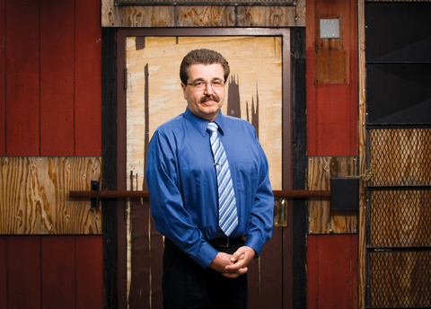
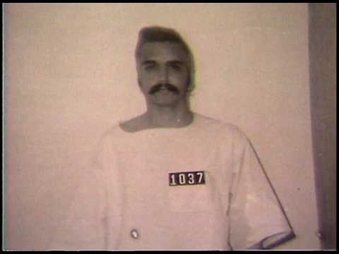
Prisoner 1037 Richard Yacco
“I was surprised they released me…”

Slide 3
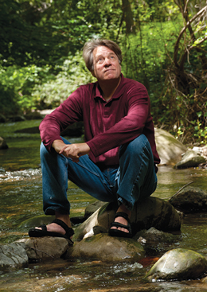
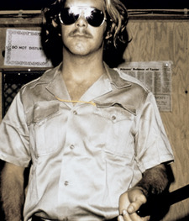
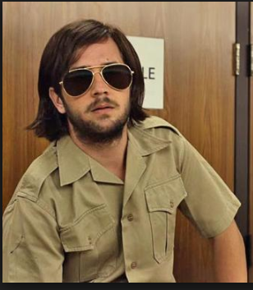
Stanford Prison Guard Dave Eshelman, AKA “John Wayne”
“I took it as a kind of improv exercise,” Dave Eshelman said. “I believed that I was doing what the researchers wanted me to do… I’d never been to the South but I used a southern accent.”

Slide 4
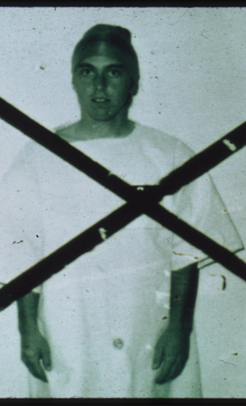
Prisoner 8612 Doug Korpi
“I’m burning up inside!”
“Anybody who is a clinician would know that I was faking,” he said. “If you listen to the tape, it’s not subtle. I’m not that good at acting. I mean, I think I do a fairly good job, but I’m more hysterical than psychotic.”
Earned his Ph.D. in clinical psychology from Berkeley. Chief psychologist in San Francisco County Jail and practicing forensic psychologist.
https://www.youtube.com/watch?v=kXOM8IK4HOs

Slide 5
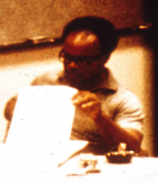
Other “Factors”
bags being placed over the heads of prisoners, inmates being bound together with chains and buckets being used in place of toilets in their cells were all experiences of mine at the old “Spanish Jail” section of San Quentin and which I dutifully shared with the Stanford Prison Experiment braintrust months before the experiment started.
--Carlo Prescott (2005 Article)
Does it matter that this study was never published?
Does it matter that Zimbardo had made strong statements against the prison community prior to the experiment…and was involved in the study itself?
Dave Jaffe: Perhaps (Dr. Z has not confirmed to date…) the catalyst for the entire project…An undergraduate student, performed a class project—many called it the “pilot” for what became the SPE…he was a guard in the “pilot” study, later the warden in the SPE.
Earned his MD—Now a physician in St. Louis…
Does it matter that there was no strong standard set for ethics until 1974?
What if I told you there may have been “coaching?” by Jaffe (and presumably Zimbardo…)
https://soundcloud.com/brian-resnick-304259267

Slide 6
Cognitive Approach
Derived from the Latin: Cognoscere, meaning “to know.”
http://forvo.com/word/cognoscere/

Slide 7
Cognitive Approach
Q: What are we really studying with this Approach?
A: The reception, storage, & use of knowledge. Attention, perception, memory, decision-making, problem-solving, and language…anything else?

Slide 8
Cognitive Level of Analysis
Q: What are we really studying with this level of analysis?
A: The Mind…

Slide 9
Cognitive Level of Analysis
Q: What are we really studying with this level of analysis?
A: The Mind…
mind (n.)
late 12c., from Old English gemynd "memory, remembrance, state of being remembered; thought, purpose; conscious mind, intellect, intention," Proto-Germanic *ga-mundiz (source also of Gothic muns "thought," munan "to think;" Old Norse minni "mind;" German Minne (archaic) "love," originally "memory, loving memory"), from PIE root *men- (1) "think, remember, have one's mind aroused," with derivatives referring to qualities of mind or states of thought (source also of Sanskrit matih "thought," munih "sage, seer;" Greek memona "I yearn," mania "madness," mantis "one who divines, prophet, seer;" Latin mens "mind, understanding, reason," memini "I remember," mentio "remembrance;" Lithuanian mintis "thought, idea," Old Church Slavonic mineti "to believe, think," Russian pamjat "memory").

Slide 10
Shall we play a game?
Partner up with someone NOT at your table group…determine who is partner #1 & partner #2
Partner 1—you will write a “C” over every capitalized letter
Partner 2—you will time partner 1 (Record the time…) Switch!
Partner 1—put a C over every capitalized consonant, and a V over every capitalized vowel. Vowels are A, E, I, O, and U. No w's or Y's have been capitalized in order to avoid confusion.
Partner 2—you will time partner 1 (Record the time…) Switch!
Partner 1—put a C over every capitalized consonant, and a V over every capitalized vowel. However, if the capitalized vowel is an E, please put an X over the letter.
Partner 2—you will time partner 1 (Record the time…) Switch!
LET’S CHART THE RESULTS…

Slide 11
Donder’s Subtractive Method
Differing levels of cognitive tasks:
a simple reaction time task
a discrimination reaction time task
a choice reaction time task
The hypothesis was that at each level of task, the amount of time needed in order to complete the task would increase…let’s compare to our results.

