Slide 1
10th World Studies 10.25.18
Turn in:
CRA 16.1 (STAMP)
Take out:
Planner
Pen/pencil
NOTES
Monarch Chart
Map of Europe
Today’s objective:
I can describe how Spain was unified and the impact of Philip II had on the balance of powers in Europe.
Today’s Agenda:
More Background on Isabella and Ferdinand
Spain: Philip II
HW:
In-Class: CRA portion of 16.4 (527-529)
Ongoing:
working on Map & Chart

Slide 2
Ferdinand and Isabella—a match made in heaven? Not quite…but still sets the foundation
Married in 1469
Spain—half-sister of Henry IV (The Impotent)
Remnants of the Medieval period…nobles gained/retained power
Looking to take power in Castile…so, she weds:
Ferdinand of Aragon
Marriage of political motivation
Use of Inquisition
Sponsored Christopher Columbus
Very Catholic and got lots of gold
Daughter: Catalina (Catherine of Aragon—wife of ???)
United the kingdom: some contemporaries compared him to Charlemagne

Slide 3
Spain a “unified” Catholic country
The Inquisition and expelling of the Jews and Moors was so successful, that by the 1500’s, Spain was almost completely Catholic
The exploration of the Americas brought $$$
In the process, Isabella and Ferdinand became the most powerful “kings” in Europe
Laid the foundation for Spain to become the most powerful nation in Europe (if not the world…)

Slide 4
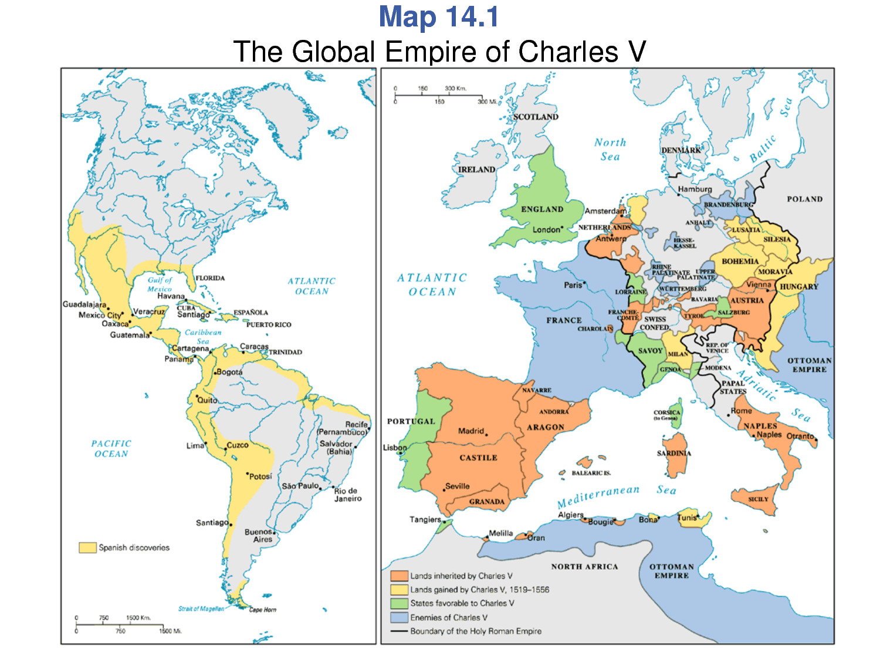
Charles I: (not the one on your chart…) Two Crowns
Grandson of Ferdinand and Isabella
As well as grandson of Maximillian I (Hapsburg family of Austria)

Slide 5
Charles V
ORANGE=LAND INHERITED GREEN=FRIENDS
YELLOW=LAND GAINED I BLUE=ENEMIES
The Netherlands
GERMAN “KINGDOMS”
Lots of land…little resistance
Austria

Slide 6
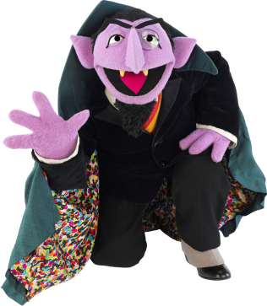
Charles I—Two Crowns
Charles V—Two Crowns
Charles I—Two Crowns
Let’s count in Spanish…
Uno, dos…uno, dos, CINCO!
Becomes Charles V, but heavy weighs the crown…
More vernacular—abdicate!

Slide 7
Charles V
ORANGE=LAND INHERITED GREEN=FRIENDS
YELLOW=LAND GAINED BLUE=ENEMIES
GERMAN “KINGDOMS”
Lots of land…little resistance, but it’s so far away…
Darn…the French, always in the way…issue with the kingdom of Burgundy…
OTTOMAN EMPIRE

Slide 8
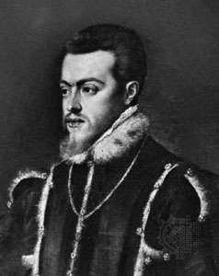
Phillip II
Grandson of Isabella & Ferdinand
Son of Charles I (V)
4 marriages
1st Son conspired to kill him…ended poorly for him
Second wife was “Bloody” Mary
But England refused to crown him king…and no issue
Elizabeth of Valois (Henry II of France)
Anne of Austria

Slide 9
Phillip II
Had supplied Spain with estimated 339,000 pounds of gold. Roughly 16,000 tons of silver bullion were unloaded. (that’s about $14 Billion @ today’s price…)
Defeated Ottoman fleet into fierce battle near Leponto.
Stopped a Protestant rebellion in the (Spanish) Netherlands (connection to 30 Years War…)
The Spanish Armada—invasion of England (1588)
Didn’t go so well for Phillip and the Spanish…
Begins the decline of Spanish power

