Slide 1
10th World Studies 10.29.15
Turn in:
Nothing…
Take out:
Planner, Pen/pencil, Monarch Chart, Map of Europe
Today’s objective:
I can describe how England’s history of monarchs differs from other European nations during Absolutism.
Today’s Agenda:
England: (End of Tudors) Stuart
James I
Charles I
Oliver Cromwell
Charles II
James II
William and Mary
HW:
Twitter Project

Slide 2
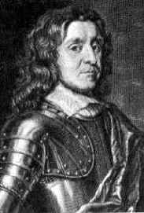
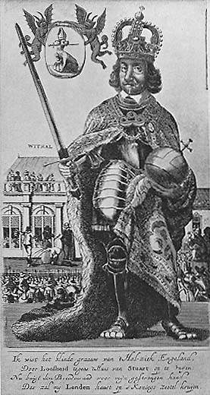
Lord Oliver Cromwell
Power Corrupts– it did me!!
A Puritan In Power!

Slide 3
Cromwell comes to Power
Parliament abolishes the Monarchy
England declared a Republic under the rule of Oliver Cromwell
Became Lord Protector (Roman republic & DICTATOR) of England after Charles’ execution
Enforced Blue Laws restricting Christmas, dancing, gambling, (you get the picture…)
Hated Catholics, sent them to barren land in West Ireland.
Any Catholic who disobeyed was to be killed on sight

Slide 4
Power Corrupts: Lord Oliver Cromwell’s End
Cromwell died in 1658
Son takes over, but can’t keep power—9 months of service—he’s viewed as a failure
People are ready for a King again
1660 Parliament asks Charles II to come back and be king
“Pssst…Hey Charles. It’s Parliament. First of all, sorry we cut of your dad’s head. Our bad….. But anyway, how are things? Good. Hey got a favor to ask of you. Do you want to be King?”

Slide 5
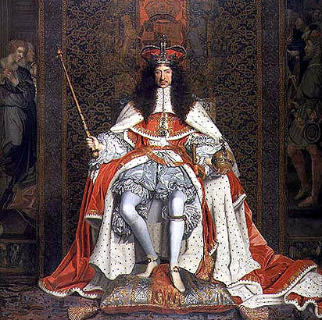
Restoration of the Monarchy 1660 King Charles II
The Restoration!

Slide 6
The Restoration & Charles II
Charles II was Charles I eldest son.
Known as the “Merry Monarch”
Why rule a country when you can party!
Cancelled Blue Laws
Supported Catholics and believed in Absolute Monarchy, but knew how to “play the game” with parliament
Dug up Cromwell’s body & put it on display for revenge against father’s death

Slide 7
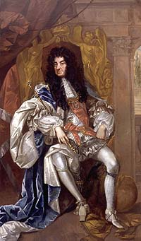
Charles II & Parliament
Charles II was now head of Church of England
He tried to protect Catholics (his brother James II is one)
Parliament reacted by passing Test Act banning Catholics from some choice political jobs
Charles dies in 1685…

Slide 8
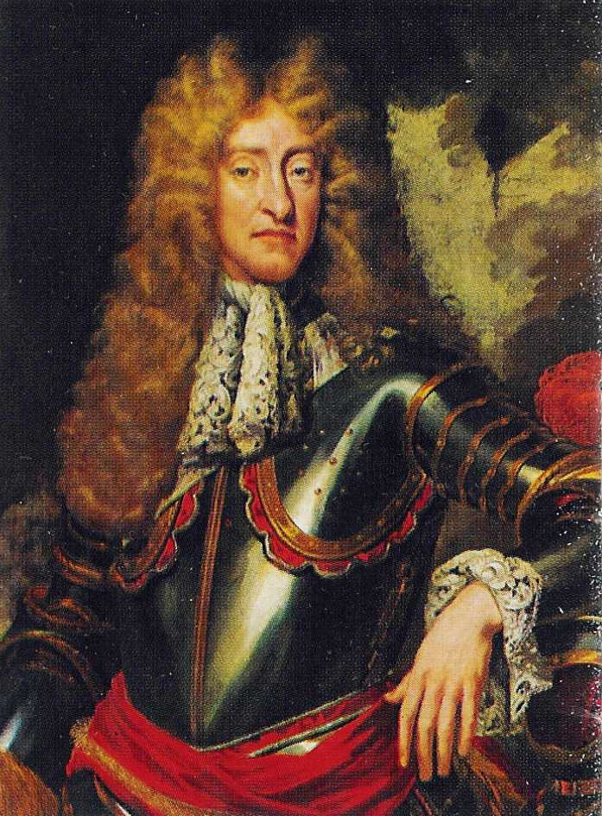
James II: The “Bad” Brother
Hi, I’m James II your new king. I’m openly Catholic.
England sure dislikes Catholics right now. I’ve given high offices to my Catholics friends.
Oh, and Divine Right of Kings, that’s my motto!
I hate compromise—I’m a KING! I instituted a reign of terror, executing rebels who opposed me.

Slide 9
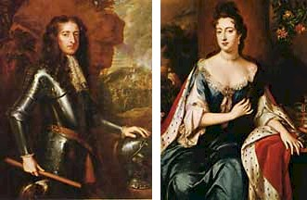
William III of Orange and Queen Mary (rule 1689 – 1702)

Slide 10
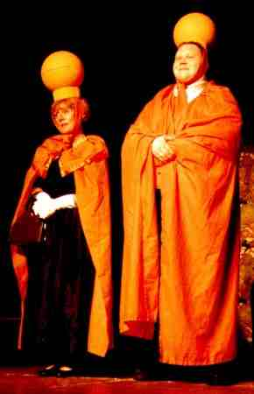
The Glorious
(and bloodless)Revolution
Parliament invites James II Protestant daughter, Mary and her husband William to rule England
But…they must obey parliament’s wishes
They accept James II flees
Divine Right to Rule is DEAD!
Will & Mary sign Bill of Rights to signal their “okay”

Slide 11
We, William and Mary
Of Orange
Do hereby recognize
Parliament as the
Real power

Slide 12
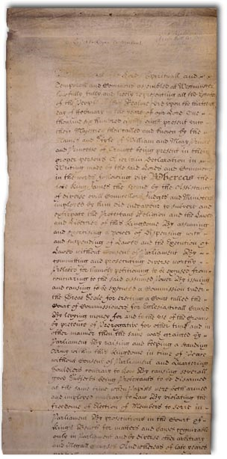
English Bill of Rights (1689)
Ratified revolution of 1688
Ensures that Parliament will now and forever be superior to the monarchy
King had to call parliament reguarly
Parliament controlled spending
King couldn’t interfere with Parliament or dissolve it
No Catholic could sit on the throne
Trial by Jury
No excessive fines or cruel and unusual punishment
Habeas corpus- couldn’t throw someone in jail without charging them with a specific crime

Slide 13
England is now a limited monarchy
Absolute Monarchy- monarch who has complete authority over the government and lives of the people he or she governs
Constitutional or limited monarchy- monarch whose power is limited by a constitution or legislative body

Slide 14
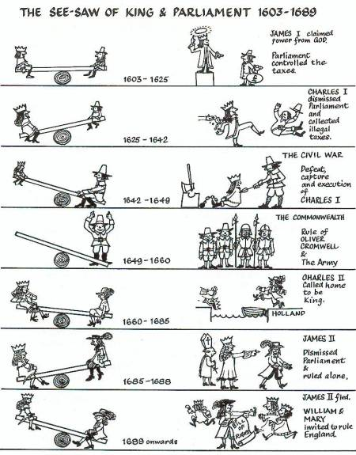

Slide 15
10th World Studies 10.29.15
Turn in:
Nothing…
Take out:
Planner, Pen/pencil, Monarch Chart, Map of Europe
Today’s objective:
I can describe how England’s history of monarchs differs from other European nations during Absolutism.
Today’s Agenda:
England: (End of Tudors) Stuart
James I
Charles I
Oliver Cromwell
Charles II
James II
William and Mary
HW:
Twitter Project

