Slide 1
IB Psych 10/29/18
Turn in:
Nothing
Take out :
Planner
Writing Implement
Notes
Today’s Learning Objectives:
I can begin to define the Cognitive Approach to psychology.
Today’s Agenda:
Cognitive Approach
Essential Questions
Memory
HW:
CRA Modules 32 & 33

Slide 2
Last day to sign up is Wednesday 10/31
IB Exams
Why should you sign up?
It’s a great experience for comparatively a small expense…
WA state schools are now required to award credit for SL classes with a 4 or better. Last year’s cohort that equaled 67.3% of students.
I tend to get adjustments on the low end of my marking…2/3 below 4 on IA

Slide 3
8 6 7 5 3 0 9
You will have 3 seconds to “learn” the following digits…

Slide 4
Essential Questions (and major components of this approach…)
How do psychologists study cognitive processes?
How are MEMORIES: encoded, stored and retrieved?
What effect does emotion have on cognitive processes?
How do cognitive processes influence our behavior?

Slide 5
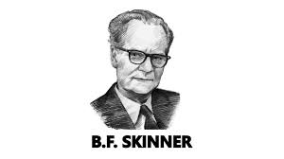
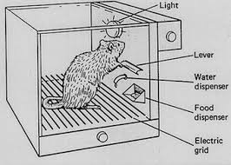
Essential Questions (and major components of this approach…)
How do psychologists study cognitive processes?
Prior to Cognitive Psychology: the Behaviorists
B. F. Skinner
the mind is a "black box" that cannot be studied.
Only observable behaviors could be studied.
Is this a cognitive process? If so, then what?
https://www.youtube.com/watch?v=L6MamDfrH-I

Slide 6
Essential Questions (and major components of this approach…)
How do psychologists study cognitive processes?
Is this a cognitive process? If so, then what?
Is this “learning?” Are other factors present?
Let’s try a simple task…fresh sheet of scratch paper

Slide 7
Essential Questions (and major components of this approach…)
How are MEMORIES: encoded, stored and retrieved?
Let’s try a simple task…fresh sheet of scratch paper
Write (so I can see them if you hold them up…) the digits I asked you to “learn”
8 6 7 5 3 0 9

Slide 8
MEMORY
What is your earliest memory?
https://youtu.be/1nHwQKT_muc
How about some easier tasks…perhaps?
What was the name of your first pet?
Where were you on Friday evening at 8:00 pm?
What was the name of the last hotel that you stayed in?
What was the name of your Kindergarten teacher?
What did you have for lunch last Friday?
What grade did you receive on your last math assessment?
What is your mobile telephone number?

