Slide 1
10th World Studies 10.30.18
Turn in:
Nothing
Take out:
Stamp Sheet
Planner
Pen/pencil
Notes
Monarch Chart & Map of Europe
Today’s objective:
I can describe how the rise of Russia impacted the balance of power in Europe.
Today’s Agenda:
Frederick the Great
Does Frederick the Great’s reign fit the model of Absolutism?
Russia (Romanov family)
Background
Peter the Great
Catherine the Great
HW:
CRA 16.5 (530-535)
Peter the Great
Catherine the Great
Chart it and map it

Slide 2
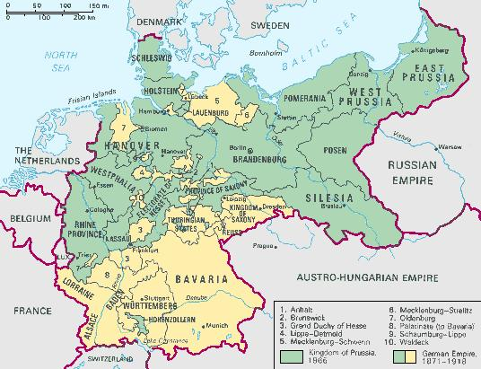
Prussia
Alsace

Slide 3
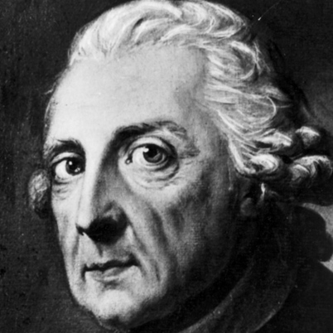
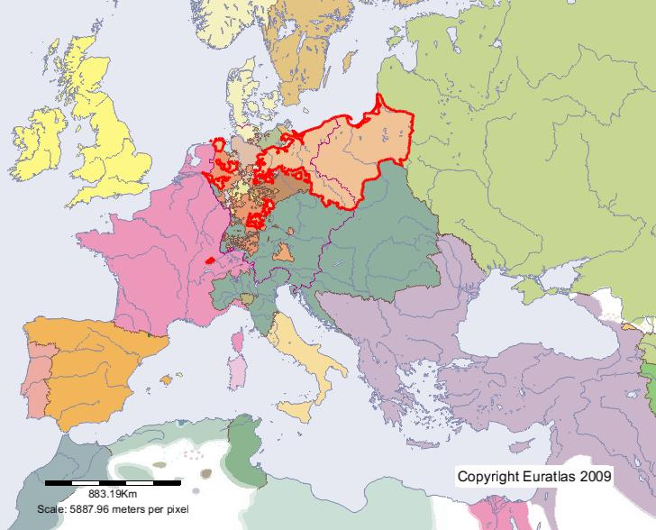
Prussia—Frederick the Great
"A crown is merely a hat that lets the rain in.”
abused as a child—attempts escape—accomplice is beheaded (1730—18 years old…)
REFORMS:
RELIGIOUS TOLERANCE
MILITARY
BASIC FREEDOM OF THE PRESS
FIRST GERMAN CODE OF LAW
Absolute Monarch by our definition?
Not really…but still viewed as an absolute monarch
Doesn’t believe in divine right…sees his role as a servant to his people. “1st servant of the people”
Listens to advisors and makes attempts to do the most good for the most people…

Slide 4
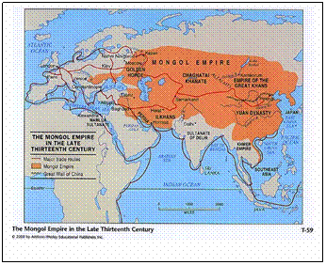
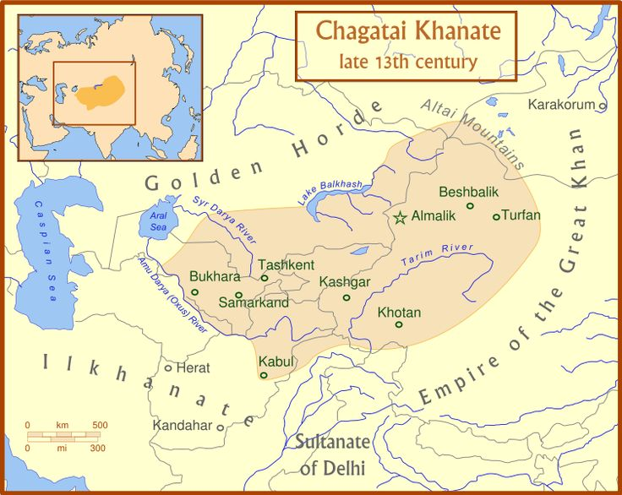
Russia
While most of Europe was advancing from the benefit of the Renaissance, Russia (from Rus) was stuck in a “feudal” state…[Vikings?]
The Mongol Empire was losing it’s grip
The Tatars (Tartars) were gaining control—assimilates w/Mongols, becomes the “Golden Horde”
“Boyars”: the ruling aristocracy, the nobility…title just below “prince”

Slide 5
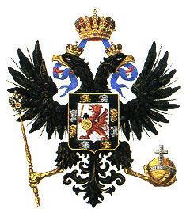
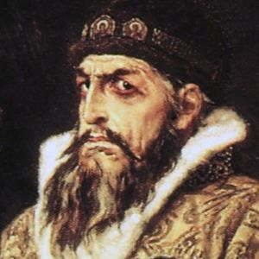
Russia
Ivan (III) the Great
Began to amass wealth
“Bought” out neighboring ruling families
Put down rebellions of his own family…just as daddy [Vasily II] did
Ivan IV (1533-1584)
Began to centralize power
Acquired a great deal of land
Many believe he was mentally ill
Again, might be a good idea to keep the
gene pool a bit deeper…

Slide 6
Ivan IV (The Terrible)
1560—deep depression and behavior became more erratic.
His suspicion of the boyars only deepened his paranoia.
He left Moscow suddenly and threatened to abdicate the throne.
He agreed to come back, but on the condition that he be granted absolute power
He also demanded the authority to punish traitors and law breakers with execution and confiscation of property.

Slide 7
Ivan the Terrible (IV)
Ivan IV conducted a reign of terror
destroying the major boyar families in the region,
Ivan beat his pregnant daughter-in-law, causing a miscarriage, killed his son in a subsequent fit of rage, and blinded the architect of St. Basil's Cathedral.
Creates the first official secret Russian police force.

Slide 8
Ivan the Terrible (IV)
His sons are incompetent, so he appoints two regents—Boris (a tartar-titled boyar...)
In the year of his death, he has another son—Dmitri (dies at age 7)
Fedor (Ivan’s son) dies childless, and Boris is “elected” tsar.
False Dmitris begin to appear…Time of Troubles
1st—somewhat successful
2nd—no one really believes, but why not?
3rd—forced to the top by Cossacks
ALL three somewhat quickly murdered within the capitol

Slide 9
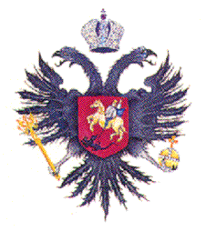
The Romanovs
A Boyar family
Mikhail Romanov
Great-nephew of Ivan IV’s wife Anastasia—her father’s name was “Roman,” hence Romanov
Elected to “The Assembly of the Land” at age 16 (1613)
Great economic prosperity
Named all-Russian sovereign in 1625
Power is consolidated into the family

Slide 10
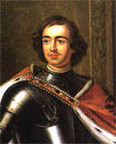
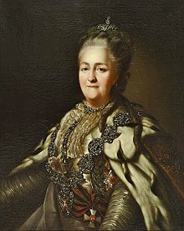
The rest of our time together…
CRA 16.5: Peter the Great & Catherine the Great
Map and Chart
Please note:
NOT husband and wife…

