Slide 1
9th Honors 10.03.14
Turn in:
Christianity Questions
Take out:
Planner (next Thursday!), notes, pen
Today’s Learning Objectives:
I can explain how religious beliefs began to shift and spread with the rising of empires and the lasting impact in today’s world.
Today’s Agenda:
Quiz (15 minutes)
Christianity
Judaism
HW:
Comparing Judaism to Christianity (available online)
Study Guide (also available online)

Slide 2
First Things First
What’s the deal with these dates?!?
BC vs BCE
AD vs CE
BC= “Before Christ” BCE= “Before Common Era
CE= “Common Era AD=
“Anno Domini” (In the year of our Lord)
Thanks so much, Dionysius Exiguus (6th century monk)
For our intents and purposes, if we use either form, I think we’ll be ok…

Slide 3
Rise of Christianity
Started by Jesus of Nazareth (6/4BCE-31/33CE) & Paul of Tarsus
Seen as an odd cult; persecuted off and on for many years in Rome—mainly for fun
All that changed with Edict of Milan in 315
Incredibly rapid expansion
Conversion of Constantine
Made official state religion in 391.
So, here’s the question:
What was the main cause of the spread of Christianity?
What does this tell us about the culture of the religion and the people practicing it at the time?

Slide 4
Rise of Judaism
We will span a great deal of time…
Explore the ancient roots first
Then we’ll get a little more modern
Then, you can get a sneak peak at some of next year’s material…

Slide 5
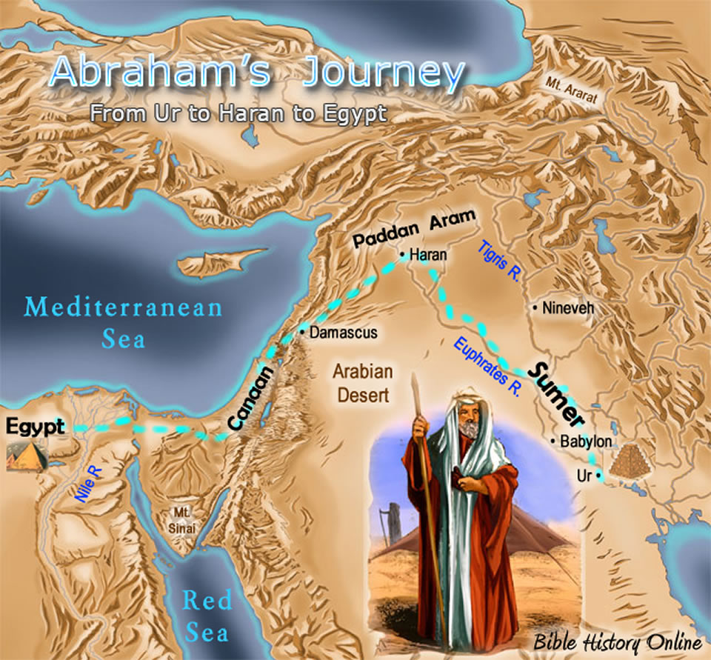
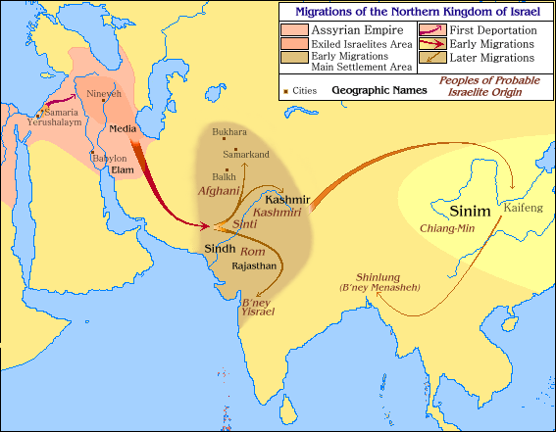
Rise of Judaism
More fun with maps!!!
Abraham’s Journey (c. 1800 BCE) Think about how the Assyrians handled people…

Slide 6
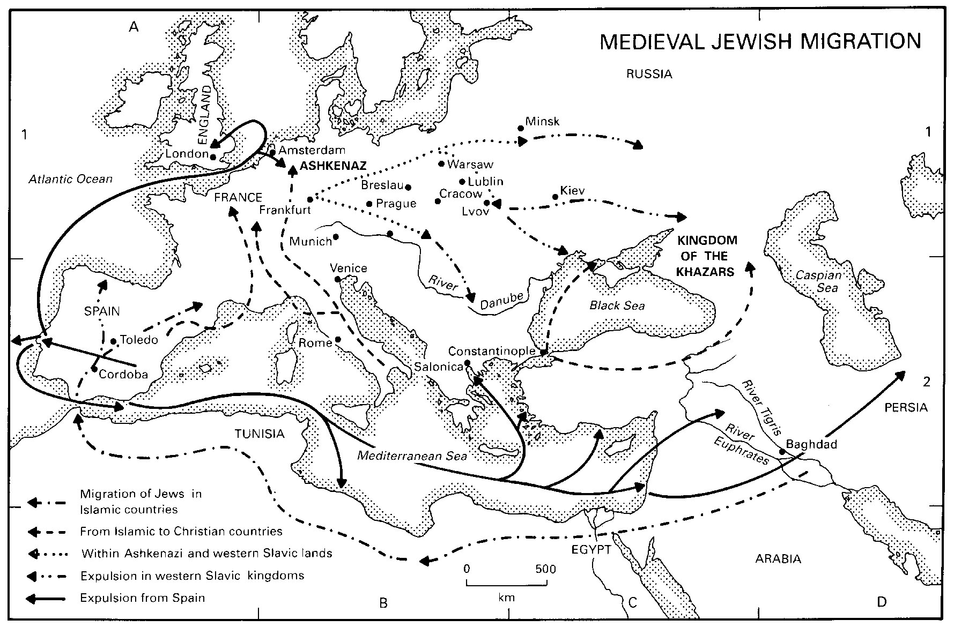
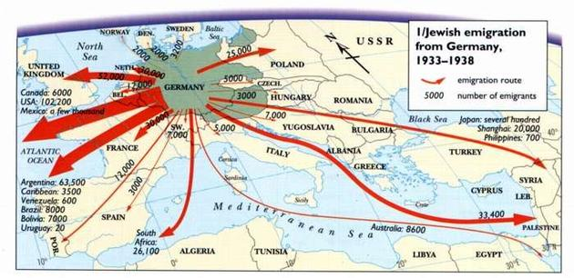
Rise of Judaism
More fun with maps!!!
Medieval Jewish Migration Jewish emigration during Nazi Germany

Slide 7
Rise of Judaism
Abraham (c. 1800 BCE) leaves Ur
Think about the roots of civilization at the time
What is the tradition of Abraham’s ancestors?
Shifting to monotheism
Consider the story of Abraham and his father
Also, consider how the Assyrian shift began to happen roughly 1000 years later…
How are his descendents represented?
Why is this important?
What does it tell us about the culture?
And now, the BIG question:
Is there a difference in how Judaism spread as opposed to Christianity?
Is there a pattern throughout history?
What does this tell us about the Jewish culture?

Slide 8
9th Honors 10.03.14
Turn in:
Christianity Questions
Take out:
Planner (next Thursday!), notes, pen
Today’s Learning Objectives:
I can explain how religious beliefs began to shift and spread with the rising of empires and the lasting impact in today’s world.
Today’s Agenda:
Quiz (15 minutes)
Christianity
Judaism
HW:
Comparing Judaism to Christianity (available online)
Study Guide (also available online)

