Slide 1
IB Psych 11.29.18
Turn in:
Nothing
Take out :
Planner
Notes
Note-taking devices
Today’s Learning Objectives:
I can describe biases in thinking and decision-making.
Today’s Agenda:
Decisions & Bias
HW:
Prepare…

Slide 2
Confirmation Bias
The tendency to seek out information that confirms pre-existing beliefs…
If a card has a vowel on one side, then it has an even number on the other side.
Name those cards, and only those cards, that need to be turned over in order to determine whether the rule is true or false.
A
K
4
9

Slide 3
A Logical Heuristic Wason’s four-card problem (1968)
A heuristic that violates logic as the normative model…
A & 7 only…
If you turn over the A card…even #, supports the rule…odd #, refutes the rule
A
K
If you turn over the K card …even #, tells nothing…odd #, also nothing…
If you turn over the 4 card …vowel, supports rule…consonant, tells you nothing…
4
7
If you turn over the 7 card …vowel, refutes rule…consonant, tells you nothing…

Slide 4
Congruence Bias
Similar to Confirmation bias, yet different…at least some might argue. Let’s try an (un)scientific test.
Given: a series of numbers…2, 4, 6
This sequence follows a rule…
Your task: discover the rule.
You are allowed to create additional three-number sequences…
You will get feedback…Yes or No

Slide 5
Congruence Bias
Similar to Confirmation bias, yet different…at least some might argue. Let’s try an (un)scientific test.
Given: a series of numbers…2, 4, 6
This sequence follows a rule…
Your task: discover the rule.
You are allowed to create additional three-number sequences…
You will get feedback…Yes or No
How do we discover the rule? By creating alternative hypotheses…(1, 2, 3…6, 4, 2)
We tend to seek positive results…as opposed to informative results…we jump to conclusions… https://www.youtube.com/watch?v=sDEL4Ty950Q

Slide 6
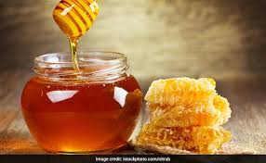
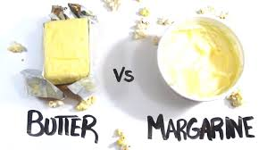
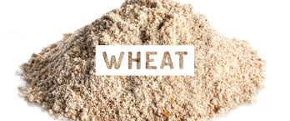
Congruence Bias
Similar to Confirmation bias, yet different…at least some might argue.
Ran out of several ingredients baking a cake…Cake turned out wonderfully…perhaps the best cake ever made!
But why?!?

Slide 7
Congruence Bias
Must be the honey…
But how do we determine?
A—use sugar instead of honey
B—keep the honey, change everything else
C—change everything

Slide 8
Congruence Bias
What if the cake was terrible???
But how do we determine?
A—use sugar instead of honey
B—keep the honey, change everything else
C—change everything

Slide 9
Anchoring Bias
How much do you pay for a gallon of gas?
How much would you be willing to pay?
What if I told you: Which is the best value?
in 1932 the avg. price in the US was: $0.18
in 1942 the avg. price in the US was: $0.20
in 1952 the avg. price in the US was: $0.27
in 1962 the avg. price in the US was: $0.31
in 1972 the avg. price in the US was: $0.36
Today, the avg. price in the US is: $2.51 ($3.33 in WA)

Slide 10
Anchoring Bias
How much do you pay for a gallon of gas?
How much would you be willing to pay?
What if I told you:
1932 $0.18 = $2.61 in current dollars
1942 $0.20 = $2.39 in current dollars
1952 $0.27 = $2.01 in current dollars
1962 $0.31 = $1.88 in current dollars
1972 $0.36 = $1.59 in current dollars
Today, the avg. price in the US is: $2.51 ($3.33 in WA)

Slide 11
Anchoring Bias
The tendency, in forming perceptions or making quantitative judgments under conditions of uncertainty, to give excessive weight to the starting value (or anchor), based on the first received information or one’s initial judgment, and not to modify this anchor sufficiently in light of later information.
Other practical examples:
Wait time at a restaurant…
Sale prices…grocery items example…
Product pricing & the power of 9
Salary negotiations

Slide 12
Cognitive Topics: 32, 33, 34, & 38
TOPIC | POSSIBLE PROMPT
General | Ethical considerations related to research studies in the cognitive approach to studying behavior. How and why particular research methods are used in the cognitive approach. Evaluation of research methods used to study cognitive processes.
Cognitive processing | Schema theory Multi-store model of memory Thinking and decision making (The concepts of thinking and decision making will be interchangeable.) Working memory model
Reliability of cognitive processes | Reconstructive memory Cognitive biases (Candidates should be able to discuss two biases).
Emotion and cognition | One theory of how emotion affects a cognitive process - e.g. flashbulb memory theory

