Slide 1
10th World Studies 11.29.18
Turn in:
Nothing
Take out:
NOTES
A Writing Implement
Thinkers Chart
Today’s objective:
I can explain how emerging thoughts of populations impacted the power structure (religion, government) of Europe.
Today’s Agenda:
Enlightenment Thinkers…the Philosophes
The 3rd Estate
HW:
CRA “What is the Third Estate?” (online…)

Slide 2
According to Hobbes
The only right people have is to protect their own lives.
All rights to everything else are trusted to the king.
All people are inherently savages, and cannot be trusted in decision making as a group.
“…the life of man, solitary, poor, nasty, brutish, and short.”

Slide 3
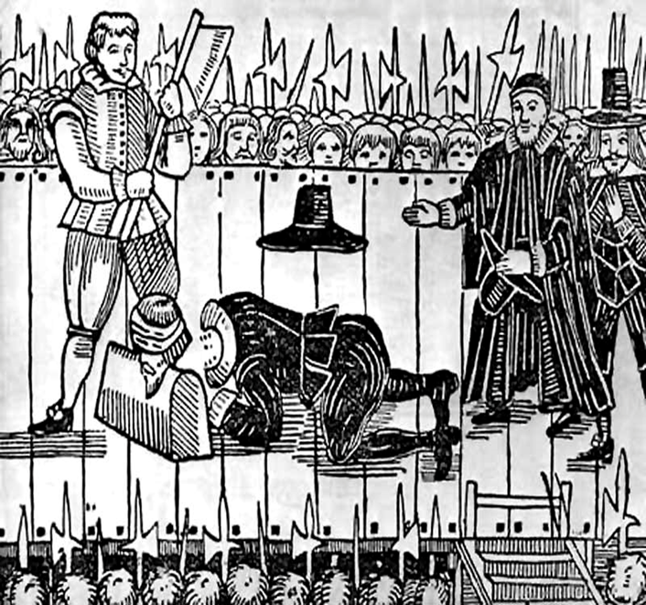
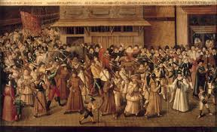
Hobbes’s Impact
Influenced supporters of the monarchy in Europe.
Said the world is a place where only the strong survive unless order is forced by a ruler.
People should give up individual liberty for public safety.

Slide 4
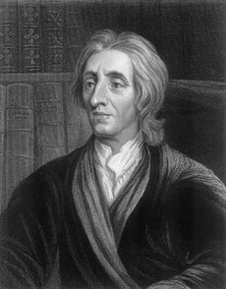
John Locke (1632-1704)
Two Treatises on Government (1689)
People born with basic rights, not subject to the whole of society…life, liberty, and property.
Governments and leaders only exist to protect these rights.
“Men being…by nature all free, equal, and independent, no one can be put out of this estate and be subjected to the political power of another without his own consent.”
A ruler who denies people their basic rights is a tyrant and can justly be overthrown.
Tabula Rasa

Slide 5
The Encyclopédie
Major achievement of the philosophes
Begun in 1745; completed in 1765
Was a translation from English to French
Frontspiece to the Encyclopédie
Notes:
Perhaps the most notable achievement of the philosophes as a group was the 17-volume Encyclopédie, known in English as Encyclopedia: The Rational Dictionary of the Sciences, the Arts, and the Crafts. In 1745, French publisher André le Breton asked writer Denis Diderot to help him translate the seminal English Cyclopedia into French. Diderot served as co-editor of the project along with mathematician Jean Le Rond d’Alembert.

Slide 6
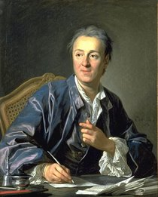
Denis Diderot and Jean Le Rond d’Alembert
Banned by the Catholic Church
Utilized the writers of the time to extend beyond a mere translation…
Notes:
Shortly after beginning, Diderot came up with a much more ambitious goal than a mere translation. He wanted instead to create a comprehensive work that would include the most up-to-date knowledge on the sciences, arts, and crafts. To this end, he enlisted several of the best thinkers of the era—many of whom were well-known philosophes—to write new articles for the Encyclopédie. He also wanted to make the work accessible to a wide audience rather than just for scholars.
Although Diderot and d’Alembert ended up writing the majority of the articles, contributions also came from many noted figures (especially Voltaire, as well as Rousseau and Montesquieu). By the time the Encyclopédie finally reached completion, it contained nearly 72,000 articles accompanied by numerous illustrations.
The work as a whole represents an outstanding example of Enlightenment thought: it praised science while also questioning religion, social institutions, the legal system, and more. As a result, the Catholic Church viewed it as undermining its authority and placed the Encyclopédie on its index of forbidden works. Nevertheless, it was widely read, with people often obtaining cheaper reprint editions published in Switzerland.

Slide 7
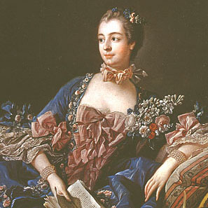
The French Salon and the Philosophes
Madame de Pompadour
Salons: gatherings for aristocrats to discuss new theories and ideas
Philosophes: French Enlightenment thinkers who attended the salons
Madame de Pompadour
She and Louis XV were good “friends”
Notes:
Madame de Pompadour, mistress of King Louis XV of France, was a devotee of art and philosophy. Around the middle of the 18th century, she began holding what became known as the salon. Salons were a sort of high class cocktail party for socialites, aristocrats, and intellectuals, where people demonstrated their knowledge of new theories and tried to outwit each other. Madame de Pompadour held the most famous and best attended salons in Paris.
Enlightenment thinkers in France who went to salons were known as philosophes. For a salon to be truly successful, it had to have a philosophe in attendance as a sort of showpiece.

Slide 8
Voltaire (1694–1778)
One of the most famous philosophe—very optimistic in his early career…then Candide
Wrote plays, essays, poetry, philosophy, and books
Attacked the “relics” of the medieval social order
Championed social, political, and religious tolerance
Notes:
François-Marie Arouet, known more famously as Voltaire, was the most renowned of the philosophes. A prolific writer, much of his work either satirized or attacked what he called the “relics” of the medieval social order—in particular, the church and the aristocracy. Despite—or perhaps because of—his controversial ideas, he was in high demand at salons not just in France but throughout Europe as well. He lived in the court of Frederick the Great for a time, and he was friends with Catherine the Great.
Above all, Voltaire attacked intolerance in society, politics, and religion. A famous quote usually attributed to Voltaire states, “I disapprove of what you say, but I will defend to the death your right to say it.” He felt that all governments were susceptible to tyranny, but he greatly admired the British model.

Slide 9
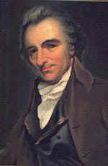
Deism—Morality could be achieved by following reason rather than the teachings of the Church
Many thought of God as: The “Great Watchmaker”
Firm believers in the existence of God
Their task was to use reason to determine the workings of this “fine Swiss watch”
Simply rejected the traditions of the Church as unnecessary—so many saw them as atheists.
Thomas Paine:
Common Sense
Voltaire
Notes:
Enlightenment philosophy emphasized experience and reason, while the Church asked worshipers to accept its principles on faith, so a conflict here was inevitable. Deists viewed God as the “great watchmaker” whose creation—the universe—operated as smoothly as a fine Swiss watch. The task, as Enlightenment thinkers envisioned it, was to try to discover the principles that governed the functioning of this “watch.” Deism thus centered around a belief in a God who operated according to reason and whose existence could be seen in the natural order and logic of all that He had created.
Thomas Paine, famous primarily for writing the classic pamphlet Common Sense, was also a key theorist of deism. In his essay “Of the Religion of Deism Compared with the Christian Religion,” Paine asserted that “there is a happiness in Deism, when rightly understood, that is not to be found in any other system of religion” because deism did not force its followers to “stifle reason” in order to accept its tenets.

Slide 10
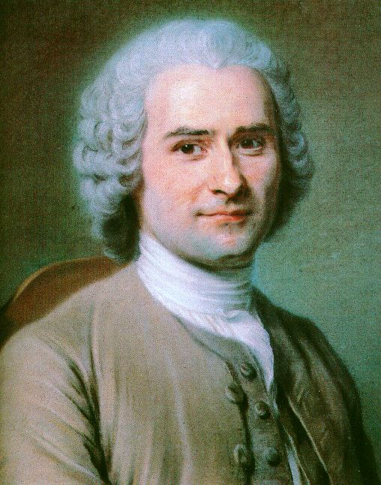
Jean-Jacques Rousseau (1712–1778)
Philosophized on the nature of society and government
The Social Contract
Also uses the concept of a “state of nature” to draw conclusions about society and government.
Notes:
Like Locke, Jean-Jacques Rousseau also used the concept of a “state of nature” to draw conclusions about society and government.
Rousseau is probably best known for his idea of the “social compact,” which he outlined in his book The Social Contract. Locke had viewed societies as having been created through mutual consent of all members. Rousseau went a step further, claiming that instead of mere consent, individuals forming a society entered into a “social compact” with one another. The social compact balanced benefits with obligations. Those who entered into it would receive mutual protection and defense, along with assistance in overcoming obstacles that they could not conquer individually. In return, the social compact obligated members of society to subordinate their “natural liberty” (i.e., the freedom enjoyed by individuals in the state of nature) to “the supreme direction of the general will.”

Slide 11
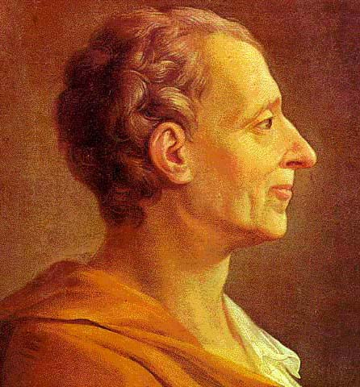
Baron de Montesquieu (1689–1755)
French noble and political philosopher
The Spirit of the Laws
A comparative study of governments
Then he proposes his own form…
Notes:
The Baron de Montesquieu was a French nobleman whose primary contributions to the Enlightenment’s political thought came in his 1748 treatise The Spirit of the Laws. Years before writing the treatise, Montesquieu had visited several European countries, carefully observing the workings of each nation’s government. In The Spirit of the Laws, he laid out a comparative study of types of governments, then put forward his own theory of government.

Slide 12
Montesquieu (continued)
Separation of powers
Constitutional monarchy
The Spirit of the Laws
Notes:
Montesquieu identified three sorts of governmental power: legislative, executive “in respect to things dependent on the law of nations,” and executive “in regard to those things that depend on civil law” (i.e., the judiciary). Montesquieu believed that if one person or group of people held any two or all three of these powers, it would result in “tyrannical laws” executed in a “tyrannical manner.” His ideas here provided the basis for the doctrine known as “separation of powers,” which significantly influenced the framers of the U.S. Constitution and thus the shaping of the American government.
Montesquieu did not believe that democracy was the best form of government. Instead, he favored a constitutional monarchy based on the British model. He greatly admired Britain’s government because he felt that Parliament, the king, and the courts worked separately and efficiently since each could limit the power of the other. This idea of the different branches of government each preventing the others from obtaining too much power later led to the theory of “checks and balances,” which also influenced the framers of the U.S. Constitution.

Slide 13
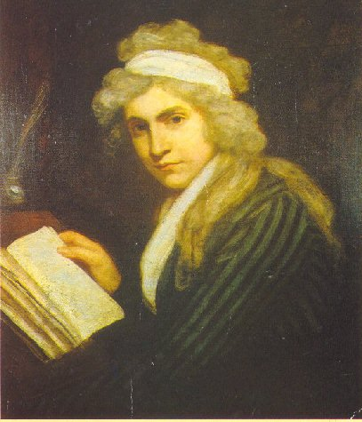
Mary Wollstonecraft
Declaration of the Rights of Man and the Citizen
(D-RO-MAC)
A Vindication of the Rights of Women (1792)
A Brit, but living in France during the Revolution…sees injustice in the liberty of the Revolution NOT being extended to females…
Notes:
During the early days of the French Revolution, the National Assembly adopted the Declaration of the Rights of Man. The document drew equally upon Enlightenment ideas and current events at the time to make statements both about basic political rights and the particular abuses which many had suffered under the rule of Louis XVI.
In 1792, Mary Wollstonecraft, a teacher and writer from Great Britain, composed A Vindication of the Rights of Women. Wollstonecraft had been living in Paris during the French Revolution and knew many of its leaders. The publication of the Declaration prompted her to outline her philosophy on the inequalities that existed between the sexes. She was disheartened by the fact that in spite of their belief in equality, the leaders of the Revolution did not extend that equality to women. She saw this as hypocritical and hoped her work would convince French leaders (especially Talleyrand, to whom she dedicated the book) to recognize that women had the same natural rights and intellectual capacity as men.

Slide 14
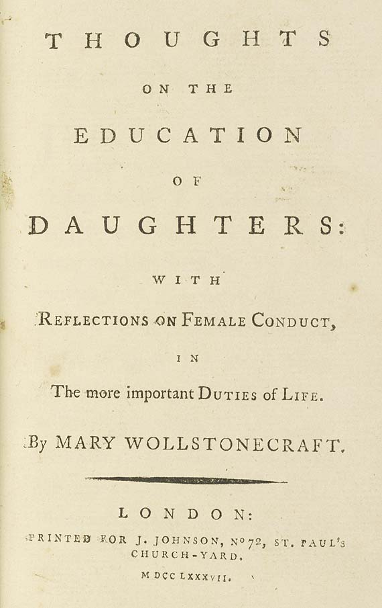
Wollstonecraft
Education
Women’s rights movement
“It is time to effect a revolution in female manners—time to restore to them their lost dignity—and make them, as a part of the human species, labour by reforming themselves to reform the world.”
Title page of Wollstonecraft’s Thoughts on the Education of Daughters
On a side note: she was also mother to Mary Shelley…
Notes:
Wollstonecraft believed women were kept in ignorance “under the specious name of innocence.” She refers here to a common argument of the time which held that women should not be educated because it would ruin their natural “innocence” and have a detrimental effect on their character. She felt that denying education to women would deprive them of the tools they needed to properly exercise their reason.
In the first chapter of her book, Wollstonecraft proclaimed, “It is time to effect a revolution in female manners—time to restore to them their lost dignity—and make them, as a part of the human species, labour by reforming themselves to reform the world.” Many regard A Vindication of the Rights of Women as marking the beginning of the modern women’s rights movement.

Slide 15
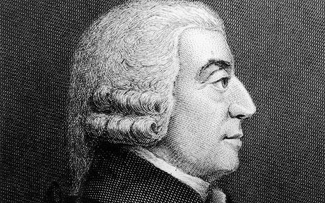
Adam Smith
Many regard him as the founder of modern economics.
He was, however, a tutor, philosopher, and moral writer (Theory on Moral Sentiments) prior to publishing, The Wealth of Nations (1776)
3 classes within society:
The capitalist
The laborer
The landlord
Notes:
During the early days of the French Revolution, the National Assembly adopted the Declaration of the Rights of Man. The document drew equally upon Enlightenment ideas and current events at the time to make statements both about basic political rights and the particular abuses which many had suffered under the rule of Louis XVI.
In 1792, Mary Wollstonecraft, a teacher and writer from Great Britain, composed A Vindication of the Rights of Women. Wollstonecraft had been living in Paris during the French Revolution and knew many of its leaders. The publication of the Declaration prompted her to outline her philosophy on the inequalities that existed between the sexes. She was disheartened by the fact that in spite of their belief in equality, the leaders of the Revolution did not extend that equality to women. She saw this as hypocritical and hoped her work would convince French leaders (especially Talleyrand, to whom she dedicated the book) to recognize that women had the same natural rights and intellectual capacity as men.

Slide 16
Adam Smith
Believed in the “market economy”
Natural process resolves conflict better than human arrangements
Optimum allocation of resources occurs in competitive markets with out intervention
He describes it as an “invisible hand”
Laissez-faire
Notes:
During the early days of the French Revolution, the National Assembly adopted the Declaration of the Rights of Man. The document drew equally upon Enlightenment ideas and current events at the time to make statements both about basic political rights and the particular abuses which many had suffered under the rule of Louis XVI.
In 1792, Mary Wollstonecraft, a teacher and writer from Great Britain, composed A Vindication of the Rights of Women. Wollstonecraft had been living in Paris during the French Revolution and knew many of its leaders. The publication of the Declaration prompted her to outline her philosophy on the inequalities that existed between the sexes. She was disheartened by the fact that in spite of their belief in equality, the leaders of the Revolution did not extend that equality to women. She saw this as hypocritical and hoped her work would convince French leaders (especially Talleyrand, to whom she dedicated the book) to recognize that women had the same natural rights and intellectual capacity as men.

Slide 17
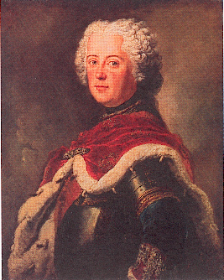
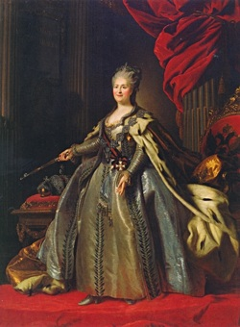
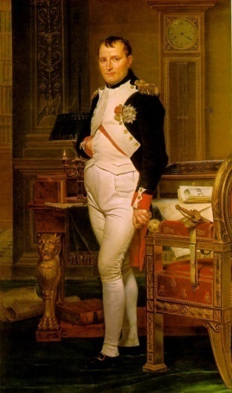
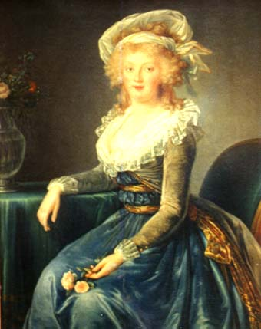
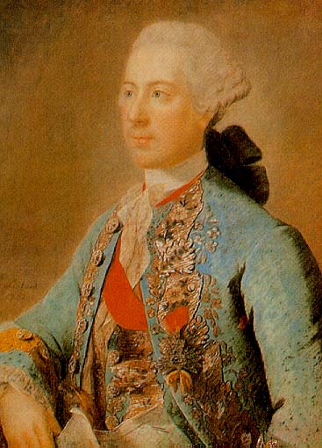
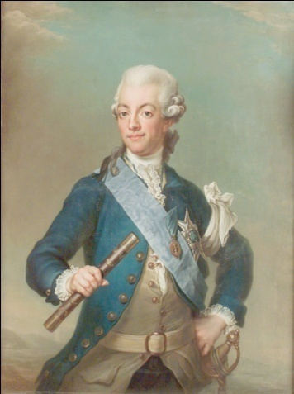
“Enlightened Monarchs”
Most of Europe ruled by absolute monarchs
Receptive to Enlightenment ideas
Instituted new laws and practices
Enlightened Monarchs
Frederick II, Prussia
Catherine the Great, Russia
Maria Theresa, Austria
Joseph II, Holy Roman Empire
Gustav III, Sweden
Napoleon I, France
Notes:
During the time of the Enlightenment, most of the countries in continental Europe were ruled by monarchs who exercised absolute power. Many of these monarchs read Enlightenment works and were intrigued by the new ideas thinkers put forth. The philosophes thought that an “enlightened” monarch could implement their ideas, which would result in better laws and a general improvement in the quality of life for all citizens. Some thinkers did end up corresponding with or advising European monarchs and eventually influenced many to put a range of Enlightenment ideals into practice.

Slide 18
The ancien rÉgime Look familiar?!?
The Third Estate: Look familiar?
The 1st ESTATE: The Church & it’s Clergy
The 2nd ESTATE: The Nobility
The BOURGEOISIE : Not nobility, not a peasant…more in line with the “middle class” Merchants, small business owners…
The 3rd ESTATE: Everyone else: although there were differing levels here as well…

Slide 20
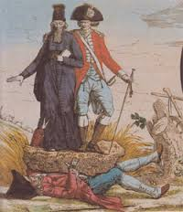
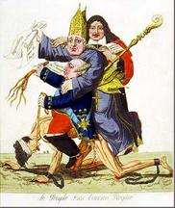

Slide 21
THE THREE ESTATES
1st Estate
2nd Estate
THE “LAW”
3rd Estate

Slide 24
Economic Issues
Wars and extravagant spending had caused serious economic hardship
7 years war
American Revolution
Taxes were high on the 3rd estate
½ government income goes toward paying interest on debt
Jacques Necker (Finance Minister) proposes taxing first two estates.
Fired by Louis XVI under pressure from nobles

Slide 27
A visual representation of the representation of the population of France.

Slide 28
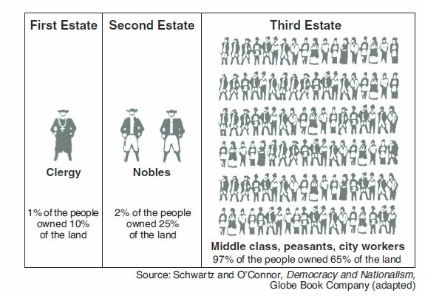
Another visual representation of the representation of the population of France.

Slide 29
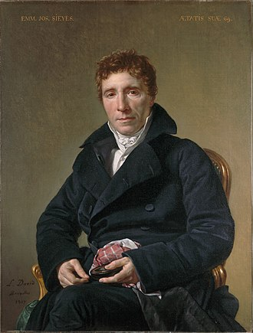
“What is the Third Estate?”
Abbe Sieyes:
(Abby Sigh-ez)
A Roman Catholic Clergyman…of modest family means…
Yet a supporter of Enlightenment thought…
David—1817

