Slide 1
10th World Studies 11.30.15
Turn in:
7:25 AM: Fall Paper—POLISHED FINAL DRAFT!!! ☺
Take out:
Planner
Pen/Pencil
Today’s objective:
I can read and interpret text in order to describe how the Scientific Revolution helped contribute to the Age of Enlightenment.
Today’s Agenda:
Continue Philosophes Station Work…(a portion of time.)
England…
HW:
None

Slide 2
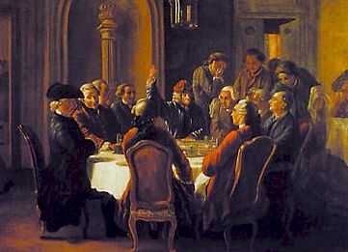
Enlightenment Principles
Religion, tradition, and superstition limited independent thought
Accept knowledge based on observation, logic, and reason, not on faith
Scientific and academic thought should be secular
A meeting of French Enlightenment thinkers
Notes:
The Enlightenment era was characterized by secularism, challenges to authority, and the glorification of reason.
Bullet #1 Many Enlightenment thinkers felt that although the great minds of the medieval and Renaissance eras had achieved much, they also had been overly constrained by religion, tradition, and superstition. To truly achieve independent thought, one had to throw off all limits and rely solely on reason.
Bullet #2 Like the pioneers of the Scientific Revolution, Enlightenment thinkers also strove to make conclusions based on observation, logic, and reason, rather than on faith.
Bullet #3 Enlightenment thinkers revived the spirit of the Renaissance quest for knowledge, choosing to focus on human nature and the workings of society rather than on spiritual matters and religious tenets. This secular approach led to the development of the social sciences.

Slide 3
So where are we…England:
England in the mid-1600s.
Chaos is everywhere. People are unhappy with the shape of their nation.
Disagreements about religion, liberties (freedoms), and properties are all over.
England is trying to figure out how government should be run.
Remember all the issues with the Civil War?
Charles I, Oliver Cromwell, Charles II, etc…

Slide 4
So who are Locke and Hobbes
Both men had a tremendous impact on revolutionary thought in England, America, and France
Both believed in a social contract, or an agreement between individuals and their government about rights in society.
What they disagreed about was what should be written in that contract…and how it should be enforced…

Slide 5
Thomas Hobbes (1588-1679)
Supported monarchies (kings)
Said people are inherently selfish and evil.
He wrote about this political philosophy in his book, Leviathan (Published in 1651)
while in France...(1640)
England on the brink of Civil War (1642)
during and after the Fronde (1643)
Said people chose a ruler and should trust his decision making, or else their natural selfishness would result lawlessness and conflict.

Slide 7
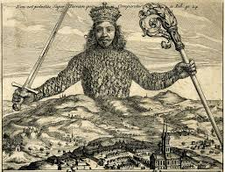
Non Est potestas Super Terram quae Comparetur ei Job 41:24

Slide 8
“A multitude of men, are made one person, when they are by one man, or one person, represented; so that it be done with the consent of every one of that multitude in particular” (Hobbes, Leviathan, I.16.13).

Slide 9
10th World Studies 11.30.15
Turn in:
7:25 AM: Fall Paper—POLISHED FINAL DRAFT!!! ☺
Take out:
Planner
Pen/Pencil
Today’s objective:
I can read and interpret text in order to describe how the Scientific Revolution helped contribute to the Age of Enlightenment.
Today’s Agenda:
Continue Philosophes Station Work…(a portion of time.)
England…
HW:
None

