Slide 1
10th World Studies 11.30.18
Turn in:
CRA “What is the Third Estate?”
Take out:
Planner
Pen/Pencil
Notes
Stamp Sheet
Today’s objective:
I can describe the mood of France leading up to the events of the French Revolution
Today’s Agenda:
The Three Estates
Revolution?
CRA 18.2
HW:
CRA 18.2

Slide 2
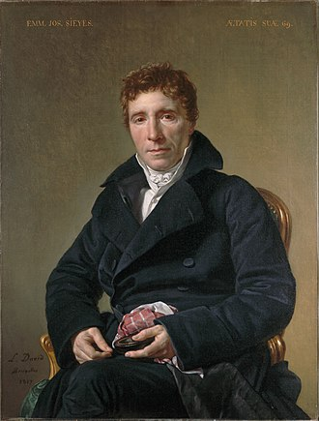
“What is the Third Estate?”
Abbe Sieyes:
(Abby Sigh-ez)
A Roman Catholic Clergyman…of modest family means…
Yet a supporter of Enlightenment thought…
David—1817

Slide 4
Economic Issues
Wars and extravagant spending had caused serious economic hardship
7 years war
American Revolution
Taxes were high on the 3rd estate
½ government income goes toward paying interest on debt
Jacques Necker (Finance Minister) proposes taxing first two estates.
Fired by Louis XVI under pressure from nobles

Slide 7
A visual representation of the representation of the population of France.

Slide 8
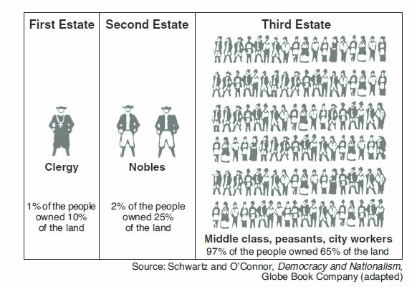
Another visual representation of the representation of the population of France.

Slide 9
Discuss at your Groups
What is the Third Estate?
What has it been until now in the political order?
What does it want to be?
Everything…
Nothing…
Something…

Slide 10
A visual representation of the representation of the population of France.

Slide 11
A visual representation of the representation of the population of France.

Slide 13
June 20, 1789

Slide 14
July 14, 1789
Rumors are surfacing that the royal troops were about to institute martial law and occupy Paris.
Parisians crowd around the Bastille demanding the release of prisoners and demanding weapons and gunpowder
The guards (wounded soldiers & some Swiss guard) let them in…they thought they could buy time for reinforcements
The reinforcements joined the crowd!
7 people freed…
They began tearing apart the building…
Louis XVI asked, “is this a revolt?” The answer, “no sire, it’s a revolution!”

Slide 15
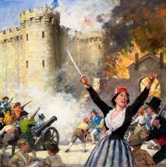
The Storming of the Bastille
The storming and fall of the Bastille represents a direct challenge to the established order of France.
This event is viewed as the beginning of the French Revolution

