Slide 1
9th Honors 12.04.15
Turn in:
Nothing…
Take out :
  Planner
  Pen/Pencil
  Document packet
Today’s Learning Objectives:
  I can understand the physical features of Africa and the role it played in the development of civilizations.
Today’s Agenda:
Mansa Musa
  Document A
  Document B & C
Crash Course(?)
HW:
Update!!! NONE…

Slide 2
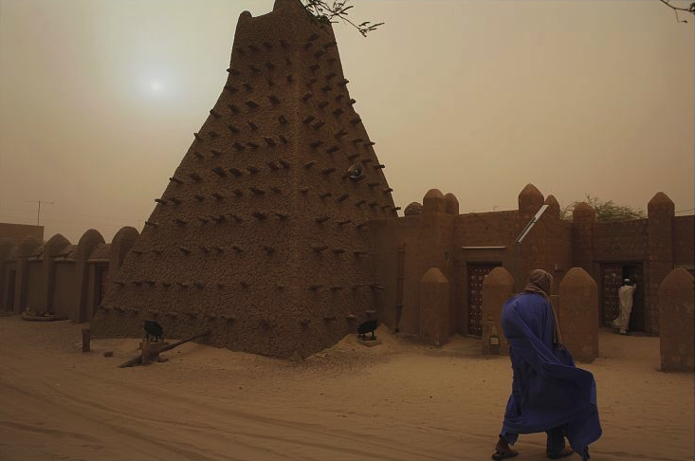
Mansa Musa’s Reign
Sankore Mosque, Timbuktu
Notes:
Image retrieved from http://www.loc.gov/pictures/item/2010648388/

Slide 3
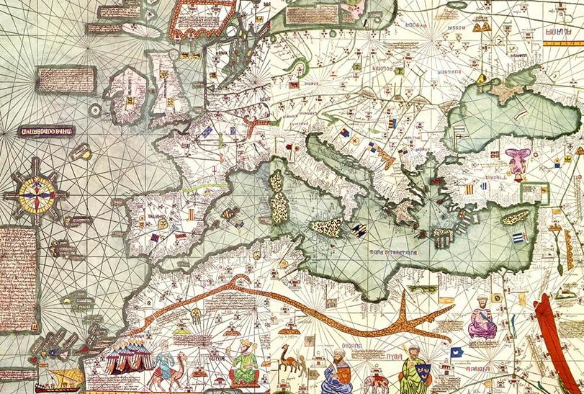
Document B: The Catalan Atlas, 1375
Notes:
Image retrieved from http://en.wikipedia.org/wiki/File:Europe_Mediterranean_Catalan_Atlas.jpeg

Slide 4
The Catalan Atlas
“This Black lord is called Musa Mali, Lord of the Black people of Mali.
So abundant is the gold which is found in his country that he is the
richest and most noble king in all the land.”—Catalan Atlas inscription
Notes:
Image retrieved from http://www.loc.gov/rr/amed/guide/afr-encounters.html

Slide 5
Document B
What kind of document is this? Who created it? When?
How does the Catalan Atlas compare to The Huffington Post blog post in terms of its depiction of Mansa Musa?
Do you think this is an accurate depiction of Mansa Musa? Why or why not?

Slide 6
Document C
How reliable is this account of Mansa Musa from a historical perspective? Who was Al-Umari?
How does this compare to the blog’s account?
In his retelling, what historical value can we place on his account?

Slide 7
Crash Course: https://www.youtube.com/watch?v=jvnU0v6hcUo
According to the video, what are the differences between the development of Western and Eastern Africa?
  Again, what does this tell us about African culture and civilizations?
How does this compare to Jared Diamond’s theory?
  Are there inherent differences between races and how does this impact the development of civilization?
MAKE SURE YOU CHECK OUT MY WEBSITE FOR “LOGOUT” QUESTION…

