Slide 1
10th Euro Studies 2.04.16
Turn in:
Nothing…
Take out:
Planner
Pen/Pencil
Internet device
Today’s objective:
I can describe how the happenings of Europe begin to impact the impending War.
Today’s Agenda:
Militarism
HW:
Militarism Research Assignment

Slide 2
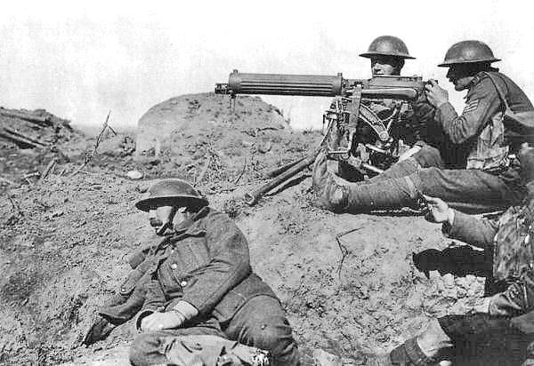
CAUSES OF “THE GREAT WAR”
M—militarism: Militarism research—Germany, France, & England (GB, UK)
A—alliances: Alliance research & graphic
N—nationalism: French Rev., German Unification (Italy too…)
I—imperialism: Scramble for Africa, Industrial Revolution
A—assassination—IT’S COMING LATER THIS WEEK!
(C)—Competition—IT’S ALWAYS PRESENT…

Slide 3
M. Militarism
The tendency to regard military efficiency as the supreme ideal of the state and to subordinate all other interests to those of the military.
Glorification of military power.
Total Defense Expenditures for the Great Powers in millions of £s.
1870 | 1880 | 1890 | 1900 | 1910 | 1914
94 | 130 | 154 | 268 | 289 | 398
 | 1910-1914 Increase in Defense Expenditures
France | 10%
Britain | 13%
Russia | 39%
Germany | 73%
ARMIES = Germany v. Russia, France
1880 1914
Germany 1.3m 5.0m
France 730,000 4.0m
Russia 400,000 1.2m

Slide 4
Naval Supremacy
Alfred Thayer Mahan – The Influence of Sea Power upon History (1887)
Control of the seas = Great Success
Emphasis placed on LARGEST & most POWERFUL navy
Germany Fleet Act (1898)
1900 – 19th Navy
1910– 2nd Navy
Great Britain
Theory of Naval Superiority – Always have a 2.5x larger navy
→ NAVAL ARMS RACE: (Competition)
NAVY = Germany v. Great Britain

Slide 5
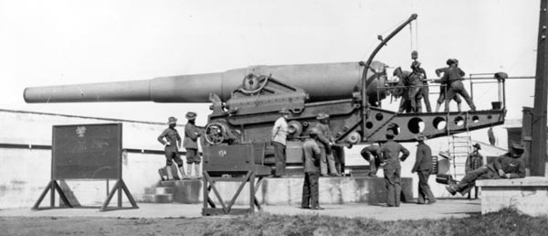
“Dreadnought” Race
Jackie Fisher (G.B.)—HMS Dreadnought (All big gun warship) [1906-1923]
Admiral that reforms the navy as we know it…
Alfred Tirpitz (Germany)—Risikoflotte “risk fleet”

Slide 6
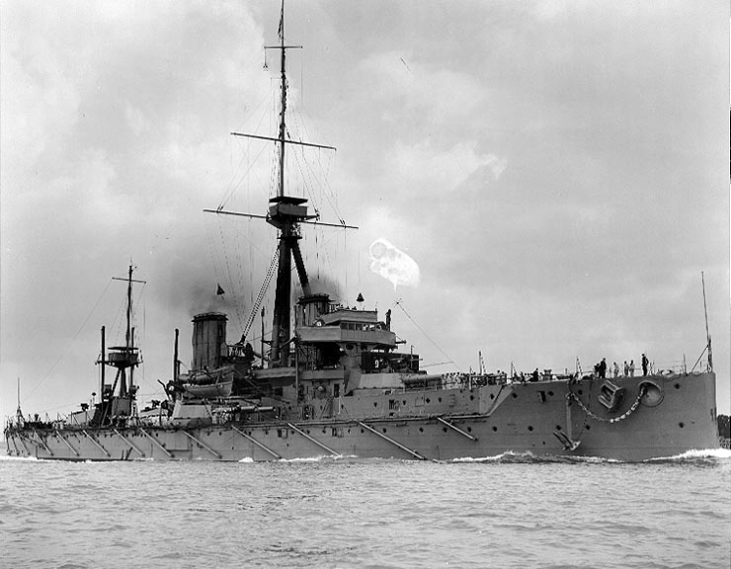

Slide 7
Naval Strength, August 1914
 | Germany | Britain
Dreadnoughts | 13 | 20
Battle Cruisers | 5 | 8
Cruisers | 41 | 102
Destroyers | 144 | 301
Submarines | 30 | 78

Slide 8
WWI: Basic Facts
During the Summer/Fall of 1914 France loses as many soldiers as the US lost in the entire 19th C
70,000,000 soldiers → 35,000,000 DEAD
11% of France’s TOTAL population injured or killed
4 ¼ years – 230 soldiers/hour
16 Countries involved
Fighting touches Africa, Asia, Europe, Americas
But WHY?

