Slide 1
10th Euro Studies 2.10.15
Turn in:
Outline Thesis form…
Take out :
Previous notes
Note-taking devices
Today’s Learning Objectives:
I can explain how technology and trench warfare impacted combatants as The Great European War began.
Today’s Agenda:
The US enters the war
Wilson…
The End of the War
The Spring Offensive
The Collapse
HW:
Outline notes of 26.4
835—?’s 1-2
837—?’s 1-3
838—?’s 1-2 “Analyzing Political Cartoons”
Exam Review online—it’s for you…

Slide 2
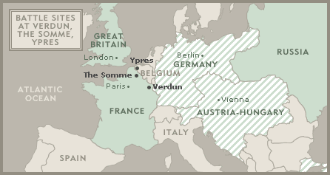
Stalemate: Neither side can gain an advantage The race to the sea…trench warfare…this is the hallmark of the western front.

Slide 3
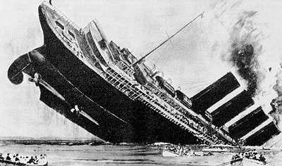
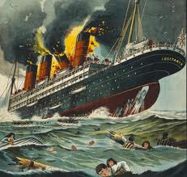
USA has remained “neutral”
Lusitania sank by German submarines (1915)
1,153 dead (128 Americans)
Germans stop “unrestricted” submarine warfare
WHY?

Slide 4
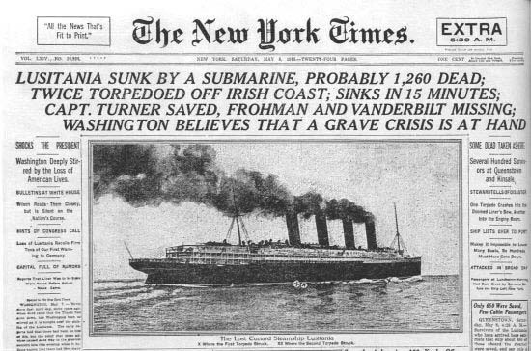

Slide 5
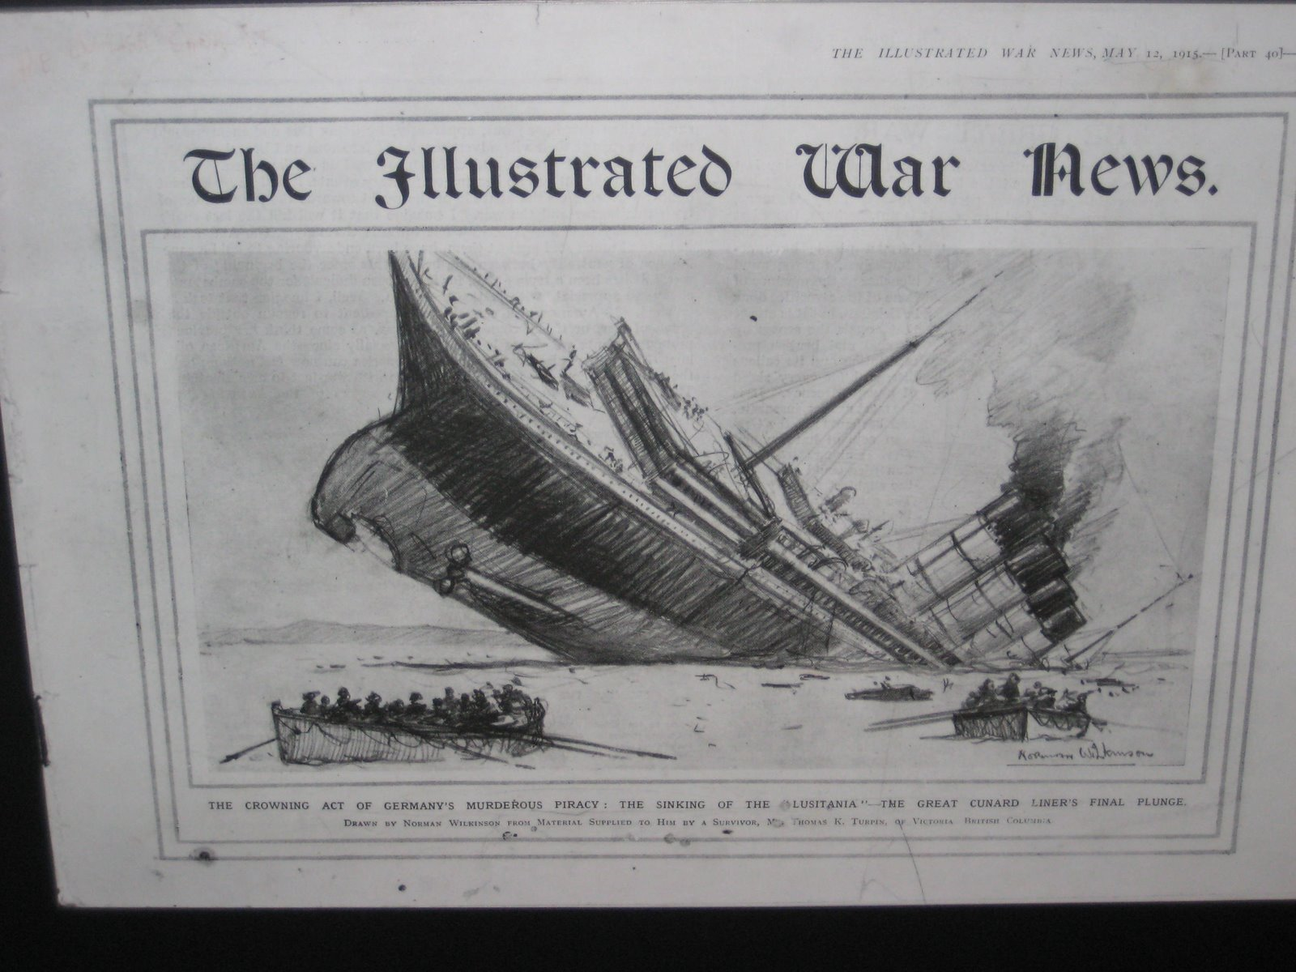

Slide 6
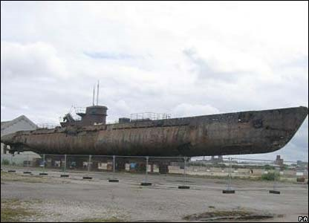
U-20: sinks the Lusitania 5/7/1915—128 US citizens killed.

Slide 7
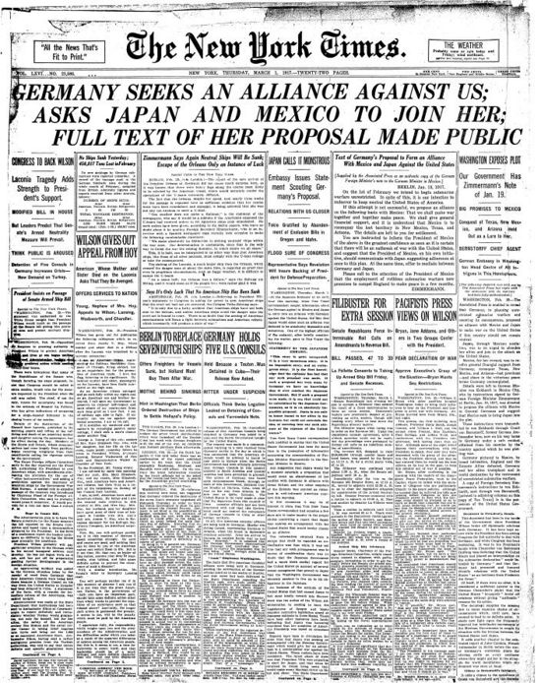
1/31/1917 → Germany declares unrestricted submarine warfare on ships
How will US respond?
Wilson had just been re-elected on the slogan, “He kept us out of the War!”
2/1917 → Zimmerman Note

Slide 8
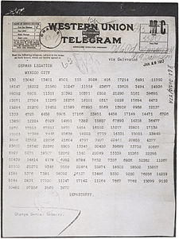

Slide 9
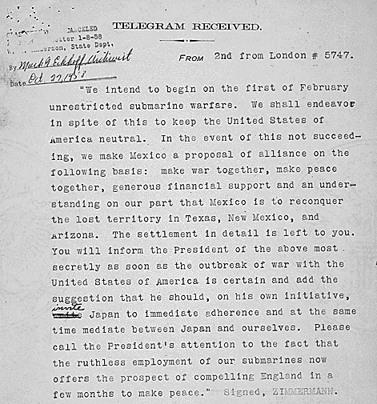

Slide 10
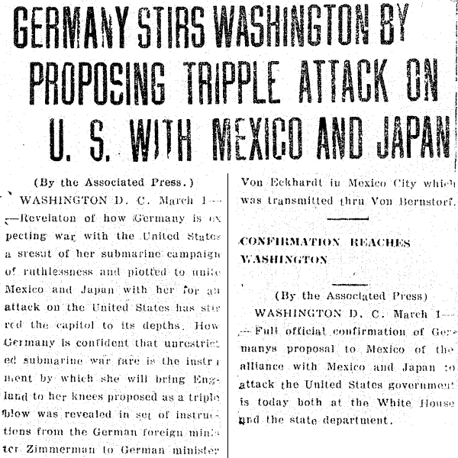

Slide 11
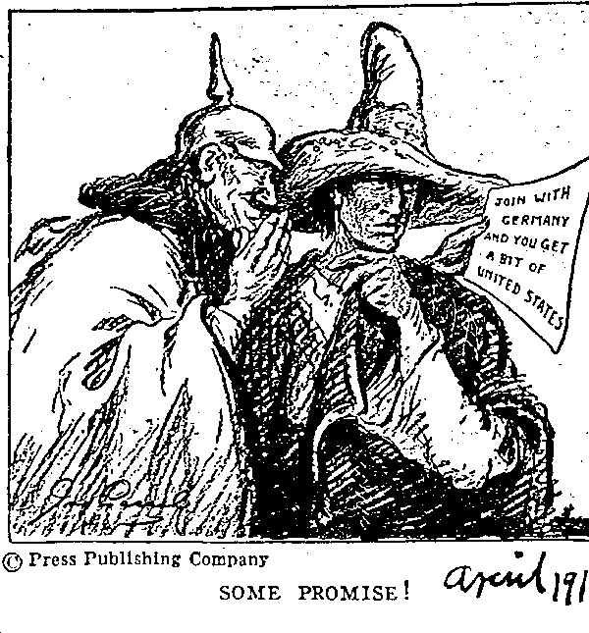

Slide 13
What else is going on??? Russian Revolution
March 1917-Russia left WWI due to a Revolution in their own country
Germany now would concentrate totally on the Western Front
Pleas from Great Britain and France to the US to join the war effort
The US had supported the Allies from the beginning through economic means.
The US had a vested interest in the outcome of the war.
What will happen if the US puts their support behind the Allied effort?

Slide 14
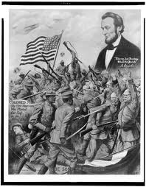
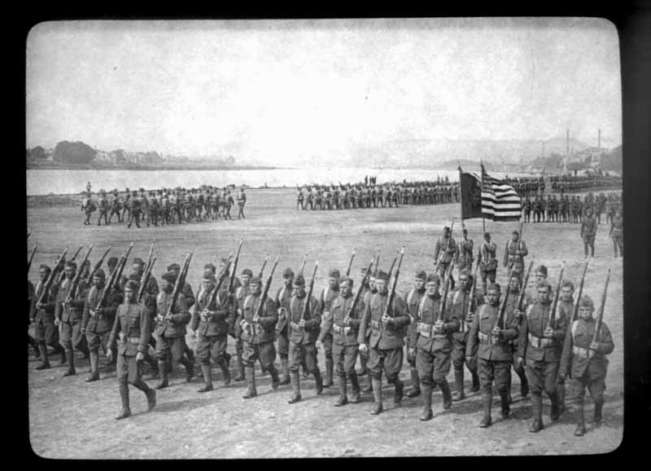
April 6, 1917 – us enters war
4/6/1917 → US enters the war w/ the Allies
Enter European warfare in May, 1918
4,272,500 Americans deployed

Slide 15
April 6, 1917 – us enters war
4/6/1917 → US enters the war w/ the Allies
Enter European warfare in May, 1918
4,272,500 Americans deployed
“The world must be made safe for democracy. We must fight for the rights and liberties of small nations.”

Slide 16
Wilson’s 14 Points- His Dream for the world
1. No more secret agreements ("Open covenants openly arrived at").
2. Free navigation of all seas.
3. An end to all economic barriers between countries.
4. Countries to reduce weapon numbers.
5. All decisions regarding the colonies should be impartial
6. The German Army is to be removed from Russia. Russia should be left to develop her own political set-up.
7. Belgium should be independent like before the war.
8. France should be fully liberated and allowed to recover Alsace-Lorraine
9. All Italians are to be allowed to live in Italy. Italy's borders are to "along clearly recognisable lines of nationality."
10. Self-determination should be allowed for all those living in Austria-Hungary.
11. Self-determination and guarantees of independence should be allowed for the Balkan states.
12. The Turkish people should be governed by the Turkish government. Non-Turks in the old Turkish Empire should govern themselves.
13. An independent Poland should be created which should have access to the sea.
14. A League of Nations should be set up to guarantee the political and territorial independence of all states.

Slide 17
COLLAPSE: A SUDDEN, COMPLETE FAILURE; BREAKDOWN
WHY DID WWI END IN A “COLLAPSE” FOR GERMANY?
Military, Political, Social, Economic Reasons

Slide 18
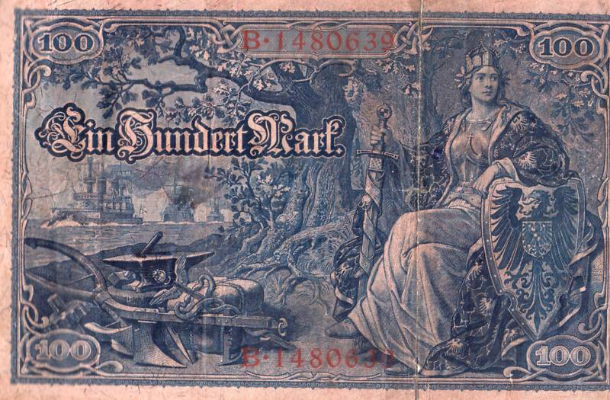
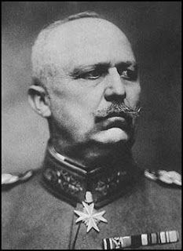
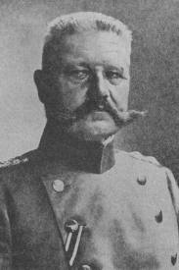
Problems for Germany in wwi
Military – War lasted longer than expected
Requires much greater commitment of resources and men
Unrestricted sub warfare fails
US entry to war forces “German Spring Offensive”
Political – Generals take power from Kaiser
War Economy in shambles – Paper money printed and bonds sold = inflation and debt after the war
Social/Economic – British blockade Northern German ports
Hyper-inflation—consumer goods ~140% increase
Massive $ printing
Blockade remained 6 months after Paris Peace Treaty = Starvation
Example of post-War treatment of Germany
Flu epidemic of 1918 + Starvation = 750,000 dead
Forced to take full blame for, and pay for, WWI
Continued after the war…1923 & a wheelbarrow full of $
Notes:
In 1923, at the most fevered moment of the German hyperinflation, the exchange rate between the dollar and the Mark was one trillion Marks to one dollar, and a wheelbarrow full of money would not even buy a newspaper.
Wartime, 4-5 marks = 1 US Dollar
By the end of the war in 1918, consumer prices had risen 140%, and the amount of issued German currency had inflated massively, going from 3 billion to 55 billion Reich marks.

Slide 19
26.4 outline (page 834)
Read and Outline Section 26.4
835—?’s 1-2
837—?’s 1-3
838—?’s 1-2 “Analyzing Political Cartoons”

