Slide 1
10th Euro Studies 2.10.16
Turn in:
Nothing…
Take out :
Previous notes
Note-taking devices
Today’s Learning Objectives:
I can explain how technology impacted combatants as The Great European War began.
Today’s Agenda:
Technology
26.2 (?)
HW:
Notes on 26.2

Slide 2
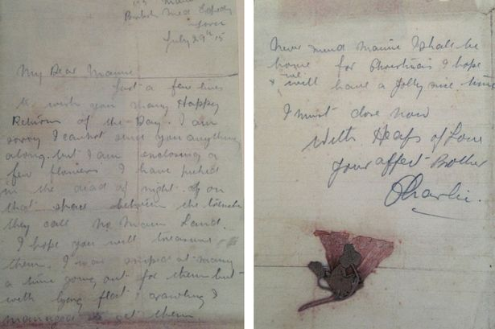
The Great War!
War was romantic. War was colorful flags, spiked helmets and flashing sabers. War was an adventure. Those called to arms would be heroes, defending their homelands and way of life.
Never mind Mamie I shall be home for Christmas I hope we will have a jolly nice time.
I must close now
With heaps of love
Your affectionate brother
Charlie”

Slide 3
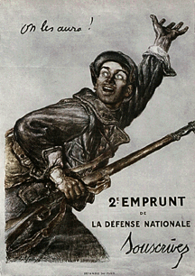
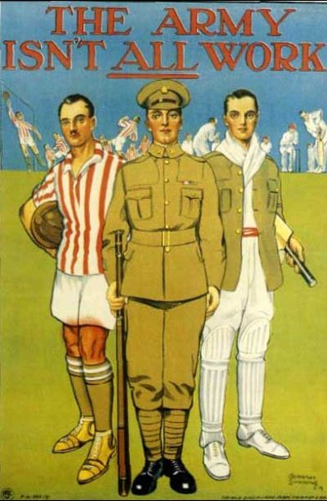
The Great War!
French 1914— “We will have them!”
British—1914 (Sport?!?!): A Christmas Story 1914

Slide 4
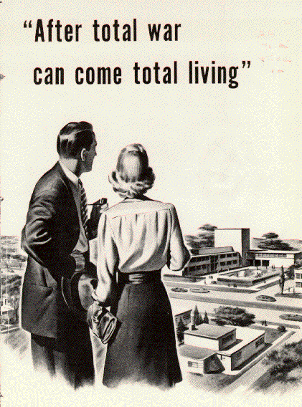
WWI: A Total War
Total War: When a country puts all of its resources towards supporting a war effort
War fought by citizens drafted into army
Women enter factories and fields
Gov’t control of economies
“We have no idea what war will be like. There are flags on all the houses in town, just as if we were having a festival.” –Excerpt from the diary of Piete Kuhr, a 12-year old girl from East Prussian Province of Posen

Slide 5
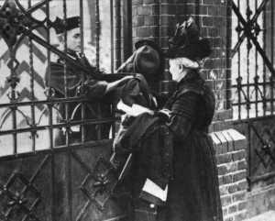
Central Powers Recruits
A German Soldier Says Farewell to His Mother
Austro-Hungarians

Slide 6
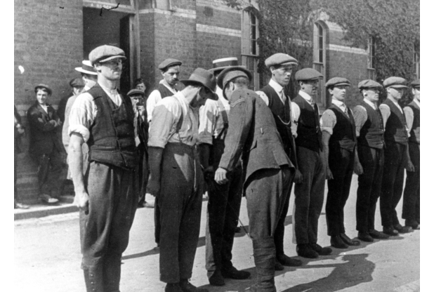
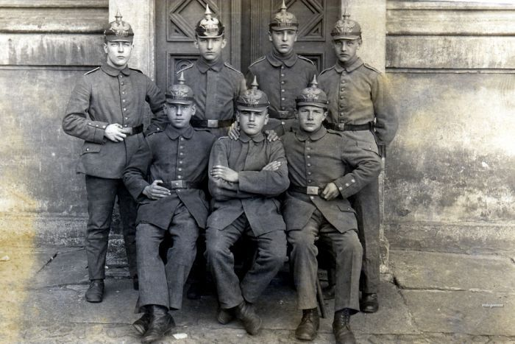
German “Recruits”

Slide 7
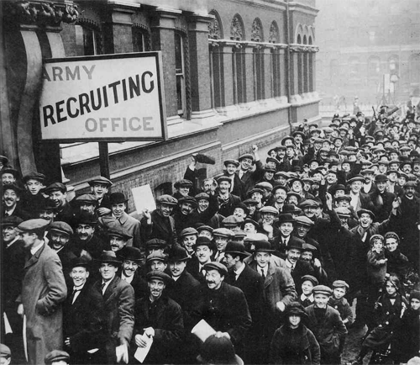
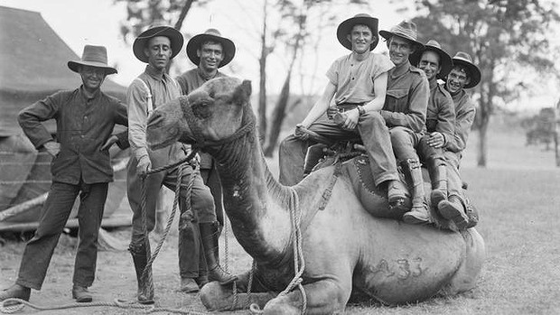
The British Empire Gathers to Join the Army

Slide 8
New French Recruits

Slide 10
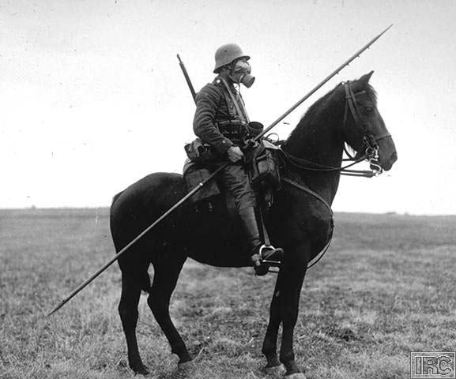
TECHNOLOGY OF WORLD WAR 1

Slide 11
Technology of World War One
In no other war has technology played such a critical role in impacting how the war would be fought.
The First World War began as a clash of 20th century technology and 19th century tactics, with inevitably large casualties.
Attaque à outrance
Think of these weapons/technologies as solutions to problems

Slide 12
Technology of World War One
Machine Guns
Artillery
Grenades
Communications
Transportation
Tanks & Armor
Aircraft
Chemical Warfare
U-Boats
Convoy system
Barbed Wire
All of these technologies had an impact on the strategy and tactics of the war.
Some were used in a new way, others were used in response to other technologies or new tactics and strategies.

Slide 13
TRENCH WARFARE
Description/Use: Trenches, often reinforced with wood, with larger underground bunkers dug in side for more protection
Series of progressively more improved trenches with interconnecting trenches
Strategy employed because of stalemate, machine guns & artillery
Impact: Many weapons and tactics were created to overcome the defensive nature of trenches
Evolution: Concrete bunkers, pillboxes and gun emplacements – obsolete by WW2

Slide 14
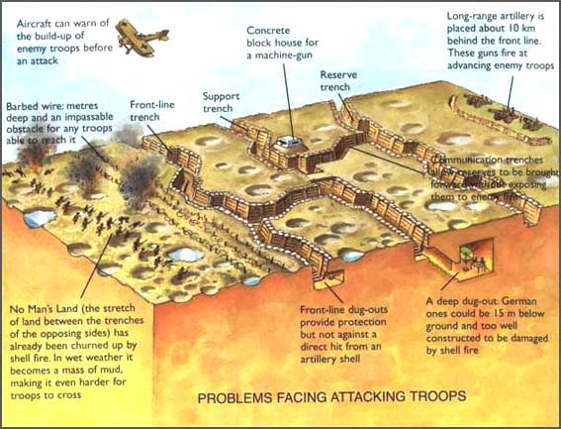

Slide 15
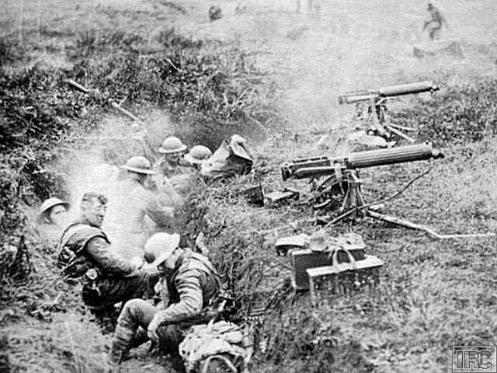
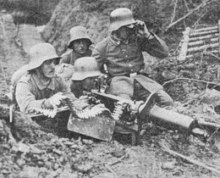
MACHINE GUN

Slide 16
MACHINE GUN
Description: Rapid fire weapon (400-800 rounds/minute) typically crewed by several men Belt-fed, .30 cal (typical)
Use: Anti-personnel, used against massed infantry
Impact: Possibly the most influential weapon of the war Contributed to stalemate and affected tactics No longer would massed infantry be the most effective
Evolution: Would be mounted on airplanes and armored vehicles Became smaller, less crew (squad-level weapon) Submachine guns at end of war

Slide 17
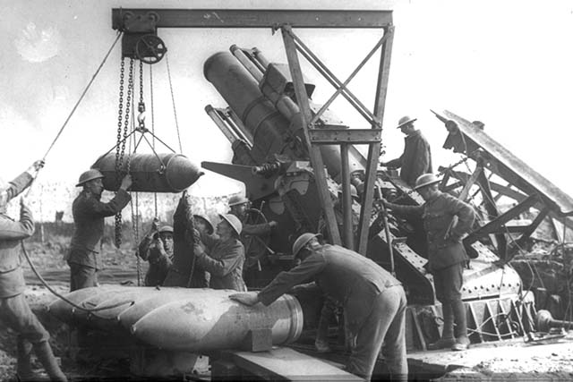
ARTILLERY

Slide 18
ARTILLERY
Description/Use: Large caliber weapon capable of direct (gun) or indirect (howitzer) fire - 37 mm – 42 cm
Impact: artillery barrage to soften up targets
Huge guns to destroy fortresses in Belgium – railway guns
Extreme long range attacks (Paris gun) terrified Parisians 126 km (68 mi) range (300 attacks)
Evolution: improved accuracy, range,
better shells and fuses, improved explosives
Faster reload, more portable
Self-propelled artillery

Slide 19
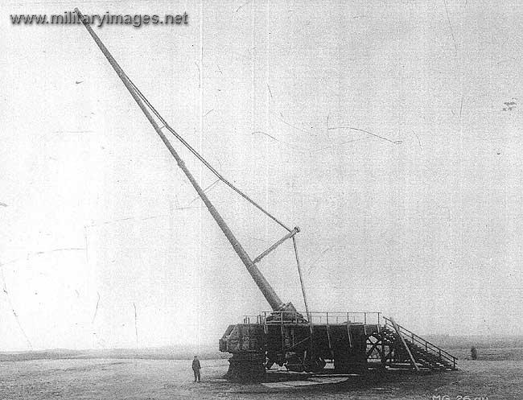
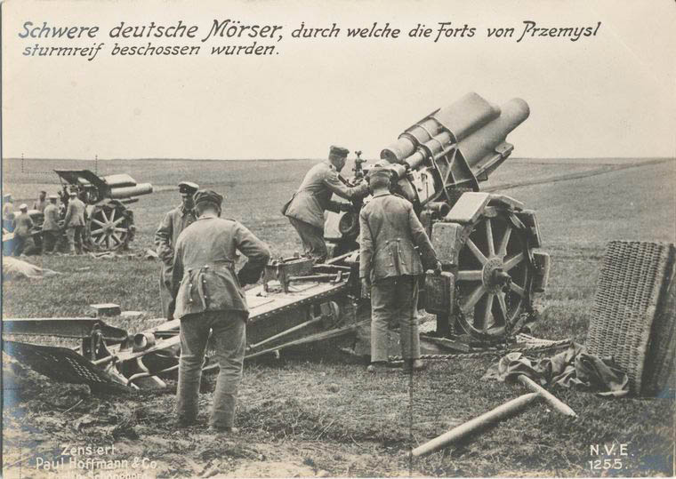
Artillery
Paris Gun
Typical German Artillery piece

Slide 20
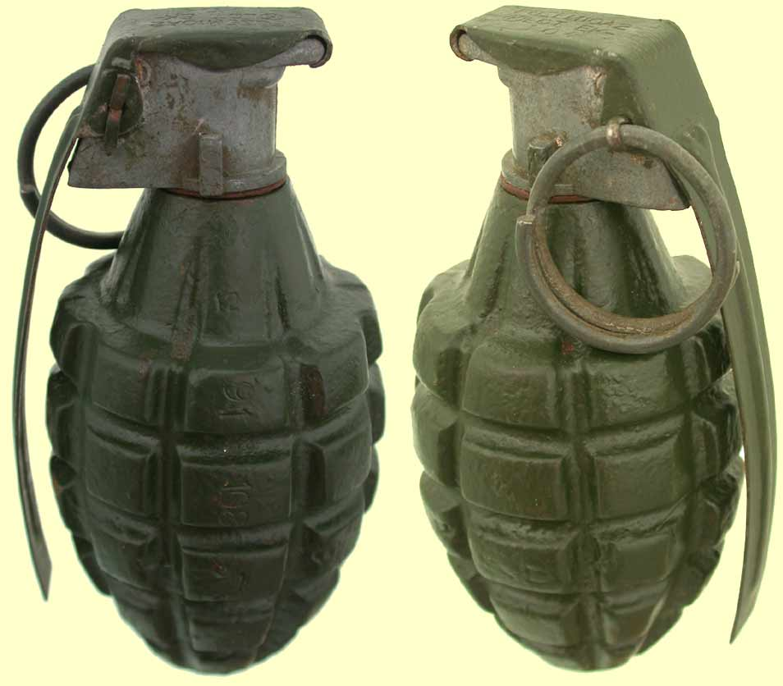
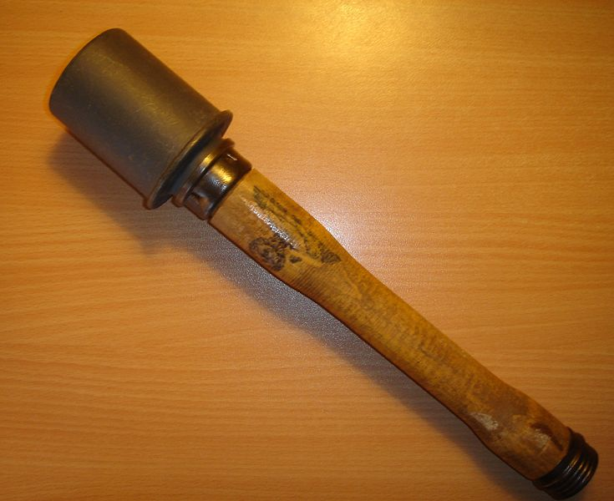
Grenades

Slide 21
GRENADES
Description/Use: small, explosive device thrown or projected to cause burst and shrapnel damage to enemy
Percussion (contact) or timed fuse
Old weapon found new use in trench warfare – often referred to as “bombs”
Impact: well-suited for trench warfare (indirect throw) – response to trench warfare
Becomes core of new trench assault strategy
sturmtruppen – trench raiders - bombers
Evolution: better fuses, charges, use of gas improved methods to propel (RPG)

Slide 22
AIRCRAFT
Description/Use: 100 mph, monoplane, biplane and tri-plane configurations. Constructed of canvas stretched over wooden frame
Single pilot fighter to several men in a bomber
Typically armed with machine guns
Initially used for observation, later fighters and bombers
Impact:
Anti-Aircraft and aerial pursuit squadrons
Most aerial combat techniques used today are derived from WW1 dog fighting.
Fixed wing aircraft most influential, though observation balloons and zeppelins played a role as well
Evolution:
Unarmed observation craft, Then purpose-built fighters, followed later by bombers - U.S. would pioneer large-scale bombing missions late in war
Fighter Aces – five kills
New tactics for air support and ground attack - strafing

Slide 23
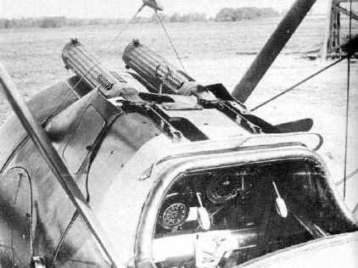
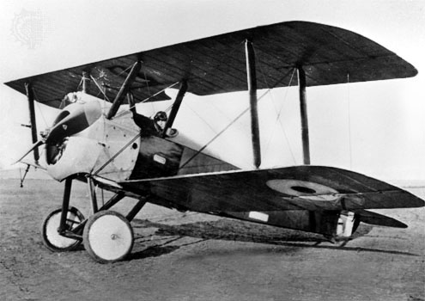
Sopwith Camel

Slide 24
Fokker Dr1 Triplane Red Baron’s Plane

Slide 25
Bombers and Zeppelins (Luftschiff)

Slide 26
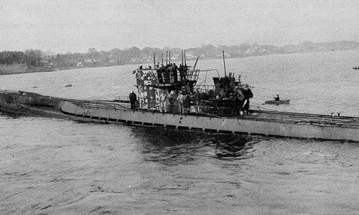
SUBMARINES

Slide 27
SUBMARINES
Description: At outset Germans had two sub types: coastal sub: (7 kts, 2 torpedoes and a crew of 14 patrol (overseas): 14 kts, 4 torpedoes, crew – 28
Use: attack allied shipping, primarily through use of deck guns NOT torpedoes
Impact: Very effective against shipping, but sinking of ocean liners was negative in public opinion Use of convoy system, depth charges and hydrophones were a response
Evolution: Submarines would get larger and faster with expanded undersea capability
Improved torpedoes

Slide 28
CONVOY SYSTEM
Description/Use:
Using armed ships such as destroyers and armed merchant vessels to protect unarmed transport ships from submarines
A TACTIC not a technology
Impact:
Fairly effective once employed (late 1917).
Declined from 242/mo to 147/mo; 1918 – 103/mo
Evolution:
Q-ships – Germany forced to use surface ships

Slide 29
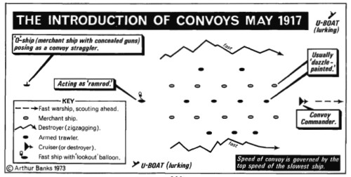
CONVOY SYSTEM

Slide 30
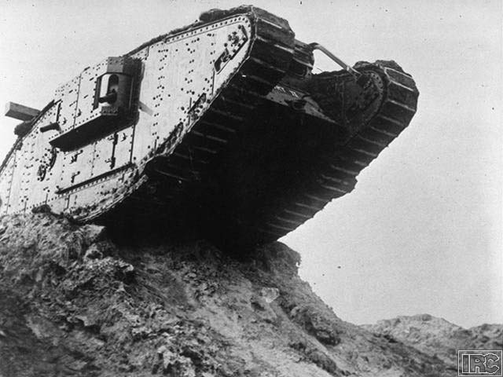
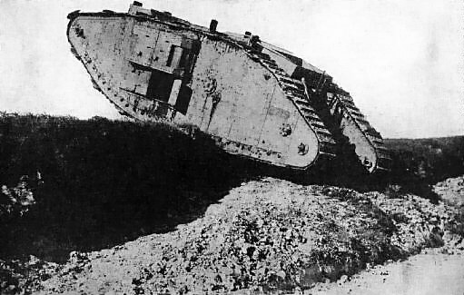
TANKS & ARMOR

Slide 31
TANKS & ARMOR
Description/Use: tracked, armored vehicle armed with machine guns and/or cannons.
Used to assault trenches, destroy barbed wire obstacles, machine gun nests
2 (6.5t) crew to 16 (32t) crews; 3-8 mph
Impact: somewhat effective depending on use; infantry support, combined arms
Debate about use breakthrough vs. support
Mechanical breakdowns, lack of speed
Evolution: the modern tank with turrets mobility was also emphasized

Slide 32
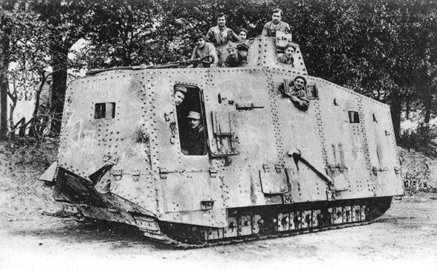
German Tank

Slide 33
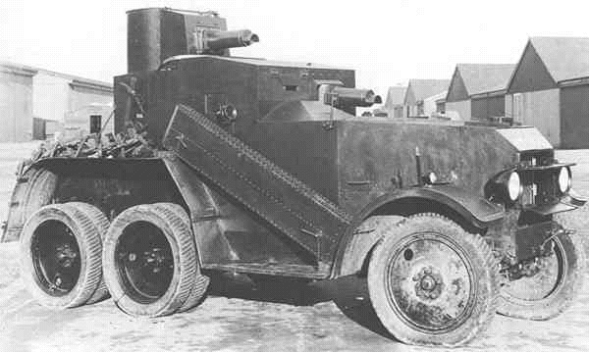
Armored Car

Slide 34
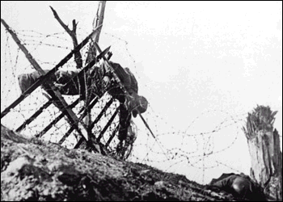
BARBED WIRE

Slide 35
Barbed Wire
Description/Use: sharp twisted strands of wire – not designed to kill
Often used in conjunction with machine guns and trenches
Create barriers while preserving field of fire
Control avenues of approach
Impact: critical to trench defense
Evolution: improved methods of emplacement
Entanglements instead of just fences
Coiled barb wire used late 20th century

Slide 36
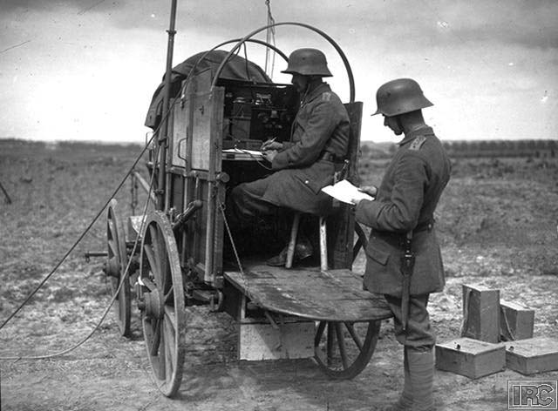
COMMUNICATIONS

Slide 37
Communications
Description/Use: New methods include telephones and wireless (radio)
Impact: Would allow for swift communications for better control by command elements
Key for Command and Control
Used for Artillery Spotting
Need for codes and ciphers (Russians sent radio signals “in the clear” – allowed for Germans to know their plans)
“Runners”, carrier pigeons still used throughout war
Evolution: more portable equipment, more range
but telephone was most reliable
Not until 1980s will new methods be used

Slide 38
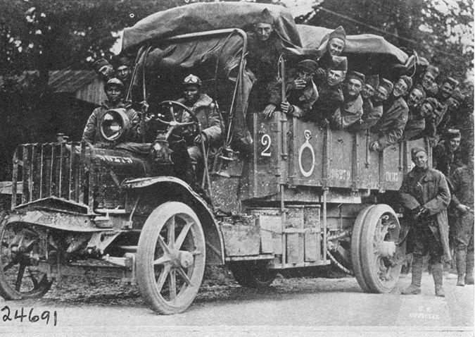
TRANSPORTATION

Slide 39
Transportation
Description/Use : Use of motorized vehicles and railroads to transport supplies and men.
Impact: Railroads were a critical element for mobilization and transport of ultra-heavy artillery
Evolution: As war progressed more trucking used.

Slide 40
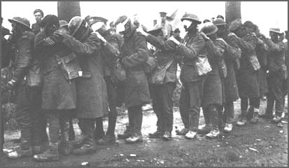
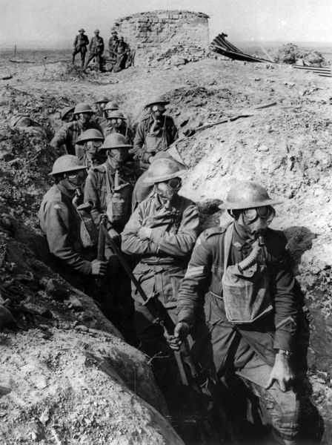
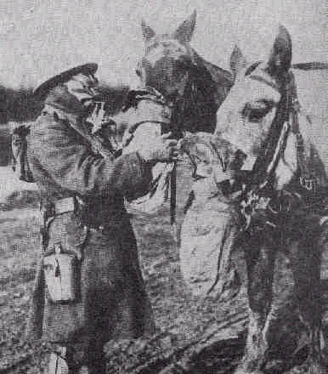
CHEMICAL WARFARE

Slide 41
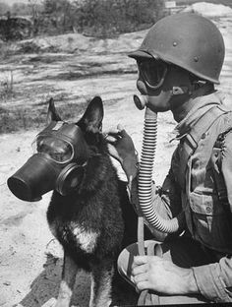
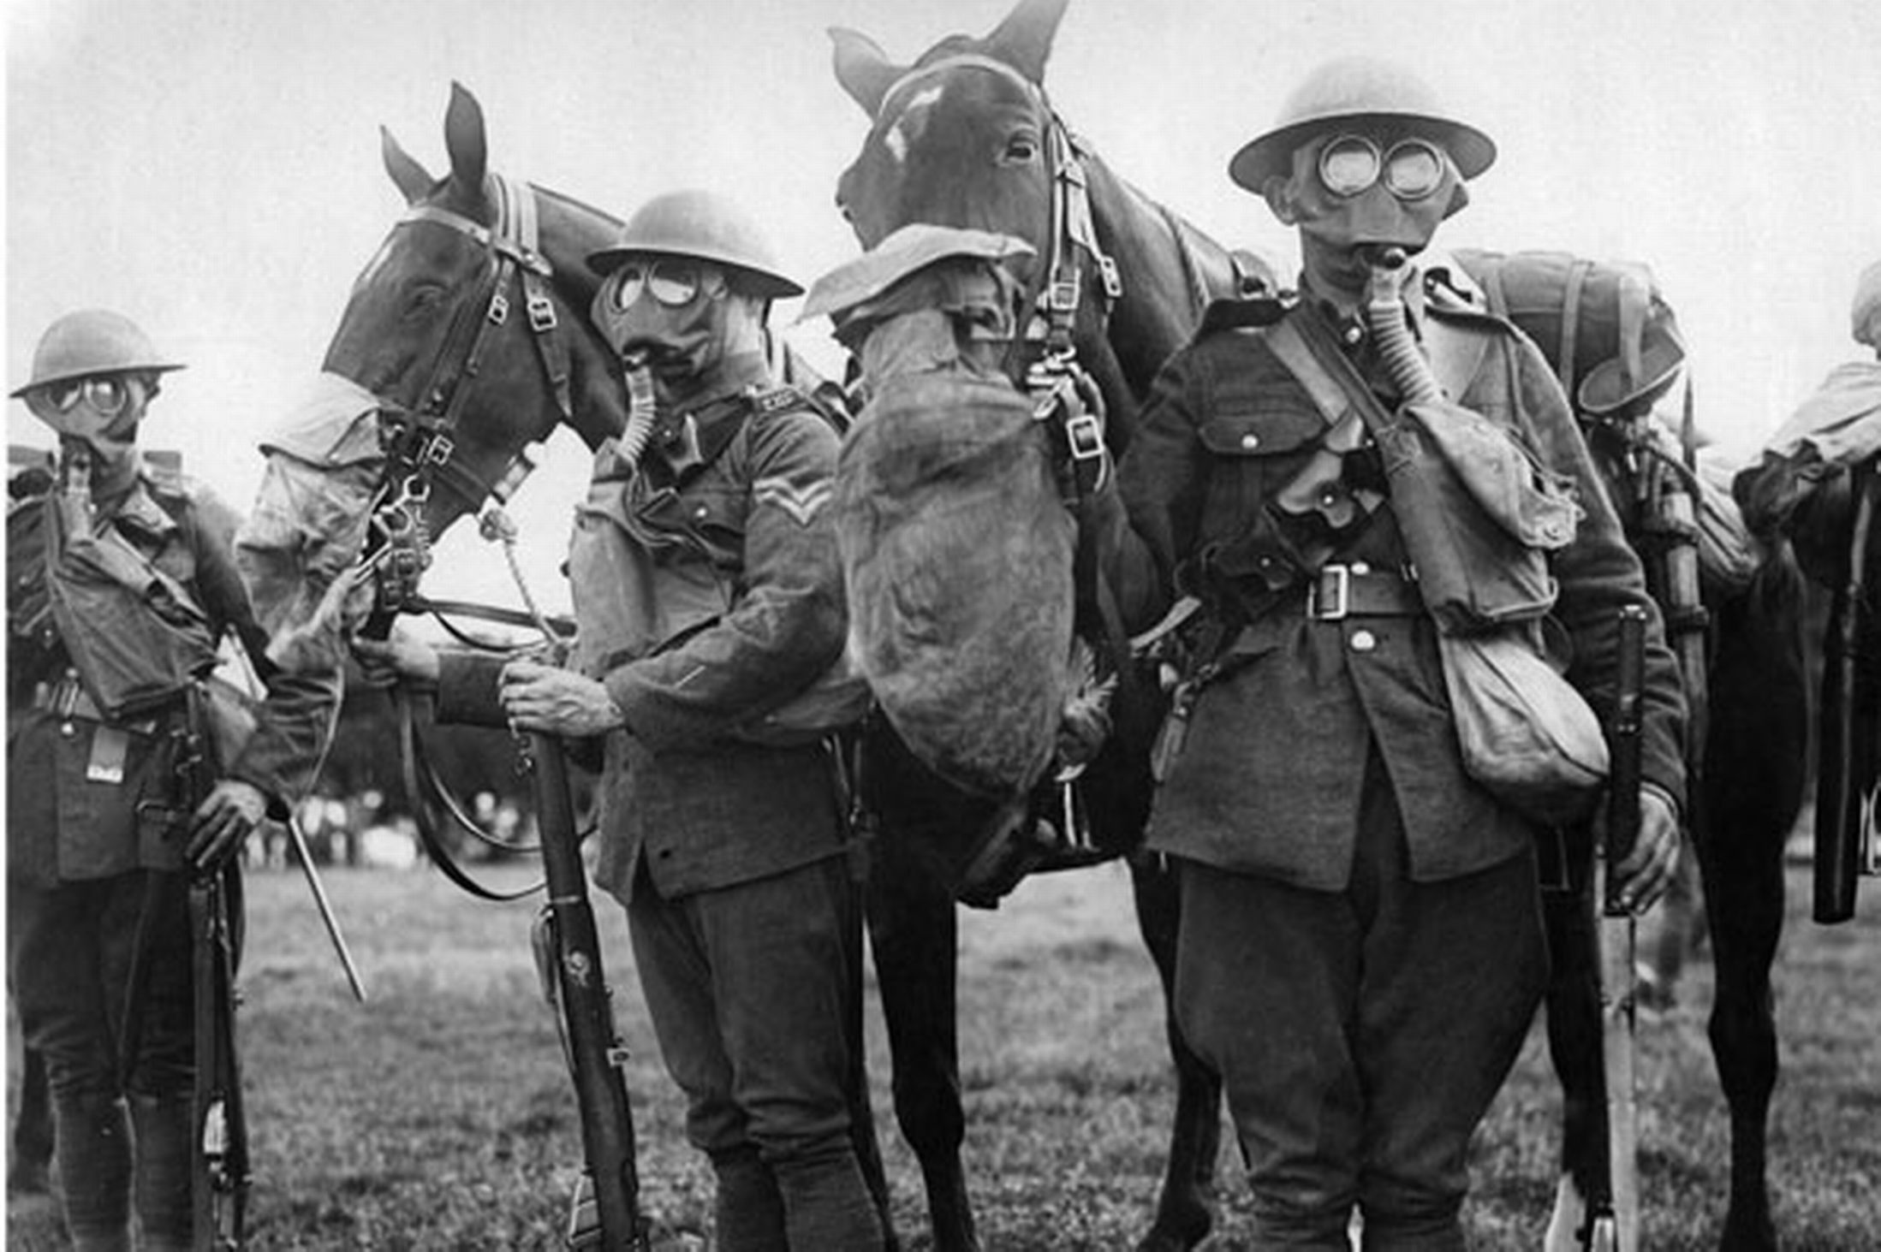
CHEMICAL WARFARE

Slide 42
Chemical Warfare
Description/Use: Chemical gas used to incapacitate or kill enemy. An attempt to find a breakthrough weapon to end stalemate
“tear gas” introduced in 1914
Mustard, chlorine, introduced in 1915
Horrible wounds and death
Initially just “sprayed”
Hard to control
Impact: Troops had to wear masks making fighting difficult
Masks often ineffective
Surprisingly, not a great deal of death
Evolution: Better means of dispersal
artillery shells and bombs
Although outlawed, chemical weapons still made throughout cold war

Slide 43
Video…
http://www.history.com/topics/world-war-i/world-war-i-history/videos/tech-developments-of-world-war-i

