Slide 1
10th Euro Studies 2.11.16
Turn in:
Nothing…
Take out :
Previous notes
Note-taking devices
Today’s Learning Objectives:
I can explain how technology impacted combatants as The Great European War began.
Today’s Agenda:
Technology
26.2
HW:
Notes on 26.2

Slide 2
AIRCRAFT
Description/Use: 100 mph, monoplane, biplane and tri-plane configurations. Constructed of canvas stretched over wooden frame
Single pilot fighter to several men in a bomber
Typically armed with machine guns
Initially used for observation, later fighters and bombers
Impact:
Anti-Aircraft and aerial pursuit squadrons
Most aerial combat techniques used today are derived from WW1 dog fighting.
Fixed wing aircraft most influential, though observation balloons and zeppelins played a role as well
Evolution:
Unarmed observation craft, Then purpose-built fighters, followed later by bombers - U.S. would pioneer large-scale bombing missions late in war
Fighter Aces – five kills
New tactics for air support and ground attack - strafing

Slide 3
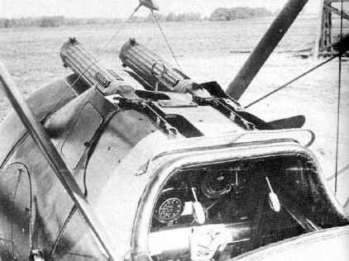
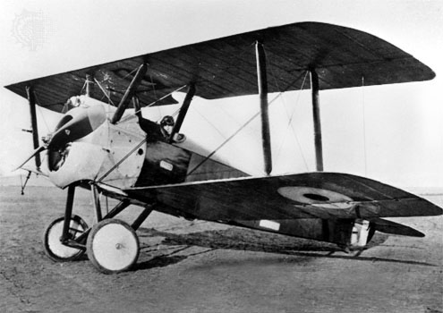
Sopwith Camel

Slide 4
Fokker Dr1 Triplane Red Baron’s Plane

Slide 5
Bombers and Zeppelins (Luftschiff)

Slide 6
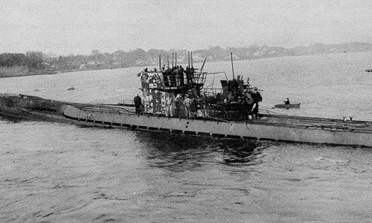
SUBMARINES

Slide 7
SUBMARINES
Description: At outset Germans had two sub types: coastal sub: (7 kts, 2 torpedoes and a crew of 14 patrol (overseas): 14 kts, 4 torpedoes, crew – 28
Use: attack allied shipping, primarily through use of deck guns NOT torpedoes
Impact: Very effective against shipping, but sinking of ocean liners was negative in public opinion Use of convoy system, depth charges and hydrophones were a response
Evolution: Submarines would get larger and faster with expanded undersea capability
Improved torpedoes

Slide 8
CONVOY SYSTEM
Description/Use:
Using armed ships such as destroyers and armed merchant vessels to protect unarmed transport ships from submarines
A TACTIC not a technology
Impact:
Fairly effective once employed (late 1917).
Declined from 242/mo to 147/mo; 1918 – 103/mo
Evolution:
Q-ships – Germany forced to use surface ships

Slide 9
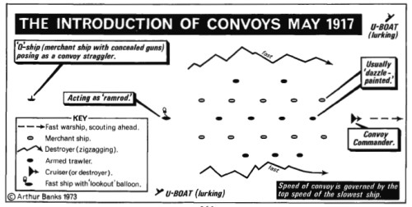
CONVOY SYSTEM

Slide 10
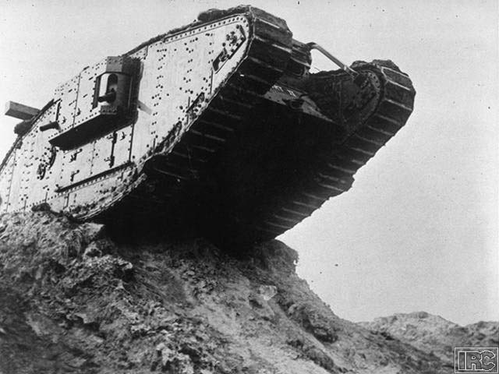
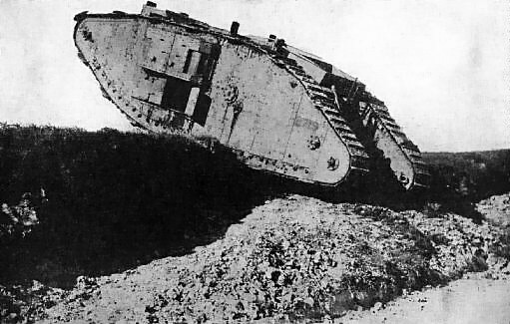
TANKS & ARMOR

Slide 11
TANKS & ARMOR
Description/Use: tracked, armored vehicle armed with machine guns and/or cannons.
Used to assault trenches, destroy barbed wire obstacles, machine gun nests
2 (6.5t) crew to 16 (32t) crews; 3-8 mph
Impact: somewhat effective depending on use; infantry support, combined arms
Debate about use breakthrough vs. support
Mechanical breakdowns, lack of speed
Evolution: the modern tank with turrets mobility was also emphasized

Slide 12
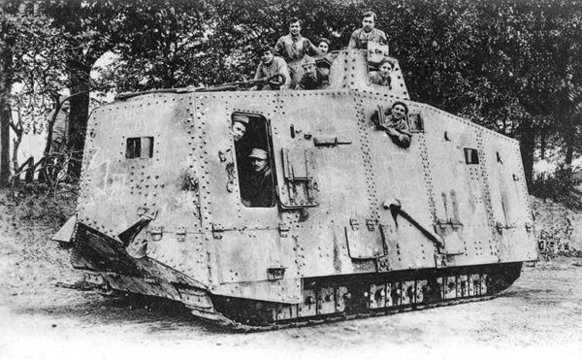
German Tank

Slide 13
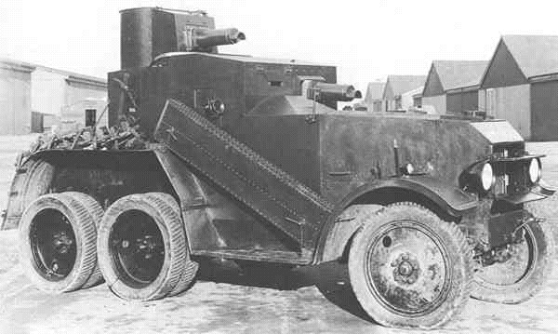
Armored Car

Slide 14
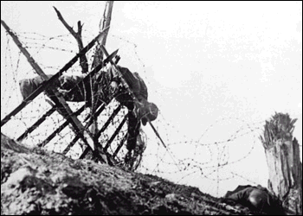
BARBED WIRE

Slide 15
Barbed Wire
Description/Use: sharp twisted strands of wire – not designed to kill
Often used in conjunction with machine guns and trenches
Create barriers while preserving field of fire
Control avenues of approach
Impact: critical to trench defense
Evolution: improved methods of emplacement
Entanglements instead of just fences
Coiled barb wire used late 20th century

Slide 16
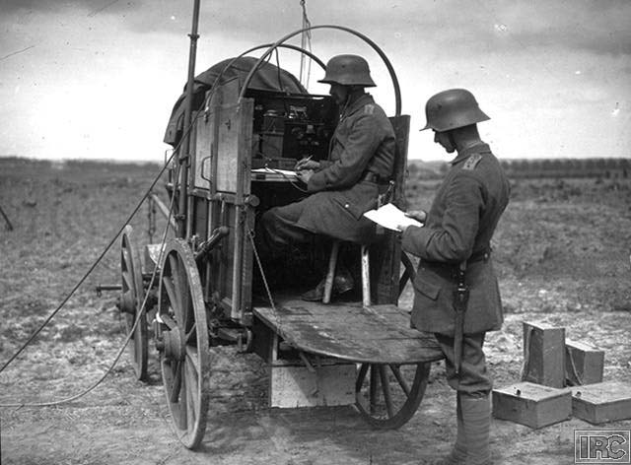
COMMUNICATIONS

Slide 17
Communications
Description/Use: New methods include telephones and wireless (radio)
Impact: Would allow for swift communications for better control by command elements
Key for Command and Control
Used for Artillery Spotting
Need for codes and ciphers (Russians sent radio signals “in the clear” – allowed for Germans to know their plans)
“Runners”, carrier pigeons still used throughout war
Evolution: more portable equipment, more range
but telephone was most reliable
Not until 1980s will new methods be used

Slide 18
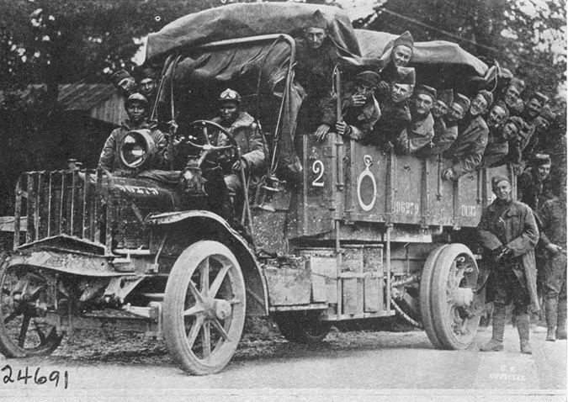
TRANSPORTATION

Slide 19
Transportation
Description/Use : Use of motorized vehicles and railroads to transport supplies and men.
Impact: Railroads were a critical element for mobilization and transport of ultra-heavy artillery
Evolution: As war progressed more trucking used.

Slide 20
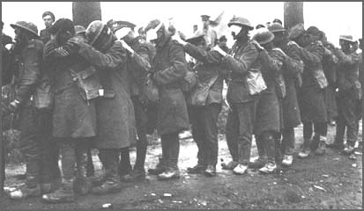
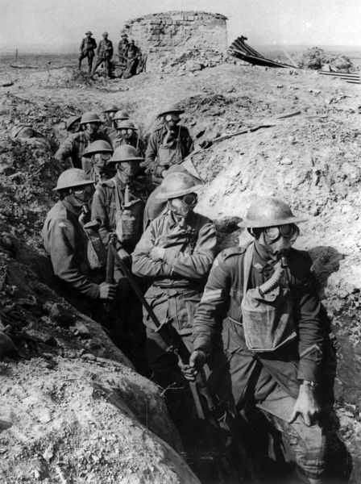
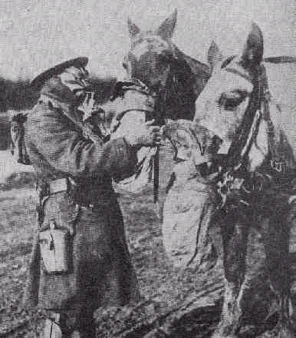
CHEMICAL WARFARE

Slide 21
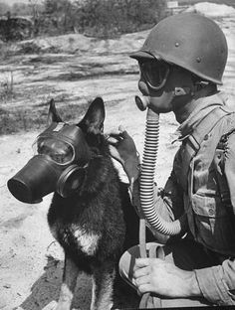
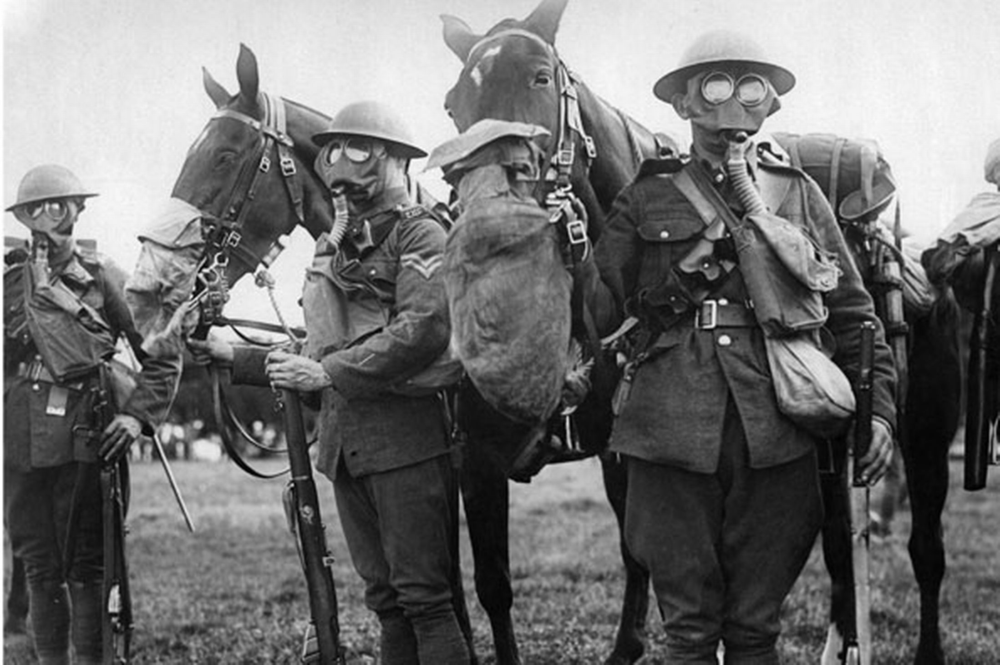
CHEMICAL WARFARE

Slide 22
Chemical Warfare
Description/Use: Chemical gas used to incapacitate or kill enemy. An attempt to find a breakthrough weapon to end stalemate
“tear gas” introduced in 1914
Mustard, chlorine, introduced in 1915
Horrible wounds and death
Initially just “sprayed”
Hard to control
Impact: Troops had to wear masks making fighting difficult
Masks often ineffective
Surprisingly, not a great deal of death
Evolution: Better means of dispersal
artillery shells and bombs
Although outlawed, chemical weapons still made throughout cold war

Slide 23
Video…
http://www.history.com/topics/world-war-i/world-war-i-history/videos/tech-developments-of-world-war-i

Slide 24
10th Euro Studies 2.11.16
HW:
READ & take Notes on 26.2 (stamp)

