Slide 1
9th Honors 2.2.16
Turn in:
Nothing
Take out :
Pen/Pencil
Notes
Today’s Learning Objectives:
I can describe the manner in which power changes from ancient India to it’s independence.
Today’s Agenda:
Finish Gandhi
The Partition of India
HW:
NONE

Slide 2
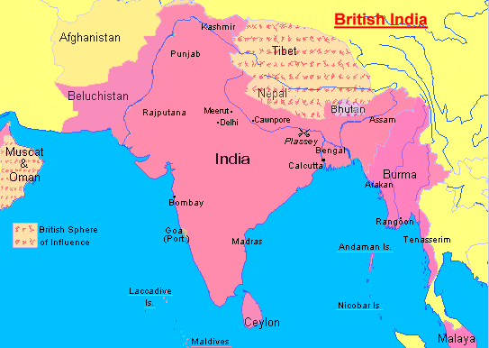
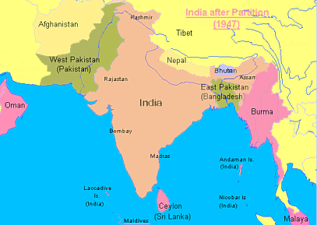
Partition of India August 15, 1947

Slide 3
Was Gandhi really a hero?
[The demand for Pakistan] as put forth by the Moslem League is un-Islamic and I have not hesitated to call it sinful. Islam stands for unity and the brotherhood of mankind, not for disrupting the oneness of the human family. Therefore, those who want to divide India into possibly warring groups are enemies alike of India and Islam. They may cut me to pieces but they cannot make me subscribe to something which I consider to be wrong.

Slide 4
Was Gandhi really a hero?
A friend from Eastern Pakistan asks how can I declare myself an inhabitant of undivided India when it is cut into two, and when to be of one part excludes you from the other?
…What every one of us has to guard against is the harboring of ill-will against a State or its people. . . .

Slide 5
Was Gandhi really a hero?
In actual life, it is impossible to separate us into two nations. We are not two nations. Every Moslem will have a Hindu name if he goes back far enough in his family history. Every Moslem is merely a Hindu who has accepted Islam. That does not create nationality. . . . We in India have a common culture. In the North, Hindi and Urdu are understood by both Hindus and Moslems. In Madras, Hindus and Moslems speak Tamil, and in Bengal, they both speak Bengali and neither Hindi nor Urdu.

Slide 6
Was Gandhi really a hero?
. . . We must not cease to aspire, in spite of [the] wild talk, to befriend all Moslems and hold them fast as prisoners of our love.

Slide 7
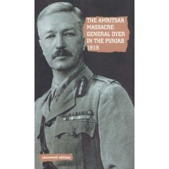
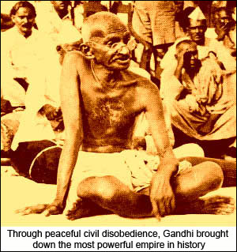
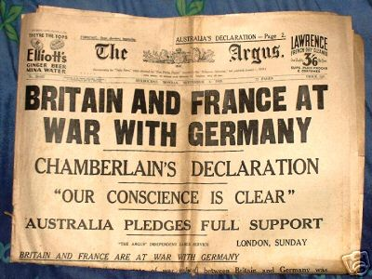
Why Great Britain leaves India…

Slide 8
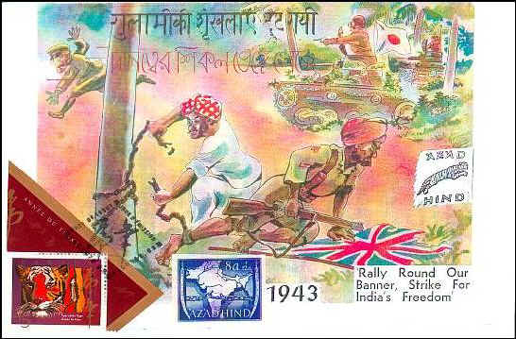
India and WWII
Over 2 million Indians fought in WWII for the British
India raised food for soldiers at expense of its own population, (Great Bengali Famine took over 1 million lives)
Britain owed $$ to India
Clement Attlee, new Prime Minister of Britain, sympathetic to Indian independence

Slide 9
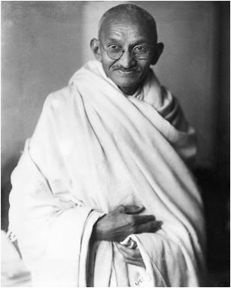
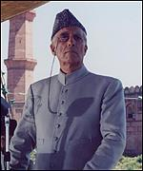
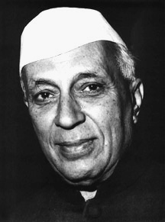
Important People
Gandhi
Muhammad Ali Jinnah
Jawaharlal Nehru

Slide 10
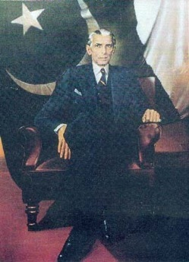
Muslim League under Jinnah
Leader: Mohammad Ali Jinnah
Worked with Nehru and Gandhi to gain independence from Great Britain
But eventually feared for the Muslim minority in India and pushed for Pakistan, a separate nation for Muslims

Slide 11
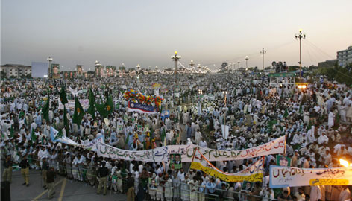
Lahore Resolution: 1940
Jinnah announced the official position of the Muslim League: to secure a new nation for Muslims called Pakistan

Slide 12
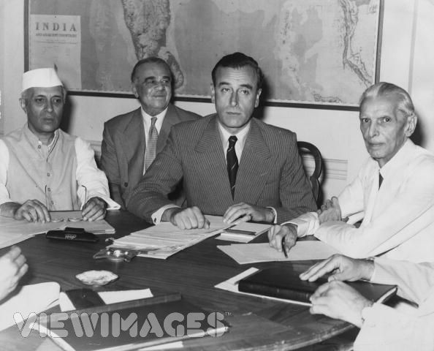
Indian Congress Party & Muslim League cannot agree on 1 or 2 state solution

Slide 13
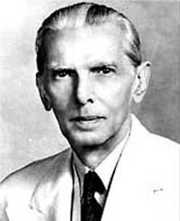
Partition

Slide 14
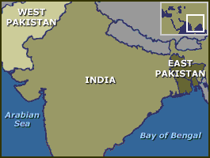
Partition (Division) of India 2 Countries: Pakistan & India

Slide 15
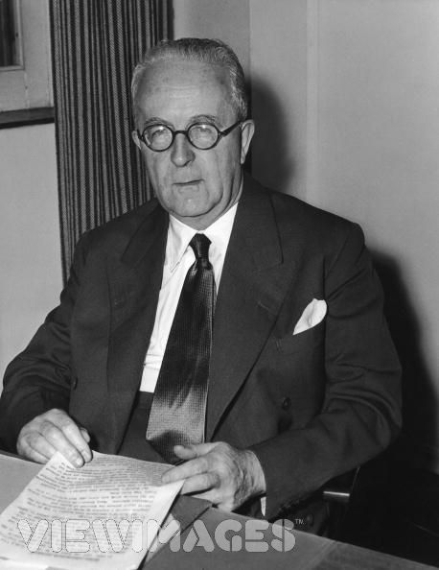
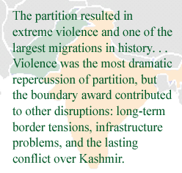
Englishman Cyril Radcliffe draws the boundaries
-Historian Lucy Chester

Slide 16
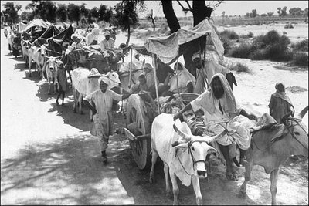
Refugees Flee

Slide 17
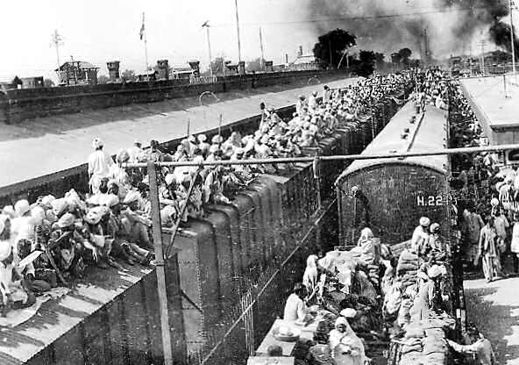
Refugees Flee

Slide 18
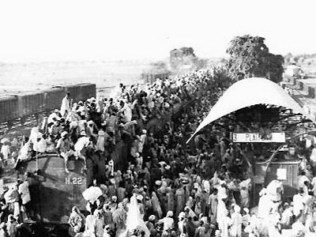
Refugees Flee

Slide 19
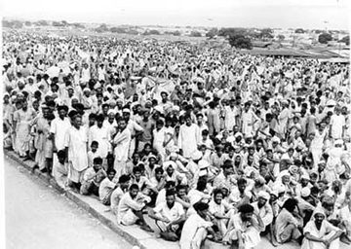
Refugees Flee

Slide 20
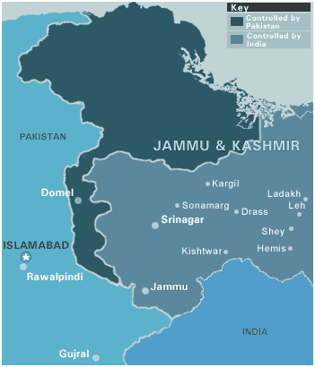
What will Kashmir do?
Leader of Jammu- Kashmir: Maharaja Hari Singh
Muslim majority
Singh was Hindu
Options:
Join India
Join Pakistan
Independence

