Slide 1
10th Euro Studies 2.5.16
Turn in:
NOTHING…YET
Packets will be coming due next week…
Take out :
Pen/Pencil
Note-taking devices
Militarism research packet
Today’s Learning Objectives:
I can explain how militarism helped lead to the outbreak of The Great War.
Today’s Agenda:
Militarism
Let’s look at what you found
Tension in the Balkans
Assassination
HW:
CRA Archduke Ferdinand reading…
Explain why this would be important to Europe
Make 3 predictions about who will be doing what…

Slide 2
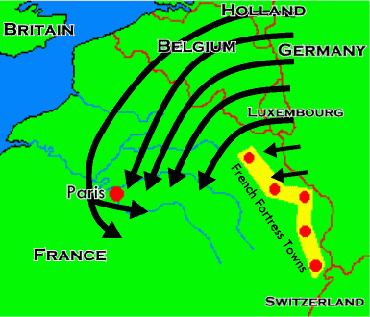
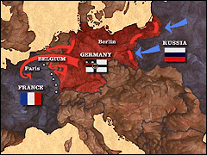
The Plans: Schlieffen and XVII (17!)

Slide 3
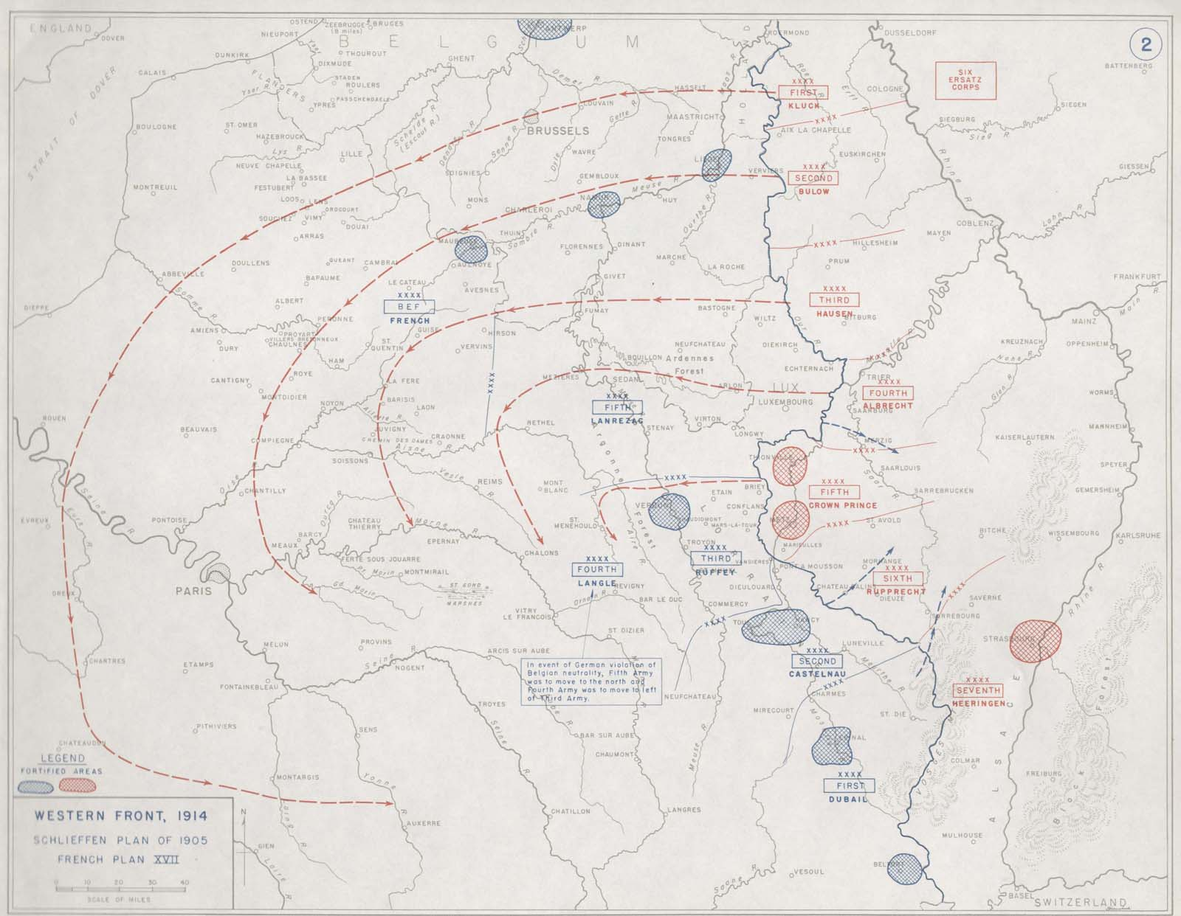

Slide 4
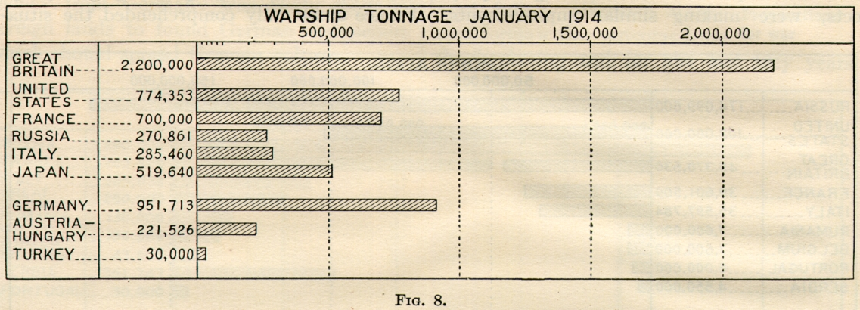
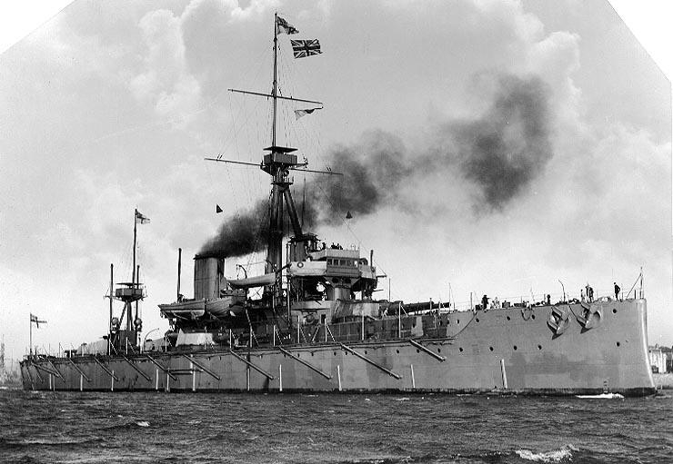
Arms Race: Why don’t they just stop???
German Fleet Acts—GB feels threatened…turns towards one-time rivals…
1902—Entente Cordiale
1907—Anglo-Russian Entente
Germany’s FEAR of complete encirclement becoming a REALITY

Slide 5
The Balkans—The fuse of WW1
"One day the great European War will come out of some damned foolish thing in the Balkans".
-Otto Von Bismarck, 1st Chancellor of Germany, 1888
“Why four great powers should fight over Serbia no fellow can understand.”
-John Burns, member of Britain’s Liberal government, July 27, 1914

Slide 6
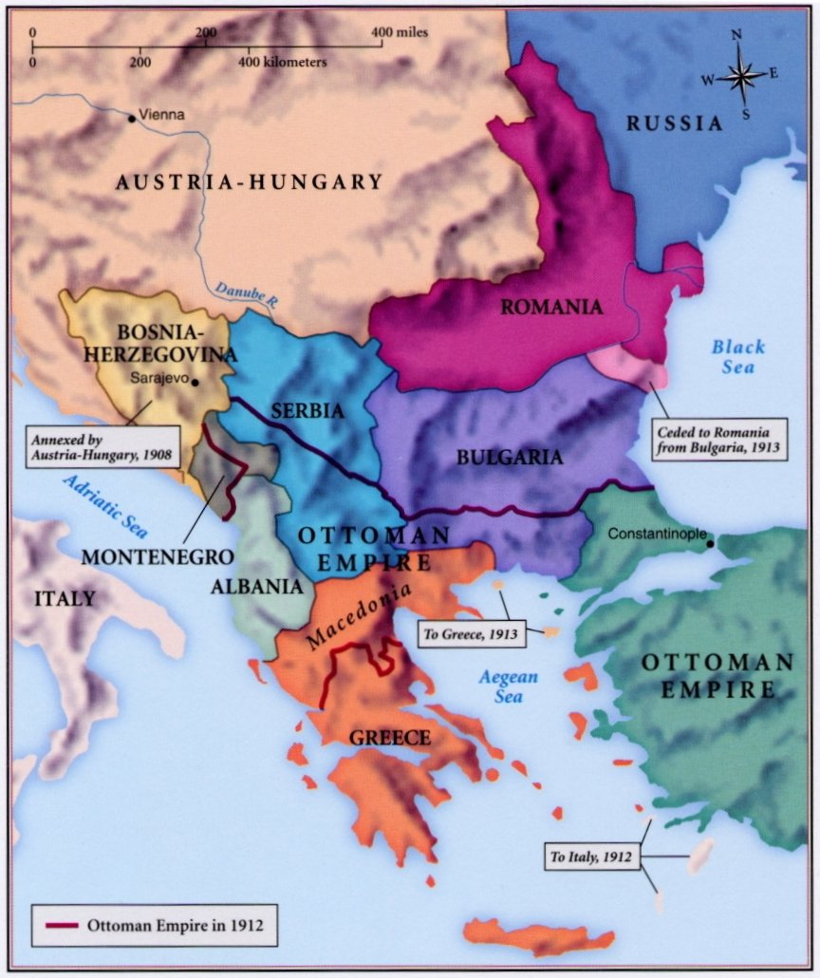
The Balkans
A peninsula “sandwiched” between 4 Seas…
Underdeveloped and less populated nations compared to western Europe.
Natural resources NOT a vital part of the equation…so WHY?
The Ottoman Empire had rule for most of the 1800’s—Greece, Montenegro, Serbia, and Bulgaria all gained independence.
Most of western Europe viewed this as an opportunity—GB, France, Germany—so did Russia
GB/FR—opposed to Russia expansion into the Mediterranean and Middle East & wanted the Ottoman Empire to remain as a buffer.
Germany—wanted to acquire the bankrupt Ottoman Empire’s assets.

Slide 7
The Balkans & our Causes…
Militarism—Germany wanted the Ottoman’s to collapse and take their armaments. Along with the build up that’s taking place in western Europe.
Alliances—GB & France opposed to Germany and Russian interests.
Nationalism—the gaining of independence of many of these nations.
Imperialism—Austria-Hungary exerting their influence over Bosnia-Herzegovina (as well as GB, FR, GER, & RUS)
Assassination—let’s see what happens tonight!
Competition—all these nations are so interested in controlling this area of Europe.

Slide 8
The Balkans—1908 Crisis
Imperialism—Austria-Hungary annexes (takes control) of Bosnia-Herzegovina in 1908, but it still remained part of the Ottoman Empire.
In July 1908—group in Constantinople (Istanbul) known as the Young Turks staged a revolution.
A-H saw this as their opportunity to take Bosnia-Herzgovina for their own!
Germany supports A-H
Russia won’t get involved because A-H agrees to not oppose sea access.
Serbia wants a part of Bosnia!
Germany threatens to invade Serbia if they press A-H on their claim to Bosnia-Herzegovina

Slide 9
The Balkans—1912-3 Wars
1st War (1912): Ottoman Empire is trying to hang on…remember, Otto is “the Sick Man of Europe.”
Balkan League is formed—Serbia, Bulgaria, Montenegro, and Greece.
Lasted from October to December…
Short ARMISTICE
2nd War (1913): Young Turks are back!
Lasts from January to May
Ottoman Empire loses all control of any European lands…

Slide 10
The Balkans
The Balkans were a cluster of nations in eastern Europe, between the Austro-Hungarian and Ottoman empires.
Their location made the Balkans strategically important, so European powers were focused on events there.
The Balkans were also politically volatile, a hotbed of ethnic and nationalist tensions.
The Balkans were disrupted by two wars in 1912-13, as well as rising Serbian nationalist groups.
Let’s see…

Slide 11
10th Euro Studies 1.28.15
HW:
Archduke Ferdinand info…critically read &:
EXPLAIN why this would matter to Europe.
Make three predictions: who will do what and why?

