Slide 1
10th Euro Studies 2.8.16
Turn in:
Nothing…
Take out :
Pen/Pencil
Note-taking devices
Militarism research packet
Today’s Learning Objectives:
I can explain how an ASSASSINATION helped lead to the outbreak of The Great War.
Today’s Agenda:
Tension in the Balkans
Assassination
Background reading In-class
HW: NONE

Slide 2
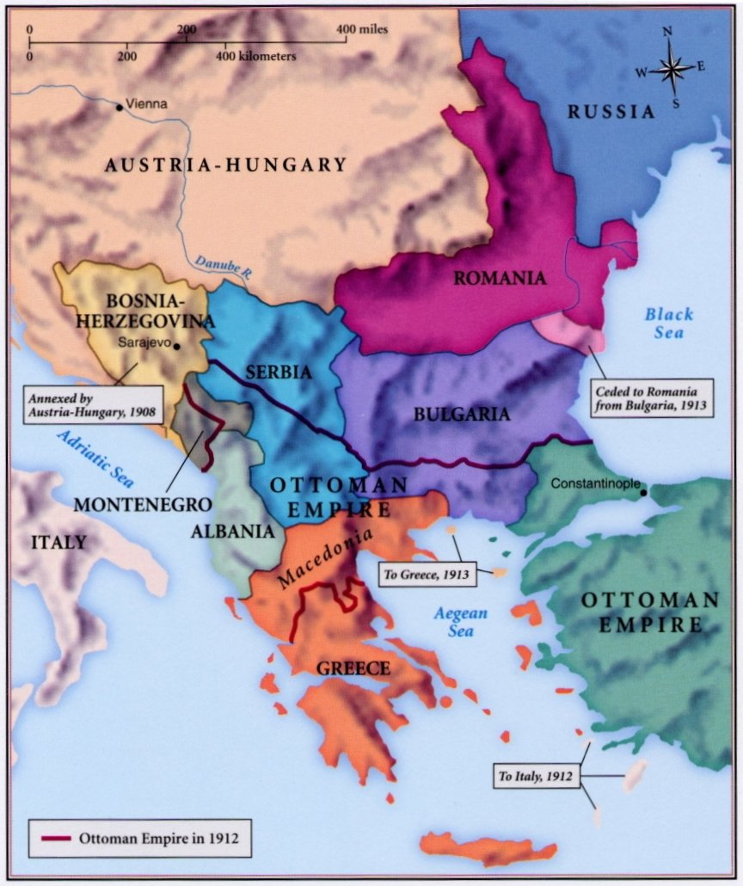
The Balkans= “The Powder Keg of Europe”
All it needs is a spark…
“…some damned foolish things out of the Balkans.”—Bismarck 1888

Slide 3
The Balkans
A peninsula “sandwiched” between 4 Seas…
Underdeveloped and less populated nations compared to western Europe.
Natural resources NOT a vital part of the equation…so WHY?
The Ottoman Empire had rule for most of the 1800’s—Greece, Montenegro, Serbia, and Bulgaria all gained independence.
Most of western Europe viewed this as an opportunity—GB, France, Germany—so did Russia
GB/FR—opposed to Russia expansion into the Mediterranean and Middle East & wanted the Ottoman Empire to remain as a buffer.
Germany—wanted to acquire the bankrupt Ottoman Empire’s assets.

Slide 4
The Balkans & our Causes…
Militarism—Germany wanted the Ottoman’s to collapse and take their armaments. Along with the build up that’s taking place in western Europe.
Alliances—GB & France opposed to Germany and Russian interests.
Nationalism—the gaining of independence of many of these nations.
Imperialism—Austria-Hungary exerting their influence over Bosnia-Herzegovina (as well as GB, FR, GER, & RUS)
Assassination—let’s see what happens tonight!
Competition—all these nations are so interested in controlling this area of Europe.

Slide 5
The Balkans—1908 Crisis
Imperialism—Austria-Hungary annexes (takes control) of Bosnia-Herzegovina in 1908, but it still remained part of the Ottoman Empire.
In July 1908—group in Constantinople (Istanbul) known as the Young Turks staged a revolution.
A-H saw this as their opportunity to take Bosnia-Herzgovina for their own!
Germany supports A-H
Russia won’t get involved because A-H agrees to not oppose sea access.
Serbia wants to combine with Bosnia!
Germany threatens to invade Serbia if they press A-H on their claim to Bosnia-Herzegovina

Slide 6
The Balkans—1912-3 Wars
1st War (1912): Ottoman Empire is trying to hang on…remember, “Otto” is “the Sick Man of Europe.”
Balkan League is formed—Serbia, Bulgaria, Montenegro, and Greece.
Lasted from October to December…
Short ARMISTICE
2nd War (1913): Young Turks are back!
Lasts from January to May
Ottoman Empire loses all control of any European lands…

Slide 7
The Balkans
The Balkans were a cluster of nations in eastern Europe, between the Austro-Hungarian and Ottoman empires.
Their location made the Balkans strategically important, so European powers were focused on events there.
The Balkans were also politically volatile, a hotbed of ethnic and nationalist tensions.
The Balkans were disrupted by two wars in 1912-13, as well as rising Serbian nationalist groups.
Let’s see…

Slide 8
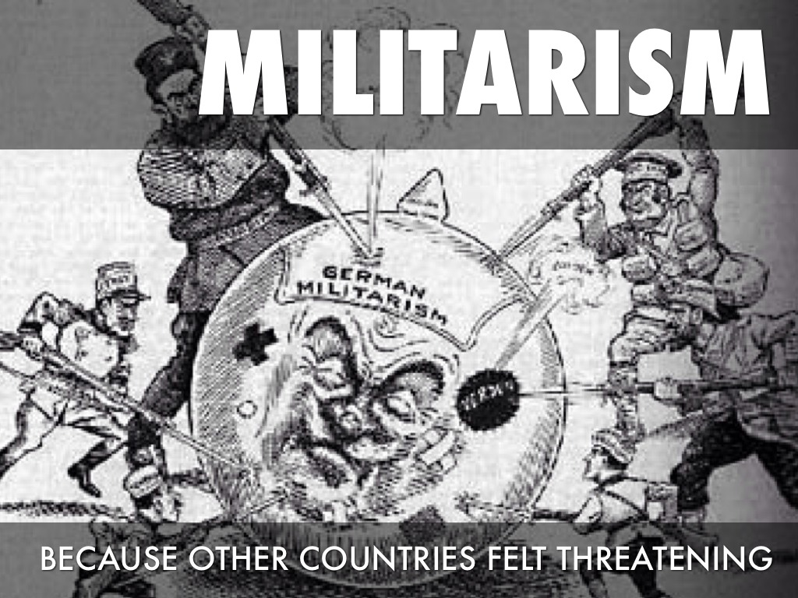
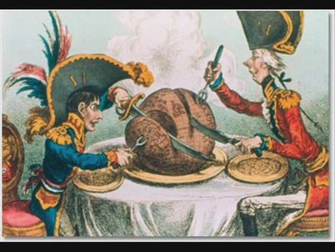
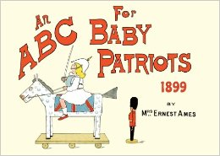
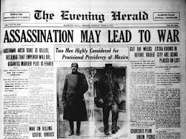
CAUSES OF “THE GREAT WAR”
M—militarism
A—alliances
N—nationalism
I—imperialism
A—assassination
(C)—Competition

Slide 9
ASSASSINATION—our last “Cause”
Individually:
Archduke Ferdinand info…critically read and do the following:
EXPLAIN why this would matter to any of the “major” powers of Europe.
Make three predictions: who will do what and why?

Slide 10
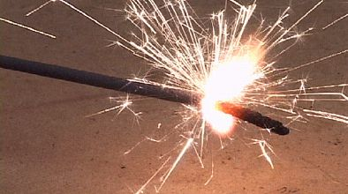
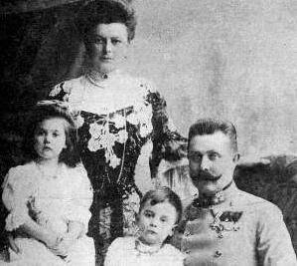
“The Spark”
Archduke Franz Ferdinand assassinated with his wife in Sarajevo, Bosnia (6/28/1914)
JUNE 1914…

Slide 11
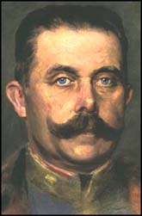
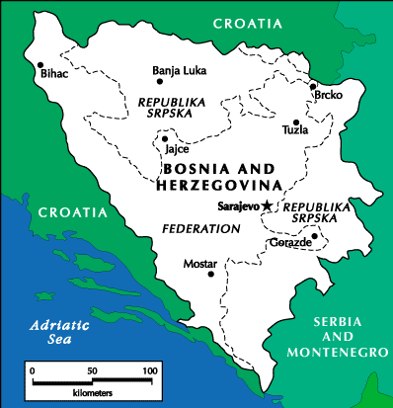
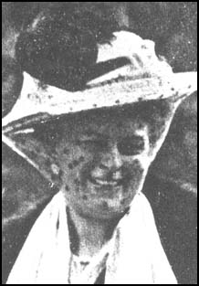
Archduke Franz Ferdinand
Heir to the Austro-Hungarian throne
Unpopular due to his marriage to Sophie who was considered to be of lower class
Visited Sarajevo in 1914 in an attempt to improve relations between the monarchy and the Bosnian people

Slide 12
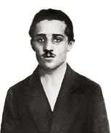
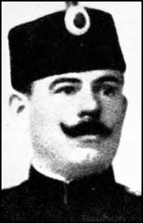
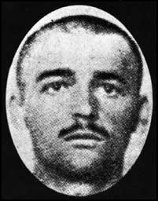
The Black Hand Society
Fierce Slav nationalists: hated Austria and prepared to kill for freedom
Goal: creation of a Greater Serbia
Secret society with links to the Serbian government and army
"...before God, on my honour and my life, that I will execute all missions and commands without question. I swear before God, on my honor and on my life, that I will take all the secrets of this organization into my grave with me."

Slide 13
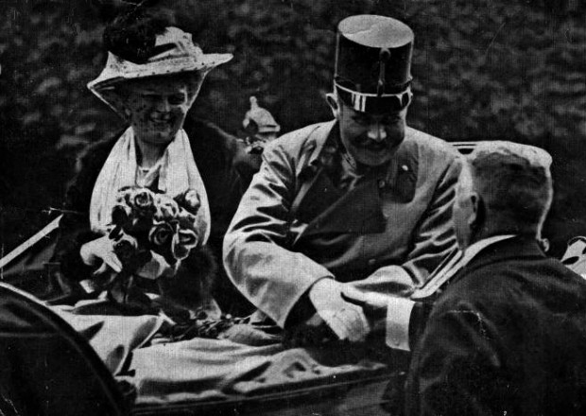
28th June 1914—it’s their anniversary...
Saw opportunity to assassinate the future Emperor of Austria-Hungary

Slide 14
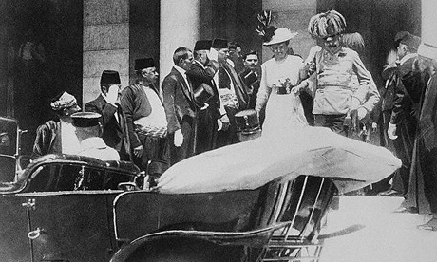
Assassination in Sarajevo

Slide 15
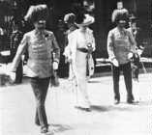
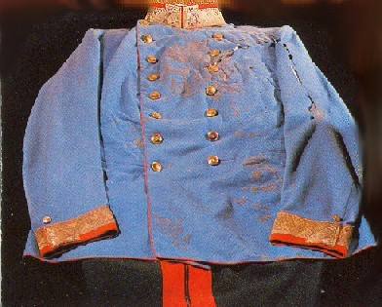
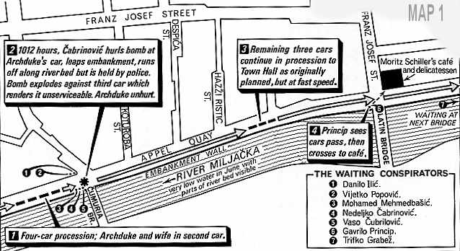
The Assassination

Slide 16
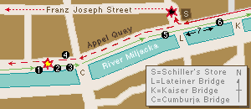
The Assassination
“Grenade” thrown…many accounts claim Ferdinand deflected the device
The would be assassin swallows a cyanide capsule and jumps into the near-by river…
Two problems—first, the cyanide was old and didn’t work: he just vomits. Second, the river was no more than knee deep…
One of Ferdinand’s men was injured and went to the hospital.
The Archduke continued to City Hall, where they discussed a change of plans for meetings.
Gavrilo Princip misses his chance…goes to get a sandwich in a nearby deli.
The Archduke’s car continues to the hospital to visit his injured man…BUT:
Makes a wrong turn…Gavrilo (while enjoying his sandwich no doubt) notices Ferdinand and seizes the moment.
He attempts to turn the gun on himself…takes a cyanide capsule (same result), and is then arrested.

Slide 17
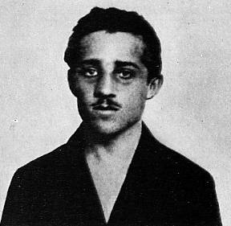
The Assassin
Gavrilo Princip
*Serbian Nationalist
*Member of “Black Hand”

Slide 18
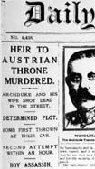
The Austrian Ultimatum
Austria-Hungary was furious and accused the Serbian government of planning the assassination
Austria-Hungary sent a 10-point ultimatum to Serbia—wanted to be directly involved in the investigation
“Ultimatum”: a warning stating that unless someone meets your conditions you will take action against them

Slide 19
July 5th – Austria are assured by Germany of support against Serbia
July 23rd- Ultimatum Sent to Serbia, Two demands are rejected
July 29th- Austria declares war on Serbia
Serbia appeal to Russia for help
July 30th- Russia mobilises her army, Germany mobilises her army for war against Russia.
Aug 1st- Germany declares war on Russia,
France mobilises her army.

Slide 20
The Sentence That Caused A War
6. The [Serbian] Government considers it its duty as a matter of course to begin an investigation against all those persons who have participated in the outrage of June 28th and who are in its territory. As far as the cooperation in this investigation of specially delegated officials of the [Austro-Hungarian] Government is concerned, this cannot be accepted, as this is a violation of the constitution and of criminal procedure.
Serbian Response to the Ultimatum, 25 July, 1914

Slide 21
How will Europe respond?
7/29 – Russia mobilizes army
8/1 – Germany declares war on Russia
8/3 – Germany declares war on France and invades Belgium—“Schlieffen” Plan…modified
8/3 - France declares war on Germany
8/4 – Britain declares war on Germany
BY EARLY AUGUST 1914, EUROPE IS PREPARING TO FIGHT A LARGE SCALE WAR

Slide 22
Britain enters the War—Aug. 4th
Germany had already planned to invade France through Belgium and Holland—the Schlieffen Plan.
Britain had always been sensitive about Belgium as it was a small country with seaports very close to Britain—it’s an Industrialized, Island Nation!
British policy was that no major naval power should be able to control Belgium.
The Kaiser (Wilhelm II) did not believe Britain would enter the war over Belgium.

Slide 23
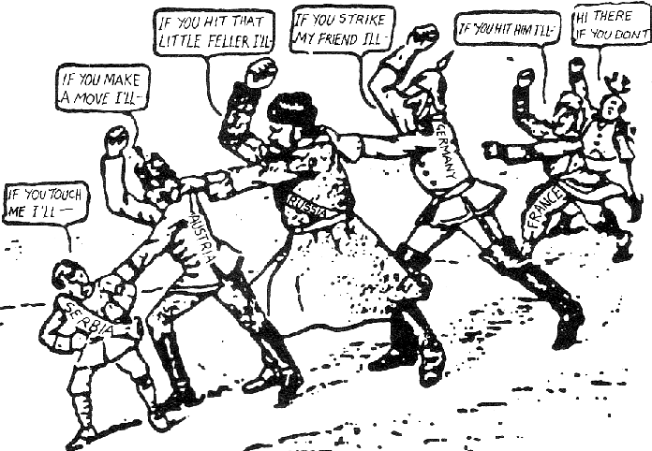
The “Spark”

Slide 24
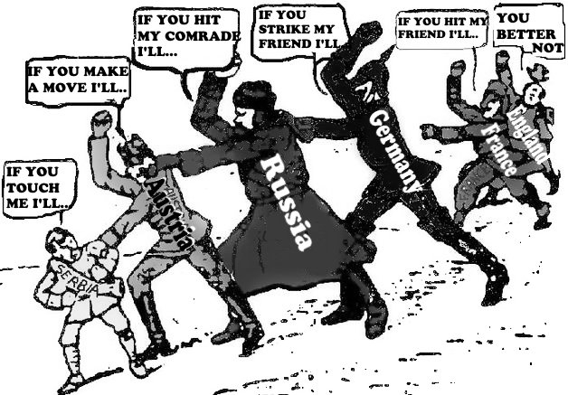
The “Spark”

Slide 25
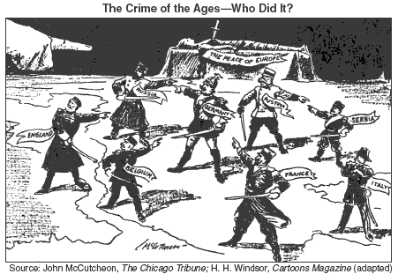

Slide 26
How Will Austria Respond To The Assassination? “The July Crisis”
7/6 → Germany grants “Blank Check” of support
7/23 → A-H sends Ultimatum to Serbia
Serbia has 48 Hours to respond
Serbia rejects ultimatum
7/28 → A-H declares war and begins bombing Belgrade

Slide 27
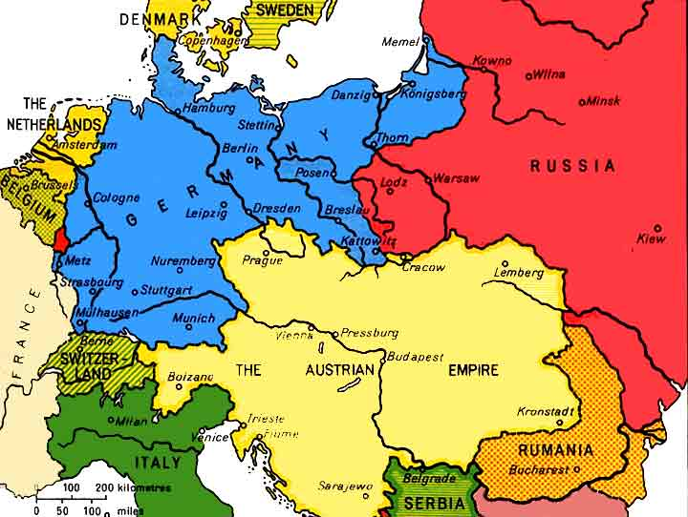
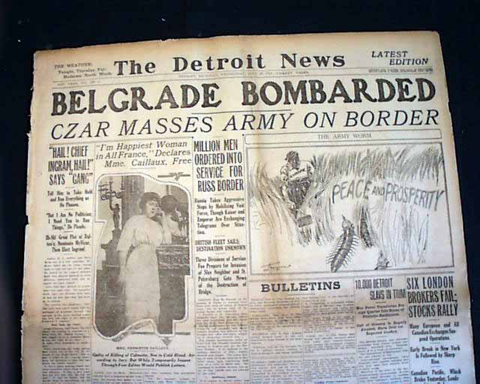
How Will Austria Respond To The Assassination? “The July Crisis”
7/6 → Germany grants “Blank Check” of support
7/23 → A-H sends Ultimatum to Serbia
Serbia has 48 Hours to respond
Serbia rejects ultimatum
7/28 → A-H declares war and begins bombing Belgrade

Slide 28
How will Europe respond?
7/29 – Russia mobilizes army
8/1 – Germany declares war on Russia
8/3 – Germany declares war on France and invades Belgium—Belgium resists…
8/3 - France declares war on Germany
8/4 – Britain declares war on Germany
“Scrap of Paper…” comment
Belgium’s “neutrality”
BY EARLY AUGUST 1914, EUROPE IS PREPARING TO FIGHT A LARGE SCALE WAR
Over the Balkans? How’d we get to this point?

Slide 29
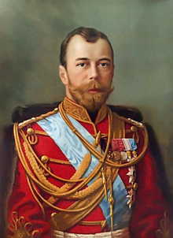
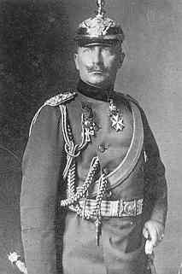
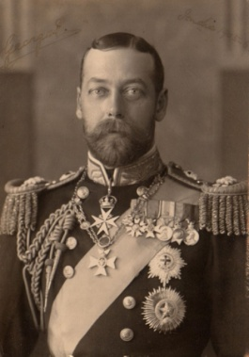
Who’s involved in this “Crisis?”
It’s a family affair…
Tsar Nicholas II
Not terribly bright…
Lost war to Japan…looking to restore pride
His people are grumbling…unifying war?
Kaiser Wilhelm II
Smart, but a bit unpredictable
Can’t stand or trust the English
Really a big fan of military strength…wants to try out his “new toy”
Cousins (3rd)…also George V of England (1st with both)

Slide 30
Diplomatic failure
7. July 28 – instigated by German Chancellor Bethman-Hollweg, and Austrian Chancellor Berchtold, Austria-Hungary declares war.
8. July 25-28 – British foreign minister, Sir Edward Grey, tried to mediate a solution. The German government rejected Britain’s interference.
July 29 – Austrian artillery bombards Belgrade.
July 30 - Bethman-Hollweg resists calls for mobilization and encourages Austria to localize the war through dialogue with Moscow.
Russia now under pressure by military leaders, and France (worried Russia is unprepared) to mobilize. France ensured Russia of support somewhere between July 20-23)

Slide 31
Mobilization
11. July 31 – Russia began full mobilization after having started “partial mobilization” on July 29; this however, was technically impossible. French military leaders (Joffre) demand France mobilizes.
12. By July 30, German high command (von Moltke) panicked that mobilization must begin and France must be defeated before Russia could complete mobilization.
August 1 – Germany declared war on Russia. Britain still refused to declare position to France.
August 3 – Germany declared war on France and invaded Belgium.
August 4 – Britain declared war on Germany, supposedly in defense of Belgian neutrality – “the scrap of paper” (Bethman-Hollweg)

Slide 32
The Telegrams…
Following the ultimatum there was a series of telegrams between Russia and Germany in the hopes of avoiding war.
With your table/partner:
Read through the background on both Nicholas II and Wilhelm II
Understand the main points of each man in each telegram.
How do other nations fit into this “crisis?”

Slide 34
Taking a Closer look

Slide 35
Austria
Berchtold (A-H Foreign minister) met Conrad’s (A-H Army Chief of Staff) demand for mobilization against Serbia. It was time, “to solve the Serbia situation.”
Two papers sent to Germany; memorandum outlining Austria’s diplomatic plans for the Balkans, as well as a personal letter to Wilhelm II from Franz Josef (A-H Emperor)

Slide 36
Letters to Germany
The letter blamed Russian and Serbian Pan-Slavism for the assassination.
The term war was never used.
Everyone was waiting for German reaction

Slide 37
Arthur Zimmerman
State Secretary Foreign Affairs
Arthur Zimmerman was trying to calmly methodically plan a reaction, the Kaiser was in a much different mood, “The Serbs must be disposed of and that right soon!”

Slide 38
Kaiser Wilhelm II

Slide 39
Upon receiving the memorandums Kaiser Wilhelm II wished to consult his advisors, but changed his mind by stating,
“[Austria] might in this case, as in all others, rely upon Germany’s full support.” He wanted a reaction without haste.
The Kaiser known to be impetuous and to react without consultation would later regret his reaction.
The Kaiser believed a strong stance would deter Russian involvement fully believing their army was nowhere near ready for war as well as that he could influence Nicholas II (cousins!) into not going to war.

Slide 40
The Big Decision
Lose the Alliance with Austria-Hungary or risk war with Russia?
Blank Check? More like, “incitement and encouragement to take action against Serbia.”
The German response became known as the, “Blank Check.”

Slide 41
Did Germany start a fight?
Might Austria have taken action without encouragement from Germany?
Probably not…but I guess we’ll never know…

Slide 42
Austrian Reaction
July 19 second Austrian Ministerial Council agreed to send an ultimatum demanding a joint investigation, public admission of Serbian responsibility, and pledge future good behavior with a 48 hour time limit to respond. To be delivered July 23.
Reasonable???
Big Problem!
The delay of ultimatum had moved public outrage into a sympathy movement towards Serbia with anger towards Austria (21 days).

Slide 43
Germanys' response to ultimatum
Germany – We don’t know what’s going on with Austria-Hungary
But in truth…
They knew everything

Slide 44
World’s Response
Britain, France, Russia tried to extend the time limit and suggested mediation.
“You are setting fire to Europe.” – Sazonov (Russia’s Foreign Minister)
Had serious doubts on readiness and economy of Russia. He was scared to depend on Britain.

Slide 45
Serbia’s Reaction to ultimatum
Serbia agreed on 9 of the 10 terms, would not agree to Austrian participation in the investigation inside Serbia. The diplomatic achievement won praise for Austria, except in Kaiser Wilhelm’s mind.

Slide 46
Falling Dominos
Franz Josef - “window of opportunity.”
28 July Austria-Hungary declared war on Serbia. 29 July, ships fired upon Belgrade.
Russian thought through firmness, not to bring war on, might stop a war from starting. They mobilized troops 28 July.
Germany warned that if Russia continued to mobilize, Germany would mobilize and war would follow.

Slide 47
Russia fully mobilized for war 13 August hoping mobilization would prevent war.
Germans mobilized in response, problem was, mobilization for them meant war.

Slide 48
Uhh Ohh!!
Kaiser called a halt to ships after reading the reply from Serbia. He planned to have Austria’s army march into Belgrade and hold it as security for Serbia to carry out promises. Message was given too late.
Austria could not reverse action of declaring war

Slide 49
Germany trying to look good
31 July Germany waited
Want to blame Russia
Germany asked Russia to stop mobilizing, Russia refused, Germany declared war 1 August
Asked France to stay neutral
France, “France will act in accordance with her interests”

Slide 50
Germany picking a fight with France
France had withdrawn troops 10 kilometers from Germany border
Germany invented stories of French violations of German territory and declared war on 3 August

Slide 51
Prime Minister Asquith’s thoughts (Of England)
1. We have no obligations of any kind to France or Russia to give them military or naval help.
2. The dispatch of the Expeditionary Forces to help France at this moment is out of the question and would serve no object.
3. We mustn’t forget the ties created by our long-standing and intimate friendship with France.
4. It is against British interest that France should be wiped out as a Great Power.
5. We cannot allow Germany to use the Channel as a hostile base.
6. We have obligations to Belgium to prevent her being utilized and absorbed by Germany

Slide 52
Britain
Britain had not made a decision yet, 31 July Cabinet was fully ready to abandon France
1 August, still negotiating means to stay neutral with Germany
2 August, Germany invaded neutral Luxemburg, Cabinet reacted by promising to protect the French coast
3 August, King of Belgium appealed for help from Britain. Britain was a part of five supporters of Belgian neutrality.
3 August Grey sent ultimatum to Germany demanding respect for Belgium’s neutrality
No response, 4 August Britain declared war on Germany
British Expeditionary force sent to France 6 August

Slide 53
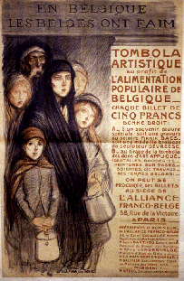
German Atrocities in Belgium

Slide 54
Grey years later, “the real reason for going to war was that, if we did not stand by France and stand up for Belgium against this aggression, we should be isolated, discredited, and hated, and there would be nothing for us but a miserable and ignoble future.”
The real danger lied within their honor, which was threatened by Germany

