Slide 1
10th Euro Studies 3.29.16
Turn in:
Nothing
Take out :
Planner/Calendar
Notes
Textbook
Today’s Learning Objectives:
I can understand how different leaders changed the power structure in Europe following WWI.
Today’s Agenda:
The Rise of Dictators
Mussolini, Franco, Hitler, (Hirohito?)
28.3
HW:
3 “Test” Questions on Stalin Readings
28.3—Chart to help serve as notes

Slide 2
Chart—Who’s who in the Zoo?
Nation | Politics (Type) | Foreign Policy | Economics | Leader: & Actions by them
You should be able to fill in some basic information on USSR and Stalin…if not, consider how you are spending your time…

Slide 3
Types of Government
Dictatorship
one person exercises absolute power and unrestricted control in a government without hereditary succession (meaning, not a king)
Totalitarian State—ideals
a government which maintains complete control over its citizens
individuals have no rights, and government suppresses opposition in order to maintain power.
Often marked by charismatic leaders
Authoritative State
Leader more interested in the status quo
Control exercised to a greater extent over the government as opposed to the people.

Slide 4
Types of Government
Communism
a governmental system where economic and social activity is controlled by a totalitarian state dominated by a single political party.
Fascism
Political movement that consists of a strong, centralized government headed by a powerful dictator.
Emphasizes the State over individuals.
Allows private enterprise
"Everything within the state, nothing against the state, nothing outside the state." The masses should only "believe, obey and fight." ~Mussolini
Militarist State
The military is the controlling power in government

Slide 5
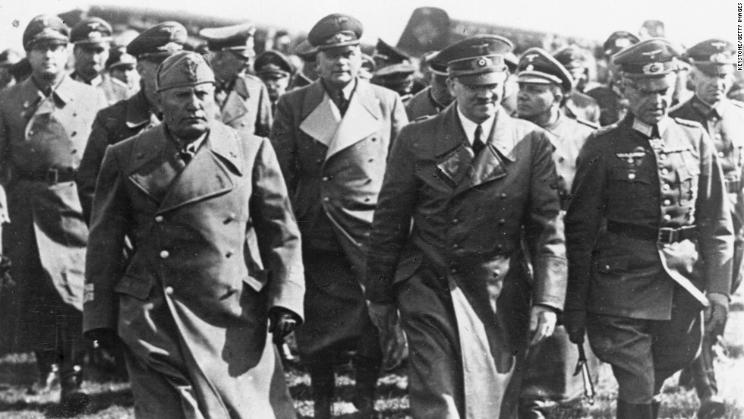
The Rise of Dicators in Europe

Slide 6
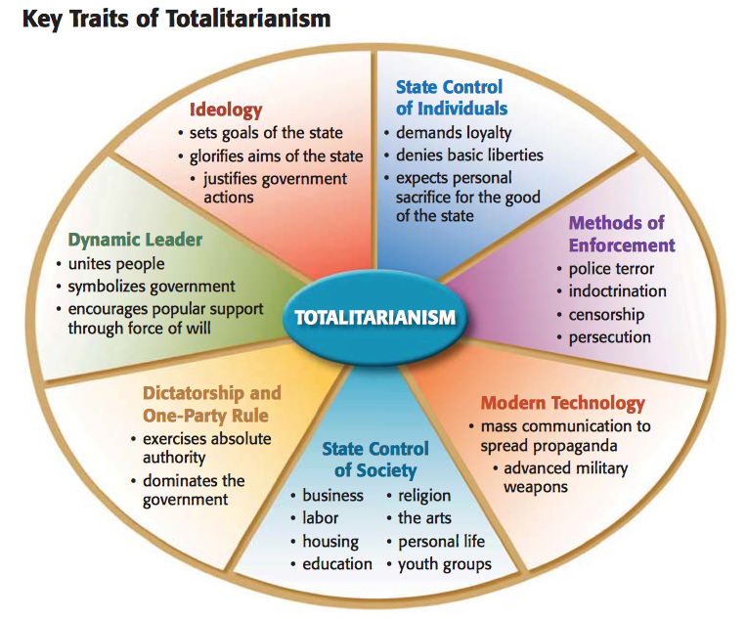

Slide 7
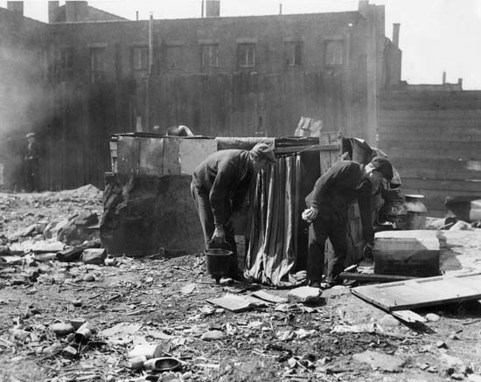
The Rise of Dictators
Widespread economic hardships caused by Great Depression contributed to the rise of dictators in Europe
People gave power to strong leaders who promised to solve nations problems
Totalitarian dictatorships replaced gov’ts that could not meet their peoples needs

Slide 8
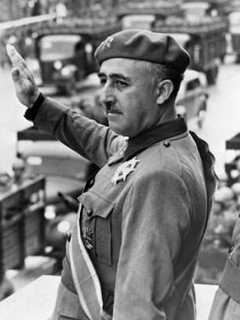
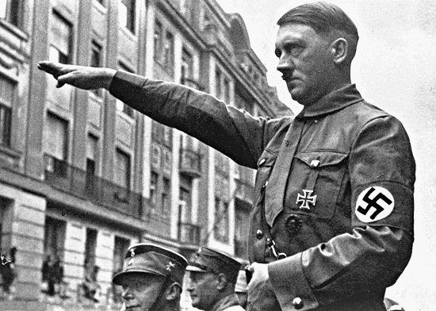
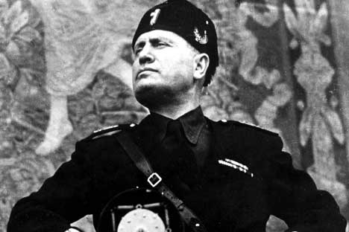
Fascism
Fascist leaders emerged in the 1920’s-30’s :
Spain
Germany
Italy

Slide 9
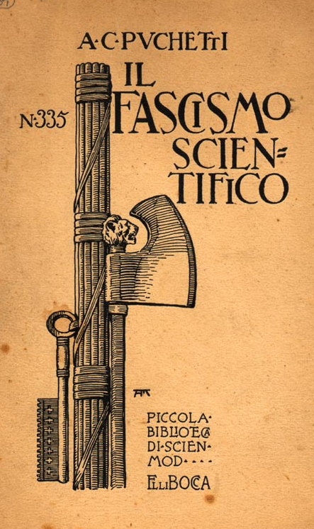
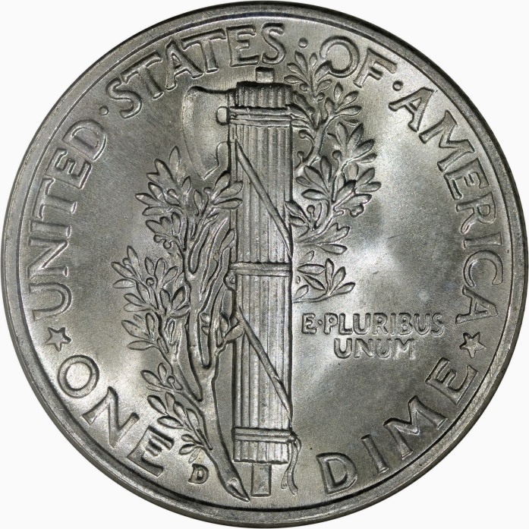
The Fasces Symbol
Comes from the Latin word fasces.
In ancient Rome, the fasces were cylindrical bundles of wooden rods, tied tightly together around an axe.
They symbolize unity and power.

Slide 10
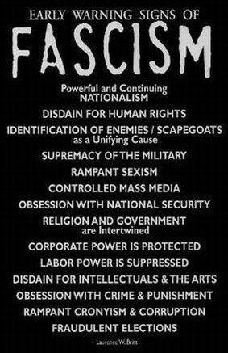
Fascism
A political movement that seeks to establish a dictatorial government that is nationalistic and imperialistic
Promoted extreme form of nationalism
A denial of individual rights
The needs of the state outweigh the needs of the individual
Dictatorial one party rule
were anti-communist

Slide 11
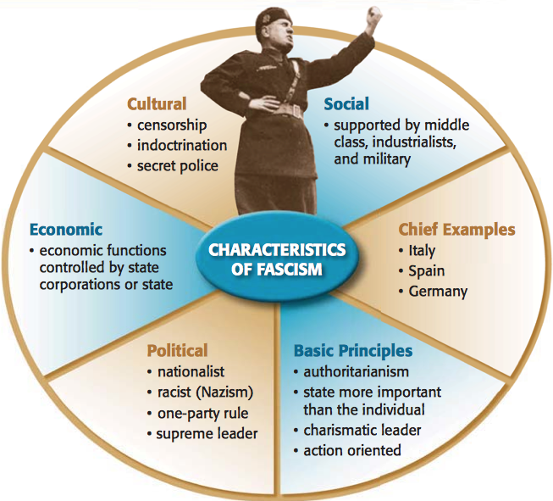

Slide 12
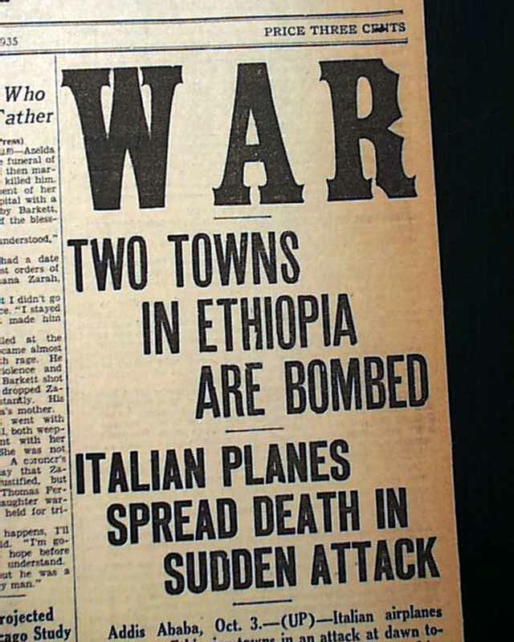
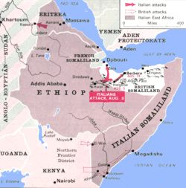
Italian Expansion
1870 (1882)—annexed part of Eritrea
1889—Italian Somaliland
1895—defeated by Ethiopia
1911—war with the Ottoman Empire

Slide 13
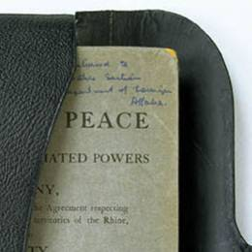
FAILURE OF VERSAILLES
The peace settlement that ended World War I (Versailles Treaty) failed to provide a “just and secure peace” as promised
Instead Germany grew more and more resentful of the treaty that they felt was too harsh and too punitive
The Versailles Treaty (above on crutches) took a beating in the U.S. and abroad

Slide 14
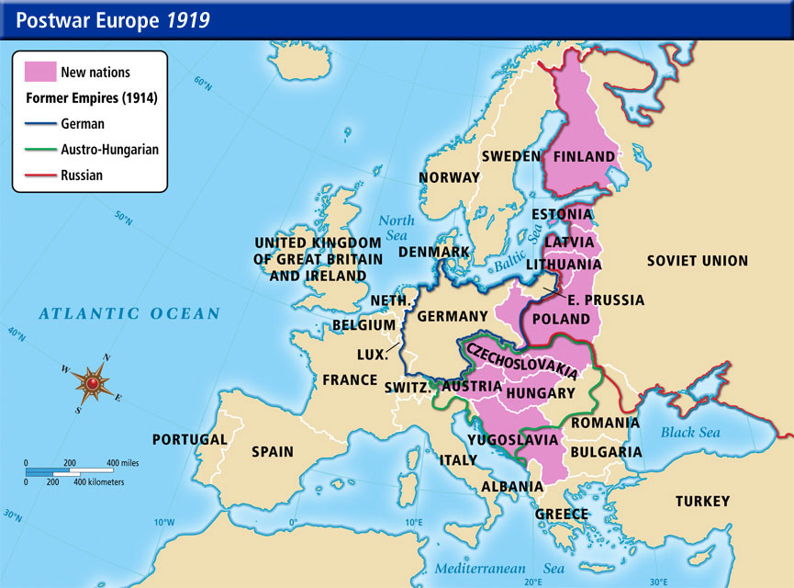
Italy After WWI
Italy was disappointed by the outcome of the Treaty of Versailles
Had hoped to gain territory
Promised land along the Adriatic (Yugoslavia)

Slide 15
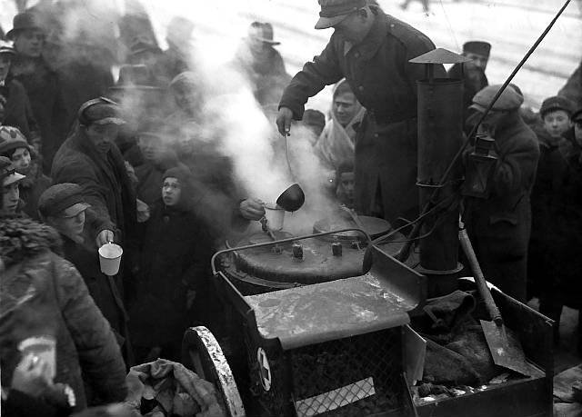
Italy After WWI
Economic problems after WWI contributed to social unrest
High inflation
High unemployment
Trade decreased
High taxes
Workers strikes led by communists
Many Italians believed democratic government couldn’t solve problems

Slide 16
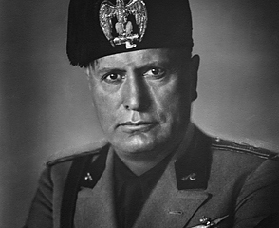
Italy After WWI
Benito Mussolini formed the Fascist Party in 1919
Had the support of many war veterans and dissatisfied Italians

Slide 17
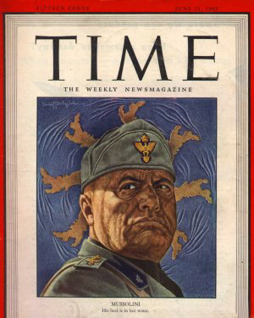
Rise of Fascism in Italy
Mussolini promised to strengthen Italy and solve economic problems
Would end unemployment
Gain more territory for Italy
Would outlaw strikes and communist threats

Slide 18
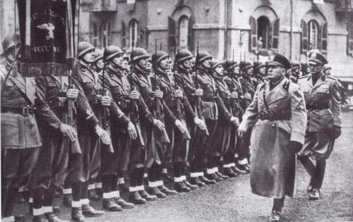
Rise of Fascism in Italy
Mussolini and the Fascists gained power in Italy in 1922
Fascist “Black Shirts” used terror and violence to intimidate opposition
Mussolini was known as Il Duce (the leader)

Slide 19
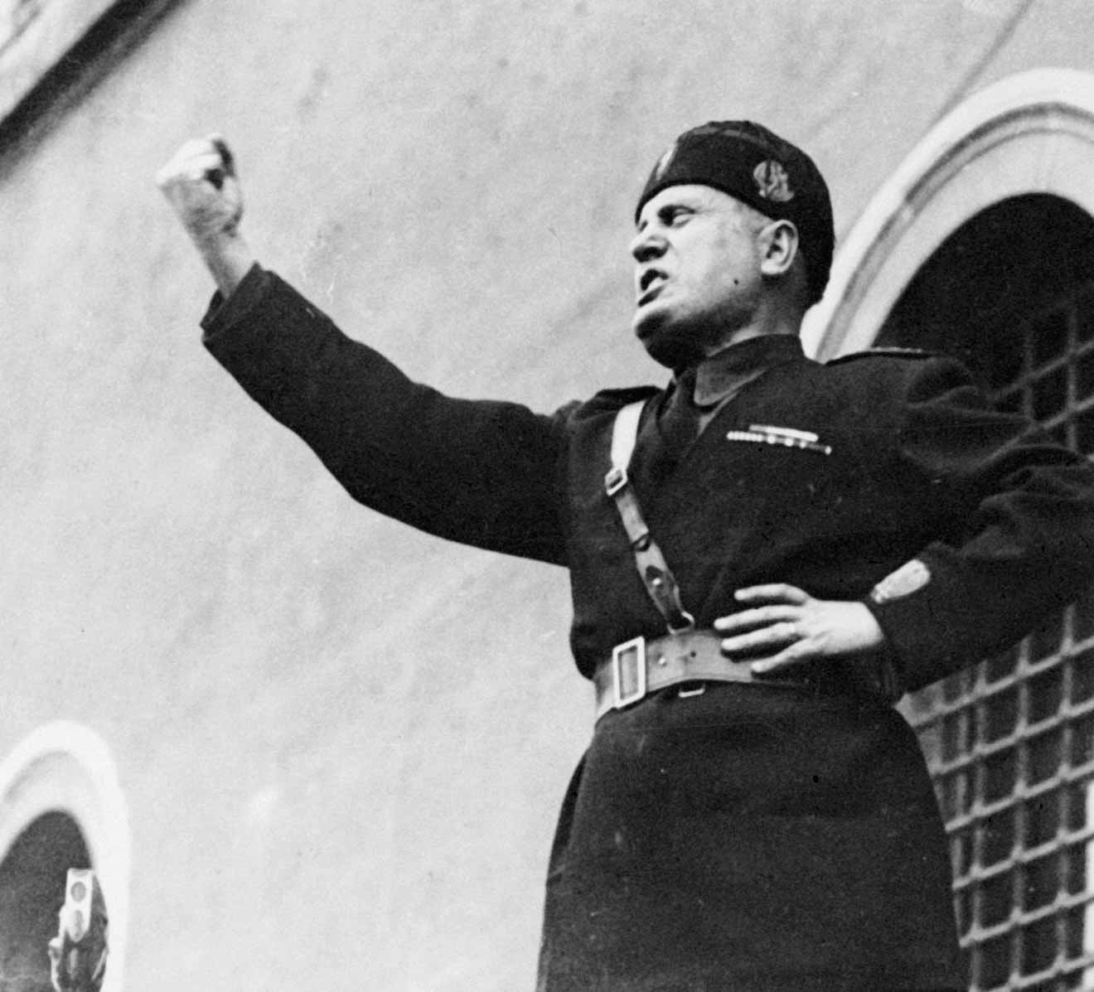
Italy Under Mussolini
Mussolini consolidated control of Italy
Ended free elections
Restricted free speech and free press
Killed or jailed political opponents
Controlled economy by allying with industrialists and large landowners

Slide 20
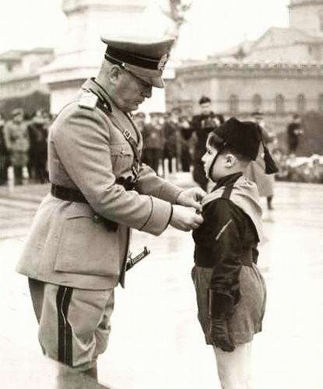
Italy Under Mussolini
Widespread Use of indoctrination and control of education
Convinced people to put goals of state before individual rights

Slide 21
Italian Expansion
Mussolini began an aggressive foreign policy
Invaded Ethiopia in 1935
What would happen?

Slide 22
Benito Mussolini - Italy
1919 advertised for War Veterans to fight politicians who were “destroying Italy.”
Feared spread of communism
Marched into Rome and got the Italian king’s permission to form a new government
Goal – wanted to make Italy a world power
Achieved efficiency, but in process crushed all opposition

Slide 23
THE RISE OF FASCISM IN ITALY
While Stalin was consolidating his power in the Soviet Union, Benito Mussolini was establishing a totalitarian regime in Italy
Mussolini seized power from King Emmanuel III during a coup d’ètat, taking advantage of high unemployment, inflation and a middle-class fear of Communism

Slide 24
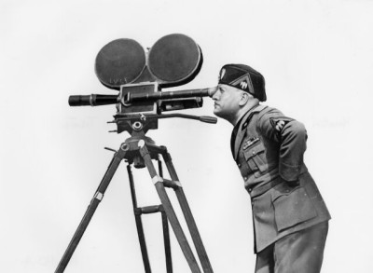
MUSSOLINI CREATES FASCIST PARTY
Mussolini was a strong public speaker who appealed to Italian national pride
By 1921, Mussolini had established the Fascist Party and government -- Fascism stressed nationalism and militarism and placed the interest of the state above the interests of the individual
By 1928 he had consolidated power and established a dictatorship suppressing all opposition

Slide 25
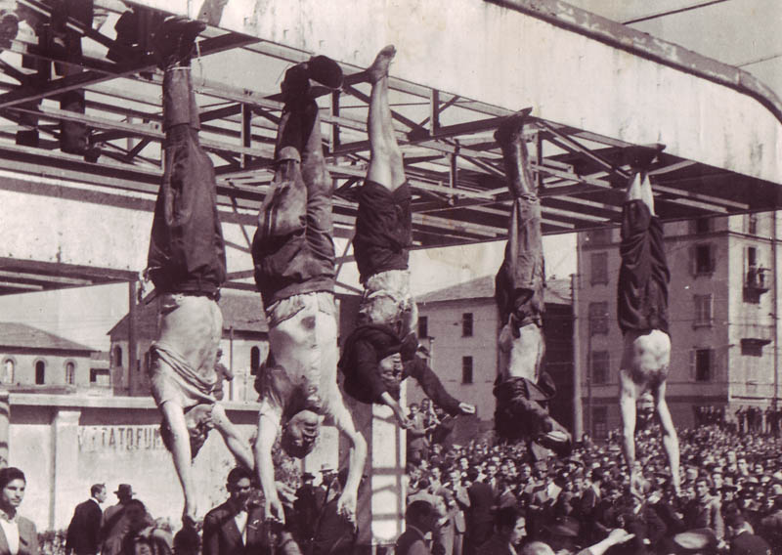
Mussolini’s Fate
After the Allies invaded Italy in July of 1945, Mussolini was forced from power and captured
Mussolini was freed by German soldiers and taken to Germany to re-establish his government
He tried to set up a new government in Northern Italy but was captured by his own people and hanged upside down

Slide 26
Points for Discussion
What is Fascism?
What conditions led many people in Italy to support Mussolini and the Fascist Party?
How did Mussolini consolidate his control over Italy?

Slide 27
DICTATORS THREATEN WORLD PEACE
For many European countries the end of World War I was the beginning of revolutions at home, economic depression and the rise of powerful dictators driven by nationalism and territorial expansion
Two powerful 20th Century dictators were Stalin & Hitler

Slide 28
Joseph Stalin – Soviet Union

Slide 29
TOTALITARIAN STATE
By 1939, Stalin firmly established in the USSR
In a totalitarian state the government suppresses all opposition and has strict control over the citizens who have no civil rights
In totalitarian states citizens are expected to treat the dictator with adoration

Slide 30
What Type of Government is STALIN running?
1 or Multi-party State?
Answer: One Party State
What type of Government?
Totalitarian
Dictatorship
Communist

Slide 31
Benito Mussolini - Italy

Slide 32
What Type of Government is MUSSOLINI running?
1 or Multi-party State?
Answer: One Party State
What type of Government?
Totalitarian
Dictatorship
Fascist

Slide 33
Francisco Franco - Spain

Slide 34
Francisco Franco - Spain
Military leader in Spain, in 1936 led a revolt against Spain’s elected party in power called the Popular Front.
Franco’s nationalist party won Spanish Civil war
After winning in 1939, his rule was law.
All opposition was ruthlessly dealt with; the nation had to endure the activities of a secret police force
Fair elections and political opposition were not tolerated
In July 1947, a law was passed that made Franco head of state for life.

Slide 35
CIVIL WAR IN SPAIN
In 1936, a group of Spanish army officers led by General Francisco Franco, rebelled against the Spanish Republic
A Civil War ensued as Hitler and Mussolini supported Franco’s fascists while the western democracies remained neutral
SPANISH LOYALIST AT THE INSTANT OF DEATH by Robert Capra, 1936

Slide 36
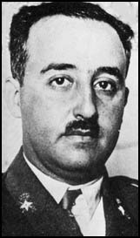
Francisco Franco
Francisco Franco took control of Spain in 1937 and became dictator, setting up a fascist government. Italy and Germany supplied him with military support needed to win control of the country. However, during the second world war, Spain stayed neutral. During WW II, he used secret police to ruthlessly deal with any opposition.

Slide 37
What Type of Government is FRANCO running?
1 or Multi-party State?
Answer: One Party State
What type of Government?
Totalitarian
Dictatorship
Fascist

Slide 38
Adolf Hitler - Germany

Slide 39
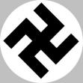
HITLER GAINS FOLLOWING
Adolf Hitler’s ability as a public speaker and organizer drew many followers
He quickly became the Nazi Party leader
Calling himself “Der Fuhrer” (the leader) he promised to return Germany to its old glory

Slide 40
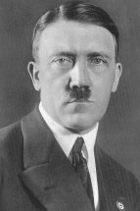
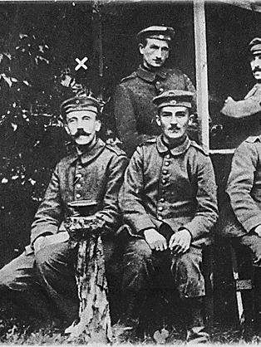
NAZIS TAKE OVER GERMANY
Meanwhile in Germany, Adolf Hitler followed a similar path to Mussolini and set up a fascist state in Germany
At the end of WWI he was a jobless soldier drifting around Germany
In 1919, he joined a struggling group called the National Socialist German Workers’ Party (Nazis)
(Despite its name the party had no ties to socialism)
Hitler, far left, shown during WWI

Slide 41
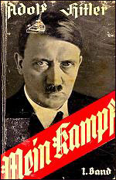
HITLER’S BELIEFS
Hitler explained his beliefs in his book, Mein Kampf, (My Struggle)
He wanted to unite all German-speaking people under one grand Empire
He wanted racial purity – “inferior” races such as Jews, Slavs and all non-whites were to form a work force for the “master race” – blond, blue-eyed “Aryans”
He alone, who owns the youth, gains the Future!
-- Adolf Hitler, speech at the Reichsparteitag, 1935

Slide 42
Revolution and the New Order
President Hindenburg nominated him as Reich Chancellor on January 30, 1933
Consolidated Presidency and Chancellorship when Hindenburg died on August 2, 1934
Established an absolute dictatorship once in power
Sent millions of “undesirables” to concentration camps and murdered up to 6 million Jewish people and 5 million of ethnic groups

Slide 43
Adolf Hitler - Germany
Belonged to National Socialist German Workers’ Party (Nazi party)
Anti- Communist, Anti-Socialist
Based on extreme Nationalism

Slide 44
Adolf Hitler - Germany
Goal:
Uniting all German speaking people in a great German empire because they were a “master” race.
National Expansion – for Germany to survive it needed more “Living Space”
“to secure German people the land and soil to which they are entitled on this earth” even if this could be accomplished only by “the might of a victorious sword.”

Slide 45
Adolf Hitler - Germany
The Great Depression and Hitler
1932 – 6 million Germans were unemployed
Germans turned to Hitler as their last hope
March 1932 elections, Nazis won the most votes
January 1933, Hitler appointed Chancellor (prime minister)
Creating the Third Reich
Quickly dismantled Germany’s democratic Weimar Republic, created THIRD REICH
1st & 2nd Reich???
Thought it would be a “1000 year Reich”

Slide 46
10th Euro Studies 3.03.15
Turn in:
Nothing
Take out :
Planner/Calendar
Notes
Textbook
Today’s Learning Objectives:
I can understand how different leaders changed the power structure in Europe following WWI.
Today’s Agenda:
The Rise of Dictators
Mussolini, Franco, Hitler, (Hirohito?)
28.2—Chart to serve as notes
HW:
TRS #2—due Wednesday: Research points
28.2—Chart to serve as notes
Nation | Politics | Foreign Policy | Economics

Slide 47
28.2: For example…
Nation | Politics | Foreign Policy | Economics
Great Britain
Germany
France
Italy
US

