Slide 1
10th Euro Studies 3.30.16
Turn in:
3 “Test” Questions on Stalin Readings
Take out :
Planner/Calendar
Notes
Textbook
Today’s Learning Objectives:
I can understand how different leaders changed the power structure in Europe following WWI.
Today’s Agenda:
The Rise of Dictators
Mussolini, Franco, Hitler, (Hirohito?)
HW:
NONE

Slide 2
Francisco Franco - Spain

Slide 3
Spain’s Background
1820—The Spanish Army overthrows the absolute monarch and makes Spain a constitutional monarchy.
1821—Absolute monarch restored by French forces
1833—to prevent a female succession, an attempted revolt by “Carlists” (Bourbon) is defeated by the army. The Carlists remain a strong, conservative force in Spanish politics.
1833-69—Rule of the Queens…army’s influence remains strong.
1869-70—Anarchy!
1870-71—Monarchy overthrown, First Republic established
1871—Army restores constitutional monarchy

Slide 4
Spain’s Background
1875-1918—Constitutional monarchy allows for “democratic elections.” System is rampant with corruption, results in an oligarchy…1898—Spanish-American War deals a fatal wound to Spain’s sense of nationalism.
1914-18—WWI, Spain remains neutral…economic growth
1918-23—economy falters (like the rest of Europe…) & 12 different governments unable to solve the problem. 1921—revolt in Spanish Morocco leads to massacre of army by Moors.
1923-30—General Primo de Rivera takes control in a bloodless coup…rules for 7years, permanently undermining the legitimacy of the monarchy.
1931—The king abdicates the throne and the Second Republic is established…

Slide 5
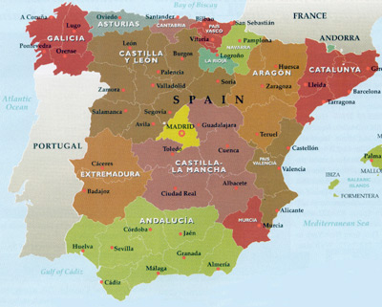
Spain’s background before 1931
Overwhelmingly agricultural population and economy
Aristocratic landowners dominated in rural areas
Extremely poor and uneducated peasantry
Church dominated schooling
Vast differences in wealth and education between cities and countryside, between regions, and between social classes
Rapid industrialization after 1910 led to emergence of working class
Growing separatist movements in Catalonia and the Basque country

Slide 6
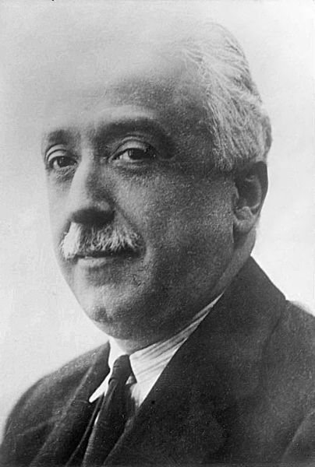
Reform Program of 1931
King fled and Second Spanish Republic was proclaimed
President Niceto Alcala Zamora
Goals
Expand power of the Cortes General
Separation of church and state
Universal suffrage
Secular school system
Govt was unable to stop mob violence against Church property and landowners
Conservatives denounced the govt for anti-clericalism, ineffectiveness, and undemocratic practices
Niceto Alcala Zamora

Slide 7
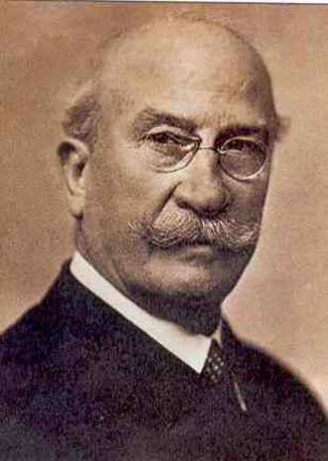
1933 Election & Aftermath
Spanish Confederation of the Autonomous Right (CEDA) won a plurality
Endorsed Alejandro Lerroux as Prime Minister
Radicals increasingly turned to violent methods
Increase in general strikes, street conflicts, assassination attempts, and attacks on religious buildings
Conservatives began to form paramilitary and vigilante groups
Govt crushed all rebellions
Support for the govt dwindled on both left and right
PM Alejandro Lerroux

Slide 8
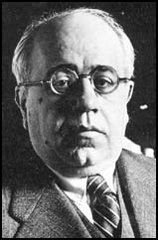
1936 Election
Loose coalition of left-wing parties called the Popular Front won a narrow victory over CEDA
Socialist Party (PSOE), Liberals, Communist Party, regional nationalist parties
Socialist Party refused to join coalition
Prime Minister Manuel Azana (liberal)
Cortes General replaced President Zamora with Azana on weak constitutional grounds
Rightists were outraged and many gave up on parliament
Manuel Azana

Slide 9
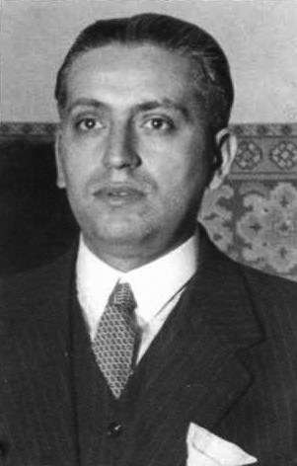
The Spark
Jose Calvo Soleto: leading monarchist and conservative in the Cortes General
Protested rising anti-religious terror, property seizures, & hasty agricultural redistribution
July 13, 1936: Murdered by police with links to the Socialist Party
Center and right parties were outraged
Nationalist generals were already planning an uprising and this provided the justification for a coup
Jose Calvo Soleto

Slide 10
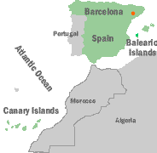
Nationalist Coup
Organized by Generals Jose Sajurjo & Emilio Mola
Prime Minister Casares Quiroga sent Generals Llopis and Francisco Franco to commands in outlying islands to distance them from coup plots
July 17: plotters broadcast the secret code to begin the coup
Llopis and Franco seized the Balearic and Canary Islands
Franco was flown to Spanish Morocco to take command of the Spanish Army of Africa

Slide 11
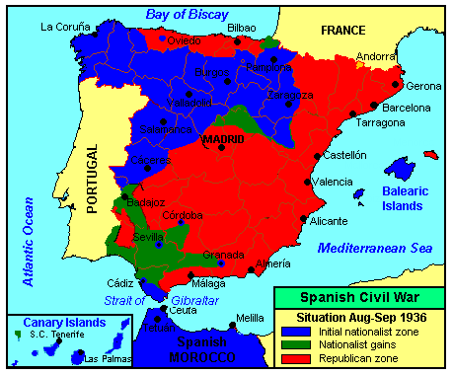
The Coup Fails
Nationalist forces failed to take control throughout most of Spain
Republican leaders were paralyzed by disagreement and indecision
In areas, workers and anarchists raided govt armories and suppressed Nationalist forces themselves
Within weeks Nationalists gained control of most of western and northern Spain
Republicans retained control of eastern and central Spain

Slide 12
The Nationalists
Cast the war as a struggle between Christian civilization and communism/anarchism
To protect tradition, security, and the rule of law
Opposed regional separatism
Strongly anti-communist
Staunchly Catholic
Favored strong central power
To defend the Church against anti-clericalism
Supporters included most businessmen, practicing Catholics, army officers, landowners
Carlists – favored restoration of the monarchy
Falange – fascist party favoring a strong dictatorship and military
Nationalists – favored a strong govt and unified country
Military – most military officers joined the Nationalists
CEDA – leaders and members of the right-wing political parties

Slide 13
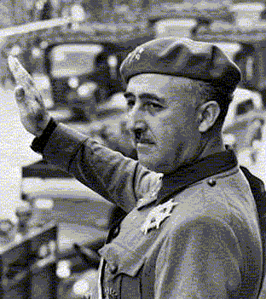
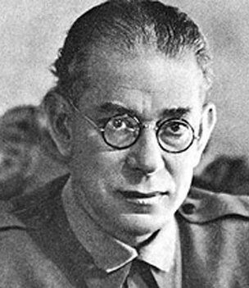
Nationalist Leaders
Francisco Franco Emilio Mola

Slide 14
The Nationalists
Cast the war as a struggle between Christian civilization and communism/anarchism
To protect tradition, security, and the rule of law
Opposed regional separatism
Strongly anti-communist
Staunchly Catholic
Favored strong central power
To defend the Church against anti-clericalism
Supporters included most businessmen, practicing Catholics, army officers, landowners
Carlists – favored restoration of the monarchy
Falange – fascist party favoring a strong dictatorship and military
Nationalists – favored a strong govt and unified country
Military – most military officers joined the Nationalists
CEDA – leaders and members of the right-wing political parties

Slide 15
The Republicans
Cast the war as a struggle between tyranny and democracy
Centrists wanted to preserve moderate capitalist democracy
Communists wanted to establish a Soviet-style “people’s republic” outlawing the right-wing
Republican groups/parties generally had a wider range of goals and ideologies
Supported by most workers, landless peasants, and educated middle class
Republican Left – favored a liberal democracy
Socialists (PSOE) – favored land distribution and worker-controlled factories
Communists (POUM) – favored a Soviet-style communist govt/economy
Trade unions – wide range of trade unions desired varying degrees of worker control over factories
Catalans & Basques – desired regional autonomy or independence

Slide 16
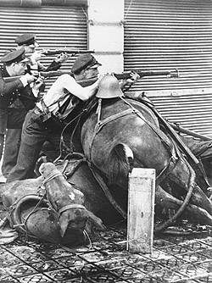
Foreign Involvement
League of Nations imposed an arms embargo to try to limit the fighting and carnage
Britain & France were sympathetic to the Republicans but chose not to sell weapons
Feared that assisting the Republicans might lead to open conflict with the Fascist powers
Arms embargo proved ineffective as weapons freely entered Spain to assist both sides

Slide 17
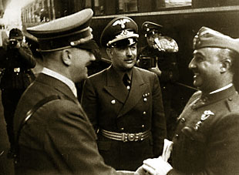
German Involvement
Franco asked Hitler and Mussolini to assist the Nationalists
Germany provided mostly aircraft, tanks, equipment and advice
19,000 troops
600 planes (Condor Legion)
200 tanks
1000 artillery pieces
Hitler’s motives
To win another ally against Britain and France
To gain access to Spanish raw materials and ports during war time
To test and improve the Luftwaffe

Slide 18
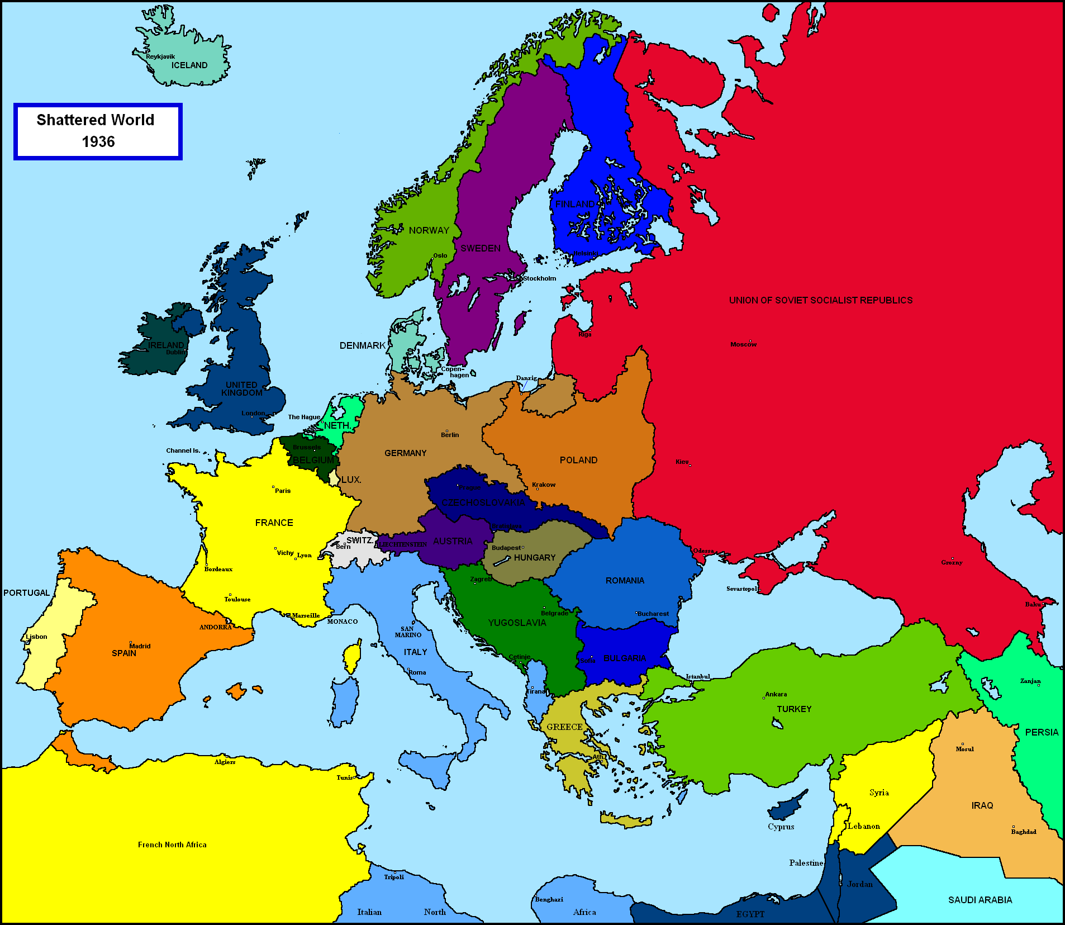
Fascism Triangle…
Block the advance of Commies!!!
MUST SURROUND THE DARN FRENCH!!!

Slide 19
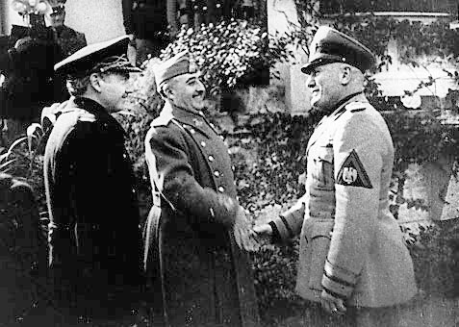
Italian Involvement
Italy provided more troops but less equipment than Germany
50,000 troops
660 aircraft
150 tanks
1000 artillery pieces
Italian Navy helped stop arms shipments to Republicans
Mussolini’s motives
Fascist solidarity
To gain concessions from Spain in the Mediterranean
Not to be outdone by Hitler

Slide 20
Soviet Involvement
Soviet Union defied the arms embargo and secretly provided the Republic with much equipment but no troops
Attempted to conceal activities by sending old equipment and disguising shipments
Arms shipments were usually small and arrived unpredictably
Forced the Republic to buy the arms using gold reserves
Equipment
3000 advisers and troops
806 aircraft
362 tanks
1555 artillery pieces
Soviet Union advised all members of Comintern to send volunteers and munitions to the Republic
Soviet agents tried to strengthen the Spanish Communist Party and weaken the other Republican factions
Stalin’s motives
To spread communism
To preoccupy the German military
To embarrass Britain and France
Soviet involvement enabled Nationalists to paint the Republicans as Bolsheviks

Slide 21
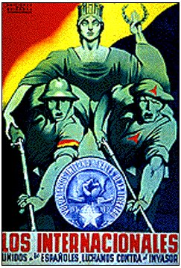
Volunteers
On the Nationalist side
8000 from Portugal
700 from Ireland
Unknown # from Romania
On the Republican side
Called the International Brigades
Saw Spain as the frontline in the fight against fascism
30,000 foreigners from 53 countries
mostly communists and intellectuals
Over 1000 each from France, Italy, Germany, Poland, US, Britain, Belgium, Ireland, Austria, Czechoslovakia, Yugoslavia, Hungary, Canada, Romania, Switzerland, China
Only the Mexican govt supported the Republic and sent a significant amount of money and equipment

Slide 22
1936
Nationalists consolidated control of northern and southern Spain
Franco consolidated his control over Nationalist forces and forced factions to unify
Nationalists launched an offensive against Madrid but were repulsed due to arrival of International Brigades
Republic moved the capital to Valencia

Slide 23
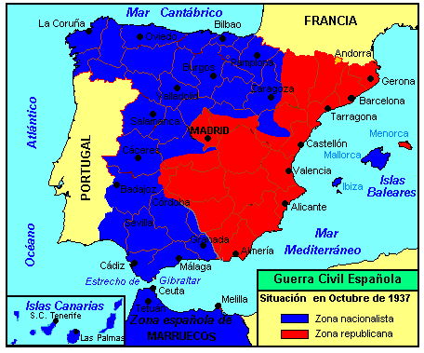
1937
Italian and German troops and equipment arrived in force
April: Condor Legion bombed town of Guernica
Republic launched counter-offensive in Madrid area and killed Mola
Nationalists consolidated control of northern Spain
Republic moved the capital to Barcelona

Slide 24
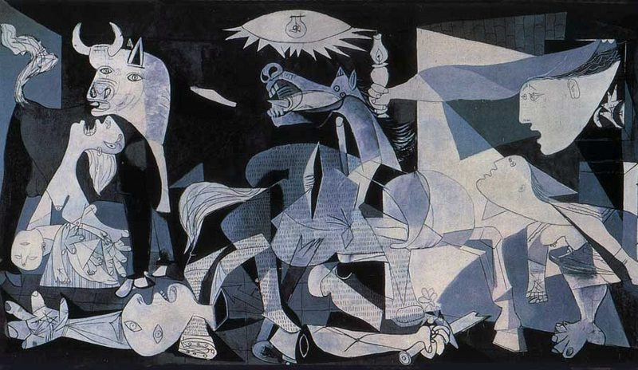
Guernica – Pablo Picasso
1937

Slide 25
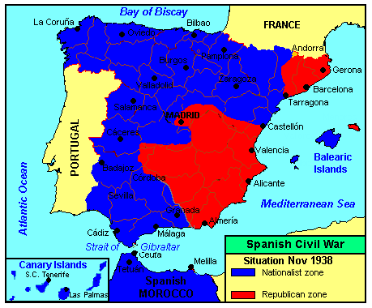
1938
Nationalists conquered most of northern Spain and isolated Catalonia from the south
Major Republican counter-offensive called the Battle of the Ebro ultimately failed
Munich Agreement destroyed Republican hope in Western support
Republic moved the capital back to Valencia

Slide 26
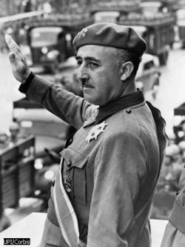
1939
Franco conquered Catalonia by February
Madrid and Valencia were conquered in March
50,000+ Republicans were executed
More were submitted to forced labor
Over 500,000 Republicans fled to France but most were deported back to Spain
Some were sent to German concentration camps during WW2
Some guerilla warfare continued into the 1950s

Slide 27
“Atrocities”
By the Nationalists
Executed at least 130,000
Targeted teachers, union leaders, officials, and citizens of captured cities
Targeted Protestants and their churches
Attempted to eradicate the Basque culture
German and Italian air forces conducted aerial bombing of cities
50,000+ Republicans were executed after the war
By the Republicans
Executed at least 55,000
Targeted clergy and desecrated Church property
Killed 20% of all Spanish clergy
Nationalist sympathizers were often killed in retaliation for Nationalist atrocities or victories
Communists frequently targeted other members of the Republican coalition

