Slide 1
9th Honors 4.22.15
Turn in:
Thesis statement
Take out :
Pen/Pencil
Planner
Internet Device
iPad
Laptop
Desktop
Today’s Learning Objectives:
I can create describe the nature of power, politics, and government
Today’s Agenda:
Government Alive!
1.1 & 1.2—how’d it go?
Online text book
HW:
1.1 & 1.2 and answer the questions in your digital notebook

Slide 2
Government Alive! Online
Go to mrsteen.weebly.com
Click on “9th Grade” banner.
Click on “Government Alive! TCI Link”
Click on “Student Sign In”
Click on “Create Account” button
Enter: steenm@issaquah.wednet.edu for teacher email.
Continue with sign up—create your own username that you will REMEMBER!
Select which period you have SS.
Check it out!

Slide 3
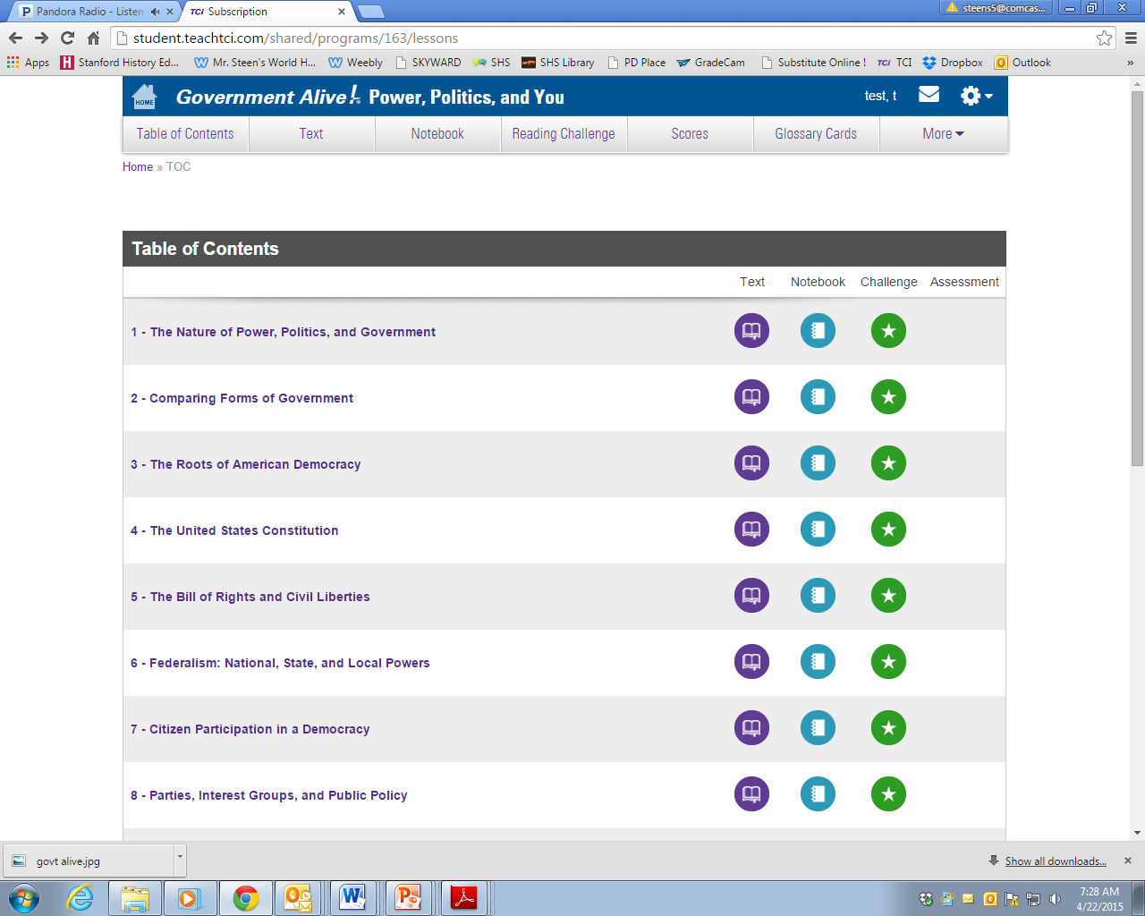
Government Alive! Online
Text
Digital Notebook
Reading Challenge
Chapters

Slide 4
Government Alive! Online
If you have completed reading 1.1 & 1.2, please provide brief answers to the questions in the “Notebook.”
Try out the features of the online text—reading challenge, glossary, etc…

