Slide 1
9th Honors 4.28.15
Turn in:
Nothing
Take out :
Pen/Pencil
Planner
Today’s Learning Objectives:
I can create describe the nature of power, politics, and government.
Today’s Agenda:
FPRP: Note cards…will discuss
What in the world?
HW:
Government Alive!
2.4-2.5: use notebook guide online & your own notes

Slide 2
Forms of Government
Describe in what type of government the United States is currently operating? Based on your reading, how would you classify the current form?
Is it still in its original form?
Is there any way to make it work more efficiently?

Slide 3
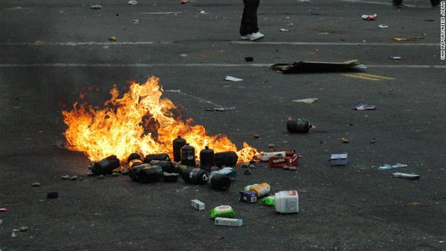
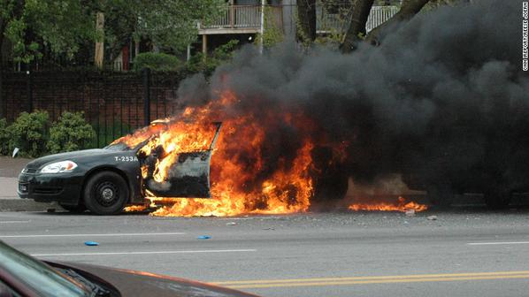
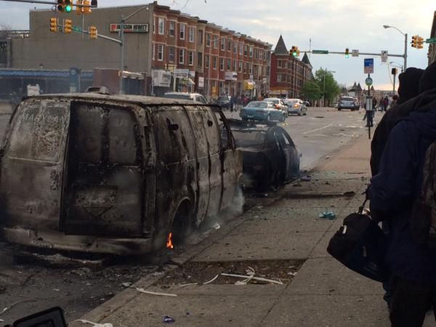
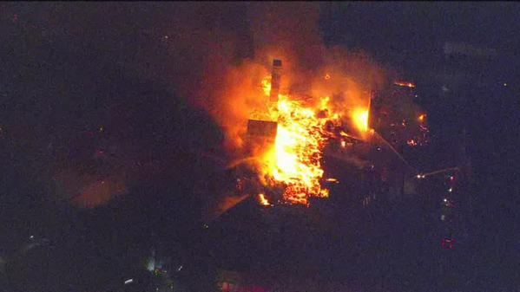
What do you see?

Slide 4
Where is this?

Slide 5
What should be “done?”

Slide 6
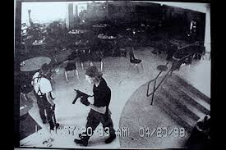
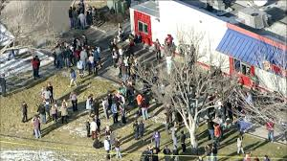
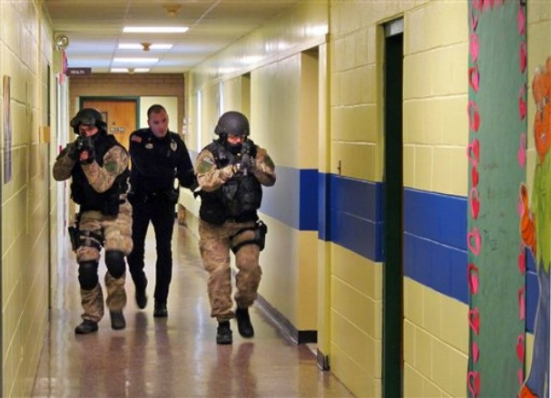
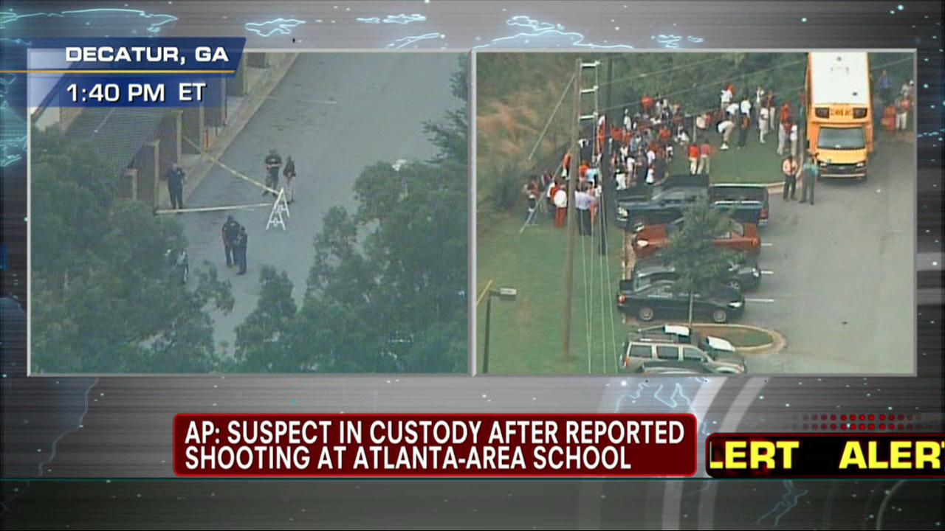
What should be “done?”

Slide 7
Forms of Government
What role should the government play in this type of scenario?

