Slide 1
10th Euro Studies 5.10.16
Turn in:
CRA 29.2
Take out :
Planner/Calendar
Note-taking device
Today’s Learning Objectives:
I can describe the events of a battle or operation of WWII and its impact on Europe.
Today’s Agenda:
Conferences
Casablanca
Atlantic
HW:
CRA Conference Readings & FOCUS questions

Slide 2
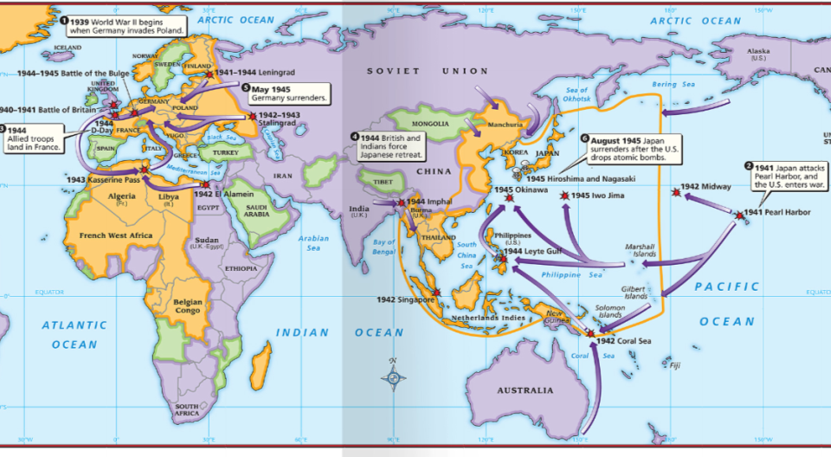
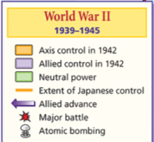
From 1939 to 1942, the Axis Powers dominated Europe, North Africa, & Asia

Slide 3
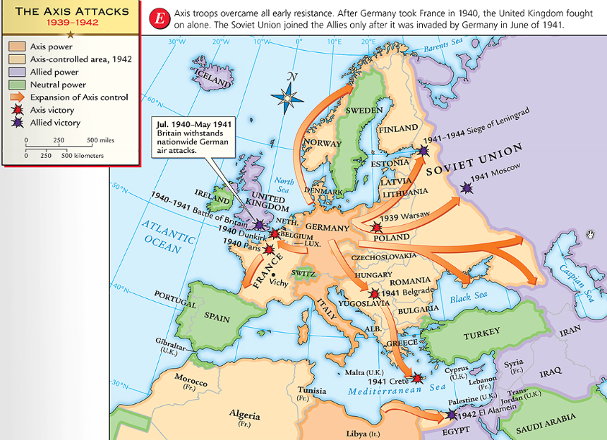
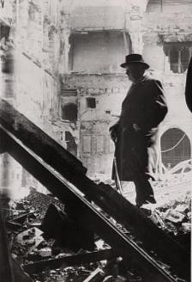
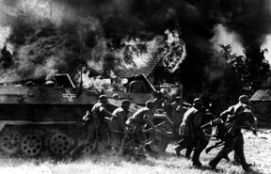
Germany used blitzkrieg tactics to dominate Eastern & Western Europe
England was wounded from German attacks in the Battle of Britain
Hitler broke the Nazi-Soviet Nonaggression Pact & marched into Russia

Slide 4
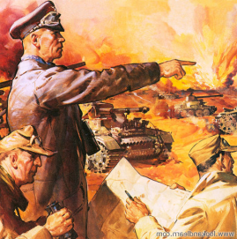
The German & Italian armies dominated Northern Africa, threatened the Suez Canal & the oil fields in the Middle East

Slide 5
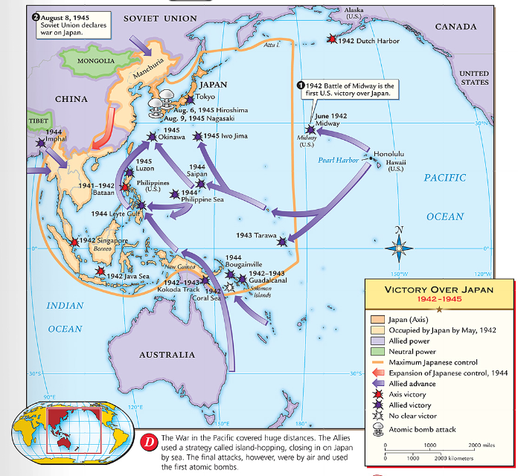
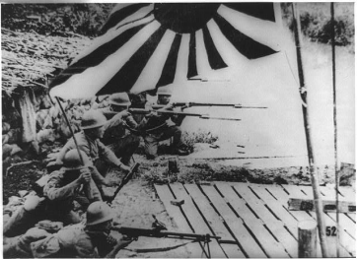
The Japanese dominated Asia, crippled the U.S. navy after the Pearl Harbor attack, & seized most Western colonies in the Pacific

Slide 6
However, the Allied Powers began to turn the tide of the war in 1942 & defeated the Axis Powers by 1945

Slide 7
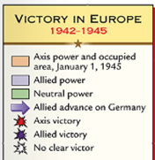
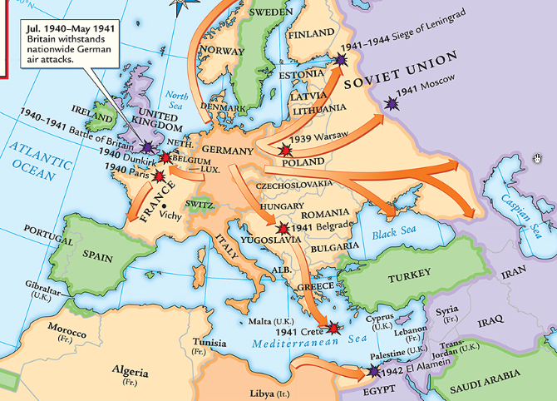
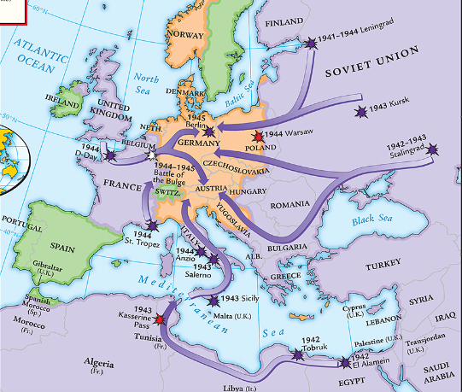
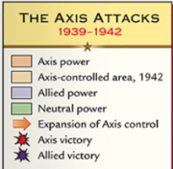
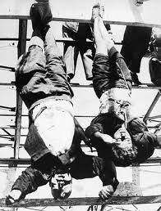
American & British troops invaded Italy, took Sicily in 1943, seized Rome in 1944
The Allies defeated Germany at the Battle of El Alamein in 1942 & then pushed the Axis Powers out of Africa
When the USA entered WWII, Stalin wanted the Allies to open a Western Front & divide German army
Instead, Britain & USA agreed to fight the Axis Powers in North Africa (Stalin was angry )
In 1945, Mussolini was captured & executed by the Italian resistance

Slide 8
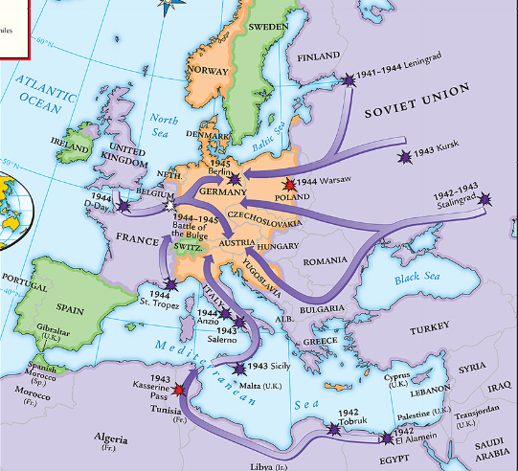
Meanwhile, the Soviet army stopped the German attack at Moscow & Leningrad in 1942
The Soviets defeated the German army at the Battle of Stalingrad
The Soviet victory at Stalingrad was a turning point in World War II because the Russians began pushing towards Germany from the East by 1943

Slide 9
Accomplished
Post war world.
“…all men in all lands may live out their lives in freedom from fear and want.”
A system of “general security” (collective).

Slide 10
Accomplished
Unconditional surrender of the Axis Powers.

Slide 11
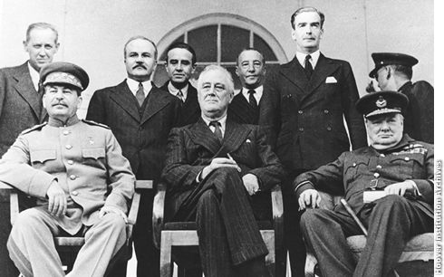
In 1943, Joseph Stalin (USSR), Franklin Roosevelt (USA), & Winston Churchill (Britain) met in Tehran to coordinate a plan to defeat Germany
At the Tehran Conference, the “Big Three” agreed to open a second front to divide the German army

Slide 12
Accomplished
Allied plans against Germany
First for Big Three
Soviet involvement against Japan.
Iran’s independence.

Slide 13
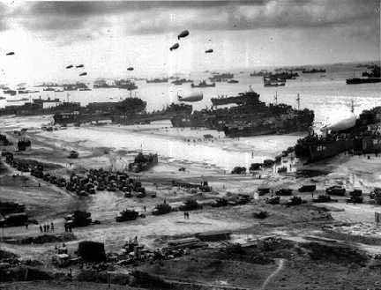
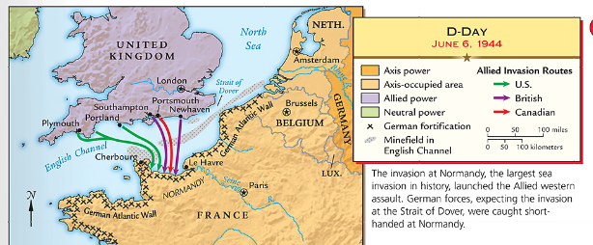
By 1944, the Allies decided to open a Western Front by invading Nazi-occupied France
Operation Overlord (called D-Day) in June 1944 was the largest land & sea attack in history

Slide 14
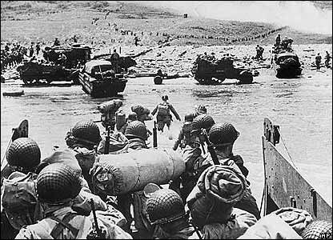
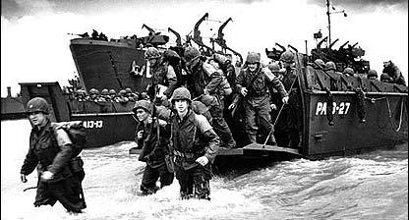
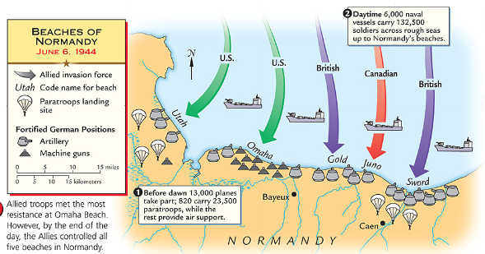
…and allowed the Allies to push towards Germany from the West
At the same time, the Soviet army pushed from the East
The Normandy invasion was deadly, but the Allied victory created a Western Front…
Forced to fight a two-front war, Hitler ordered a massive counter-attack at the Battle of the Bulge..but lost
By March 1945, the Allies were fighting in Germany & pushing towards Berlin

Slide 15
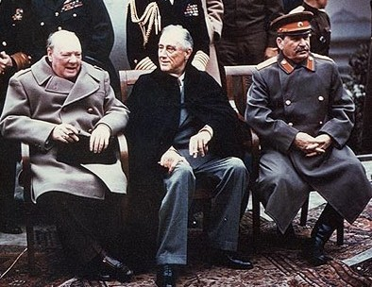
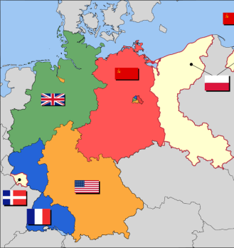
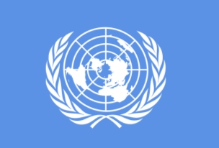
In February 1945, the “Big Three” met at the Yalta Conference to create a plan for Europe after the war was over
Stalin agreed to send troops to help the U.S. invade Japan
They agreed to allow self-determination (free elections) in nations freed from Nazi rule
They agreed to occupy Germany after the war
They agreed to create & join a United Nations

Slide 16
Accomplished
European stability.
Division of Germany.
Prosecution of criminals
Poland.
UN.
USSR against Japan.

Slide 17
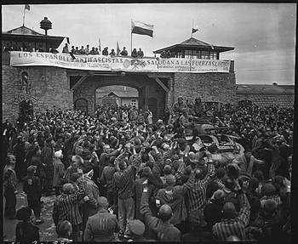
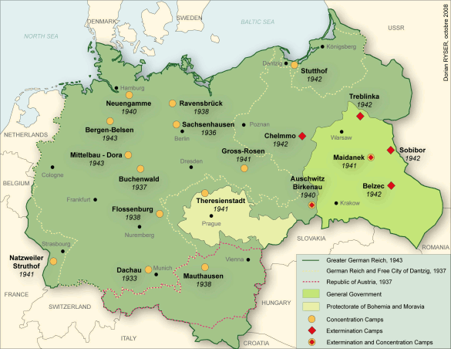
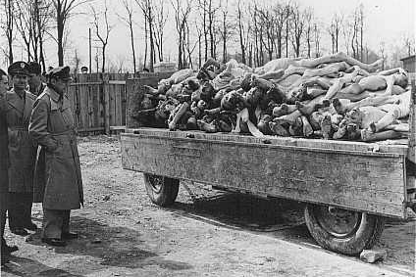
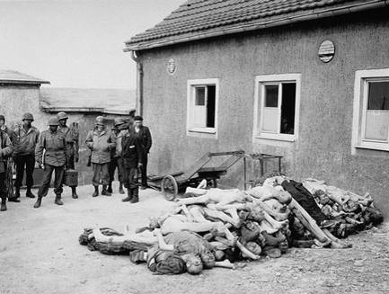
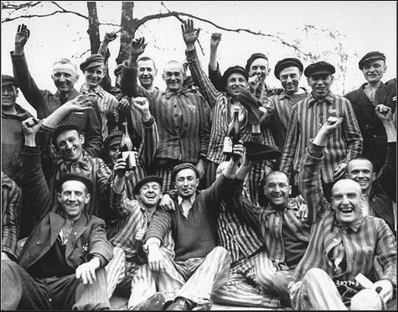
As the Allies pushed into Germany & Poland, troops discovered & liberated concentration & death camps

Slide 18
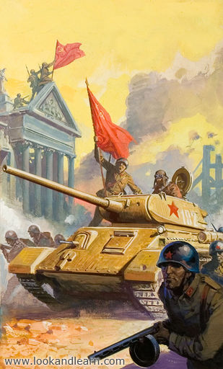
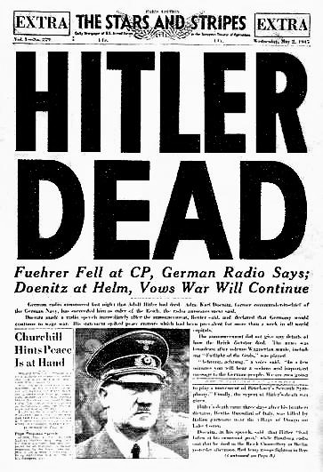
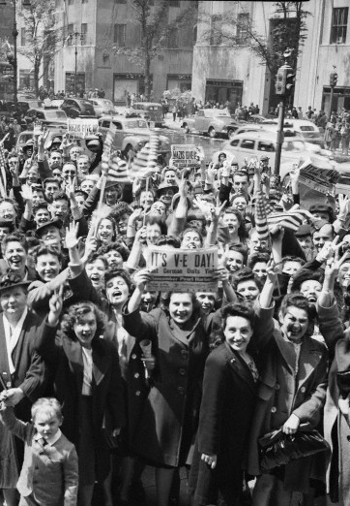
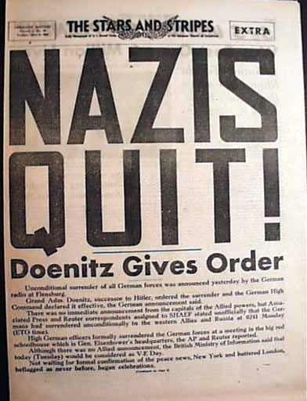
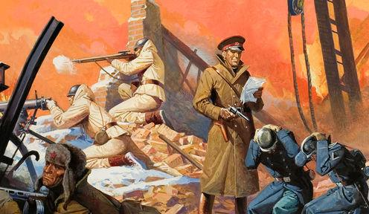
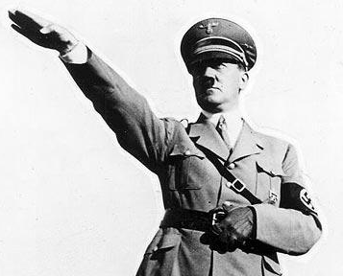
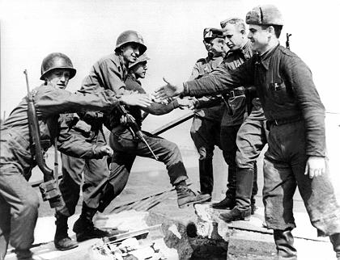
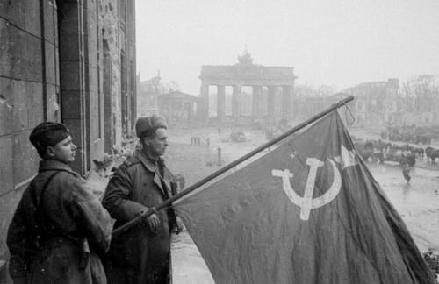
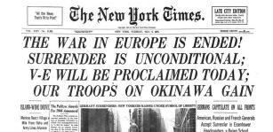
In April 1945, the Soviet army captured Berlin
On April 30, 1945, Hitler committed suicide
On May 9, 1945, the German government signed an unconditional surrender to the Allies
The world celebrated V-E Day (Victory in Europe)

Slide 19
While the war was coming to an end in Europe, the Allies continued to fight the Japanese in the Pacific

Slide 20
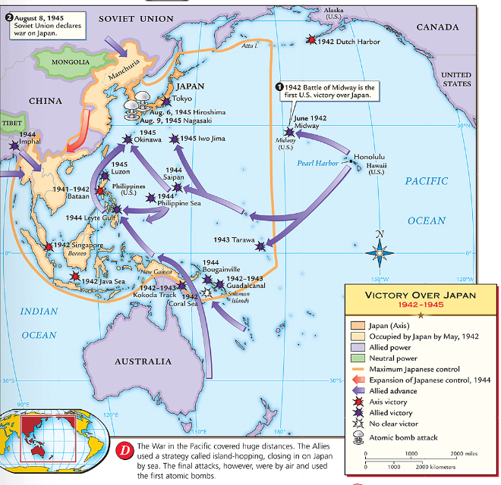
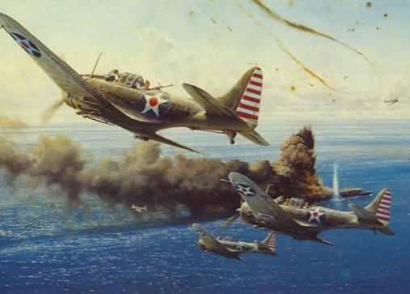
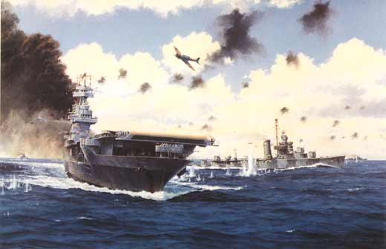
After the attack on Pearl Harbor, the USA sent troops to the Pacific theater
The Pacific war revealed a new kind of fighting by using aircraft carriers
The turning point in the war in the Pacific came at the Battle of Midway
After Midway, the Allies began to regain islands controlled by Japan

Slide 21
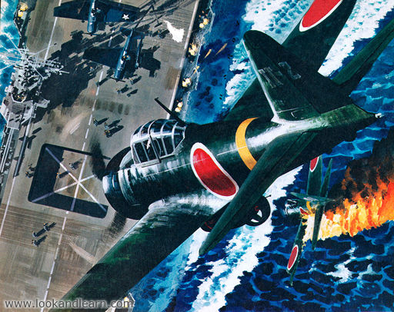
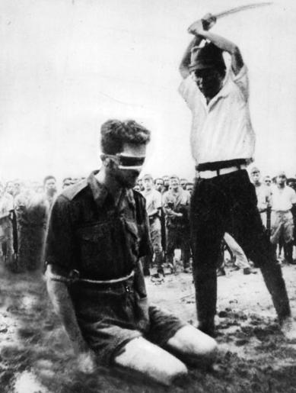
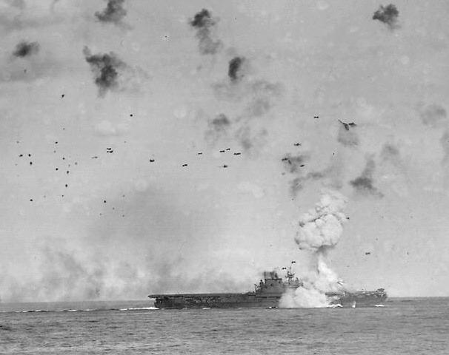
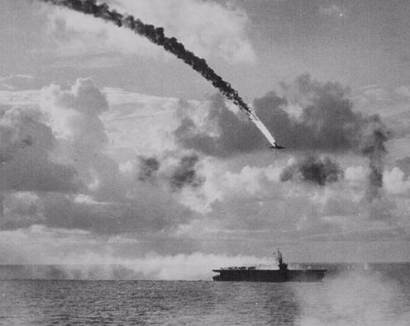
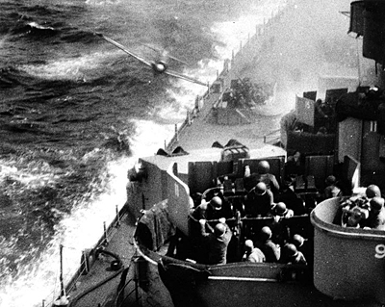
Japan did not play by traditional rules in war
“Kamikaze” pilots flew planes into battleships & aircraft carriers
Japanese soldiers refused to surrender & tortured Allied prisoners of war

Slide 22
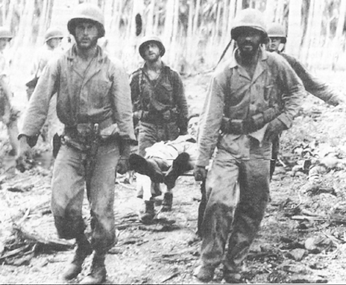
The problem for the Allies was the time & troops it would cost to retake the thousands of islands the Japanese controlled in the Pacific
The U.S. developed an island-hopping strategy to skip the heavily defended islands & seize islands close to Japan
From 1943 to 1945, the Allies took back the Philippines & were moving in on Japan
The fight for Guadalcanal took 6 months & cost 25,000 Japanese & 2,000 U.S. lives

Slide 23
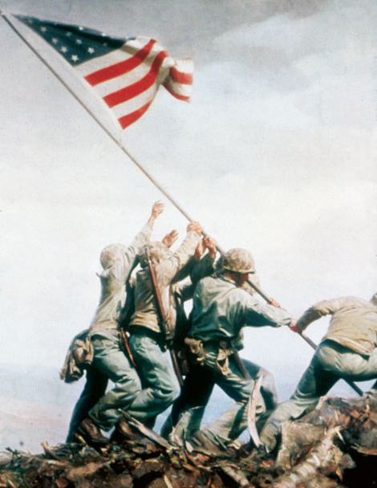
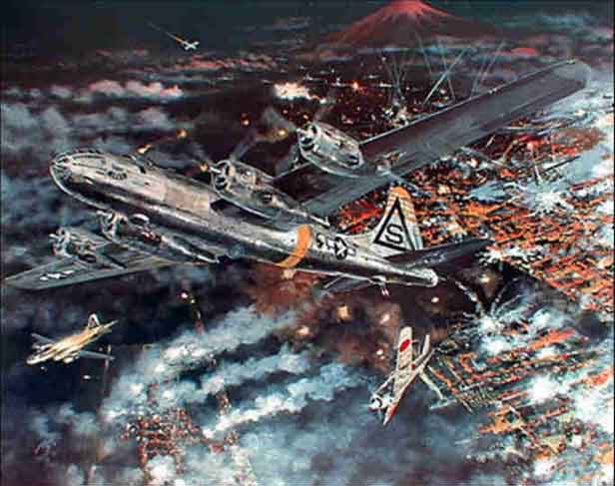
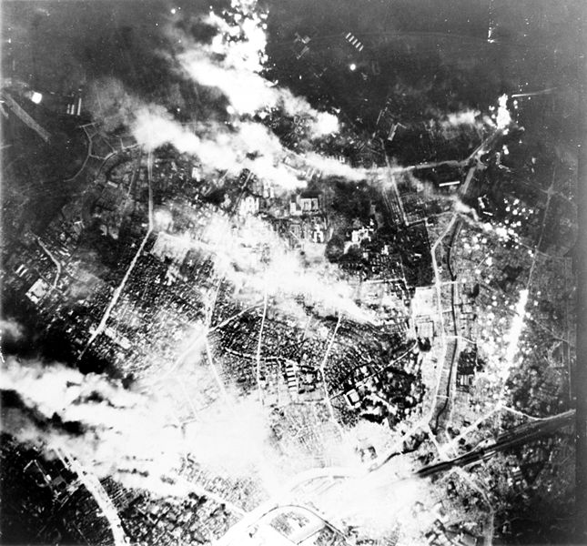
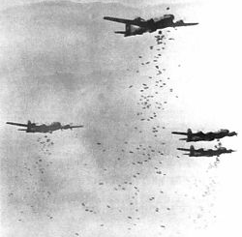
In 1945, the Allies won the islands of Iwo Jima & Okinawa
From these islands, the U.S. began firebombing Japanese cities
Aerial view of Tokyo during bombing
Victims of Tokyo firebombing

Slide 24
Despite losing control of the Pacific & withstanding firebomb attacks, Japan refused to surrender
By May 1945, the war in Europe was over & U.S. began preparing for a land invasion of Japan
…But, perhaps a land invasion was not necessary…

Slide 25
In July 1945, the bomb was successfully tested at Los Alamos, New Mexico during Project Trinity
The bomb was constructed in a secret city in Oak Ridge, TN
Physicist Enrico Fermi at the University of Chicago developed the nuclear reaction
Nuclear plant in Hanford, WA developed the plutonium
In April 945, FDR died & his VP Harry Truman had to decide how to end the war in the Pacific

Slide 26
In July 1945, the Big Three met at the Potsdam Conference to discuss the end of WWII
Truman learned the atomic bomb was ready & issued the Potsdam Declaration to Japan: “surrender or face destruction”

Slide 27
Accomplished
Atlee and Truman are new.
Four power control over Germany.
Disagreements over “spheres of influence”.
Disagreements over Polish question, fate of Germany.
Cold War begins.

Slide 28
When Japan refused to surrender, Truman ordered the bombing of Hiroshima on August 6, 1945
After 3 days, Japan did not surrender so a 2nd atomic bomb was dropped on Nagasaki
After the second atomic bomb, Emperor Hirohito agreed to a surrender

Slide 29
World War II was over

