Slide 1
10th Euro Studies 5.11.16
Turn in:
Atlantic & Casablanca Questions
Take out :
Planner/Calendar
Note-taking device
Today’s Learning Objectives:
I can describe the events of a battle or operation of WWII and its impact on Europe.
Today’s Agenda:
Conferences
Others…
Yalta
HW:
CRA Conference Readings & Discussion Questions (available online only)—turn in hard copy tomorrow

Slide 2
London Economic Conference June 12, 1933 66 Nations
Goal: to organize a coordinated attack on the global depression
Essential to revive world trade
Roosevelt withdrew from conference
Withdrawal caused the whole conference to collapse
Emphasized isolationism and American “protectionism”

Slide 3
Munich Conference September 29, 1938 Germany, France, Britain, Italy
Hoped to maintain peace by appeasing Germany/Hitler
Betrayed Czechoslovakia to Hitler--allowed Hitler to take Czech in exchange for leaving the Sudetenland
Hitler promised that the Sudetenland was “the last territorial claim I have to make in Europe”
Hitler broke his promise in March of 1939 and took the rest of Czechoslovakia

Slide 4
Molotov-Ribbentrop Treaty August 23,1939 Germany, Russia
Formalized alliance between U.S.S.R. and Germany
Considered the “Soviet-German Nonaggression Pact”
Defined secret protocols and spheres of influence in Eastern Europe
Agreed to jointly take over Poland
Would later be violated by Hitler

Slide 5
Havana Conference July 21, 1940 20 Western Hemisphere Countries, U.S.
Purpose: To uphold the Monroe Doctrine in the face of global aggression
the doctrine warns European nations that the United States would not tolerate further colonization or puppet monarchs.
Share information for mutual defense
If aggressive action was taken by any non-American nation is made, all American nations would confer to decide on measures to take

Slide 6
Atlantic Charter August 14, 1941 Britain, U.S. (later included Russia)
Formalized the alliance between Great Britain and America
Established war-time strategy--”Europe first”
Developed post-war plans
No territorial changes
Self-Determination
Establishment of the United Nations
Facilitate free trade
Demilitarize

Slide 7
Accomplished
“…all men in all lands may live out their lives in freedom from fear and want.”
A system of “general security” (collective)—The United Nations...

Slide 8
Casablanca January 14, 1943 U.S. and Britain
Establish military strategy
Step up war in Pacific
Invade Sicily
Increase pressure on Italy
Agreed that belligerents would be forced to surrender unconditionally
Brought the two exiled French resistance leaders, Henri Giraud and Charles de Gaulle, together

Slide 9
Cairo Conference November 1943 U.S., Britain, China
Determine postwar settlement of Asia
Restore all Chinese land from Japan
Secure Korean sovereignty
Permit return of Taiwan and Manchuria to China
Stalin refused invitation because a meeting with Chiang Kai-Shek may have provoked a war between Japan and Russia

Slide 10
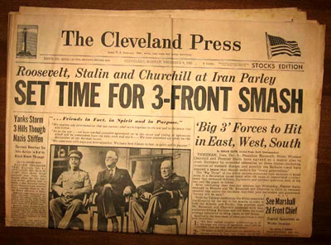
Tehran November 28, 1943 U.S., Britain, Russia
First time the Big Three met together
Discussed military strategy
Open Second Front--D Day invasion
Simultaneous Third Front--Russian counter-attack (pincer movement)
Russian commitment to attack Japan after German defeat
Inconclusive regarding postwar Germany

Slide 11
Bretton Woods Economic Conference July 1, 1944 44 Nations
International monetary fund
Fixed exchange rate based on gold
International bank for reconstruction and development

Slide 12
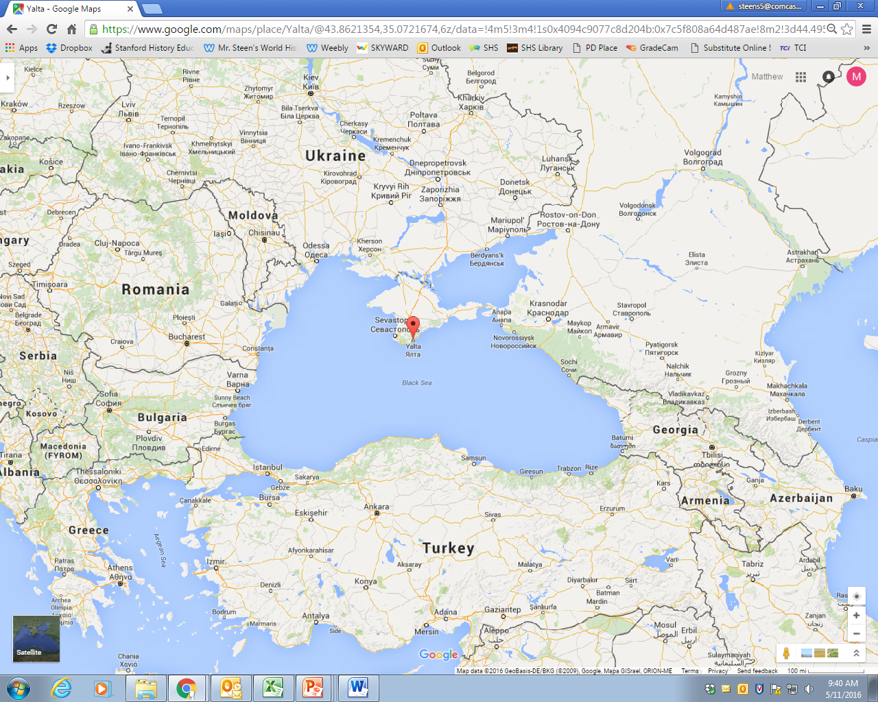
Yalta February 4, 1945 U.S., Britain, Russia

