Slide 1
10th Euro Studies 5.9.16
Turn in:
29.2—CRA up to 1st Checkpoint Question
Take out :
Planner/Calendar
Note-taking device
Today’s Learning Objectives:
I can describe the events of a battle or operation of WWII and its impact on Europe.
Today’s Agenda:
Recap Battles
HW:
CRA 29.2 (from 1st checkpoint on…)

Slide 2
Recapping the Battles:
Please assemble your groups
Be able to talk intelligently about the following:
Timeframe of the battle/operation
Who was involved and who “won”
The geography of the battle/operation (where it took place, or how it took place, depending upon the battle/operation)
Significance of the battle/operation to WWII…there might be more than one!
You should also prepare to answer specific questions pertaining to your battle/operation.

Slide 3
Recapping the Battles:
We will be coming to your group for an explanation of the four points
You will ALL be responsible for knowing these basic details…

Slide 4
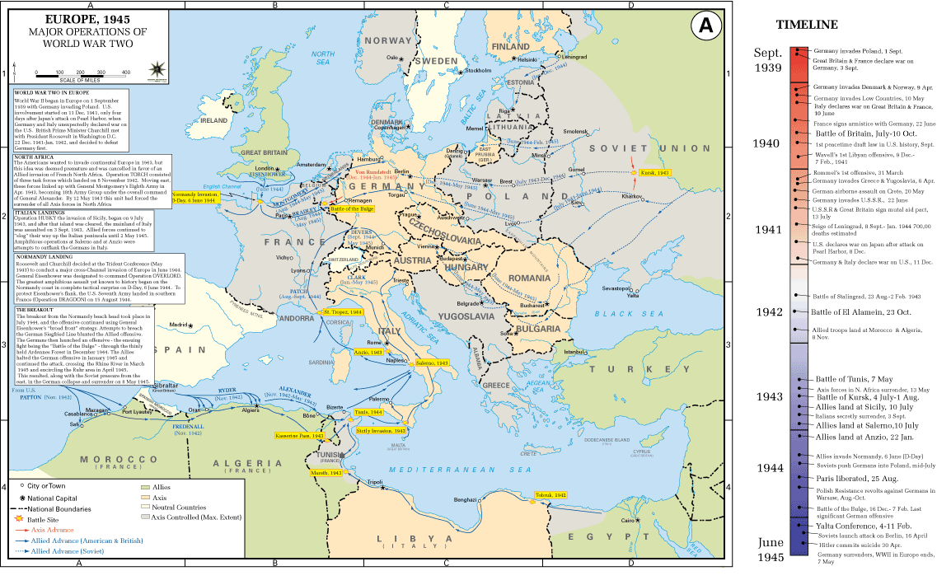

Slide 5
Winston Churchill:
https://www.youtube.com/watch?v=7-s9ji6XdAY
https://www.youtube.com/watch?v=5IHadByMvXk
Bob: http://www.historyanimated.com/wwiianimated.com/BritainAnimation.html

Slide 6
Operation Barbarossa:
https://www.youtube.com/watch?v=83R2MGZxdnY
http://www.the-map-as-history.com/demos/tome08/03-world_war_II_1941_1942_demo.php

Slide 7
Dresden:
http://www.telegraph.co.uk/history/world-war-two/11393917/The-firebombing-of-Dresden-archive-footage.html
D-Day:
Interviews: https://www.youtube.com/watch?v=17jkQeus3uQ
The landing: https://www.youtube.com/watch?v=82RTzi5Vt7w

Slide 8
BOB
BOB interviews: https://www.youtube.com/watch?v=AMUbF0ItdT0
HBOgo: http://www.hbogo.com/#home/

