Slide 1
IB Psych 9/13/18
DUE:
Nothing
Take out :
Notes/Paper
Note-taking devices
Today’s Learning Objectives:
I can begin to address a command terms and understand the structure of an SAQ.
I can explore the themes of ethics in research.
Today’s Agenda:
Marking our first SAQ
Command Terms
Ethics Intro
HW:
Be sure to have the reading done (so we can “Celebrate”):
--Discussion Section of “Brain Drain”
--Module 1

Slide 2
Command Terms
Command Term | IB “Definition” | What is really means…
Describe | Give a detailed account | Write a narrative that outlines the details of something using examples.
Outline | Give a brief account or summary of something. | Give a brief summary of whatever is mentioned in the question.
Explain | Give a detailed account including reasons and causes. | Give reasons and causes for a behavior or psychological phenomenon.
Construction of Prompts: A General Guideline
Describe the use of one research method in the cognitive approach to studying human behavior.
Command Term: The task | The topic or theory | Approach to Psychology
Describe | research method(s) | cognitive approach

Slide 3
Ethics: “Moral principles that govern a person's behavior or the conducting of an activity.” (OED)
What needs to be addressed in dealing with ethical principles for psychological research ?

Slide 4
6 Key Themes in Ethical Research
Informed Consent
Freedom from Coercion
Protection from Physical and Psychological Harm
Protection of Privacy, Confidentiality, or Anonymity
The Risk-Benefit Rule
Debriefing

Slide 5
6 Key Themes in Ethical Research
Informed Consent
According to the APA guidelines:
“…psychologists inform participants about
the purpose of the research, expected duration and procedures;
their right to decline to participate and to withdraw from the research once participation has begun;
the foreseeable consequences of declining or withdrawing;
reasonably foreseeable factors that may be expected to influence their willingness to participate such as potential risks, discomfort or adverse effects;
any prospective research benefits;
limits of confidentiality;
incentives for participation;
whom to contact for questions about the research and research participants' rights.
They provide opportunity for the prospective participants to ask questions and receive answers.”

Slide 6
6 Key Themes in Ethical Research
Freedom from Coercion
Restrictive techniques such as extended audio, visual, verbal, or tactile fixation, exhaustive, exact repetition of routine activities, sleep restriction, and/or social restriction. Establishment of control over the victim's social environment, time, and sources of social support by creating social isolation Rejection of alternate information and separate opinions. Rules exist about permissible topics to discuss. Communication is highly controlled. Forcing the victim to re-evaluate the most central aspects of his or her experience of self and prior conduct in negative ways. The victim is made to feel like a "bad" person. Creating a sense of powerlessness by subjecting the victim to intense and frequently confusing, conflicting actions and situations which undermine the victim's self-confidence and judgment. Creating strong, aversive, emotional arousals in the subject Intimidation of the victim

Slide 7
6 Key Themes in Ethical Research
Protection from Physical and Psychological Harm
What constitutes “harm?”
What if it is temporary? What is temporary/long-lasting?
Protection of Privacy, Confidentiality, or Anonymity
Where is this line? What if subjects require follow-up?
Are there times in which this can be ignored or revealed for the sake of the common good?

Slide 8
6 Key Themes in Ethical Research
The Risk-Benefit Rule
Risk is defined as the probability of physical, psychological, social, or economic harm occurring as a result of participation in a research study. Both the probability and magnitude of possible harm in human research may vary from minimal to considerable.
The federal regulations define only "minimal risk." Minimal risk exists where the probability and magnitude of harm or discomfort anticipated in the proposed research are not greater, in and of themselves, than those ordinarily encountered in daily life or during the performance of routine physical or psychological examinations or tests. [45 CFR 46.102(i)]

Slide 9
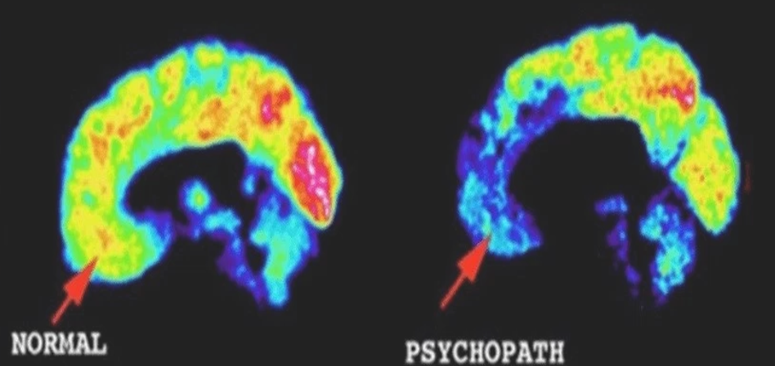
The Risk-Benefit Rule: So then…
Dilemma: If we could predict crimes (or criminals more specifically), say murders for example, what responsibility do we have as a society to act on that “information?”
Meet Tom Cruise as John Anderson:
https://www.youtube.com/watch?v=2l_IUAcvfv8

Slide 10
6 Key Themes in Ethical Research
Debriefing
Section 8.08 of APA Guidelines for Research
Psychologists provide a prompt opportunity for participants to obtain appropriate information about the nature, results, and conclusions of the research, and they take reasonable steps to correct any misconceptions that participants may have of which the psychologists are aware.
If scientific or humane values justify delaying or withholding this information, psychologists take reasonable measures to reduce the risk of harm.
When psychologists become aware that research procedures have harmed a participant, they take reasonable steps to minimize the harm.

Slide 11
Special Issue: Deception
Is Deception Permissible?

Slide 12
When is Deception Permissible?
According to the American Psychological Association (APA), it is permissible to use deception under these conditions:
The research is important
There are no alternatives
There is no foreseeable harm to participants
Sometimes deception is the only way to investigate important questions.

Slide 13
APA on Deception
a) Psychologists do not conduct a study involving deception unless they have determined that the use of deceptive techniques is justified by the study's significant prospective scientific, educational, or applied value and that effective non-deceptive alternative procedures are not feasible.
(b) Psychologists do not deceive prospective participants about research that is reasonably expected to cause physical pain or severe emotional distress.
(c) Psychologists explain any deception that is an integral feature of the design and conduct of an experiment to participants as early as is feasible, preferably at the conclusion of their participation, but no later than at the conclusion of the data collection, and permit participants to withdraw their data.

