Slide 1
European Studies 9.14.15
Turn in:
  NOTHING
Take out:
  Planner,
  pen, paper for other notes.
Today’s Learning Objectives:
  I can describe what impact the Catholic Church had on people in the Middle Ages.
Today’s Agenda:
More Definitions: “Vernacular”
More hierarchy
Group Readings—you’ll help all of us…
HW: Church Hierarchy Chart with definitions (stamp)

Slide 2
In your table groups:
  Write down the questions for your particular reading
  CRA the brief reading provided to your group
  Discuss the answers at your table
  Be prepared to share out with the group, so we can all be brilliant!
As individuals:
  Begin to fill in the hierarchy chart as you read and listen to other groups…we will be coming back to it a bit.
  Also define the “vernacular” as best you can.

Slide 3
Role of the Catholic Church in Medieval Society
How did the Catholic Church influence everyday life during the Middle Ages?
How did the Catholic Church impact the SPEC of the Middle Ages?

Slide 4
Catholic Church Key Terms
Monastery
Clergy
Excommunicate
Relic
Sacrament
Monasticism
Friar

Slide 5
3.2—Church Organization

Slide 6
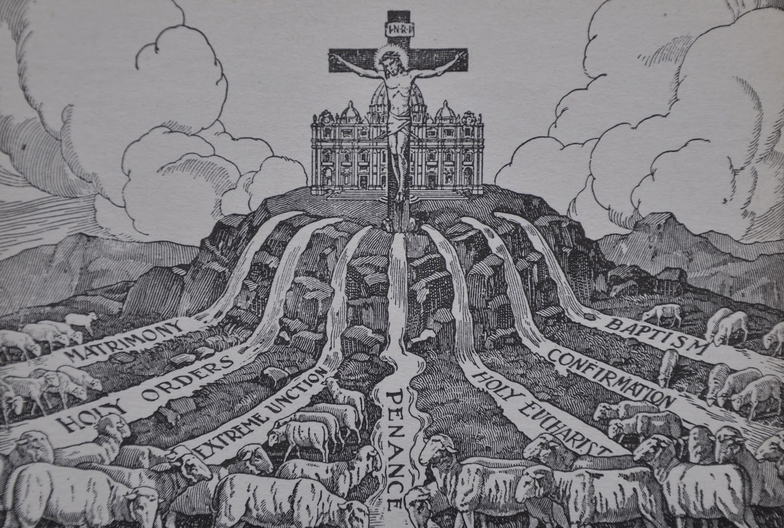
3.3--Sacraments

Slide 7
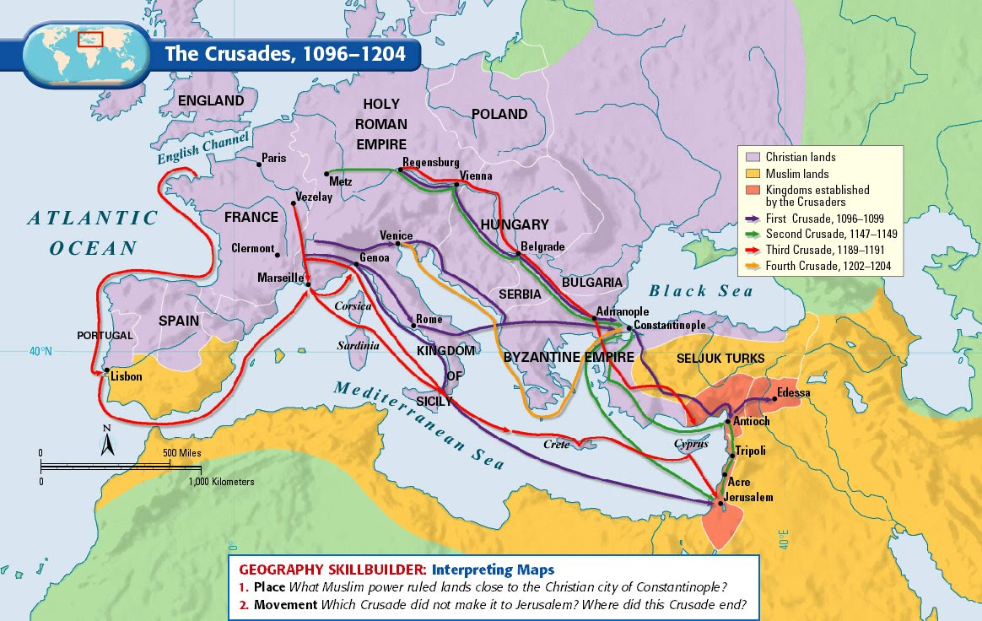
3.4--Pilgrimages

Slide 8
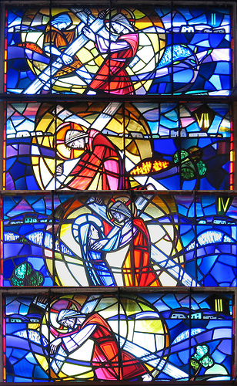
3.5—Art & Architecture

Slide 9
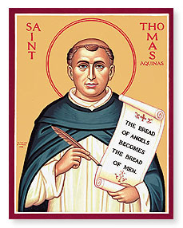
3.6--Education
Who was Thomas Aquinas?

Slide 10

3.7--Holidays
What role did holidays play in the lives of Christians?

Slide 11
3.8—Monastic Life
What is the difference between medicant friars and monks?
What was life for a monk like?

