Slide 1
European Studies 9.16.15
Turn in:
Church Hierarchy Chart with definitions (stamp)
Logout: Online questions
Take out:
Planner
Stamp Sheet
Art supplies?
pen, paper for other notes.
Today’s Learning Objectives:
I can describe what impact the Catholic Church and the Crusades had on people in the Middle Ages.
Today’s Agenda:
Nursery Rhyme Time!
The Crusades
HW:
In-Class: Create your own nursery rhyme

Slide 2
European Studies 9.16.15
What nursery rhymes can you recall from your lovely childhood?
Do you know what they were really about?

Slide 3
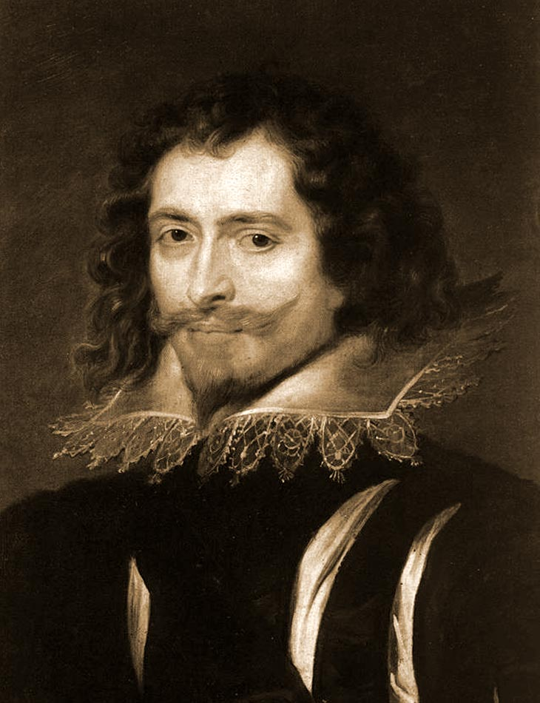
Georgie Porgie
Georgie Porgie pudding and pie, Kissed the girls and made them cry When the boys came out to play, Georgie Porgie ran away.
George Villiers: Great friend of King James I of England…as well as a dear friend of Anne of Austria—the wife of the French King, Louis XIII.

Slide 4
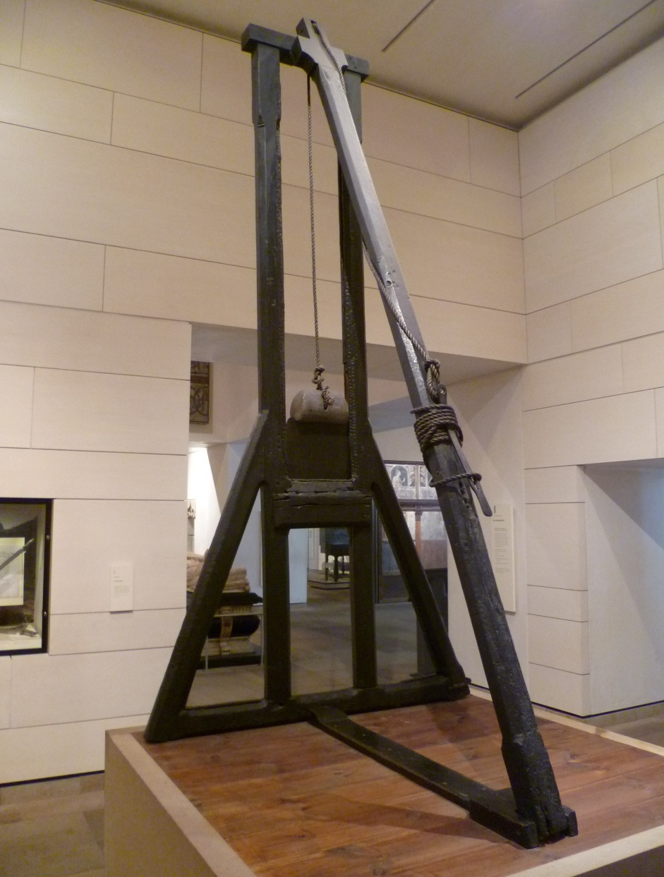
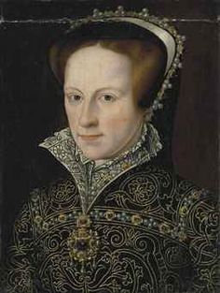
Mary, Mary, Quite Contrary
Mary Mary quite contrary, How does your garden grow? With silver bells and cockle shells And pretty maids all in a row.
Mary Tudor: daughter of King Henry VIII, strict Catholic, and opposed to any Protestant faith within her beloved country! Earned the nickname, “Bloody Mary”

Slide 5
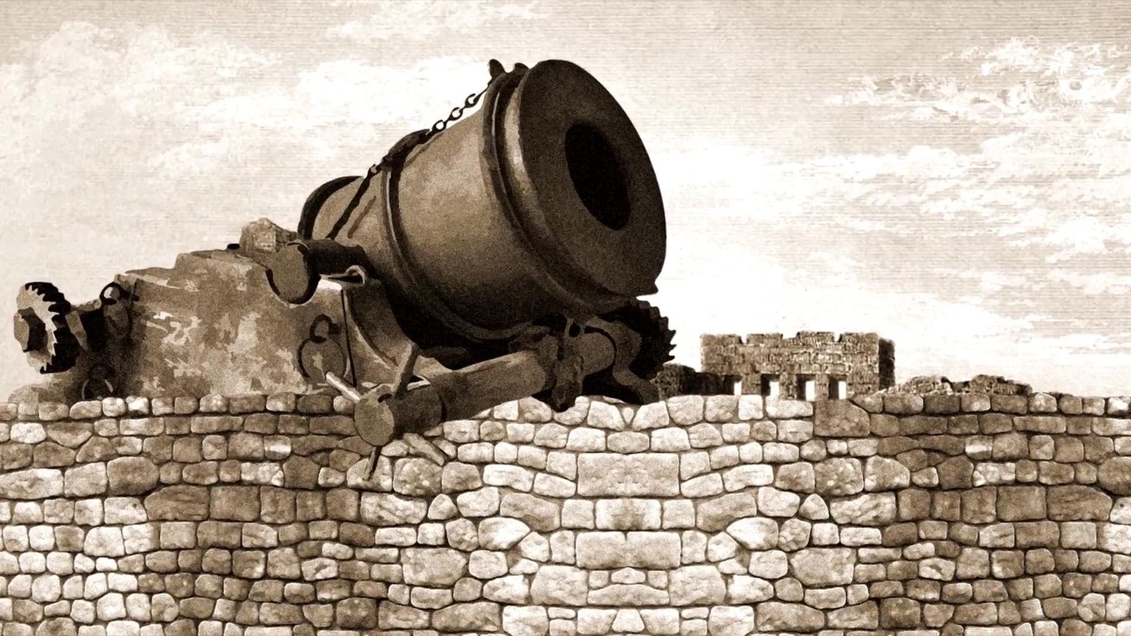
Humpty Dumpty
Humpty Dumpty sat on a wall, Humpty Dumpty had a great fall. All the King's horses, And all the King's men Couldn't put Humpty together again!
Humpty Dumpty: often referred to folks with some large girth…but in this case, it refers to a cannon sitting atop of St. Mary’s Church, destroyed in the English Civil War.

Slide 6
Nursery Rhyme Time!
In your groups, read the background info on the Crusade you have been provided.
Create your own nursery rhyme that describes the details…
However, you MUST use fictitious names, places, etc.
Otherwise, you may face the wrath of the king, pope, or other important person…

