Slide 1
10th World Studies 9.22.15
Turn in:
Logout question (Online)
Take out:
Planner
Pen/pencil
Notes from yesterday
Today’s objective:
I can describe how the time period following the Middle Ages began to take shape and lay the foundation for a modern world.
Today’s Agenda:
The “ism’s” of the Renaissance
Online Textbook
HW:
CRA remainder of 13.1 & answer logout questions

Slide 2
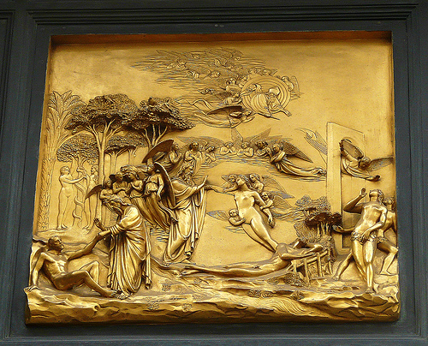
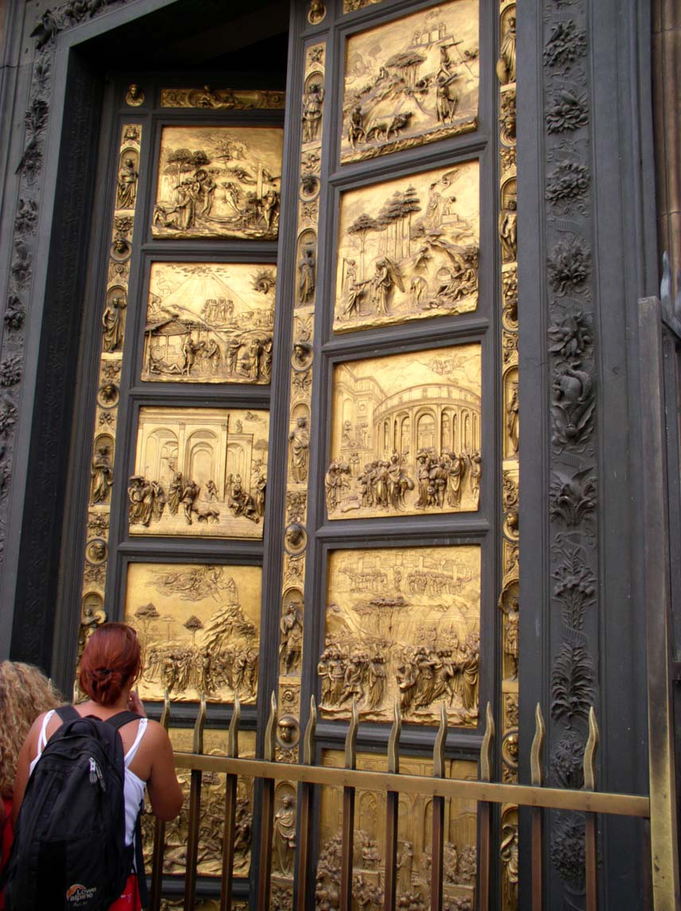
“The Gates of Paradise”, 1425
"undeniably perfect in every way and must rank as the finest masterpiece ever created.” – Georgio Vasari

Slide 3
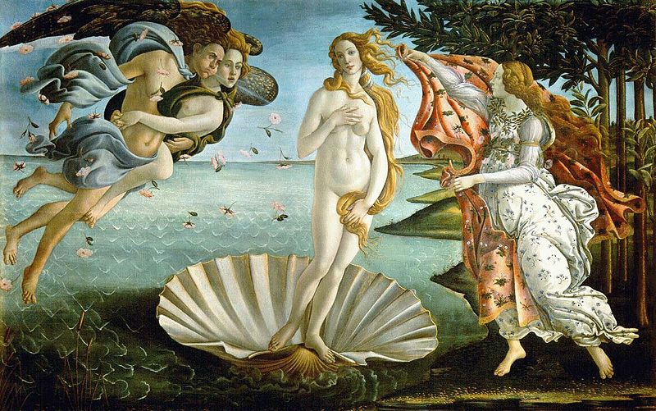
Renaissance Values
The “4 Ism’s” shown through art:
Classicism
Humanism
Individualism
Secularism
5th: Realism
...Quantification

Slide 4
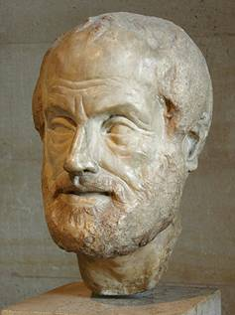
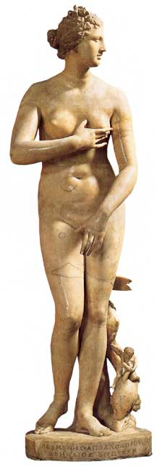
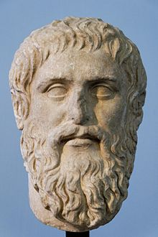
Classicism
-Greek/Roman Influence
-Symmetry/Balance
-Nudes
-Active/Motion
-Lack of Emotion
Contraposto

Slide 5
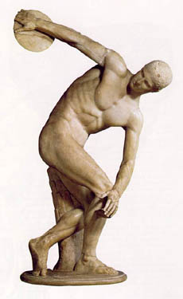
Classical Art Characteristics
500 BC – 500 CE
Balance and Harmony
Lifelike but idealized (Large Humans)
Nude or with togas
Active/motion
Without emotion
Little sense of perspective in background

Slide 6
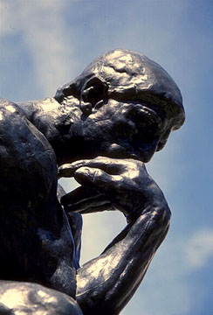
Humanism
Humanism - The study of classical society to define what made man truly human
Emphasis on classical scholars and culture
Centered on education – questioning, logic, and reason
Desire to find classical manuscripts
Desire to learn about the surrounding world
Notes:
*Erasmus: “Men are made, not born”
*Classical antiquity → Italy retained Latin literacy (lay education)
*Stressed dignity of man – “best of God’s creatures below the angels”
*Did not interpret classical texts for Christian meaning, but instead for comments on human nature → Understand in context of their own culture
*Zeal in uncovering, securing, and copying old manuscripts
In the fourteenth century, scholarship shifted from the hands of the Church to the hands of laymen such as lawyers and doctors.
These men revived the classical studies of Greece and Rome
Instead of focusing exclusively on God and religion, they were more interested in human aspects such as culture, society, and values.

Slide 7
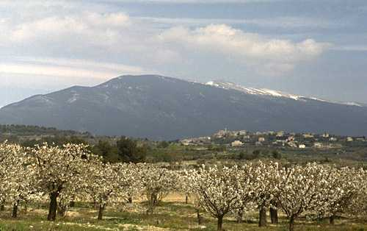
Humanism
Francesco Petrarch – Poet Laureate of Rome, 1341
Official start of the Renaissance (?)
Focus on nature
Inventor of mountain climbing?
Most writings in Latin
Song Book
Vernacular
Mount Ventoux – 6,263 Feet
Notes:
*Petrarch’s philosophy of friendship was a very simple one. In a letter to Simonides he says, ‘I practise no art except to love utterly, to trust utterly, to feign nothing, to hide nothing, and in a word, to pour out everything into my friends’ ears, just as it comes from my heart.’
*Song Book = Collection of sonnets written to Laura (365 sonnets – 1 per day)
*Shows struggle between spirit and flesh as he pines after a married woman
*” the poems swept Europe and immortalized their author. Their mood, imagery, and rhyme scheme dominated literary circles for centuries, and the names of Petrarch and Laura”
*‘Letter to Posterity’ Petrarch wrote: “In my younger days I struggled constantly with an overwhelming but pure love affair - my only one, and I would have struggled with it longer had not premature death, bitter but salutary for me, extinguished the cooling flames. I certainly wish I could say that I have always been entirely free from desires of the flesh, but I would be lying if I did.”

Slide 8
Petrarch – Sonnet to Laura #90
Sonnet 90
She used to let her golden hair fly free For the wind to toy and tangle and molest; Her eyes were brighter than the radiant west. (Seldom they shine so now.) I used to see Pity look out of those deep eyes on me. ("It was false pity," you would now protest.) I had love's tinder heaped within my breast: What wonder that the flame burned furiously? She did not walk in any mortal way, But with angelic progress; when she spoke, Unearthly voices sang in unison. She seemed divine among the dreary folk Of earth. You say she is not so today? Well, though the bow's unbent, the wound bleeds on.
Notes:
Francesco Petrarch was born shortly after 1300 in a time and place where very few could read or write and those that did considered it a chore where as Petrarch saw a blessing. His passion to write his thoughts to paper was only overcome by the need to sleep or eat. So great was his desire to write his thoughts and feelings and so difficult was it to find anyone in Europe to match his desire he found himself writing to Cicero, one of the only people he believed really shared his passion. (Cicero was a Roman Poet/Politician that died over 1200 years before Petrarch was born).
His writings would go on to influence countless others such as Boccaccio to write his own great works. And centuries later others such as Shakespeare would study his works and copy his sonnets.
Petrarch lived through the harshest bouts of the plague and lost nearly everyone he knew to it. His mother and father had died in his early years but his son, his grandson, numerous friends and a woman named Laura for which his writings of her will live on forever, all died as victims of the disease.
So great were his writings that royalty treated him, the son of exiled nobles, like a king and in a letter to a friend he even goes as far as to say that he has caused his own plague to spread over Europe, one which has caused people to take up pen and paper and write and read.
And so ended the dark ages and the start of Humanism.

Slide 9
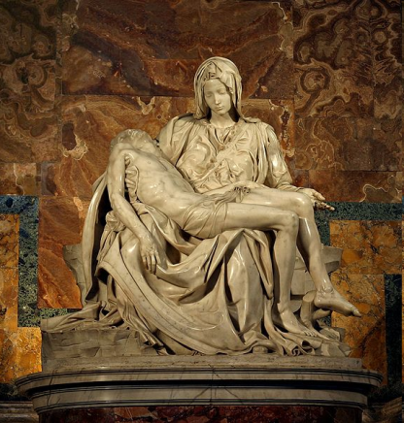
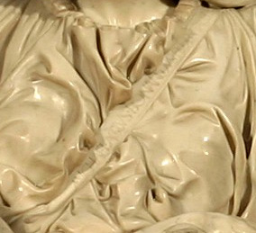
Individualism
“Men can do all things if they will”
-Leon Battista Alberti
Emphasis on individual accomplishments, abilities, uniqueness, and genius
Quest for glory
Autobiography and realistic characters
Decameron, Cantebury Tales
Individual Portraits
Michelangelo – La Pieta
“Michelangelo Buonarroti, Florentine, made it”
Notes:
*Autobiography → Presumes the reader is interested in your particular life
*Proud of individual abilities and scorned medieval humility (discouraged self absorption)
*Pride in abilities (boastfulness) → Fame and quest for glory
*Pieta – Body of Jesus in the lap of Mary after the crucifixation
*Younger Mary rather than older, small crucifixation marks
*Housed in St. Peter’s Basilica
*Rich Artists

Slide 10
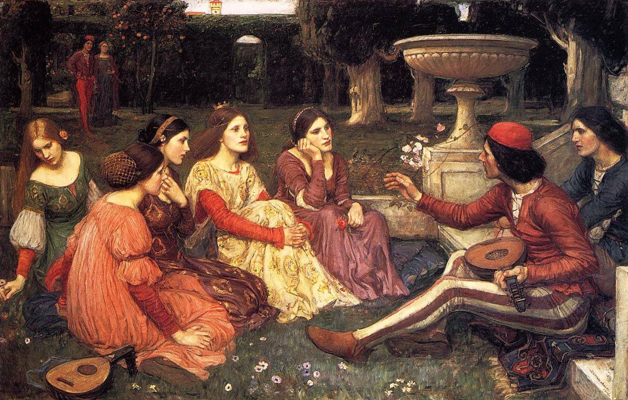

Slide 11
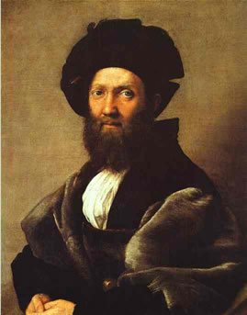
The “Ideal Man” as described in The Courtier
A noble, a courtier, a diplomat, and a writer. He rubbed elbows with many of the most famous of the time…
Baldassare Castiglione

Slide 12
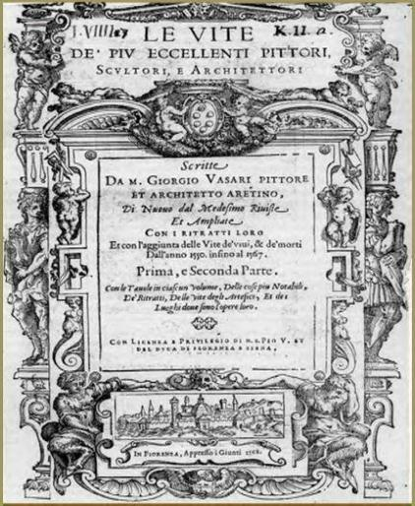
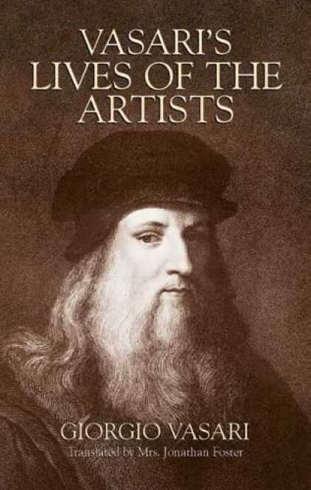
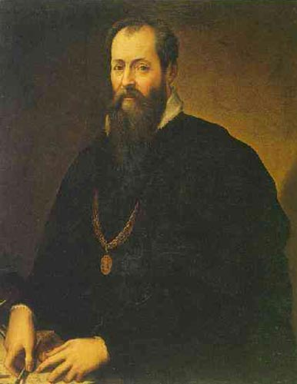
Lives of the Most Excellent Painters, Sculptors, and Architects
Giorgio Vasari,1550
*Celebration of Renaissance Artists

Slide 13
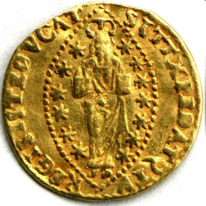
Status of the artist
Artists viewed as “geniuses” rather than craftsmen
Genius = $$$$$
Ghiberti earned 500 Florins/Year
Da Vinci earned 2,000 Ducats /Year (= to Florins)
Michelangelo worth ~60,000 Ducats at death
Notes:
"He liked to keep large amounts of money in a wooden box by his bed. When he died, 8,400 ducats were found in the box," Hatfield said. (Michelangelo)

Slide 14
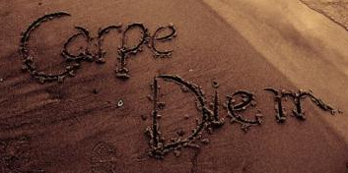
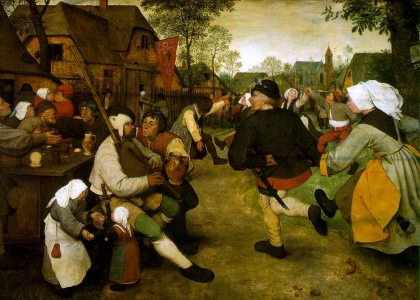
Secularism
Concern with the material, rather than spiritual, world
NOT atheism
Secularization of the papacy
Examples:
Extravagant dress
Manners
Hygiene
Private Palaces (Medici)
Notes:
*Wealth = Opportunity for sensual pleasure
*Valla – On Pleasure defends pleasure of the senses as the highest good

Slide 16
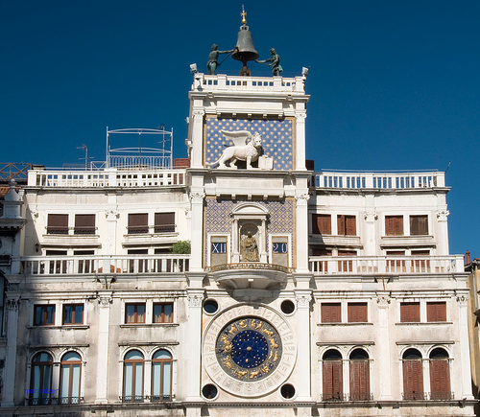
Quantification
Measuring the universe in visual and quantitative way
Break universe down into measurable units
Clocks
Music divided into measure in order to be “seen”
Notes:
*Timelessness of the world replaced by obsession with time and numbers
*Clocks in village churches allow peasants to see new ideas about time
*During Medieval - The #6 was seen as perfect b/c it was created by adding the numbers of the Holy Trinity (now a neutral #)
*Measures allow music to be seen and graphed and quantified

Slide 17
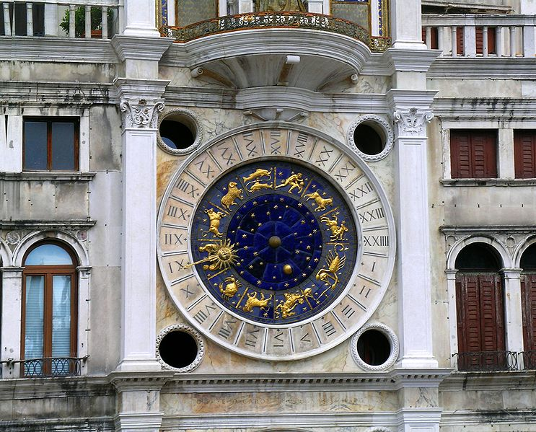
Notes:
VENICE
Music
Since the Middle Ages, music theorists had been studying proportions, a subject that the Greek mathematician Pythagoras had written about when discussing music. The theorists explained how to make different pitches (sounds) on stringed instruments by lengthening or shortening the strings by different proportions. For example, if a musician were to divide a string in half (the proportion of 2:1), he would create a new tone that is an octave above the original tone. Renaissance musicians carried on this idea in their own music.
Renaissance composers also incorporated the classics into their craft. By studying Greek drama, they discovered the art of making their music reflect the lyrics in their songs--making music sound happy for words of joy and sorrowful for words of grief. When they learned that ancient Greek drama (which featured music) brought the audience to tears with its sad music, Renaissance composers tried to re-create that theatrical experience. They didn't succeed, but their efforts resulted in the birth of opera.

Slide 18
10th Euro Studies 9.23.14
Turn in:
In-class write
PROPER HEADING PLEASE!
Points are at stake…
Take out:
Planner
Pen/pencil
Notes from yesterday
Blank paper
Today’s objective:
I can describe how the time period following the Middle Ages began to take shape and lay the foundation for a modern world.
Today’s Agenda:
In-class write: answer the following question in a paragraph: Why was Italy a favorable setting for the Renaissance? Provide at two points of emphasis.
Support thought with evidence
Reading, lecture, etc.
The “ism’s”
HW:
Read remainder of 13.1

