Slide 1
10th World Studies 9.25.18
Turn in:
CSI Questions (online)
Take out:
Planner
Notes & note-taking devices
Today’s Learning Objectives:
I can describe how a mysterious illness began to spread across Europe in the late Middle Ages.
Today’s Agenda:
Debrief the Black Death, the Plague, the Pestilence, the Great Mortality…
HW:
CSI OUTLINE due to TII.com by Wednesday 10:09 am

Slide 2
Website “Stuff”
4 of you lovely souls…out of 94 emailed me about my issue with linking the button…one of which attached their work! (BTW, you had the questions in class…)
It was corrected as soon as I saw the emails…last night about 8:30
1 other student emailed about a different mistake, and it was corrected…
Yet 1 other student emailed…at 7:22 this morning explaining the issue…had worked on it, etc.

Slide 3
Website “Stuff”
So, what’s Steen’s point?!?
His mistake, he shouldn’t punish me for it, right?
What’s your responsibility in this situation?

Slide 4
TII.com Assignment
To clarify: put in OUTLINE FORM
“Argument” Perhaps who was responsible for the spread of the Plague through the village…
Evidence—from your travels yesterday…
Analysis—these are your thoughts on what the evidence means
Analysis—these are your thoughts on how the evidence supports your argument.
Evidence—another piece from your travels yesterday…
Analysis—these are your thoughts on what the evidence means
Analysis—these are your thoughts on how the evidence supports your argument.

Slide 5
How a Mysterious Disease Laid Low Europe’s Masses
The Black Plague

Slide 9
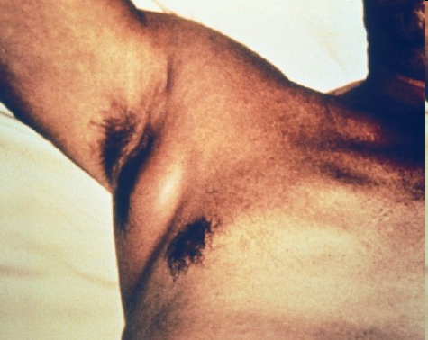

Slide 13
Symptoms of the Plague
Headaches and general weakness followed by aches and chills
Soon the tongue was coated with white, pulse increased, speech slurred, and the staggering gait developed
The flea bite would turn blackish and begin to ooze puss and by the third day the lymph nodes swelled

Slide 14
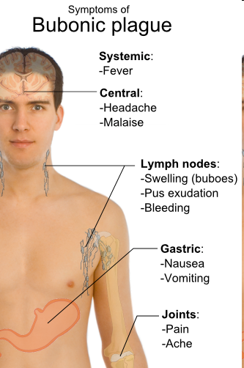

Slide 15
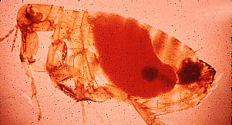
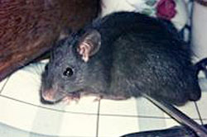
The Origin of the Black Death
The Bubonic Plague or “Black Death” comes from the bacillus Yersinia pestis
Yersinia pestis can be carried by rodents and transmitted to fleas
The intestines of fleas are the ideal breading ground for the bacilli
Most of the rats and fleas carrying Yersinia pestis have lived for millions of years in rodent nests in China, India, and even the United States

Slide 16
The Origin of the Black Death (cont.)
The Plague had struck human populations in Constantinople in 541 and 542 C.E. killing about 40% of the city’s people
In 1345 C.E. news reached Europe, by trade routes, that the black death was laying waste to India, Mesopotamia, and Armenia
At the same time, rats had reached the Crimea—on the northern coast of the Black Sea—where Italian merchants had established many trading posts

Slide 17
The Plague Spreads to Europe
From the Black sea region, the plague entered Italian ports in 1347 C.E.
The most famous account comes from the port in Messina
The townspeople blamed the sailors for the sickness and drove them out of port which started the rapid spread as they entered other European ports

Slide 18
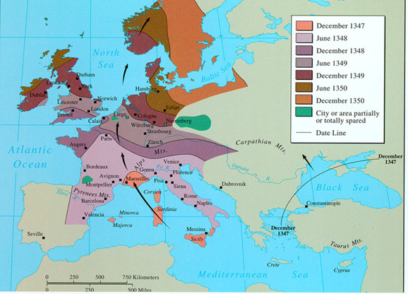
The Plague Spreads to Europe
What can we “infer” about these areas?

Slide 19
Responses to the Plague
The city of Pistoia wrote nine pages of regulations to try to stop the spread of the Plague:
Nobody could go to places were the plague was
Anyone who did visit a plague infested place was not let back into the city
No imported linen or wool
Funerals could only be attended by immediate family
None of the regulations worked
In Milan, those who were sick were locked in their homes—it seemed to work, the fatality rate was lower in Milan

Slide 20
Medieval Medicine & The Plague ‘Cito, Longe, Tarde,’
“Leave quickly, go far away, come back slowly…”
Most doctors were viewed as skilled craftsmen, not men of real learning
Practices were based more on ancient texts than on clinical experience:
Live chickens, flowers in your pockets, potions with arsenic, mercury, or ground horn from “unicorns,” & ornaments
Pope Boniface VIII published a bull—a decree from the church—in 1300’s aimed at stemming the sale of bones as holy relics by forbidding the mutilation of corpses; this bull also discouraged dissection

Slide 21
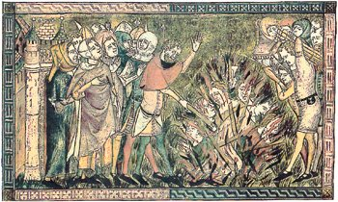
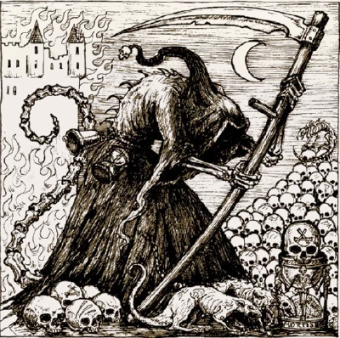
Medieval Medicine (cont.)
Theories abounded on the cause of the plague; they ranged from the wrath of God to the corruption of the atmosphere
Some people even made an entire group a scapegoat—thousands of Jews were killed because people believed they started the Plague
Consider the role of the Catholic Church in people’s everyday lives & whether you were in or out…as well as Jewish laws/traditions

Slide 22
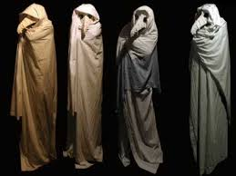
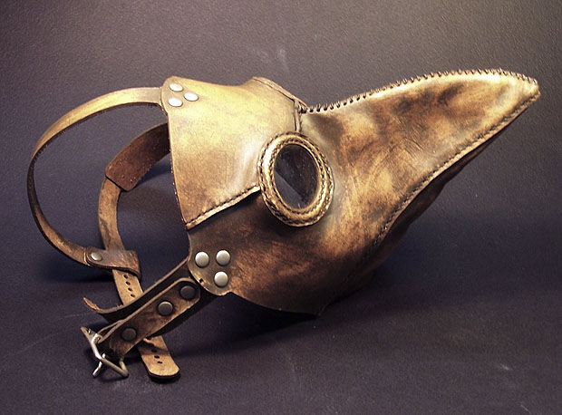
Medieval Medicine (cont.)
THE HAT THE BIRD-LIKE MASK
THE RED GLASS EYES THE BLACK OVERCOAT
THE LEATHER BREECHES THE WOODEN CANE

Slide 23
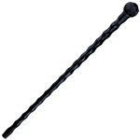
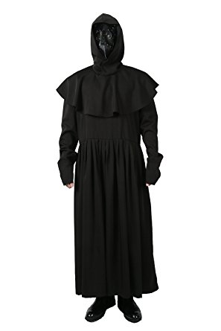
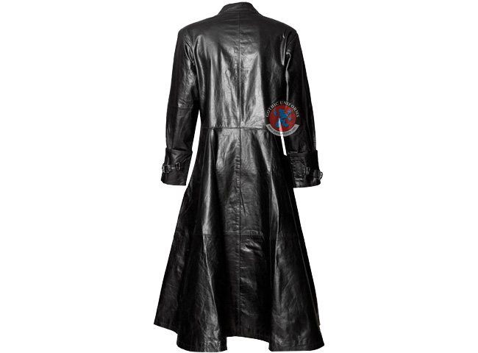
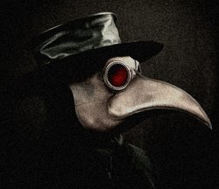
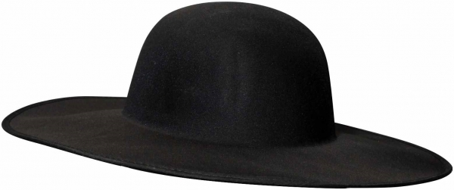
Medieval Medicine (cont.)
THE HAT THE BIRD-LIKE MASK
THE RED GLASS EYES THE BLACK OVERCOAT
THE LEATHER BREECHES THE WOODEN CANE
Miasma theory: mala + aria = “bad” + “air”

Slide 24
Washington Dept. of Health: Germs, Prevent Their Spread
Always wash your hands after sneezing, blowing your nose, or coughing, or after touching used tissues or handkerchiefs.
Wash your hands before eating, or touching your eyes, nose or mouth.
Wash your hands after touching anyone who is sneezing, coughing or blowing their nose.
Don’t share things like towels, lipstick, toys, or anything else that might be contaminated with respiratory germs.
Don’t share food, utensils or beverage containers with others.

Slide 25
Jewish Cleanliness Laws
The conception of personal cleanliness as both a prerequisite of holiness and an aid to physical fitness is central to Jewish tradition.
The hands must also be washed on certain occasions:
after rising from bed in the morning,
after urination and/or defecation,
bathing,
clipping of the fingernails,
removal of shoes, touching the naked foot, washing the hair,
visiting a cemetery, touching a corpse,
undressing, sexual intercourse,
touching a louse, or touching any part of the body generally clothed.

Slide 26
Jewish Cleanliness Laws
It is a particularly important religious duty to wash hands before eating a meal.
Similarly, hands should be washed after the meal and before grace, because, inadvertently, a person may touch his eyes with salty hands.
A person who neglects the washing of hands before or after a meal "will be uprooted from the world"

Slide 27
Jewish Cleanliness Laws
Scholars were forbidden to live in a city in which there was no doctor or where there was no bathhouse.
Hillel the Elder (110 BCE-10 CE) considered that the act of bathing is an act of caring for the vessel containing the divine spirit.

Slide 28
Forms of the Plague
There are three forms of the plague
Bubonic
Transmitted from rat to person by flea bite—how on Earth are they traveling so fast?!?
Pneumonic
The bacillus invades the lungs—aaahhh-choo! Bless you!?!
Septocemic
The bacillus invades through the bloodstream—open sores, etc…

Slide 29
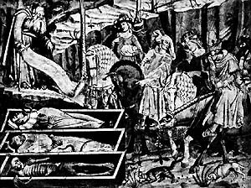
Consequences of the Plague
Social
1/3 of Europe’s Population was killed
Towns were shutdown, trade slowed and interactions between different groups changed
Groups were turned into scapegoats—a recurring theme…
Political
The feudal system shows signs of crumbling; after the deaths of nobility and peasants, monarchs and nations emerged
The political power of the pope waned

Slide 30
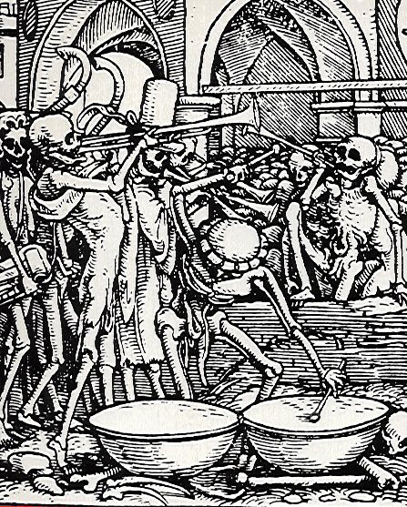
Consequences of the Plague
Economic
With a smaller population, the demand for agriculture diminished, lowering prices and nobility’s wealth
Skilled labor became a high demand area which increased wages
Trade diminished
Cultural
Whole family groups died
Religion was questioned, shifting the focus from spiritual to material

Slide 31
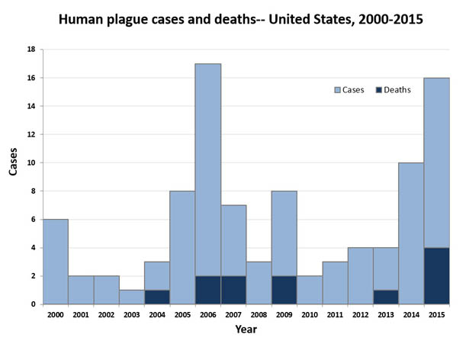
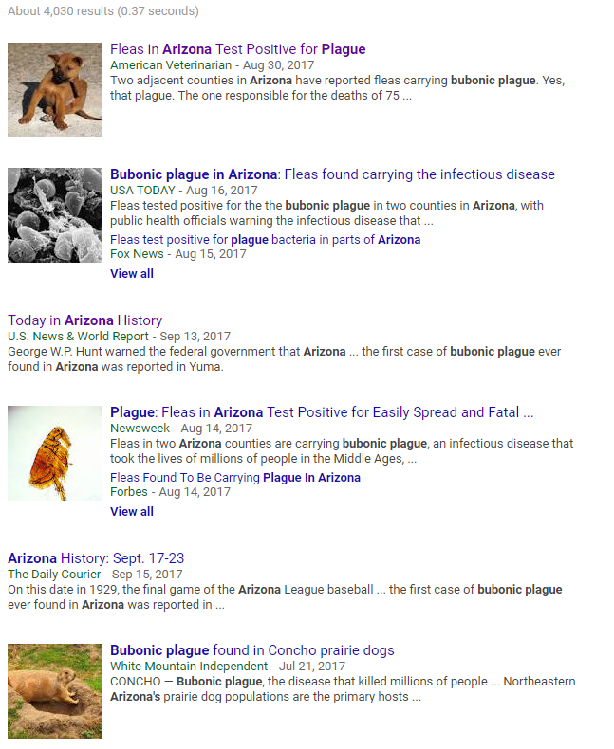
Is the Plague Gone???

Slide 32
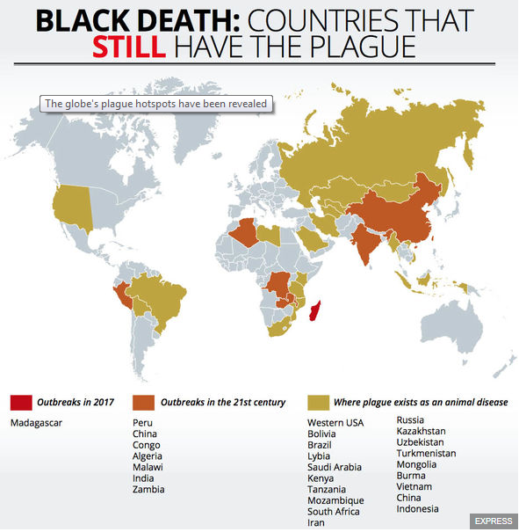
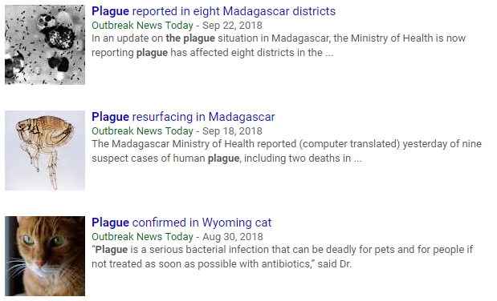
Is the Plague Gone???
Notice the dates…
Bubonic and Pulmonary in Madagascar…
article states there’s “yearly” outbreaks from September to April.

