Slide 1
10th Euro Studies 9.11.14
Turn in:
Exit Slip (24 as of this morning…)
Take out:
Planner, Pen, & Paper
Today’s Learning Objectives:
I can explain the hierarchy of the Catholic Church, and compare it to the structure of the feudal system.
Today’s Agenda:
Lecture
Chart, vocab, reading
HW:
Chart and Vocab
Critically read 7.3

Slide 2
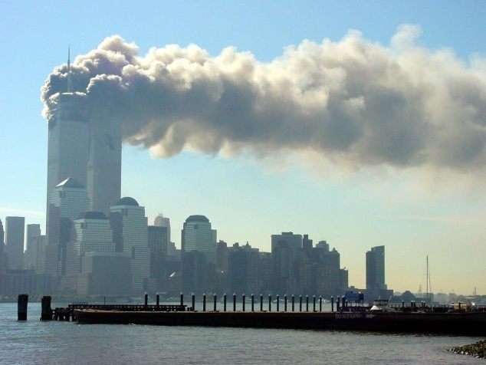
Warm up: Sept. 11, 2014
9/11/2001
What do you know about 9/11?
What aspects of culture cause the most conflict between humans?

Slide 3
Part I: After the fall of Rome, Europe created a society based around religion, order and hierarchy that dominated for nearly 1,000 years.

Slide 4
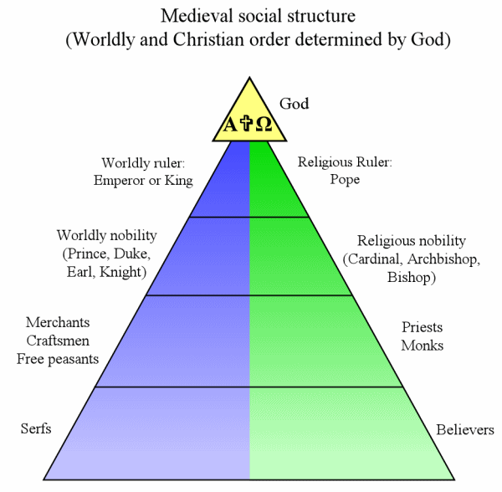
The Foundations of Early Modern Europe
(1,000 years of European History in one hour)

Slide 5
Side effects of the fall
Result is one of the oddest phenomena in history:
Progress went backwards → people could see the old work in architecture, art, medicine, etc., but could not recreate it or build future ideas off it (and won’t be able to for nearly 325 more years)
General size and skill of life decreases
Trade disruption
Decline of cities: population shifts out to regressive, agrarian society
Decline of arts and learning
Loss of a common language
All this leads to a major, disunifying void

Slide 6
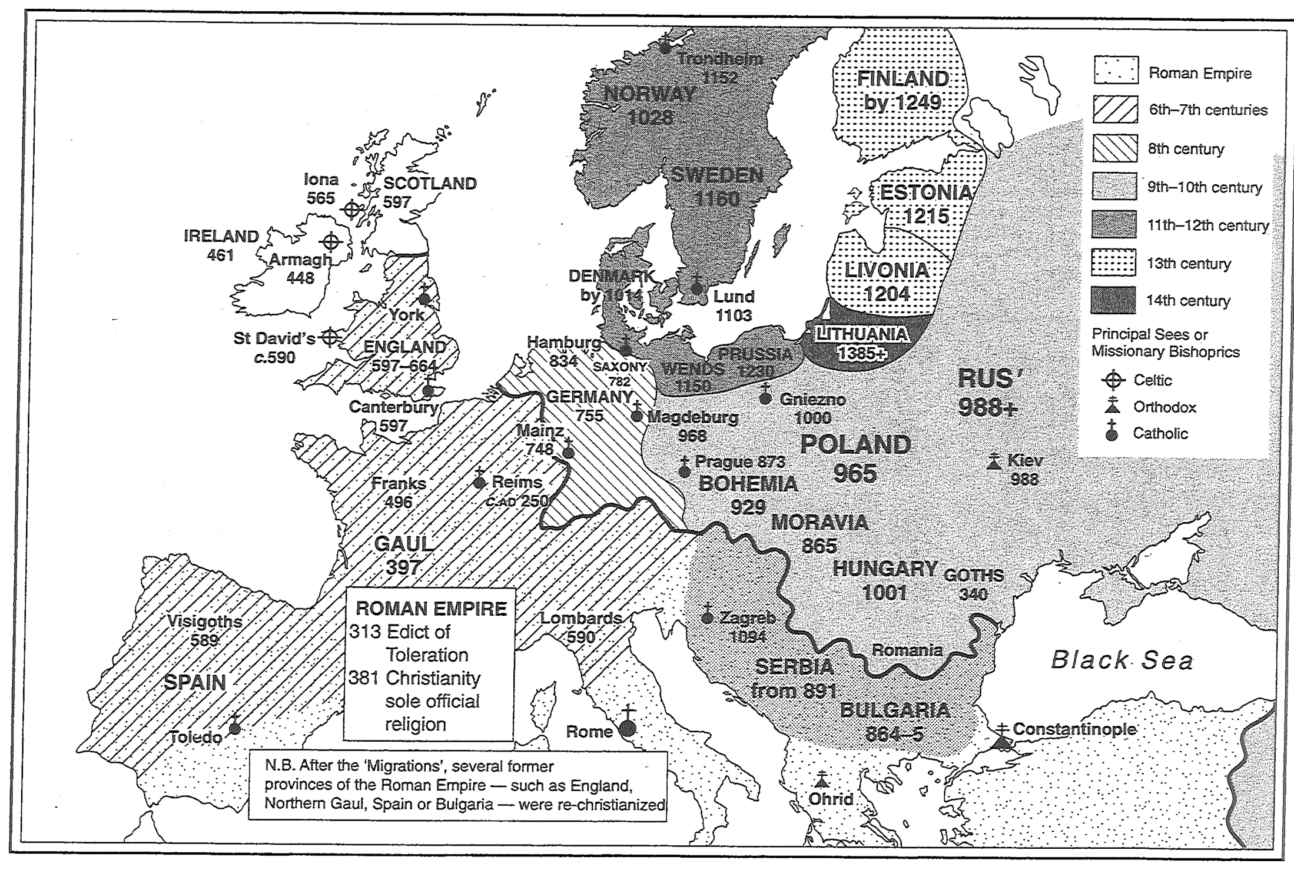
The Spread of Christianity through the Middle Ages

Slide 7
Rise of Christianity
Started by Jesus of Nazareth (6/4BCE-31/33CE) & Paul of Tarsus
Seen as an odd cult; persecuted off and on for many years in Rome—mainly for fun
All that changed with Edict of Milan
Incredibly rapid expansion
Made official state religion in 391. Leading to two key issues:
1. Beginning of tension between religion and politics (church and state)
2. Disagreements over key issues lead to first Christian split.
Catholics led by the Pope in the West
Orthodox led by Patriarch of Constantinople in the East
Each sect thought the other was heretical. So they fought. Physically and verbally. Constantly.
Clovis spreads Christianity
Coverts on battlefield and then uses it as a way to lord over others → eventually you had to be Christian to do anything
Erases lines of church and state
Everyone safe until…

Slide 8
10th Euro Studies 9.11.14
Turn in:
Exit Slip (24 as of this morning…)
Take out:
Planner, Pen, & Paper
Today’s Learning Objectives:
I can explain the hierarchy of the Catholic Church, and compare it to the structure of the feudal system.
Today’s Agenda:
Lecture
Chart, vocab, reading
HW:
Chart and Vocab
Critically read 7.3

