Slide 1
Age of Absolutism
Rulers NOT Named Louis XIV

Slide 2
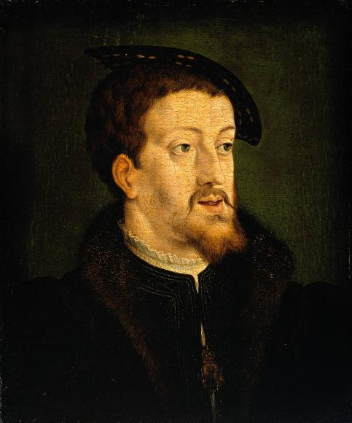
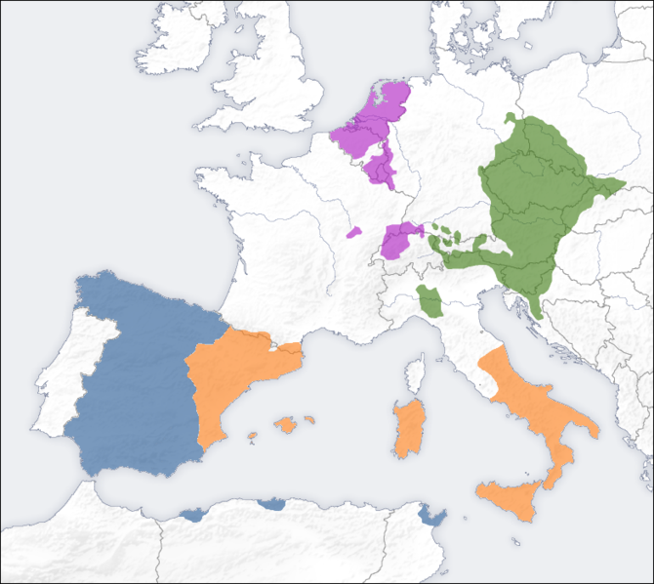
Spain – Hapsburg Empire
Charles V
Heir to 3 major dynasties
Controlled Spanish and Holy Roman Empire
WHAT PROBLEMS DO YOU SEE?
Happily abdicates to his
Brother and Son (Phillip II),
(1555)
Notes:
Grandson of Hapsburgs and of Ferdinand and Isabella
Charles was the eldest son of Philip the Handsome and Joanna the Mad. As the heir of three of Europe's leading dynasties—the House of Habsburg of the Habsburg Monarchy; the House of Valois-Burgundy of the Burgundian Netherlands; and the House of Trastámara of the Crowns of Castile and Aragon—he ruled over extensive domains in Central, Western, and Southern Europe; and the Spanish colonies in the Americas and Asia

Slide 3
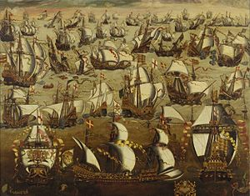
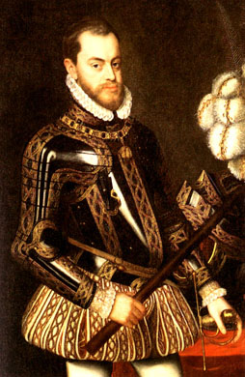
Spain – Hapsburg Family
Phillip II
Strong central government
Four Marriages: Maria (Portugal), Mary Tudor (England), Elizabeth Valois (France), Anna (Austria
Defend Catholicism in Spain and led Inquisition
Spanish Armada (1588)

Slide 4
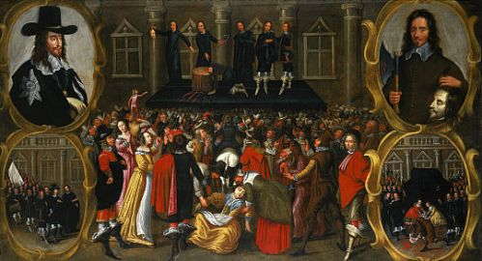
England – The Tudors and Stuarts
The Tudors
Henry VIII and the Church of England
The Stuarts
Charles I
Battles with Parliament
“a tyrant, traitor, murderer, and public enemy.”
Limited Monarchy:
Constitution, or legislative
Body limits the power of
the king

Slide 5
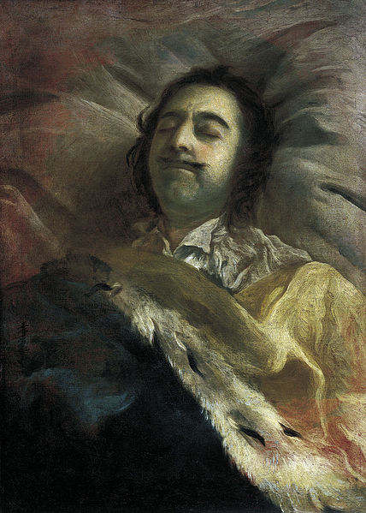
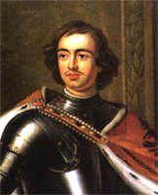
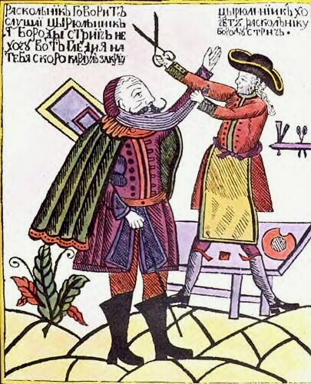
Russia – The Romanovs
Peter The Great
GOAL = WESTERNIZATION/MODERNIZATION
Arts, Sciences, Education, Army, Dress, etc…
Strengthens serfdom
The Great Northern War vs. Sweden
St. Petersburg = symbol of Russian power
Notes:
Peter the Great’s sheer physical presence seemed to indicate the way his rule would go. He was nearly 7 feet tall and very broad. He was massively powerful, "loud-mouthed, violent, ruthless and impetuous". He always wanted to learn and was always active. He learned how to be carpenter, talked to mathematicians and learned how best to train soldiers- including how to torture people. While Sophia had been regent, he had lived in Germany and had spent time living with soldiers learning about fortifications and ballistics. When back in Russia he formed a small army out of his servants and used them in live ammunition firing war games.

Slide 6
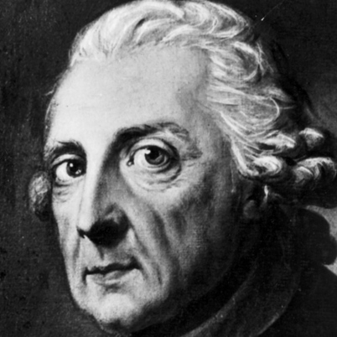
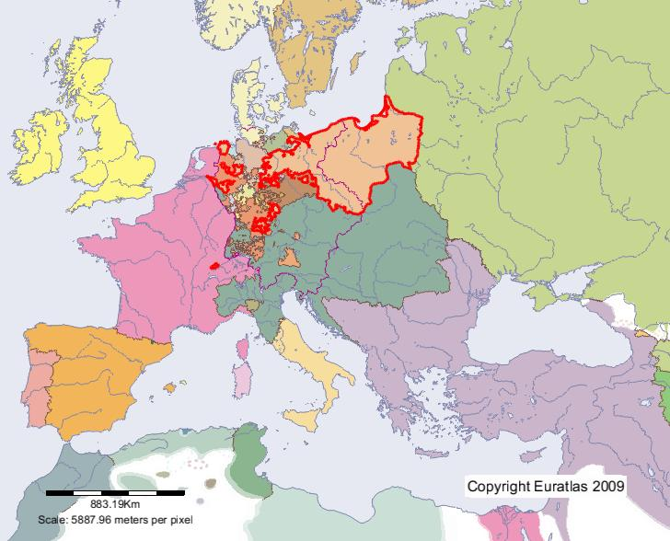
Prussia—Frederick the great
"A crown is merely a hat that lets the rain in.“
ABUSED AS A CHILD—ATTEMPTS ESCAPE—ACCOMPLICE IS BEHEADED
REFORMS:
RELIGIOUS TOLERANCE
MILITARY
BASIC FREEDOM OF THE PRESS
FIRST GERMAN CODE OF LAW

