Slide 1
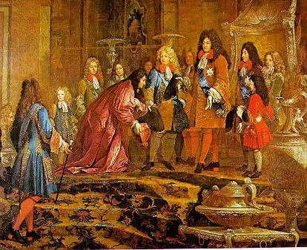
King Louis XIV
Focus Question:
How was King Louis able to maintain absolute power?

Slide 2
Add a slide about Colbert and $$$$$

Slide 3
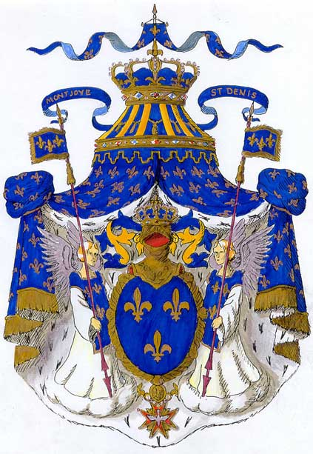
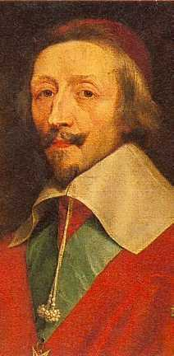
LOUIS XIV BACKGROUND
Bourbon Family (Henry IV)
Religious Battles in France
Catholics and Huguenots (Protestants)
Edict of Nantes = Toleration
Large bureaucracy
Courts, Roads, Bridges, Postal Service, etc…
Cardinal Richelieu strengthens power of king
Period where advisors are powerful
Louis XIV takes throne at age 5
The Fronde
72 Year Reign
Louis XV

Slide 4
Data Set I
When viewing the paintings of Louis XIV, pay close attention to the King’s clothing and posture. Keep in mind that the majority of the population of France would never actually see the king in person. Instead, they would see statues and paintings of the king, much like these.

Slide 5
Data Set II

Slide 6
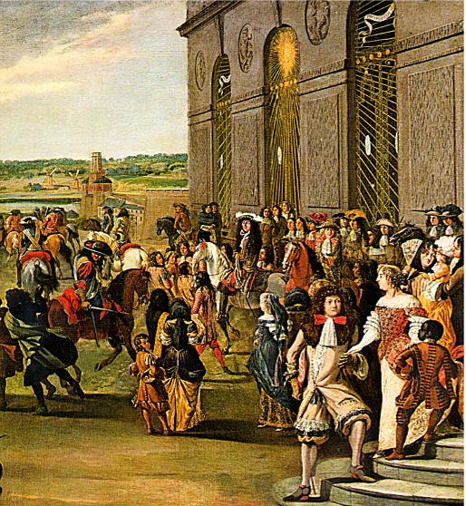
Data Set III
Louis took the nickname “Sun King”

Slide 7
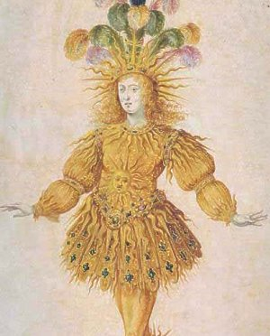
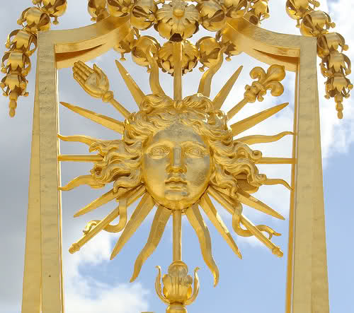

Slide 8
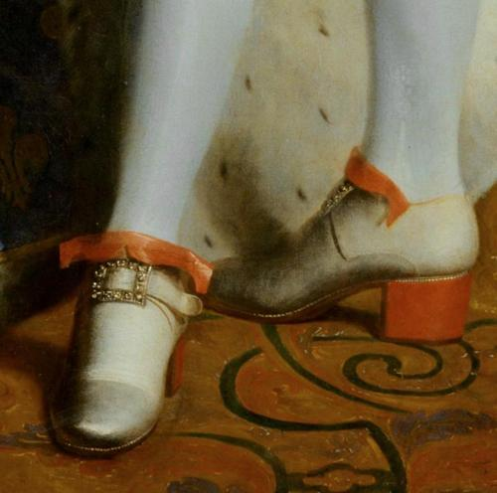
Data Set IV
Louis XIV was 5’ 3” and enacted laws that no one could have heels higher than the king, and that only nobility could wear red high heels

Slide 9
Data Set V

Slide 10
Data Set VI
King Louis XIV created a whole new bureaucracy, known as intendants. This bureaucracy was composed of people who were not from the hereditary, upper class aristocracy.
Many of the intendants were tax collectors in France during the reign of Louis XIV. They were given these high ranking positions based on merit and hard work instead of on heredity.

Slide 11
Data Set VII
Louis XIV limited the intendants’ terms to 2 years. Intendants who remained loyal to the king were allowed to remain in office.
The continuation of their high status in society depended on the stability of the government. The intendants were not appointed to oversee their own communities.

Slide 12
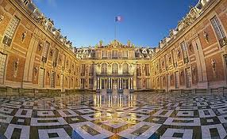
Data Set VIII
Here, the entire French nobility was expected to take residence and to participate in elaborate ceremonies, festivals and dinners. The elaborate ceremonies there impressed the king’s subjects and aroused the admiration and envy of all other European monarchs.
Notes:
Louis XIV’s elaborate rules of etiquette included the following:
People who wanted to speak to the king could not knock on his door. Instead, using the left pinkie finger, they had to gently scratch on the door, until they were granted permission to enter. As a result, many courtiers grew that fingernail longer than the others;
A lady never held hands or linked arms with a gentleman. Besides being in bad taste, this practice would have been impossible because a woman’s hooped skirts were so wide. Instead, she was to place her hand on top of the gentleman’s bent arm as they strolled through the gardens and chambers of Versailles;
When a gentleman sat down, he slid his left foot in front of the other, placed his hands on the sides of the chair and gently lowered himself into the chair. There was a very practical reason for this procedure. If a gentleman sat too fast, his tight pants might split;
Women and men were not allowed to cross their legs in public;
When a gentleman passed an acquaintance on the street, he was to raise his hat high off his head until the other person passed;
A gentleman was to do no work except writing letters, giving speeches, practicing fencing, or dancing. For pleasure he engaged in hawking, archery, indoor tennis, or hunting. A gentleman would also take part in battle and would sometimes serve as a public officer, paying the soldiers;
Ladies’ clothing did not allow them to do much besides sit and walk. However, they passed the time sewing, knitting, writing letters, painting, making their own lace, and creating their own cosmetics and perfumes.
~2.75 square miles

Slide 13
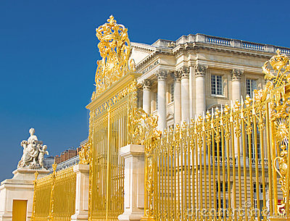

Slide 15
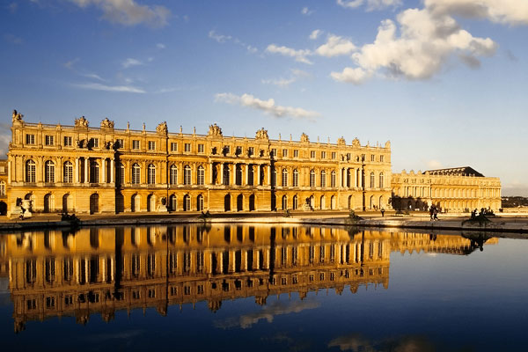

Slide 16
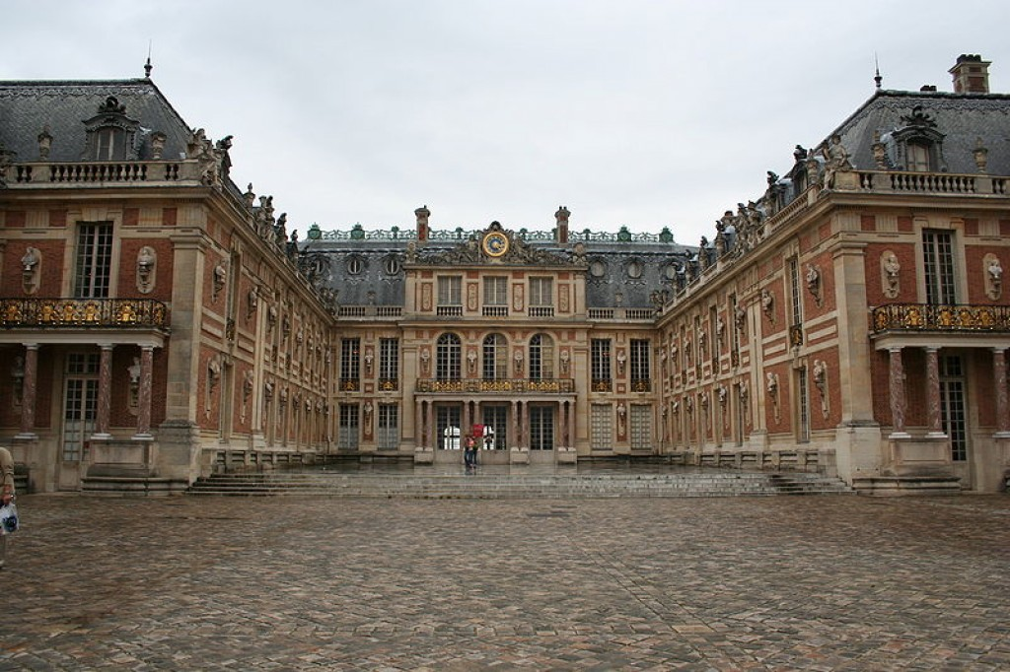

Slide 17
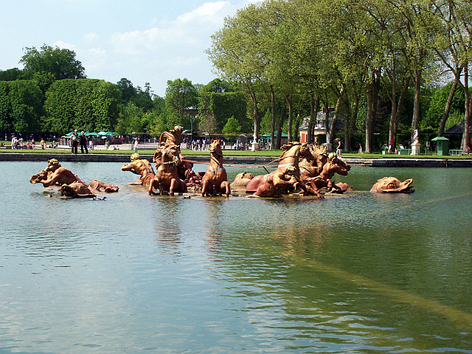

Slide 18
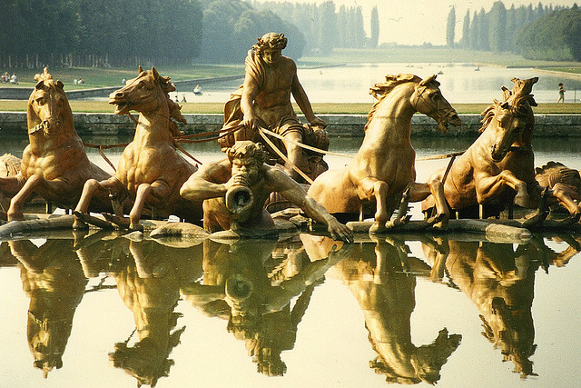

Slide 19
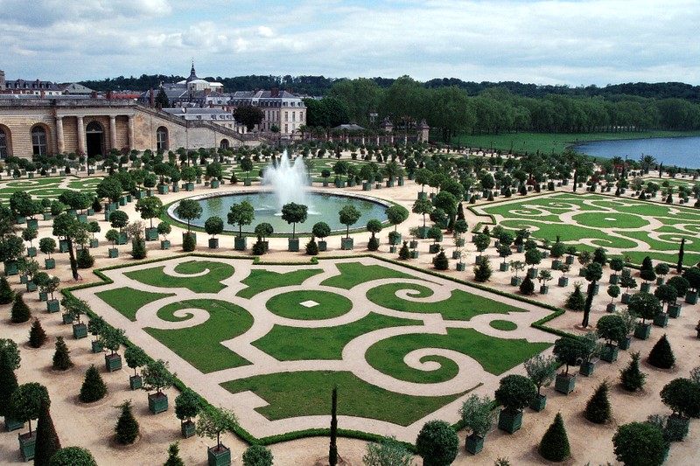

Slide 20
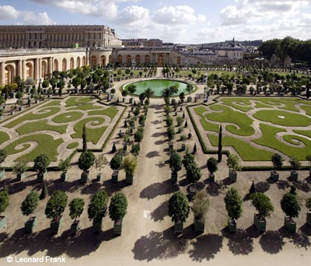

Slide 21
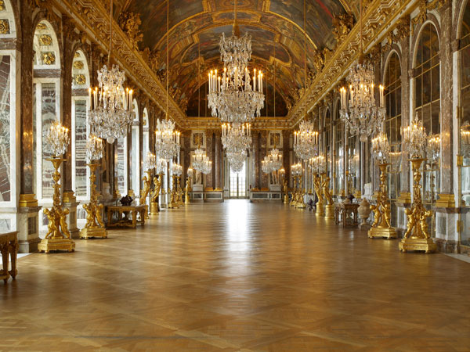

Slide 22
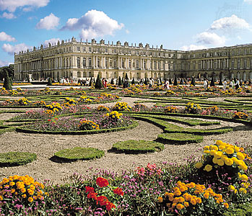

Slide 23
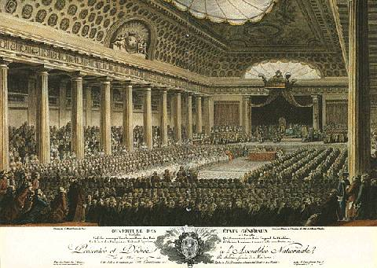
Data Set IX
Louis XIV never calls a meeting of the Estates General

Slide 24
Data Set X
Under Louis XIV, France was the most powerful country in Europe. The French army, numbering 100,000 in peacetime and 400,000 in wartime, was far ahead of other states’ armies in size, training, and weaponry.

Slide 25
After looking at the data:
How was King Louis able to maintain absolute power?

