Slide 1
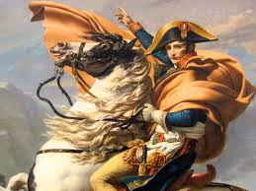
In your Journals: Define the word, “tyrant.” List some historical or contemporary examples Define the word, “hero.” List some historical or contemporary examples Are these terms mutually exclusive? Is it possible that a hero could be a tyrant or a tyrant a hero?

